Slide 1

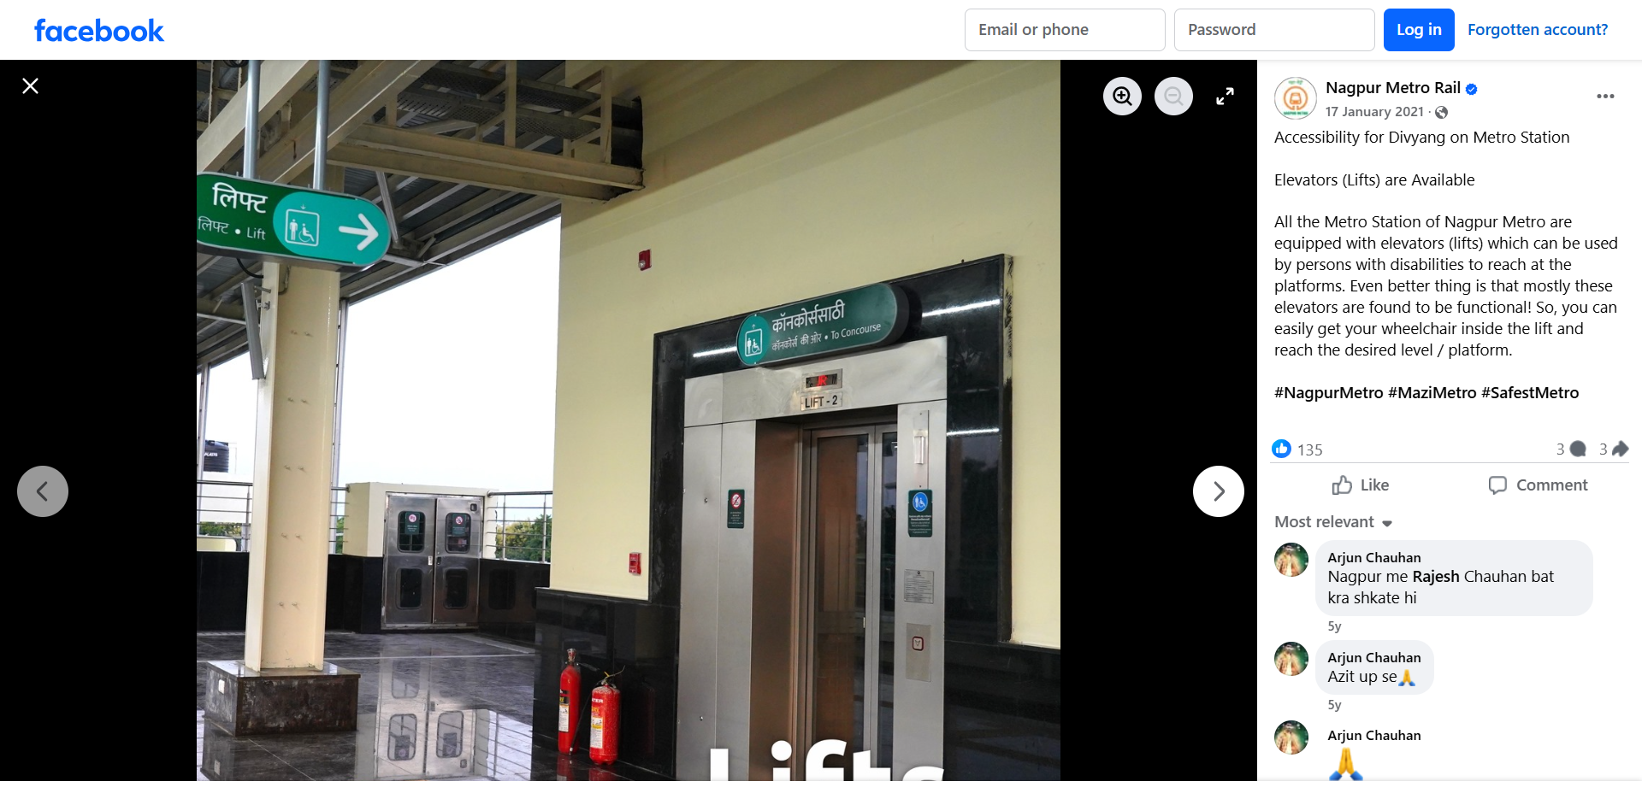


Problem
Walks - in
Have to wait..
No Priority

Slide 2



Solution
Intelligent Lift Management (ILM)
0/1 Knapsack Algorithm
Intelligent Route Planning
Object Detection

Slide 3
Let’s see it in Action !

