Slide 1
Enforcing Network-Wide Policies in the Presence of Dynamic Middlebox Actions using FlowTags

Slide 2
SDN expectations
Middle boxes violate two specific important rules
1. ORIGINBINDING: There should be a strong binding
between a packet and its origin
2. PATHSFOLLOWPOLICY: Explicit policies should determine
the paths that a packet should follow.

Slide 3
Architecture
Flow tags API
Flow tags controller modules
Flow tags enhanced middleboxes

Slide 4
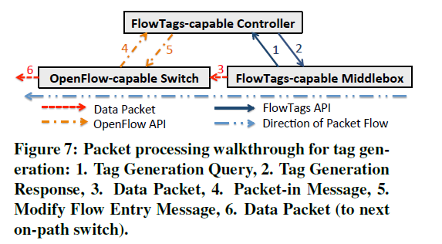

Slide 5
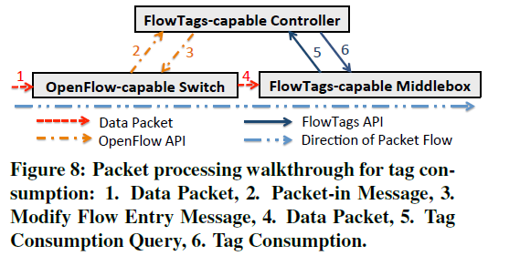

Slide 6
IMPLEMENTATION

Slide 7
Controller
H2(192.168.1.10)
H3(192.168.1.11)
NAT
Firewall
HTTP Server (10.0.0.1)
H4(192.168.1.12)

Slide 8
Controller
H2(192.168.1.10)
ASK for flow tag
H3(192.168.1.11)
NAT
Firewall
HTTP Server (10.0.0.1)
H4(192.168.1.12)

Slide 9
Controller
H2(192.168.1.10)
Configures a flow entry
H3(192.168.1.11)
NAT
Firewall
HTTP Server (10.0.0.1)
H4(192.168.1.12)

Slide 10
Controller
H2(192.168.1.10)
H3(192.168.1.11)
NAT
Firewall
HTTP Server (10.0.0.1)
Natize the packet
and store ip_port to new src_port mapping
H4(192.168.1.12)

Slide 11
Controller
H2(192.168.1.10)
Send the flow tag
and get tag – ip mapping
H3(192.168.1.11)
NAT
Firewall
HTTP Server (10.0.0.1)
H4(192.168.1.12)

Slide 12
Controller
H2(192.168.1.10)
Configures flow entry based on ips to block
H3(192.168.1.11)
NAT
Firewall
HTTP Server (10.0.0.1)
H4(192.168.1.12)

Slide 13
Controller
H2(192.168.1.10)
H3(192.168.1.11)
NAT
Firewall
HTTP Server (10.0.0.1)
H4(192.168.1.12)
Block packets based on flow entries

Slide 14
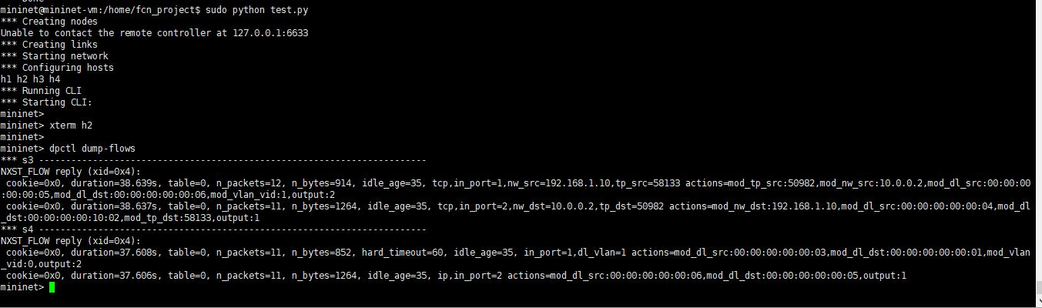
Flow entries before block

Slide 15
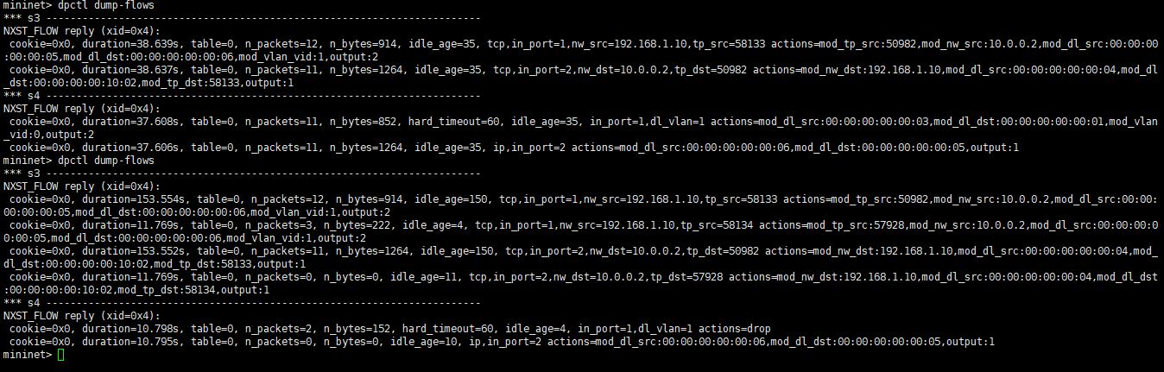
Flow entries after block

Slide 16
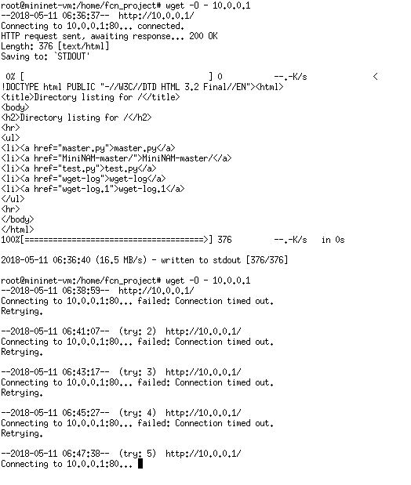
H2 client request before and after block

Slide 17


