Slide 1

Retail Sales & Customer Analytics
A MySQL + Python + Power BI portfolio project analyzing $2.30M in revenue, 793 customers, and 5,000 orders to uncover where a retail superstore is losing money, which customers are at risk, and why.
PREPARED BY MOHAN
DATA ANALYST PORTFOLIO PROJECT

Slide 2


The Business Question
Superstore's leadership needed answers to three critical questions — this project was built to deliver them.
Is revenue growing?
1
Track month-to-month trends and volatility across the full dataset.
Which customers are at risk?
2
Identify the most valuable customers — and those most likely to churn.
Which categories are least profitable?
3
Pinpoint underperforming product lines and understand the root causes.

Slide 3

Project Approach
A three-layer analytical pipeline — from raw data to interactive insights.
Phase 1
Phase 3
Database design and ETL with Python
Power BI dashboard with ODBC and DAX
Phase 2
SQL analysis, RFM, cohorts and correlation
Each phase builds on the last: a clean relational schema enables rigorous SQL analysis, which feeds directly into a live-connected Power BI dashboard.

Slide 4
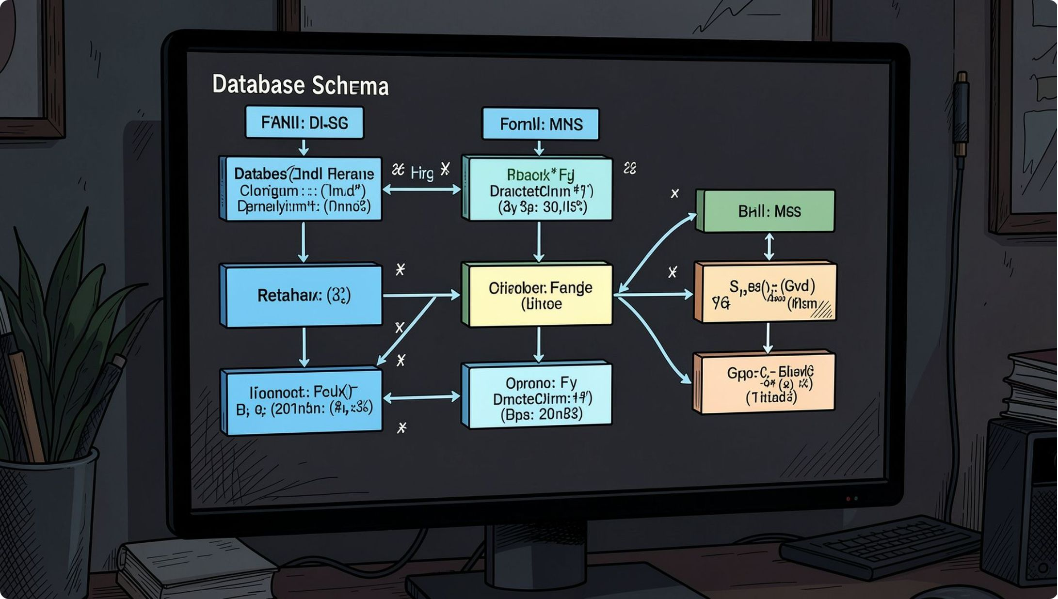
Database Design & ETL Pipeline
Normalized Relational Schema
Rather than a flat CSV, a four-table normalized schema was designed in MySQL:
Customers — demographic and geographic attributes
Products — category, sub-category, and pricing
Orders — transaction headers with dates and regions
Order_Details — line-item granularity linked via foreign keys
A Python ETL script handled staging, cleaning (mixed date formats, encoding issues), and loading — resolving Windows-specific MySQL driver challenges along the way.

Slide 5
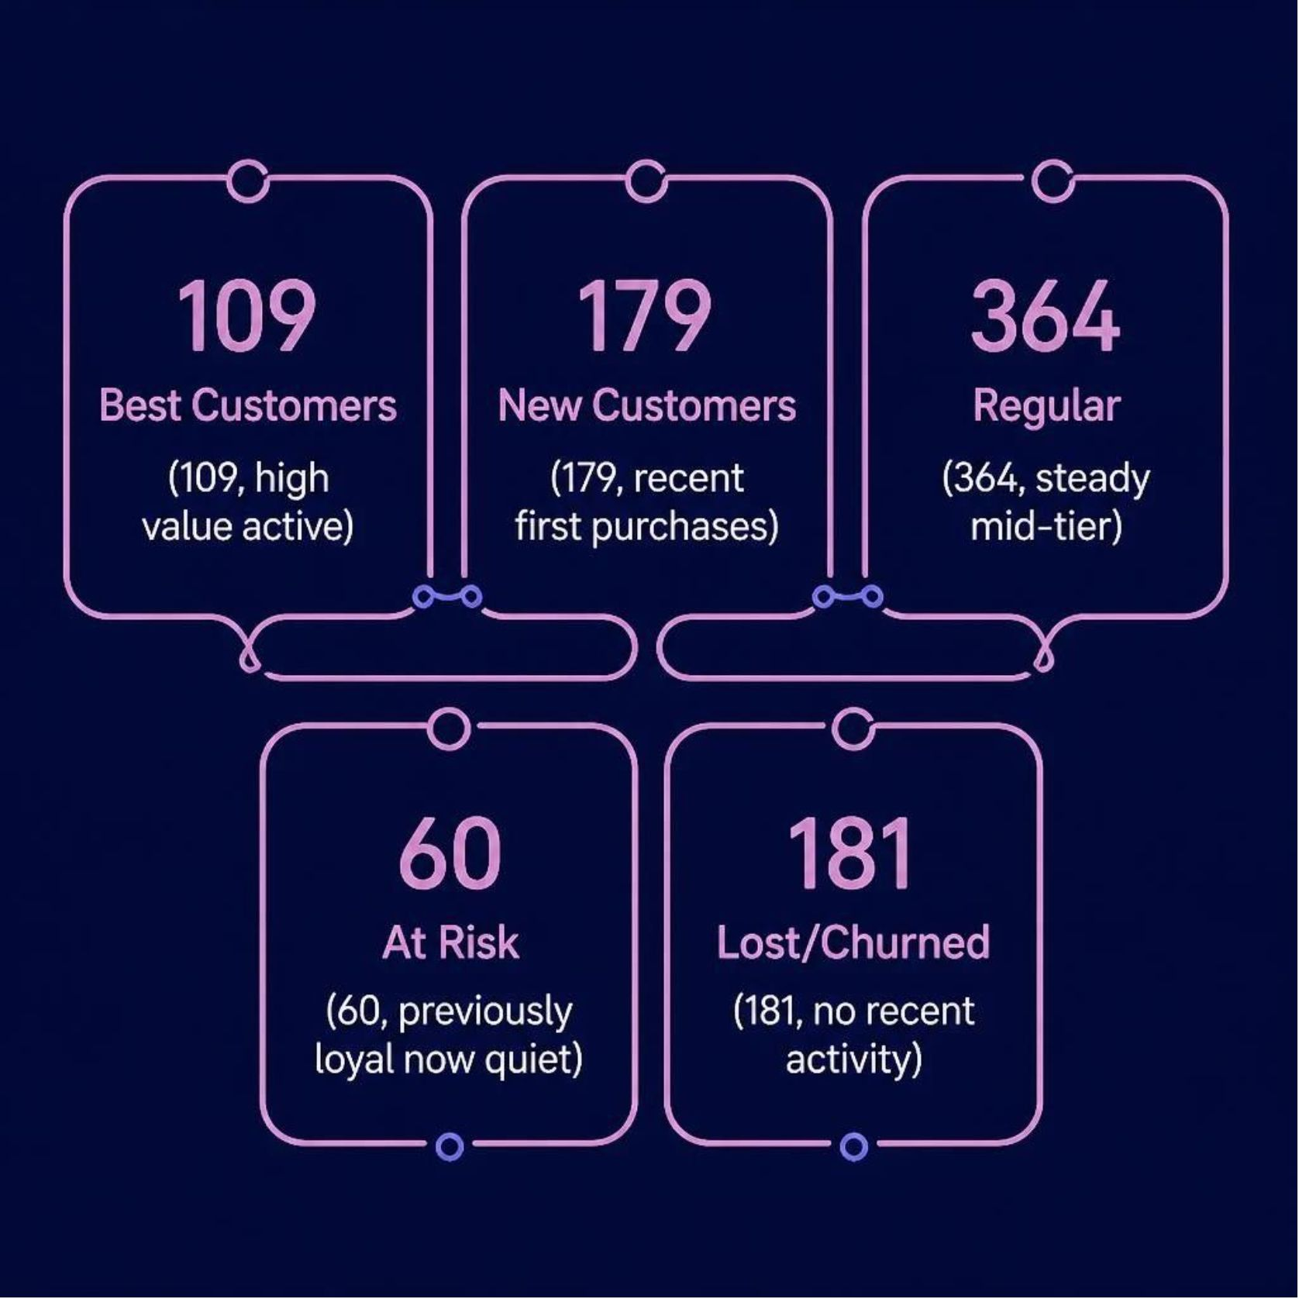
SQL Analysis & RFM Segmentation
What the Queries Uncovered
SQL joins, GROUP BY, and window functions (NTILE) calculated monthly revenue trends, top products by profit, and category/region profit margins.
An RFM (Recency, Frequency, Monetary) model using CTEs classified all 793 customers into five segments:
Best Customers — 109
New Customers — 179
Regular — 364
At Risk — 60
Lost / Churned — 181

Slide 6


Python: Discount Correlation & Cohort Retention
Two Analyses Beyond SQL
Data was pulled via SQLAlchemy into Pandas for deeper exploration:
Discount vs. Profit Correlation
A correlation of –0.22 confirmed that higher discounts erode margins — a relationship strongest within Furniture.
Cohort Retention Heatmap
Repeat purchase behavior tracked across 47 months using Seaborn, revealing retention patterns by acquisition cohort.

Slide 7
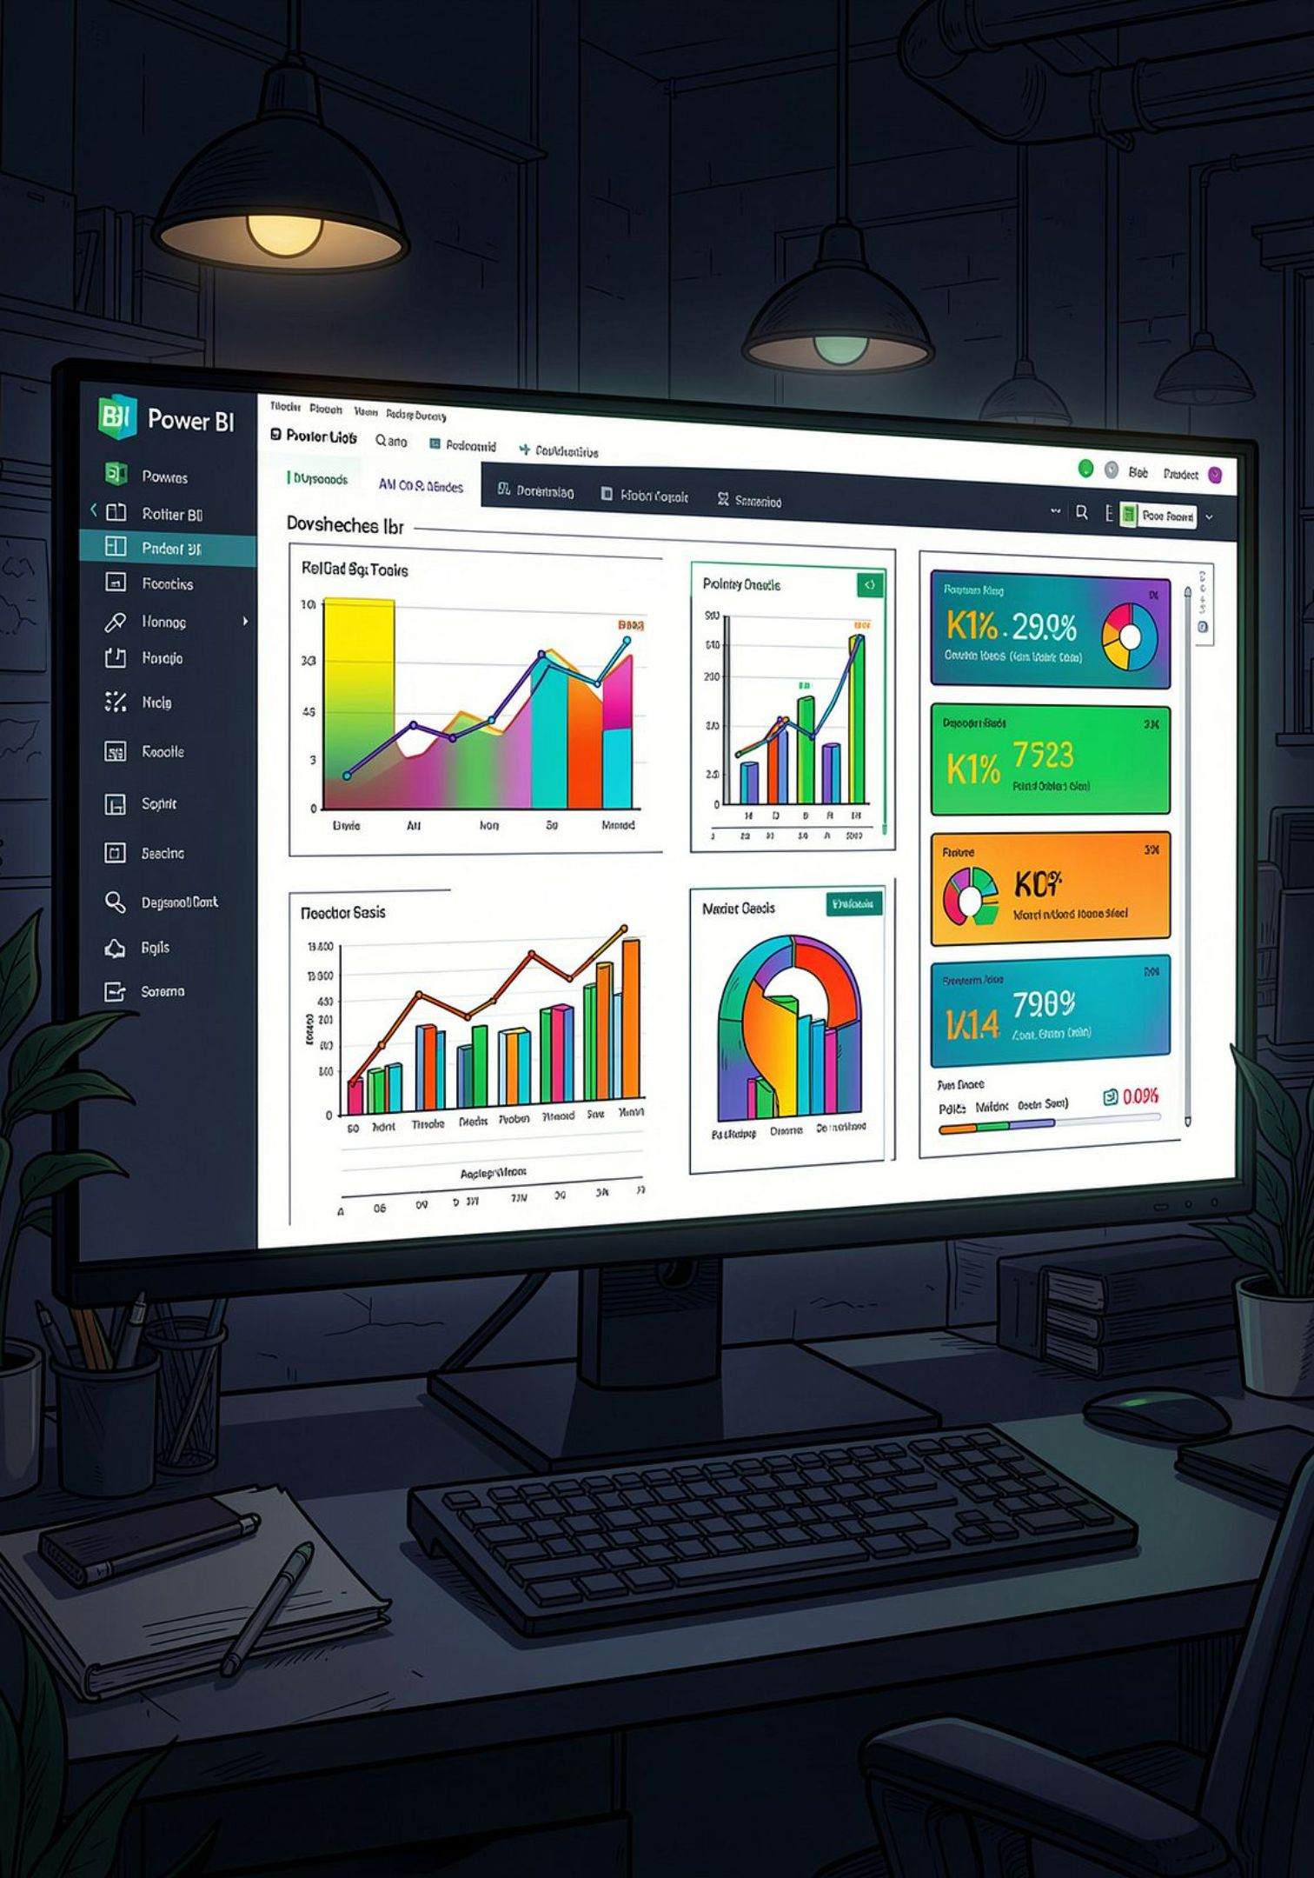
Power BI Dashboard
Power BI connected directly to MySQL via ODBC. A relational data model mirrored the schema, and DAX measures — Total Revenue, Profit Margin %, and Total Orders — powered an interactive, cross-filterable single-page dashboard.
$2.30M
Total Revenue
$286K
Total Profit
12.47%
Profit Margin
5K
Total Orders

Slide 8
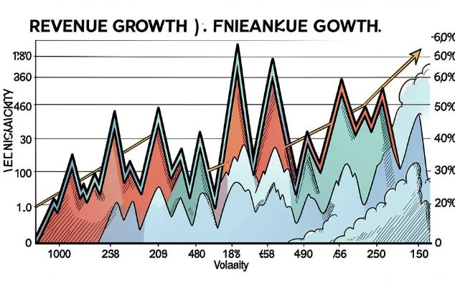

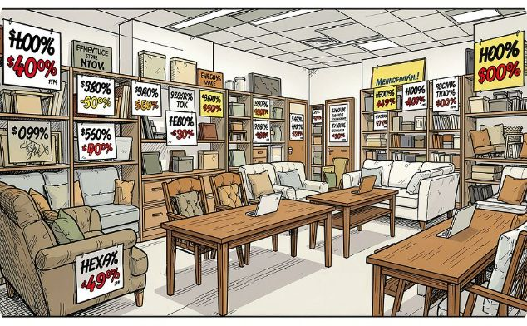
Key Findings
Revenue Growing — But Volatile
~30% of Customers Churned or At Risk
Furniture Weakest — Driven by Discounting
Revenue grew steadily 2014–2017, but sharp month-to-month swings (e.g., $82K → $12K) suggest seasonality or inconsistent demand.
181 customers (23%) fully churned and 60 (8%) at risk — nearly a third of the base, representing a major retention opportunity.
Furniture margins were negative in 2 of 4 regions (Central: –67%, East: –9%). Average discounts of 17.4% — highest of any category.

Slide 9
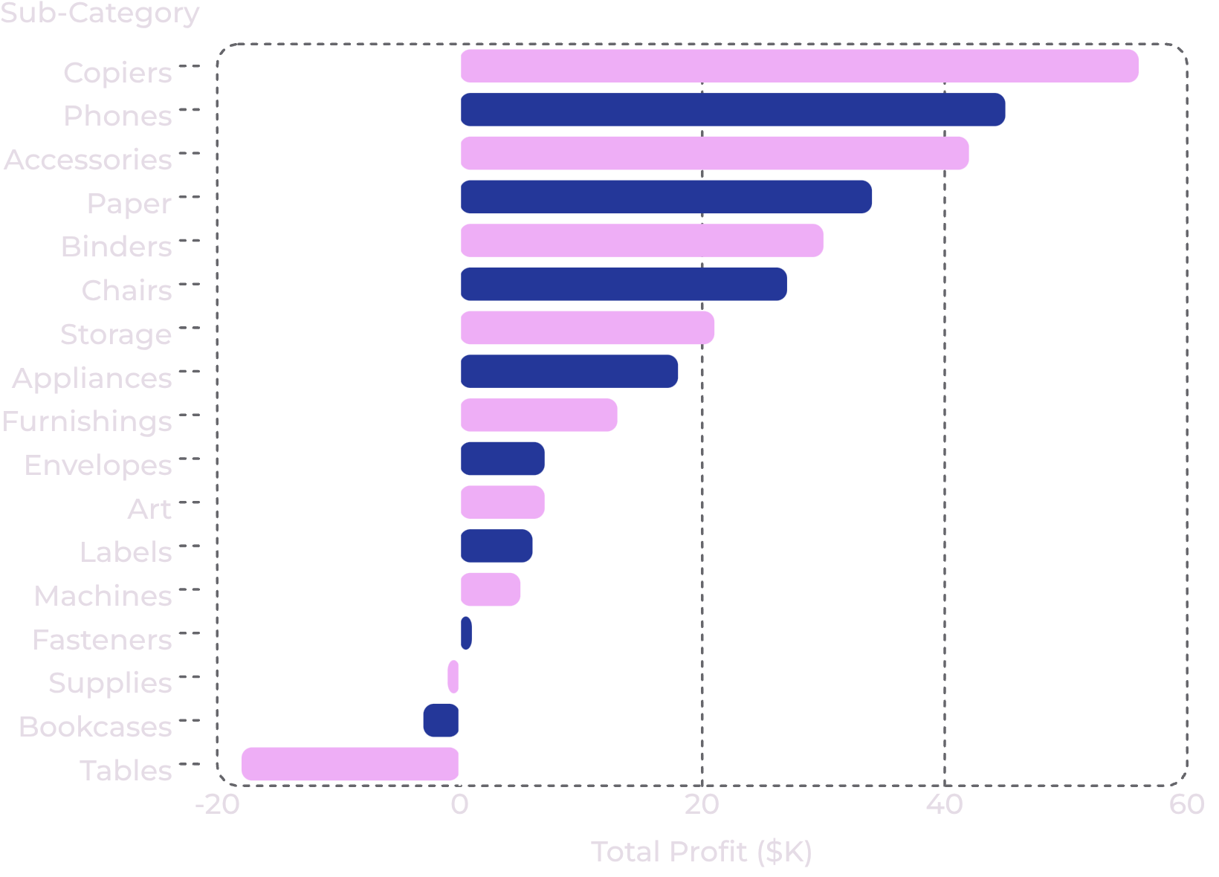

Profit by Sub-Category
Furniture Sub-Categories Are Losing Money
While Technology and Office Supplies drive strong margins, Furniture sub-categories tell a different story. Tables (–$18K) and Bookcases (–$3K) are the only sub-categories with negative total profit — both dragged down by aggressive discounting that consistently exceeds the profitability threshold.
Tables and Bookcases alone account for $21K in net losses — the clearest target for pricing intervention.

Slide 10


Recommendations & Tools
Three Actions to Take Now
Tools & Skills Demonstrated
1
Cap Furniture Discounts Below ~30%
MySQL
Python
Especially for Tables and Bookcases, where profit turns consistently negative above this threshold.
Schema design, joins, CTEs, window functions
Pandas, SQLAlchemy, Seaborn — correlation & cohort analysis
2
Launch a Win-Back Campaign
Power BI
Target the 241 customers in At-Risk and Lost/Churned segments — prioritize At-Risk first given their proven purchase history.
DAX measures, data modeling, ODBC connectivity, interactive dashboards
3
Diagnose Revenue Volatility
Determine if monthly swings are seasonal (predictable) or signal inconsistent demand that marketing cadence could smooth.

