Slide 1
Internet Protocol
  Training Division

Slide 2
Objectives
  Describe the format and fields of an
  IP datagram
  The fields used for fragmentation
  Know why a datagram may be fragmented
  Describe the options available in an
  IP datagram

Slide 3
The Layers in the TCP/IP Protocol Suite
Application
FTP
HTTP
DNS
NFS
Presentation
…
Session
Transport
TCP
UDP
IP
ICMP
IGMP
Network
ARP
RARP
Data link
Physical

Slide 4
Internet Protocol (IP)‏
unreliable and connectionless datagram protocol
a best-effort delivery service

Slide 5
Datagram
packets in the IP layer are called datagrams
a variable-length packet consisting of a header and data

Slide 6
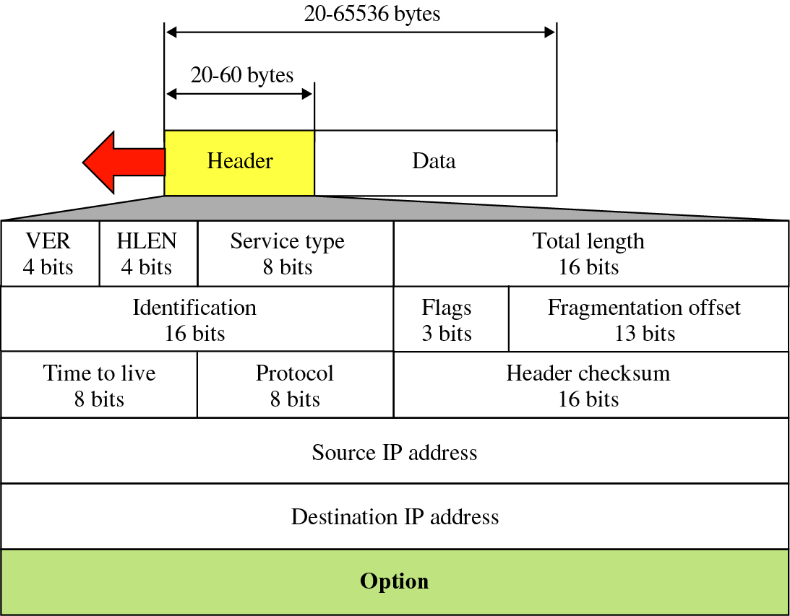
IP Datagram

Slide 7
Fields
Version (VER)‏
  4-bit
  defines the version of IP4 or 6
Header Length (HELN)‏
  4-bit
  total length of the datagram header
  in 4-byte words (20 – 60)‏

Slide 8
Fields
Differentiated Services (formerly Service Type)‏
  8-bit
  Differentiated Services is compatible with the Service Type interpretation

Slide 9
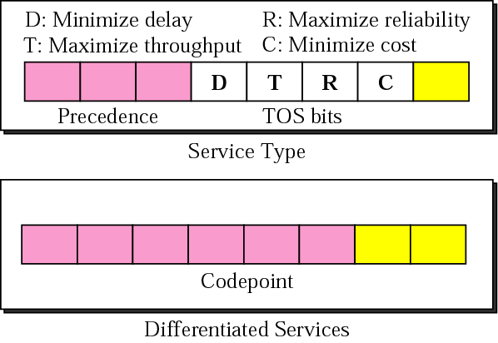
Service Type or Differentiated Services

Slide 10
Service Type
Precedence (000 - 111)‏
TOS DTRC
  ICMP 0000 Normal
  NNTP 0001 Minimize cost
  SNMP 0010 Maximize Reliability
  SMTP 0100 Maximize throughput
  FTP 1000 Minimize Delay

Slide 11
Differentiated Services
6 bits
  xxxxx0 Internet 24 services
  xxxx11 Local 16 services
  xxxx01 Experimental 16 servides

Slide 12
Fields
Total Length
  16-bit
  defines total length (header plus data) of the IP datagram in bytes
  length of data = total length - header length
  16-bits only allows a datagram to have a maximum size of 65,535 bytes
  Ethernet restricts the size of data to be encapsulated to between 46 and 1500 bytes, so padding is required if less than 46 bytes, fragmentation if larger than 1500 bytes

Slide 13
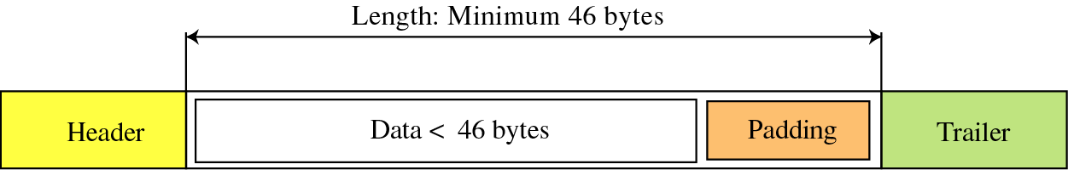
Length (Encapsulation)‏

Slide 14
Fields
Identification
  Used in fragmentation
Flags
  Used in fragmentation
Fragmentation offset
  Used in fragmentation

Slide 15
Fields
Time to live
  8-bit
  datagrams have a limited lifetime
  used to control maximum number of hops (routers) visited by the datagram
  each router decrements value by one
  datagram discarded when value reaches zero
  prevents datagrams from living too long
  can be used to limit the journey of a packet

Slide 16
Fields
Protocol
  8-bit
  specifies the final destination protocol to which the IP datagram should be delivered
  eg. TCP - 6, UDP – 17, ICMP – 1 and IGMP - 2

Slide 17
Fields
Checksum
  16-bit
  protects against the corruption that may occur during transmission
  redundant information added to the packet
  calculated at the sender and sent with the packet
  recalculated at the receiver and compared
  if they differ the packet is rejected

Slide 18
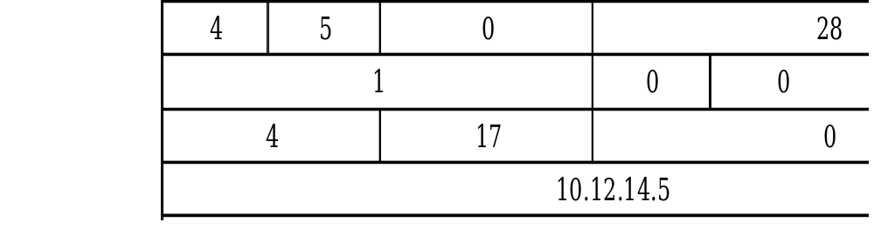
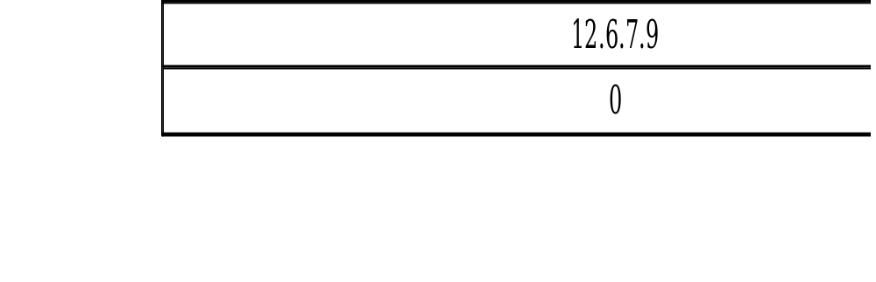
Checksum
Sum = 744E
Checksum = 8BB1

Slide 19
Checksum
4 5 0 0
0 0 1 C
0 0 0 1
0 0 0 0
0 4 1 1
0 0 0 0
0 A 0 C
0 E 0 5
0 C 0 6
0 7 0 9
________________
7 4 4 E

Slide 20
Fields
Source address
  32-bit
  IP address of the source
Destination address
  32-bit
  IP address of the destination

Slide 21
Fragmentation
As a datagram travels through different networks the frames that it is encapsulated in, may vary in size depending on the protocol used by the physical network
The datagram may need to be divided to allow it to pass through particular networks

Slide 22
Maximum Transfer Unit (MTU)‏
Each data link layer protocol has its own frame format and hence maximum and minimum size
The maximum length of data allowed is known as the MTU

Slide 23
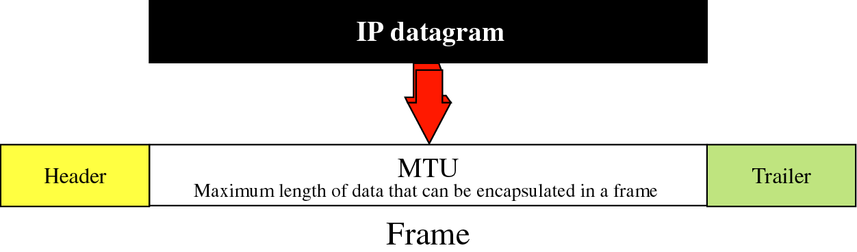
MTU
Protocol
MTU
Hyperchannel
65,535
Token Ring (16 Mbps)‏
17,914
Token Ring (4 Mbps)‏
4,464
FDDI
4,352
Ethernet
1,500
X.25
576
PPP
296

Slide 24
Fragmentation and reassembly
Fragmentation can occur at the source host or any router in the path
Reassembly of the datagram is done only by the destination host

Slide 25
Fields related to Fragmentation
The host or router that fragments a datagram must change the values of the fragmentation fields
Other fields must be copied
The checksum must be recalculated

Slide 26
Identification
16-bit counter to label the datagrams
combination of IP address and Identification field uniquely defines a datagram as it leaves the source host
the value is copied into all fragments
helps destination reassemble the datagram

Slide 27
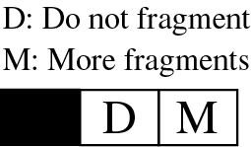
Flags
3-bit field
reserved bit

Slide 28
Fragmentation offset
13-bit
relative position of fragment with respect to whole datagram
offset of the data in original datagram measured in units of 8 bytes

Slide 29
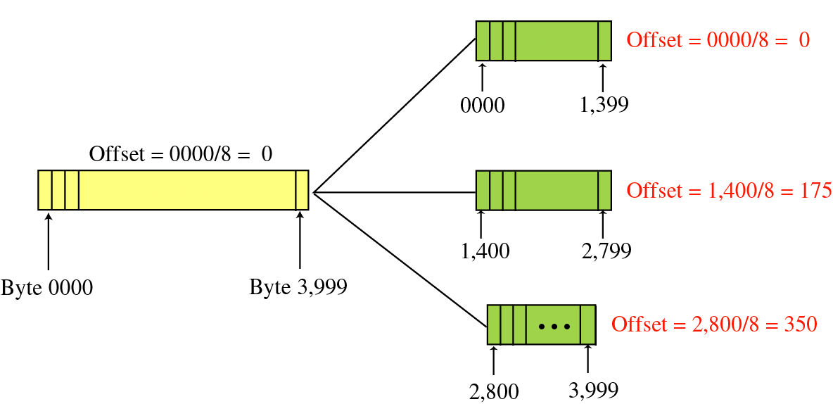
Fragmentation example

Slide 30
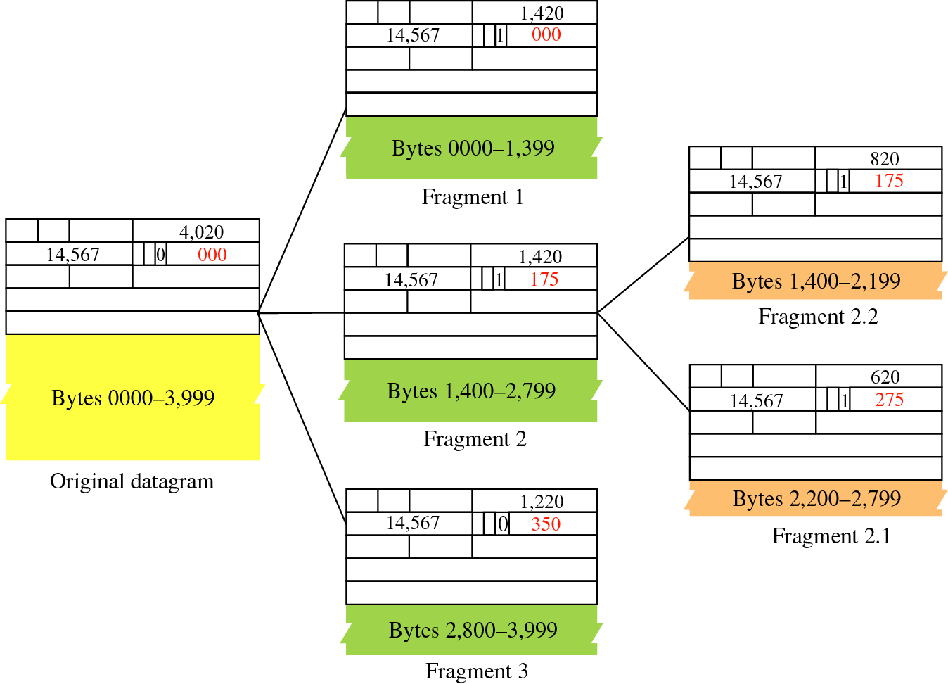
Fragmentation example

Slide 31
Reassembling strategy
The first fragment has an offset field value of zero
Divide the length of the first fragment by 8; the second fragment has an offset value equal to that result
Divide the total length of the first and second fragment by 8; the third fragment has an offset value equal to that result
Continue the process; the last fragment has a more bit value of 0

Slide 32
Options
Variable size; maximum of 40 bytes
not required for every datagram
used for network testing and debugging

Slide 33
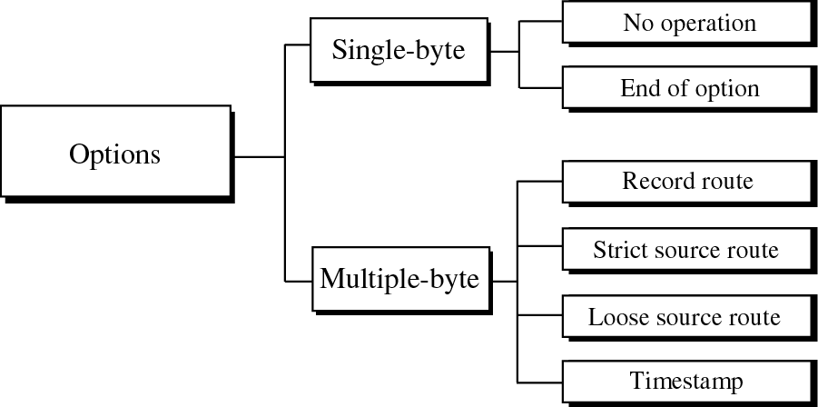
Option Types

Slide 34
Option Types
No Operation
  1-byte option used as a filler between options
End of Option
  1-byte option used for padding at the end of the option field

Slide 35
Record Route
used to record the internet routers that handle the datagram
can list up to nine router IP addresses

Slide 36
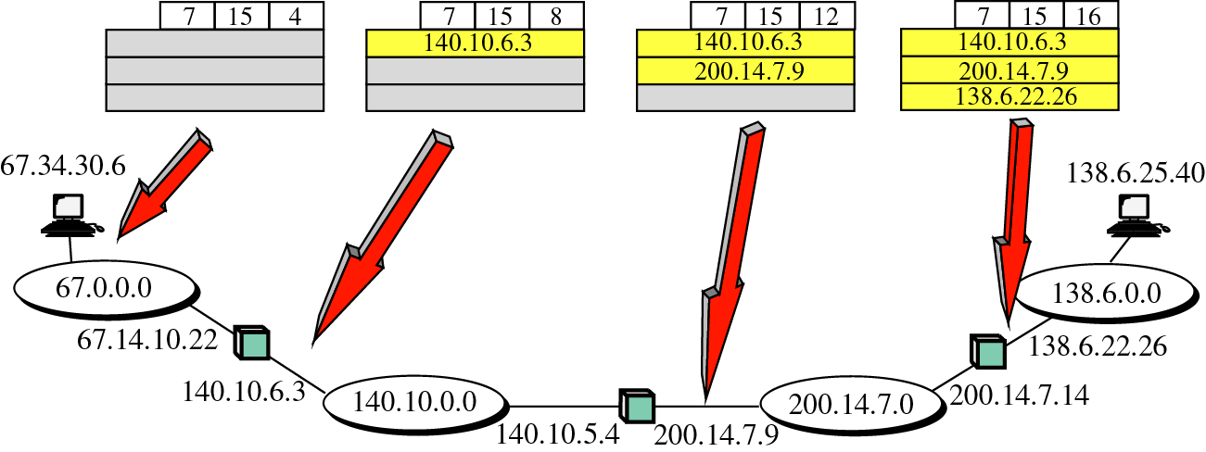
Record route concept

Slide 37
Strict Source Route
used by source to predetermine a path for the datagram
datagram must visit all and only IP addresses listed
can select path based on minimum delay or maximum throughput
can ensure a safer or more reliable route

Slide 38
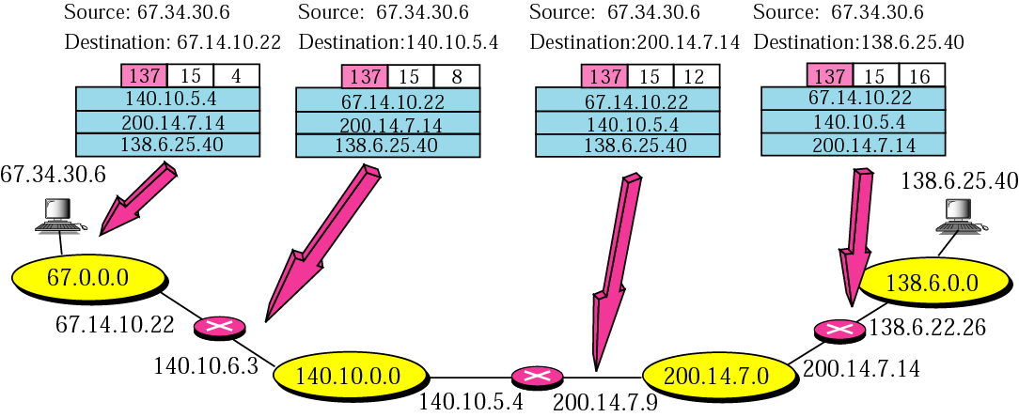
Strict Source Route

Slide 39
Loose Source Route
Same as Strict Source Route but datagram can visit other routers

Slide 40
Timestamp
used to record the time a datagram is processed by a router
can help track behaviour of routers

Slide 41
Checksum at Sender
The packet is divided into k sections, each of n bits (n = 16)‏
All sections are added together using one’s complement arithmetic
The final result is complemented to make the checksum
The checksum in the IP packet covers only the header, not the data

Slide 42
Checksum at Receiver
Receiver divides the received packet into k sections
Adds all sections
Complements the result
If final result is 0, the packet is accepted

Slide 43
Thank You
  Training Division

