Slide 1
DRM
Bharath P

Slide 2
Introduction
Direct Rendering Manager
Subsystem of Linux Kernel, responsible for interfacing with GPU of modern video cards.
Exposes API that user programs can use to perform operations such as configuring the mode setting of the display.

Slide 3
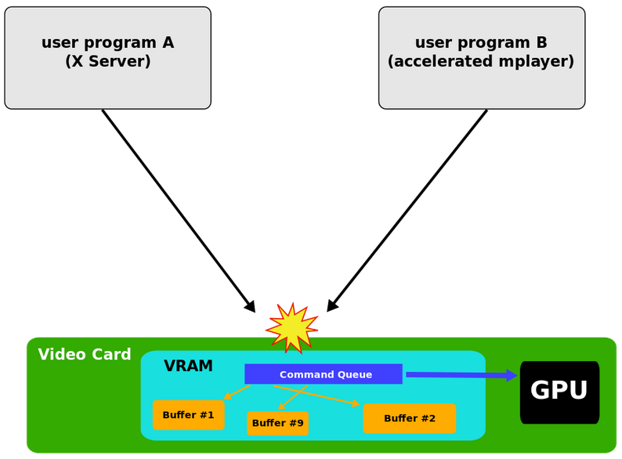
Why DRM?
The Linux Kernel already had an API called fbdev, but it couldn't handle needs of modern GPU based video cards.
When two or more programs tried to control the same video card at the same time, they ends with disastrous event.

Slide 4
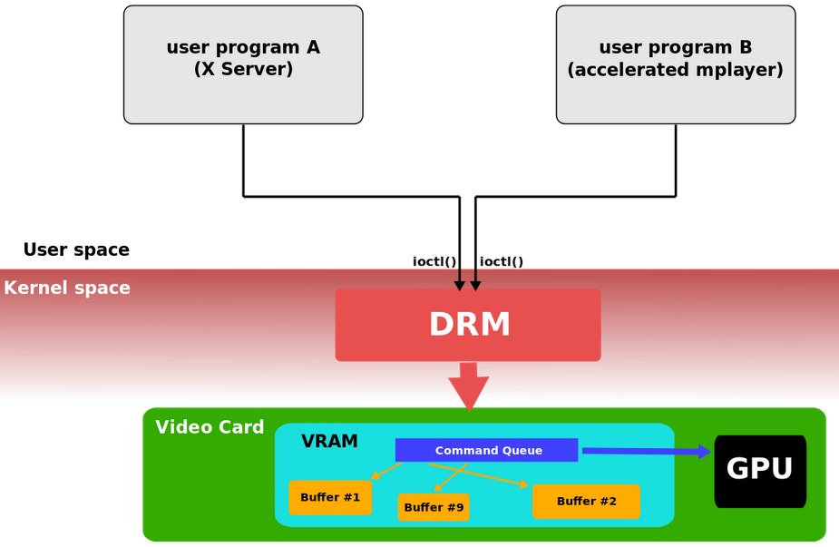
Continued....
DRM supports multiple programs to control same video card at the same time.
DRM responsible for initializing and maintaining the command queue, the VRAM and other resources.

Slide 5
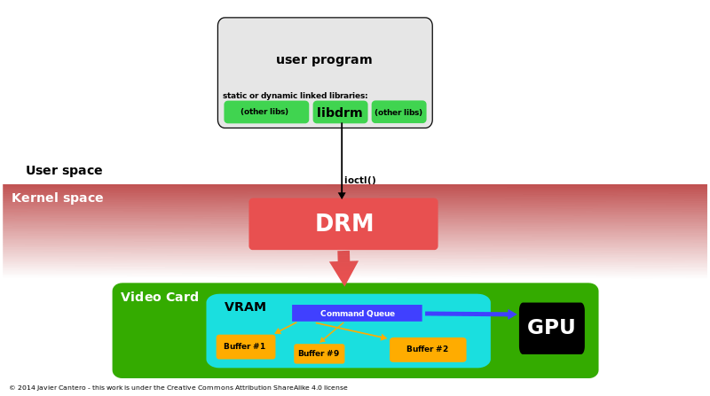
Software architecture
DRM exposes GPU through the filesystem name space using device files under /dev hierarchy.
Each GPU detected by DRM referred as DRM device, and device file /dev/dri/cardX (where X is sequential number) created to interface with it.
libdrm facilitates interface of user space programs with DRM subsystem.

Slide 6
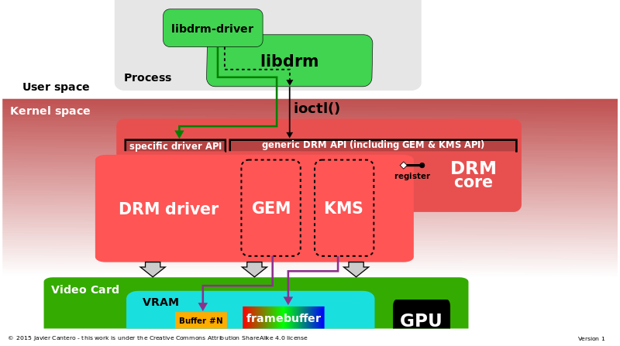
Continued....
DRM consists two parts:
DRM core
DRM Driver
DRM core provides framework where different DRM drivers can register, and also provides ioctls.
DRM driver implements hardware-dependent part of the API.

Slide 7
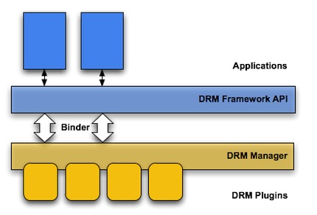
Continued....
DRM framework that lets applications manage rights-protected content according to the license constraints.
Two architectural layers.,
DRM framework API : Exposed to applications through Android application framework and runs through Dalvik VM
A native code DRM manager : Implements the DRM framework and exposes an interface for DRM plug-ins (agents)

