Slide 1
Device Driver Basics
Anfal Qureshi

Slide 2
Contents
Device Driver Definition
Role of Device Driver
Driver Types
Classes of Device Driver
Kernel Version Numbering
Building and Running Module
Kernel Modules vs Application

Slide 3
Definition Device Driver
A Device Driver is a collection of functions that accept general requests for I/O operations and manipulate the device to perform the requested operations.
Device Drivers are the translators of the Linux operating system kernel.
They stand between the kernel and pheripherals.

Slide 4
Role of Device Driver
The role of device drivers is to communicate with I/O devices attached to the system.
e.g. Hard Disks, Floppies, interfaces, sound cards and so on.
The role of a driver is to provide mechanisms and not
Policies.
Mechanisms????
“what capabilities are to be provided”
Policies????
“how these capabilities can be used”

Slide 5
Driver Types
1. Statically linked driver
2. Dynamically linked driver
Statically linked driver | Dynamically linked driver
The object code of driver compiled along with kernel compilation. | Object code can be added or removed dynamically during kernel runtime. Also called as modules.
Since it is within the kernel the size is increased. | The kernel size is less.
Any modification of the driver requires entire kernel recompilation. | Any modification of object code recompilation of kernel is not required.

Slide 6
Classes of Devices
Character Devices
Block Devices
Network Devices

Slide 7
Character Devices
Can be written to and read from a byte at a time.
Represented as stream.
Usually permit only sequential access.
Implement open,close, read and write functions/oprations.
Example – Serial port, keyboard etc.
Device file exmples - /dev/tty0, /dev/jp1

Slide 8
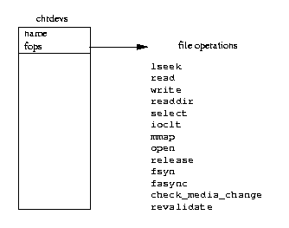
Character Device
Figure: Character Devices

Slide 9
Block Devices
Can be written to and read from only on block-size multiples.
permit random access.
Example – Hard disk, flash disk, cdroms etc.
Device file exmples - /dev/sda, /dev/sda1, /dev/fd0 etc

Slide 10
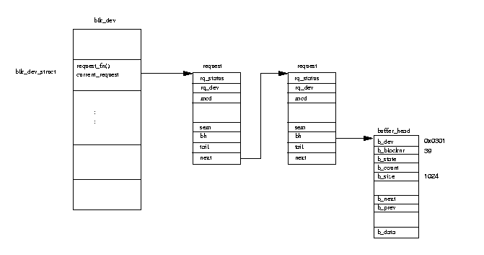
Block Device Requests
Figure: Buffer Cache Block Device Requests

Slide 11
Network Device
Transfers packets of data. Device sees the packets, not the streams.
Most often accessed via Socket Interface.
Reception and transmission functions are implemented.
Example Device files – eth0, pp0

Slide 12
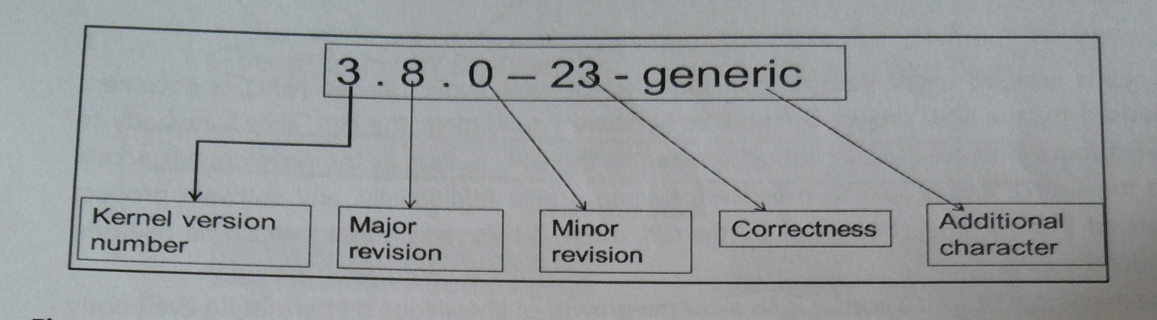
Kernel Version Numbering
Linux kernels come in two flavours:
Stable
Development
Fig. Kernel Version Numbering meaning

Slide 13
Building and Running Module
Creating Makefile
Initialization Module
Cleanup module

Slide 14
Module overview
Module Documentation
Every module should specify which license applies to its code.
MODULE_LICENSE (“GPL”) ;
The speacific license recognized by the kernel are “GPL” (for any version of the GNU General Public License).
Other descriptive definition that can be contained within the module include :
    MODULE_AUTHOR (starting who wrote the module)
    MODULE_DESCRIPTION (a human readable statement of what the module does)
    MODULE_VERSION (for code revision number)
    MODULE_ALIAS (another name by which module can be known)

Slide 15
Kernel Symbol Table
When modules are loaded, they are dynamilly linked into kernel. As with userspace, dynamically linked can call only into external functions explicitly exported for use. In the kernel, this is handled via speacial directives called EXPORT_SYMBOL()
The set of exported kernel symbols are known as the exported kernel interfaces.
The table contains the addresses of global kernel items functions and variables that are needed to implement modulazed drivers.

Slide 16
Module Parameter
Passing command line argument to module using macro module_param()
module_param(name, type, perm) ;
Here name is the name of both the parameter exposed to the user and the variable holding the parameter inside your module.
The type arg holds the parameters datatype;
It is one of byte, short, ushort, int, uint, long, ulong, charp, bool etc
The perm arg speacies the permission of the corresponding file in sysfs.

Slide 17
Kernel Module vs Application
Application Programming | Linux module Programming
Application program will perform a single task from beginning to end. | The kernel program can start anywhere and end anywhere.
There is glib c library. | No library support.
Application program has single entry point main | Kernel programs have multiple entry points like open, release, ioctl,read, write etc
Applications run in user space. | A module run in kernel space.

Slide 18


