Slide 1
Software Methodologies
S. Sabari Manoj

Slide 2
Contents
  SDLC
  Methods
    Waterfall Model
    Iterative Model
    Spiral Model
    V-Model
    Big Bang Model
    Agile Model
  Conclusion

Slide 3
What is Software Development Life Cycle ?
Software Development Life Cycle (SDLC) is a process used by the software industry to design, develop and test high quality softwares.
It is also called as Software Development Process.
ISO/IEC 12207 is an international standard for software life-cycle processes.

Slide 4
Why Software Development Life Cycle ?
The SDLC aims to
  Produce a high-quality software
  Meets or exceeds customer expectations
  Reaches completion within time and cost estimates

Slide 5
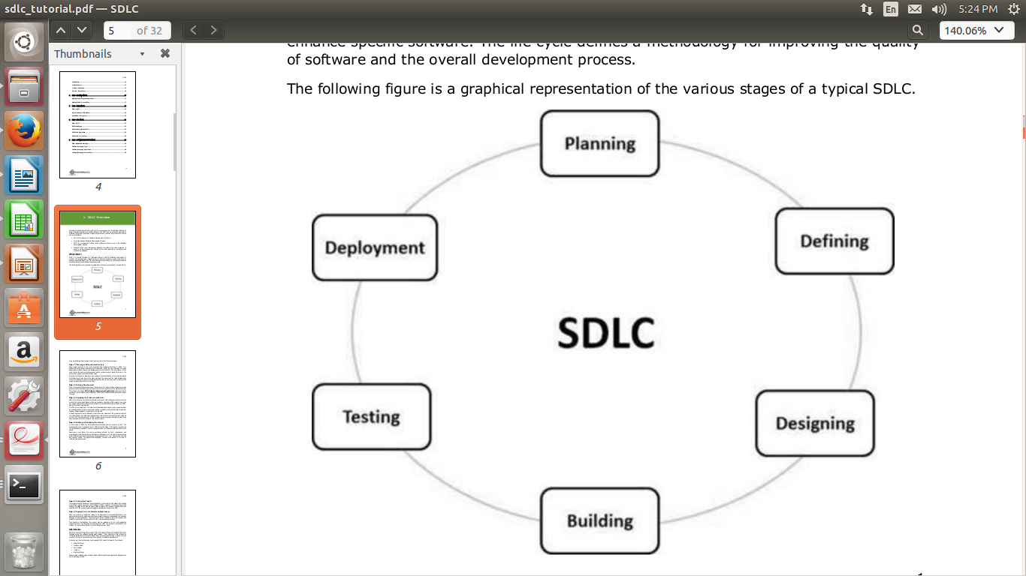
How SDLC works ?

Slide 6
Planning and Requirement Analysis
Most important and fundamental stage
Planning for
  Quality assurance requirements
  Identification of the risks associated
  Cost and time factors
Performed by
  Architect and team led members of the team
  Sales department with the help of Market Surveys
  Domain experts in the industry

Slide 7
Defining Requirements
To clearly define and document the product requirements
To get them approved from the customer or the market analysts
This is done through an SRS (Software Requirement Specification) document

Slide 8
Designing the Product Architecture
The best architecture for the product to be developed
More than one product architectures are proposed & documented in a DDS - Design Document Specification.
DDS is reviewed & the best design approach is selected for the product.

Slide 9
Building or Developing the Product
Actual development starts and product is built
Programming code is generated as per DDS
Developers must follow the coding guidelines
Programming language is chosen with respect to the type of software being developed

Slide 10
Testing the Product
Testing activities are mostly involved in all the stages of SDLC
Product defects are reported, tracked, fixed and retested until the product reaches the quality standards defined in the SRS.

Slide 11
Deployment in the Market and Maintenance
Product to be deployed is released formally in the appropriate market
The product may first be released in a limited segment and tested in the real business environment (UAT- User acceptance testing).

Slide 12
Software Methodologies
What is it ?
  - Defined and designed which are followed during the software development process
  Why is it ?
  - Already verified methods
  - To ensure success in the process of software development

Slide 13
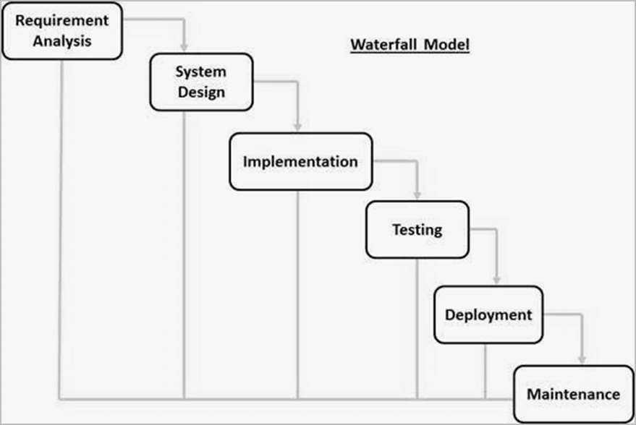
Waterfall Model ─ Design

Slide 14
Waterfall Model ─ Advantages
Simple and easy to understand and use
Phases are processed and completed one at a time
Clearly defined stages
Well understood milestones
Easy to arrange tasks
Process and results are well documented

Slide 15
Waterfall Model ─ Disadvantages
No working software is produced until late during the life cycle
High amounts of risk and uncertainty
Poor model for long and ongoing projects
Risk and uncertainty is high with this process model
It is difficult to measure progress within stages
Cannot accommodate changing requirements

Slide 16
Waterfall Model ─ Application
Requirements are very well documented, clear and fixed.
Product definition is stable.
Technology is understood and is not dynamic.
There are no ambiguous requirements.
The project is short.

Slide 17
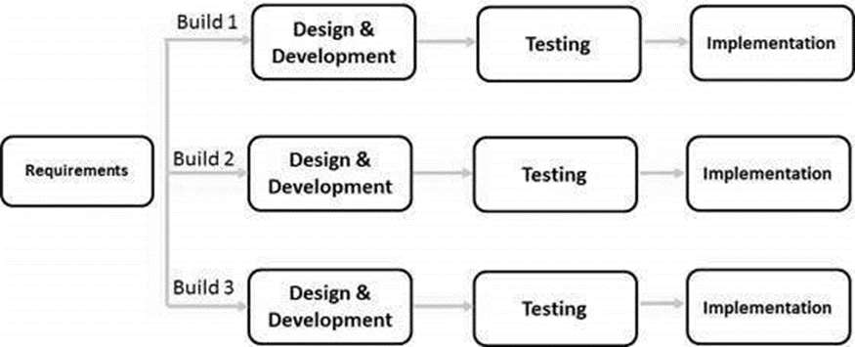
Iterative Model ─ Design

Slide 18
Iterative Model ─ Advantages
Risk analysis is better
It supports changing requirements
Initial Operating time is less
Results are obtained early and periodically
Parallel development can be planned
Progress can be measured
Less costly to change the scope/requirements
Testing and debugging during smaller iteration is easy

Slide 19
Iterative Model ─ Disadvantages
Defining increments may require definition of the complete system
Not suitable for smaller projects
Management complexity is more
End of project may not be known which is a risk
Highly skilled resources are required for risk analysis
Projects progress is highly dependent upon the risk analysis phase

Slide 20
Iterative Model ─ Applications
Requirements of the complete system are clearly defined and understood
There is a time to the market constraint
Resources with needed skill sets are not available and are planned to be used on contract basis for specific iterations
There are some high-risk features and goals which may change in the future

Slide 21
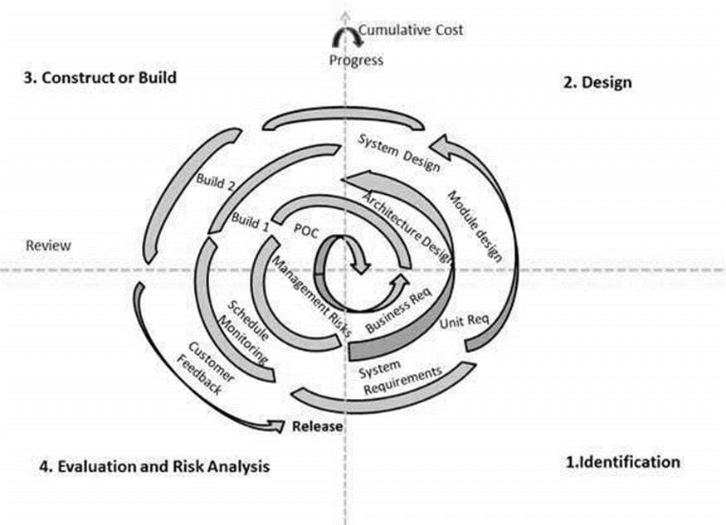
Spiral Model ─ Design

Slide 22
Spiral Model ─ Advantages
Changing requirements can be accommodated
Allows extensive use of prototypes
Requirements can be captured more accurately
Users see the system early
Development can be divided into smaller parts and the risky parts can be developed earlier which helps in better risk management

Slide 23
Spiral Model ─ Disadvantages
Management is more complex
End of the project may not be known early
Not suitable for small or low risk projects and could be expensive for small projects
Process is complex
Spiral may go on indefinitely
Large number of intermediate stages requires excessive documentation

Slide 24
Spiral Model ─ Applications
When there is a budget constraint and risk evaluation is important
For medium to high-risk projects
The requirements change with time
Customer is not sure of their requirements which is usually the case
Requirements are complex and need evaluation to get clarity

Slide 25
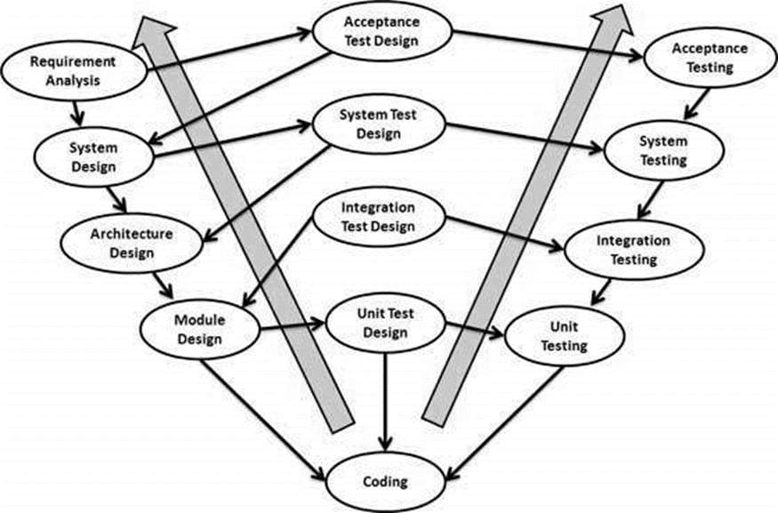
V Model ─ Design

Slide 26
V Model ─ Advantages
This is a highly-disciplined model and Phases are completed one at a time.
Works well for smaller projects where requirements are very well understood.
Simple and easy to understand and use.
Easy to manage due to the rigidity of the model. Each phase has specific deliverables and a review process.

Slide 27
V Model ─ Disadvantages
High risk and uncertainty
Not a good model for complex and object-oriented projects
Poor model for long and ongoing projects
Once an application is in the testing stage, it is difficult to go back and change a functionality
No working software is produced until late during the life cycle

Slide 28
V Model ─ Applications
Requirements are well defined, clearly documented and fixed
Product definition is stable
Technology is not dynamic and is well understood by the project team
There are no ambiguous or undefined requirements
The project is short

Slide 29
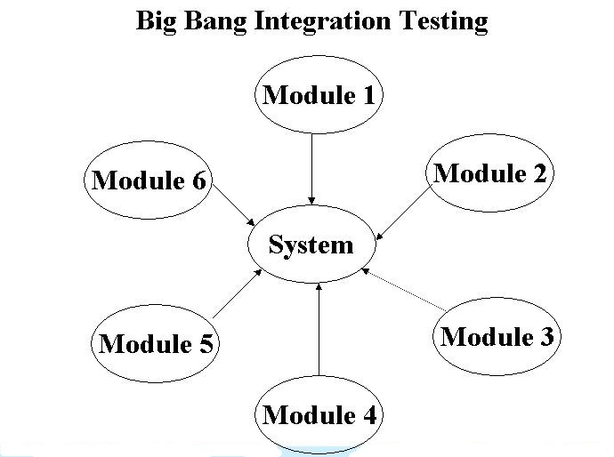
Big Bang Model ─ Design

Slide 30
Big Bang Model ─ Advantages
This is a very simple model
Little or no planning required
Easy to manage
Very few resources required
Gives flexibility to developers
It is a good learning aid for new comers or students

Slide 31
Big Bang Model ─ Disadvantages
Very High risk and uncertainty
Not a good model for complex and object-oriented projects
Poor model for long and ongoing projects
Can turn out to be very expensive if requirements are misunderstood

Slide 32
Big Bang Model ─ Applications
Ideal for small projects
Useful for academic or practice projects
It is an ideal model for the product where requirements are not well understood and the final release date is not given

Slide 33
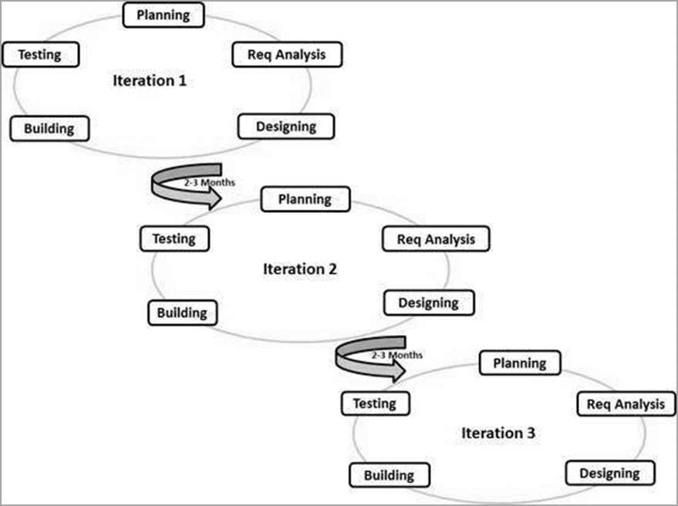
Agile Model ─ Design

Slide 34
Agile Model ─ Advantages
Functionality can be developed rapidly and demonstrated
Resource requirements are minimum
Suitable for fixed or changing requirements
Delivers early partial working solutions
Enables concurrent development and delivery within an overall planned context
Little or no planning required
Easy to manage
Gives flexibility to developers

Slide 35
Agile Model ─ Disadvantages
Not suitable for handling complex dependencies
More risk of sustainability, maintainability and extensibility
An overall plan, an agile leader and agile PM practice is a must without which it will not work
Strict delivery management dictates the scope, functionality to be delivered, and adjustments to meet the deadlines

Slide 36
Agile Model ─ Applications
New changes are needed to be implemented
The end user's needs are ever changing in a dynamic business and IT world

Slide 37
Views
  “ Agile: The World's Most Popular Innovation
  Engine. “
  - Forbes magazine

Slide 38
Views
  “ In my previous life I spent many years creating project management software. My advice for people is to not focus too much on one approach to project management or development, and instead be open to different ideas and techniques. The best practices for software development are really unique to each team and each project -- there's no one size fits all solution out there. “
                - Alex Wiesen, worked at Google

