Slide 1
COMPILATION ( SYNTHESIS )
MOHAN

Slide 2
CONTENTS
  Intermediate Code Generation.
Code Optimization.
Code Generation.

Slide 3
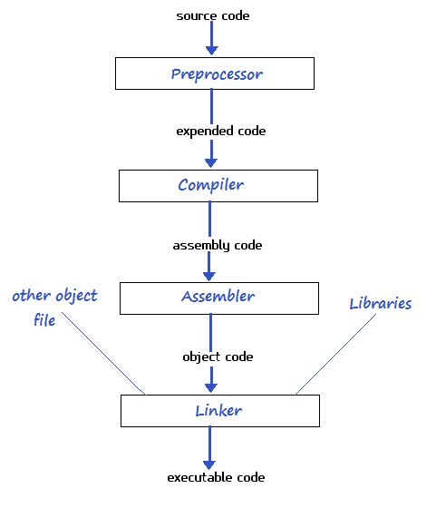
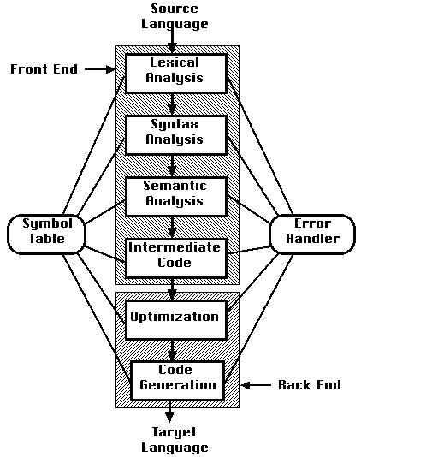

Slide 4

INTERMEDIATE CODE GENERATOR
WHAT
WHY
HOW

Slide 5



Slide 6
INTERMEDIATE CODE GENERATOR
The front end of a compiler translates a source program into an intermediate representation
Used to give the best path to the compiler,to convert high level language to machine code
Back end of the compiler uses this intermediate code to generate the target code which can be understood by the machine.
Portability will be enhanced.

Slide 7
INTERMEDIATE CODE GENERATOR
Commonly used intermediate code representations
Postfix notation
Three-address code

Slide 8
INTERMEDIATE CODE GENERATOR
Postfix Notation
(infix)
(postfix)
a + b
ab +
(a – b) * (c + d) + (a – b)
ab – cd + * ab -+

Slide 9
INTERMEDIATE CODE GENERATOR
Three-Address Code
TAC instruction can have at most three operands.
TAC is typically generated by the compiler.
It can be represented in two forms.
Quadruples
Triples

Slide 10
INTERMEDIATE CODE GENERATOR
Quadruples
A quadruple has four fields, which we call op, arg,arg2 and result.
The op field contains an internal code for the operator.

Slide 11
INTERMEDIATE CODE GENERATOR
t1 = b * c;
t2 = b * d;
t3 = t1 + t2;
a = t3;
a = b * c + b * d;
operator | argument1 | argument2 | result
* | b | c | t1
* | b | d | t2
+ | t1 | t2 | t3
= | t3 |  | a

Slide 12
INTERMEDIATE CODE GENERATOR
Triples
Each instruction in triples presentation has three fields operator,argument 1,argument 2.
The result of respective sub expression are denoted by
the position of expression.

Slide 13
INTERMEDIATE CODE GENERATOR
b * c; (0)
b * d; (1)
(0) + (1); (2)
a = b * c + b * d;
Operator | argument1 | argument2 | Position
* | b | c | (0)
* | b | d | (1)
+ | (0) | (1) | (2)
= | (2)

Slide 14
OPTIMIZATION
WHAT
WHY
HOW

Slide 15
OPTIMIZATION
It is a method of code modification to improve code quality and efficiency.
A program may be optimized so that it becomes a smaller size, consumes less memory, executes more rapidly.

Slide 16
OPTIMIZATION
Machine independent optimization.
In this optimization, the compiler takes in the intermediate code and transforms a part of the code that does not involve any CPU registers and/or absolute memory locations.

Slide 17
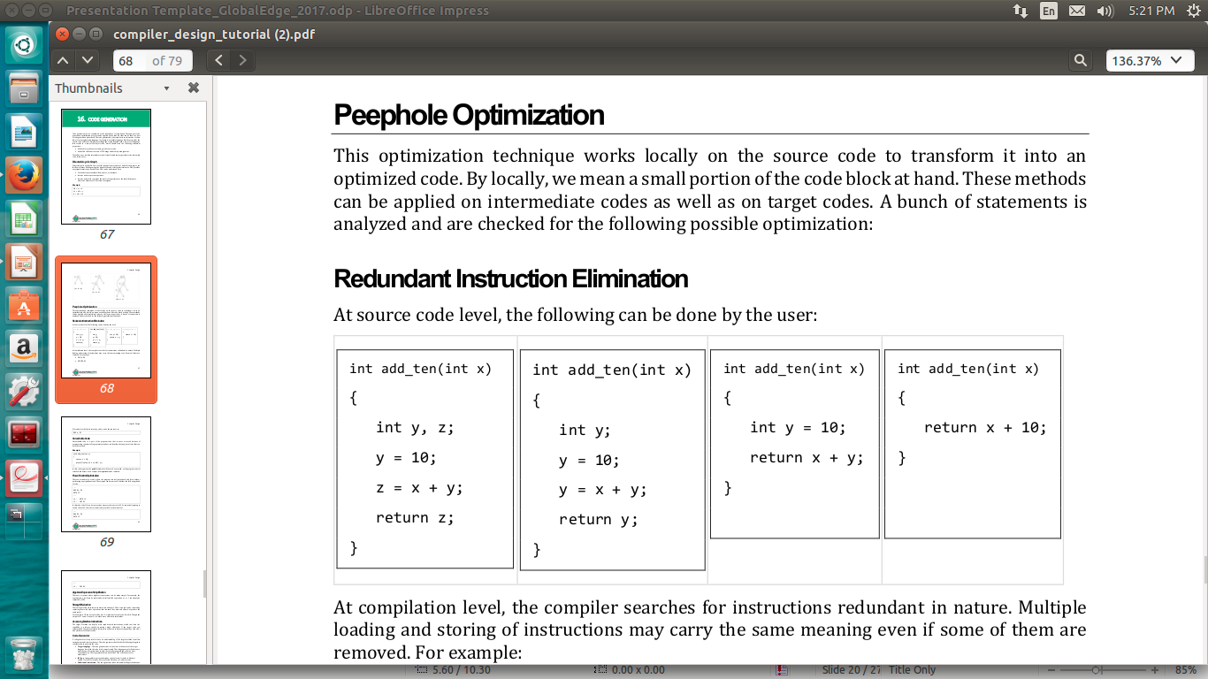
OPTIMIZATION

Slide 18
CODE GENERATION
The code generator takes as intermediate representation of the source program and convert it into target code.
Intermediate instructions are translated into sequence of machine instructions,that perform the same task.
The main aspect of code generator is to assign the registers to hold the variables.
Storage allocation decision are made either at intermediate code generation or code generation.

Slide 19
CODE GENERATION
How the intermediate code is transformed into target object code?

Slide 20
