Slide 1
FRAME BUFFER
PRIYANKA & MOHAN

Slide 2

CONTENTS
Display Devices
Frame Buffer
Frame Buffer Device (fbdev)

Slide 3
DISPLAY
Display is a term used to describe the device used to view images
and text.
Some of the important display devices:
Cathode Ray Tube Display
Liquid Crystal Display

Slide 4
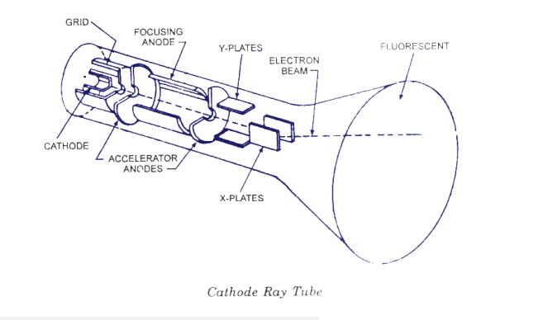
CRT DISPLAY DEVICE

Slide 5
CRT DISPLAY Cont..
Cathode Ray Tube consist of :
a. Electron gun
b. Heater
c. Cathode
d. Control grid
e. Pre – accelerating anode
f. Focusing anode
g. Electrostatic deflection plates
h. Fluorescent screen

Slide 6
CRT DISPLAY Cont..
Applications of CRT:
In TVs , radar systems and CRO we are using CRT principle.
Advantages:
We can easily increase the brightness by reflecting the light.
Low cost as compared to LCD and plasma.
The quality of image displayed is higher to the LCD and plasma.

Slide 7
CRT DISPLAY Cont..
Disadvantages:
CRT emits small amount of x-ray radiations which causes health
hazard.
CRT operates at high voltage which can overheat system and
results in an implosion.

Slide 8
CRT COLOUR MONITORS
Color monitors use a combination of phosphors that emits different
colored light.
We have two types of technologies:
1. Beam penetration method
2. Shadow mask method

Slide 9
BEAM PENETRATION METHOD
Applications:
Used in Random scan system.
Advantages:
Less expensive.
Disadvantages:
Quality of image are not good compared to other methods.
Four colors are allowed only.

Slide 10
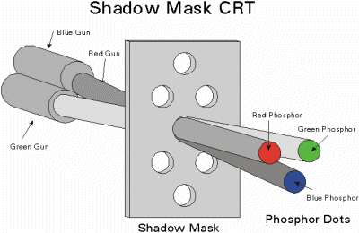
SHADOW MASK METHOD

Slide 11
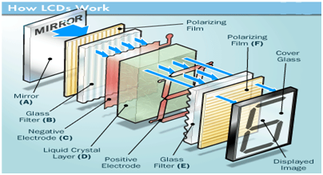
LCD DISPLAY DEVICE
LCD structure

Slide 12
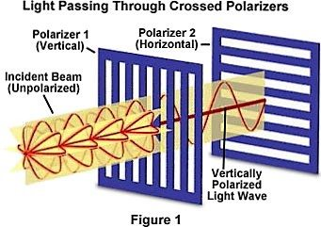
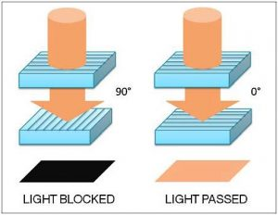
LCD DISPLAY Cont..

Slide 13
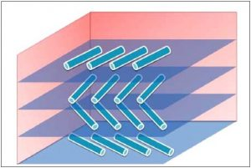
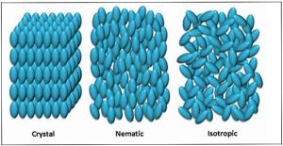
LCD DISPLAY DEVICE cont..
Orientation of molecules-LCD
Liquid crystal phases

Slide 14
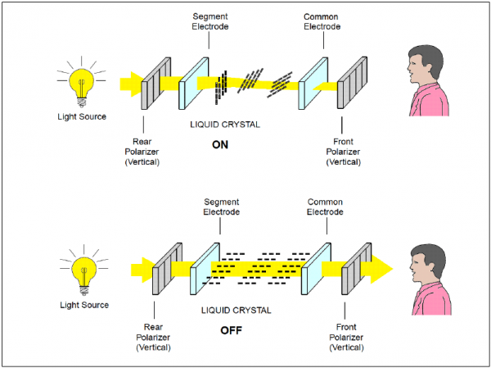
LCD DISPLAY Cont..
We have two types of LCD displays:
1.transmissive
2.reflective
Transmissive display

Slide 15
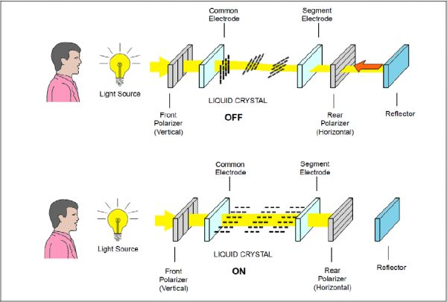
LCD DISPLAY Cont..
Reflective display

Slide 16
LCD DISPLAY Cont..
Advantages:
LCD consumes less power compared to CRT and LED.
LCD is low cost ,thinner and lighter compared to CRT and LED.
Disadvantages:
Low reliability.
More light sources are used.
Speed is very low.
Applications:
Computers ,clocks ,science and medical equipments ,mobiles etc.,

Slide 17
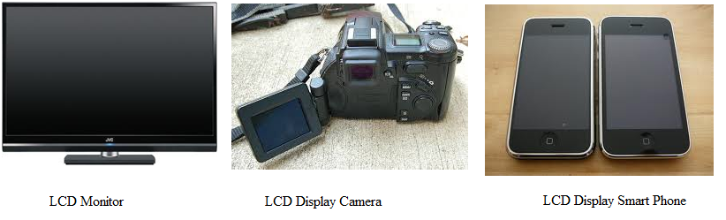
LCD DISPLAYS

Slide 18
SUB-SYSTEMS
How to display things in the Linux world?
Different solutions, provided by different subsystems:
FBDEV: Frame buffer Device
DRM/KMS: Direct Rendering Manager / Kernel Mode Setting
V4L2: Video For Linux 2

Slide 19

FRAME BUFFER
Frame buffer is a computer memory
organized into an m x n rectangular grid of dots, called picture elements (or) pixels.
Its a part of GPU memory(VRAM).

Slide 20
FRAME BUFFER
Holds the pixel properties.
No. of bits per pixel (depth).
Performance of the graphics depends above properties.
Picture Quality
Brightness

Slide 21
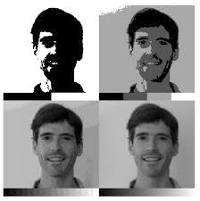
FRAME BUFFER
Bitmaps
Bits per pixel
1 bit /pixel = 2 colors
2 bits/pixel = 4 colors
4 bits/pixel = 16 colors
8 bits/pixel = 256 colors

Slide 22
FRAME BUFFER
Size of frame buffer ?
Color depth
Resolution
Size of FB = M x N x P.
M : no. of horizontal scan lines.
N : no. of pixels per scan lines.
P : no. of bits per pixel.
cat /sys/class/graphics/fb0/virtual_size

Slide 23
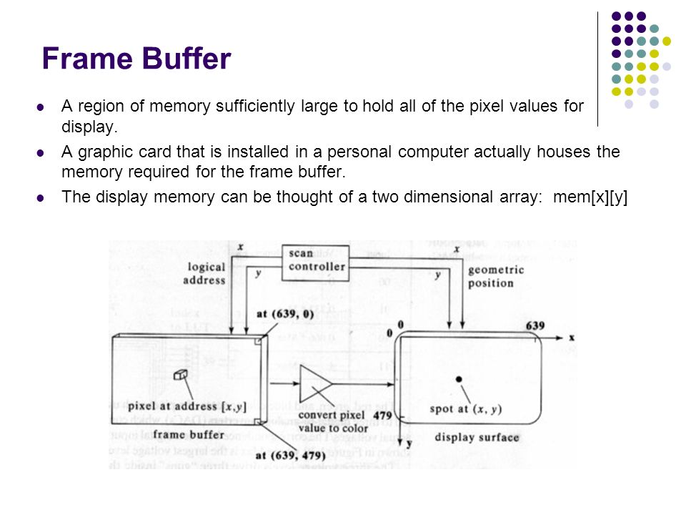
FRAME BUFFER
How FB communicate with Standard display ?
The video RAM is continuously read out by a specialized DMA component on the video card and sent to the monitor.

Slide 24
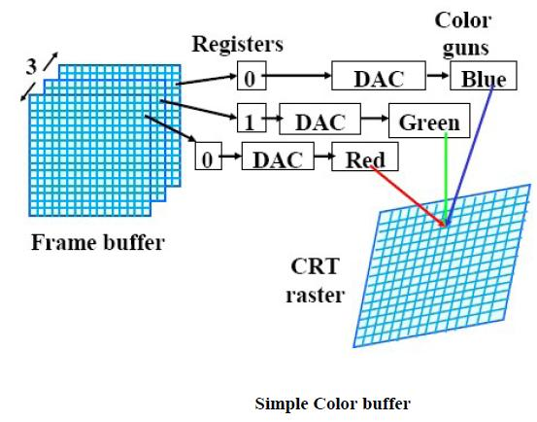
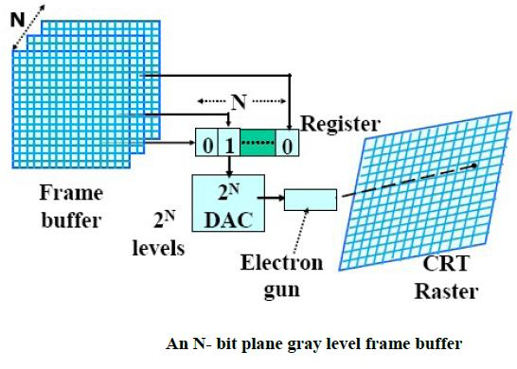
FRAME BUFFER

Slide 25
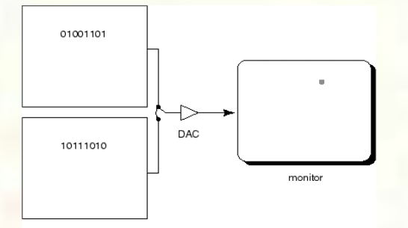
FRAME BUFFER
Double buffering
double buffering can be used to show one image or frame while a separate frame is being buffered to be shown next.
This method makes animations and games look more realistic than the same done in a single buffer mode

Slide 26
GPUs
Graphics Processing Unit
A Graphics Processing Unit (GPU) is a single-chip processor primarily used to manage and boost the performance of video and graphics.
Need of separate processor ?
Faster execution.
More ALUs compared to CPU.

Slide 27
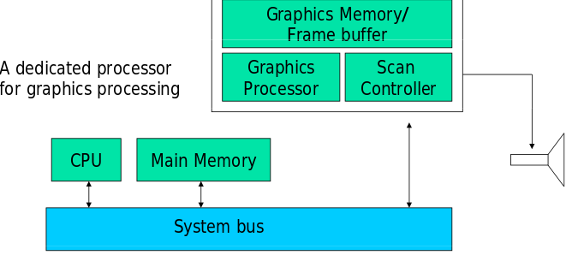
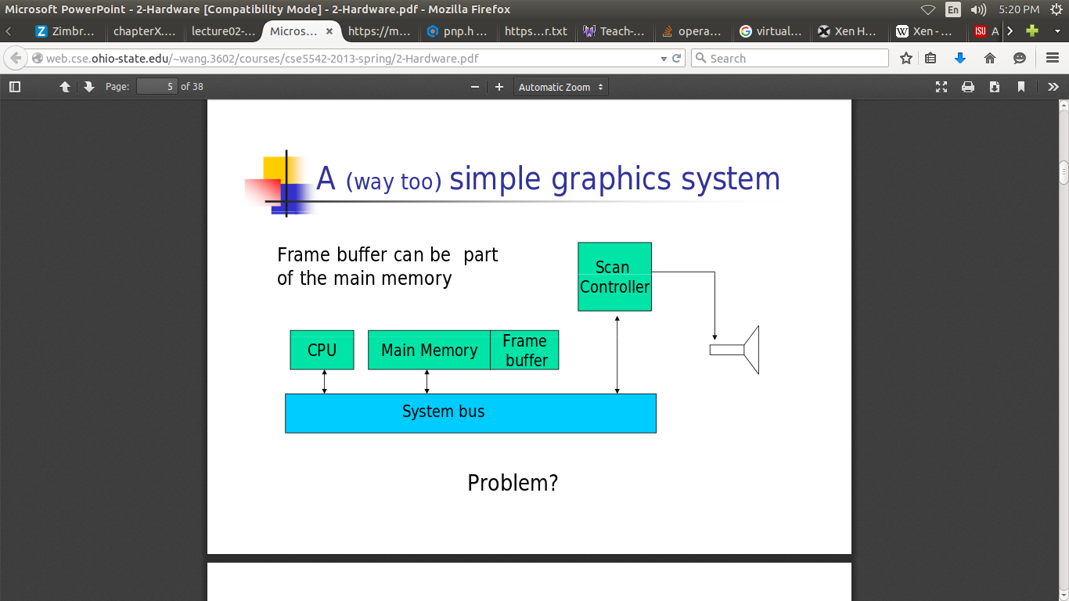
GPUs

Slide 28
FBDEV
The frame buffer device provides an abstraction for the graphics hardware.
/dev/fb0 is actual frame buffer device node.This node has a unique access to the devices based on major and minor numbers.
drivers/video/fbdev/ contains the drivers for the video.

Slide 29
Driver Vs Device
Driver
Device
fbdev
Frame buffer
dmesg
BCM2708FB: allocated DMA memory %08x

Slide 30

Flow Of Drivers
Terminologies
Device or
end point
PCI,PnP,interrupt controller,
CPU,interrupt handler,
Driver

