Slide 1
MESSAGE QUEUE
Katam Raju

Slide 2
CONTENTS
IPC Mechanisms
Message Queue
System V Message Queue
POSIX Message Queue
Advantages

Slide 3
IPC Mechanisms:
Pipe
FIFO
Message Queue
Shared memory

Slide 4
Message Queue:
A process can communicate with one another by means of IPC messages.
Each message generated by the process is send to an IPC message queue, Where it stays until another process read it.
Two (or more) processes can exchange information via access to a common system message queue.

Slide 5
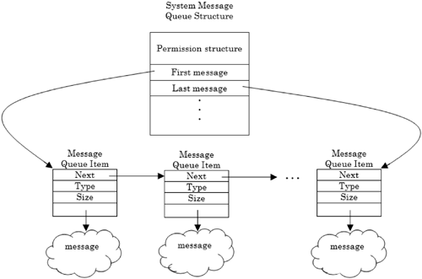
Message Queue: cont...

Slide 6
System V Message Queue:
msgget : Create a new Message Queue
msgsnd : Send a Message to Message Queue
msgrcv : Receive a Message from Message Queue
msgctl : Get info & Set info about Message Queue and Delete the Message Queue

Slide 7
System V Message Queue:cont...
msgget : int msgget(key_t key, int msgflg);
msgsnd : int msgsnd(int msqid, const void *msgp, size_t msgsz, int msgflg);
msgrcv : int msgsnd(int msqid, const void *msgp, size_t msgsz, long msgtyp, int msgflg);
msgctl : int msgctl(int msqid, int cmd, struct msqid_ds *buf);

Slide 8
POSIX Message Queue Functions:
mq_open
mq_getattr
mq_notify
mq_close
mq_receive
mq_send
mq_setattr
mq_timedreceive
mq_timedsend
mq_unlink

Slide 9
Advantages:
There are no direct connections between programs.
Communication between programs can be independent.
Applications can assign a priority to a message.
Security.
Data integrity.
Recovery support.

Slide 10


