Slide 1
GraphQL
Client and server side

Slide 2
Introduction
It is a query language and server-side run time for executing queries. Independent to database engines. It supports type system by default. Replacement to REST API’s.
Supports multiple languages.
You can be selective of what you want returned to you.
Single end point for every thing.

Slide 3
Introduction
Domain.com/books/:id
title, genere, authorId
Domain.com/authors/:id
name, ag, biography

Slide 4
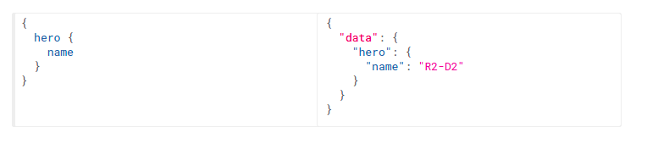
Queries
GraphQL is about asking for specific fields in the query
Response shape is same as query fields.

Slide 5
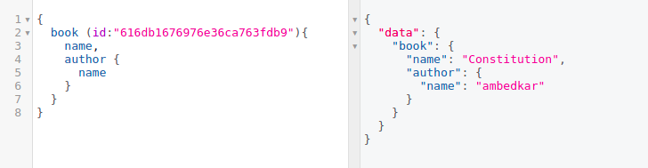
Queries - Arguments
Every field and nested object has it’s own set of arguments.
GraphQL query language is basically about selecting fields on objects
Named arguments

Slide 6
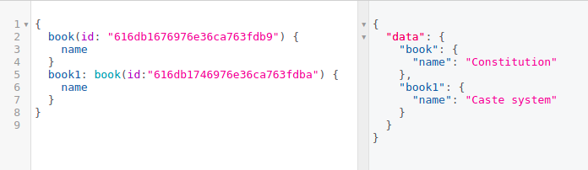
Queries - Aliases
As response JSON contains field names as key
we can use aliase name for contradiction fields

Slide 7
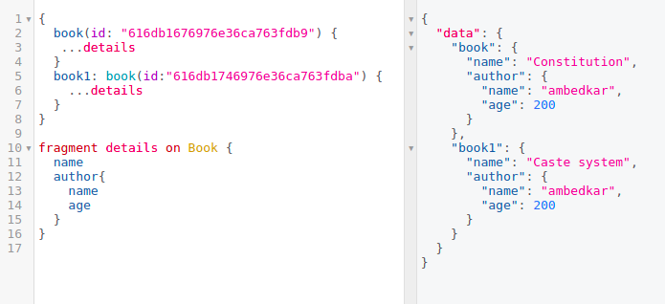
Queries - Fragments
Incase we have fields that require in multiple palces we can define them as Fragments and reuse them

Slide 8
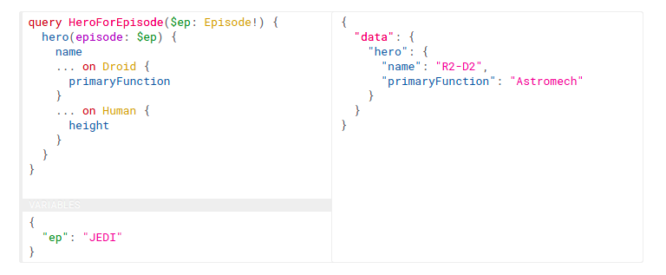
Queries – Inline Fragments
If the hero is of type Droid, we get PrimaryFunction or if it is Human we get height

Slide 9
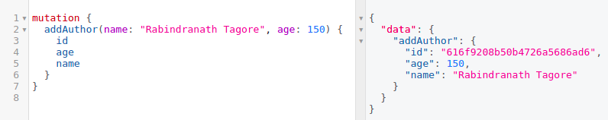
Mutations
By conventions this is useful for data write operations.
While query fields are executed in parallel, mutation fields run in series, one after the other.

Slide 10
Schema - Types
Types are basic components in GraphQL schema.
GraphQLInt
GraphQLString
GraphQLID
GrapQLObjectType
GraphQLList,
GraphQLNonNull

Slide 11
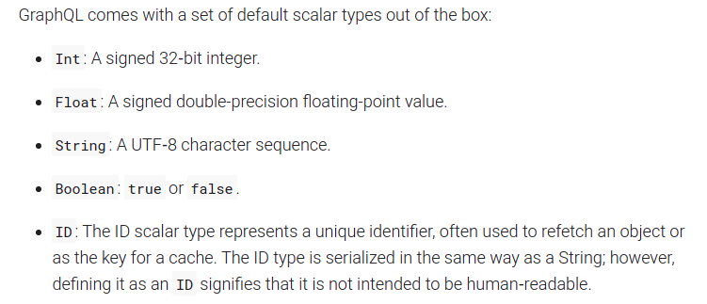
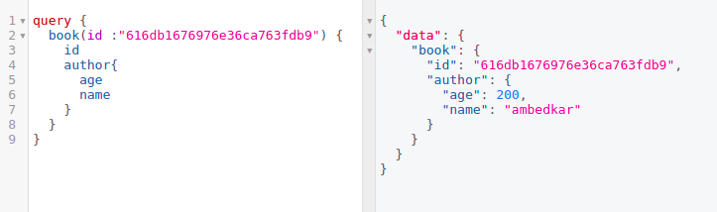
Scalar Types
A GraphQL object type has a name and fields, but at some point those fields have to resolve to some concrete data which are konwn as scalar types.
They represent the leaves of the query.

Slide 12
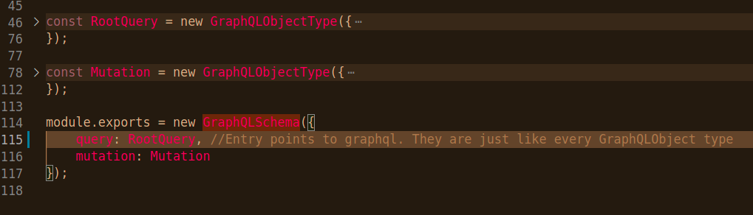
Schema - Entry Point

Slide 13
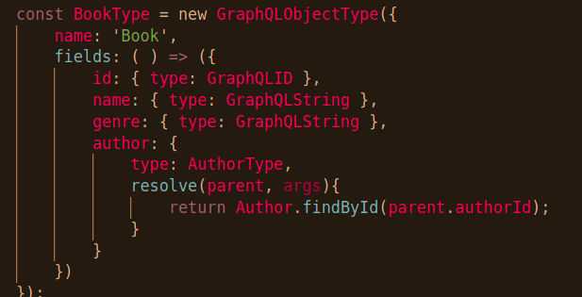
Schema

Slide 14
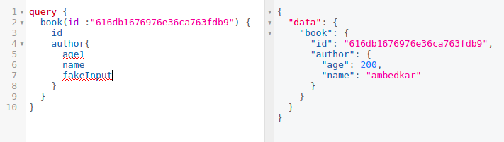
Validation
Since GraphQL is type based system we can validate the graphQL queries on FE itself.

Slide 15
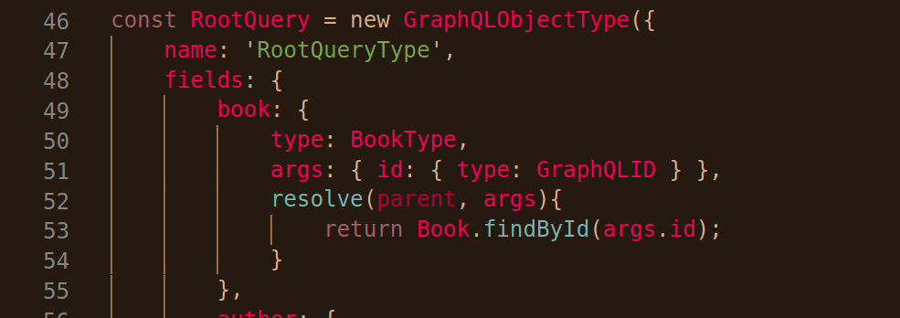
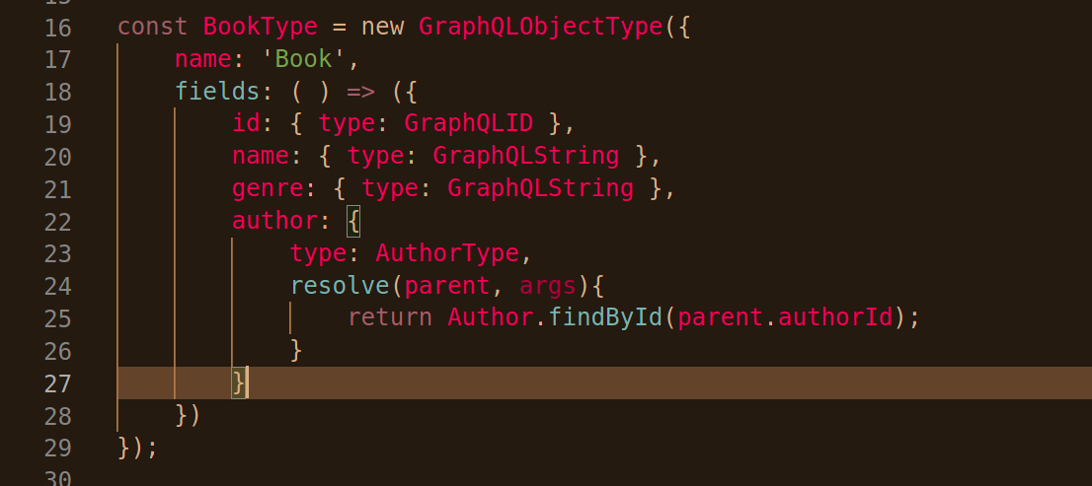
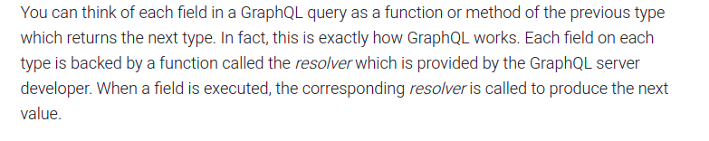
Execution
In fact, many GraphQL libraries will let you omit resolvers this simple and will just assume that if a resolver isn't provided for a field, that a property of the same name should be read and returned.

Slide 16
Resolver (obj, args, context, info)
Obj
The previous object, which for a field on the root Query type is often not used.
Args
Arugements provided in the query
Context
Holds the Mutual information that is required for all the resolvers
Info
Holds field specific info as well as shema details

Slide 17
GraphQL client (react-apollo)
State management library
Helps us to manage both local and remote data with one GraphQL query
Declarative data fetching tools.
Caching and Polling, error handling support

Slide 18
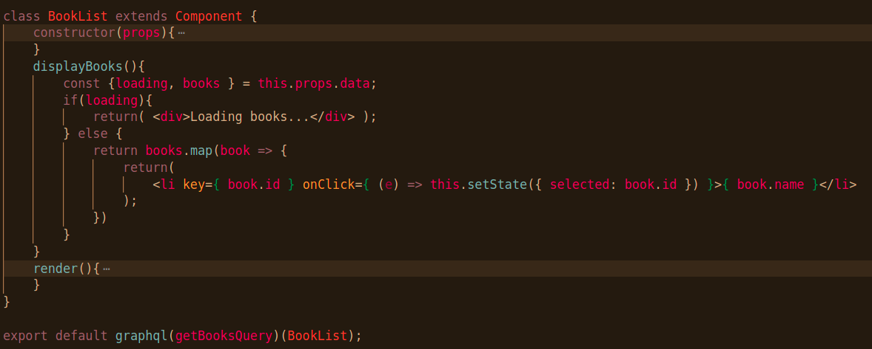
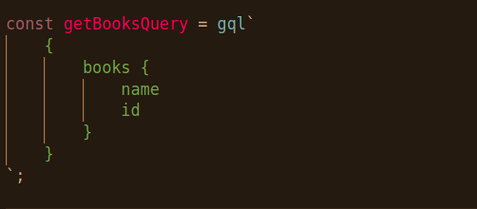
How to fetch and update data?
useQuery
useMutation
useLazyQuery

Slide 19
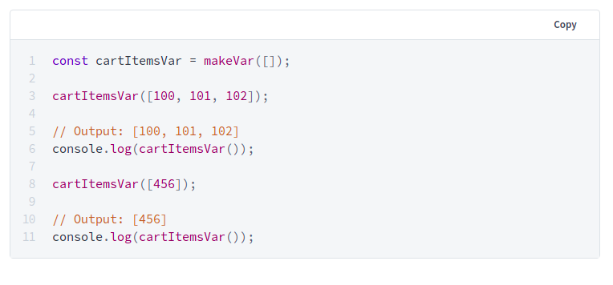
Reactive variables
MakeVar
Automatic update of queries that has these variables.

Slide 20
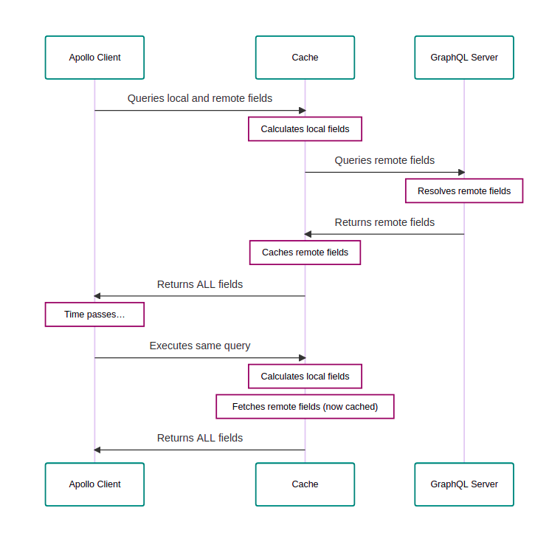
Local State

