Slide 1
ADP SecurTime: Easily track employee hours and attendance for accurate payroll processing.
ADP SecurTime

Slide 2

Opening Hook
• Elimination of payroll leakage caused by time theft
• The critical difference between reported time and verified presence
• The financial risk of relying on outdated attendance tracking methods
2
Notes:
• Emphasize that labor is typically a company's largest expense, yet often the least accurately audited.
• Introduce the concept of 'buddy punching' as a quantifiable financial drain that ADP SecurTime eliminates through biometric verification.

Slide 3
Section
•
3

Slide 4
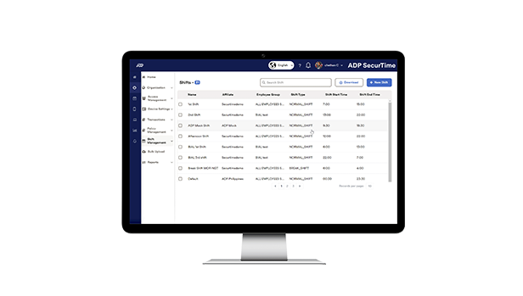
The Solution: ADP SecurTime
• Centralized workforce management with real-time visibility
• Enhanced security and accuracy through biometric verification
• Seamless payroll integration to reduce processing errors
• Location-intelligent tracking via mobile geofencing
4
Notes:
• Emphasize the elimination of 'time theft' and manual data entry errors to ensure payroll accuracy.
• Highlight the operational agility gained by automating complex shift schedules.
• Connect mobile geofencing capabilities to the challenge of managing remote and field-based teams.
• Stress the value of a unified system that bridges the gap between time capture and payroll processing.

Slide 5
Key Features
• Enhance Workforce Visibility and Control: Real-time tracking provides a single, accurate view of attendance and productivity, effectively preventing time leakage and unauthorized absences.
• Streamline Payroll Accuracy: Automated synchronization pushes attendance and leave data directly to systems like ADP Vista, eliminating manual entry errors and ensuring precise compensation.
• Eliminate Attendance Fraud: Advanced biometric authentication—including facial recognition and fingerprint scanning—ensures accurate identification and prevents proxy attendance.
• Validate Remote Operations: Mobile geofencing restricts attendance marking to defined geographic areas, ensuring accountability for off-site and field employees.
• Optimize Staffing Efficiency: Automated scheduling tools generate shifts based on employee availability and skill sets, reducing administrative errors and maximizing resource allocation.
5
Notes:
• Demonstrate the real-time dashboard to show immediate visibility into workforce status.
• Walk through the automated payroll integration to highlight time savings and error reduction.

Slide 6
What You Will Achieve with ADP SecurTime
• Eradicate payroll leakage and unauthorized payments through biometric authentication, effectively stopping time fraud and manual errors to directly recover lost revenue.
• Achieve absolute visibility over distributed workforces, enabling seamless management of on-premise, remote, and field employees across thousands of locations in real-time.
• Reduce administrative overhead by automating complex scheduling and rostering, allowing management to focus on high-value strategic initiatives rather than manual logistics.
• Mitigate legal risks and ensure audit readiness by automatically applying localized labor laws, overtime rules, and leave policies to prevent non-compliance penalties.
• Streamline payroll processing with error-free, automated data integration, ensuring employees are compensated accurately and on time while eliminating manual data entry.
• Prioritize employee well-being with contactless technology and health screening features that support rigorous health and safety protocols within physical workspaces.
6
Notes:
• Discuss how manual time tracking often leads to 'buddy punching' and calculation errors, which can inadvertently inflate gross payroll costs significantly.
• Highlight the operational confidence gained by managing workforce productivity across 1,000+ locations from a single dashboard, ensuring consistent standards regardless of geography.
• Emphasize the return on investment achieved by replacing manual data entry with automated integration, which drastically reduces the hours spent on payroll reconciliation.

Slide 7
Section
•
7

Slide 8
Optimize Workforce Management with ADP SecurTime
• Schedule a personalized platform demonstration
• Request a consultation for custom pricing
8
Notes:
• Propose a specific time next week for a 30-minute walkthrough of the interface.
• Offer to forward a detailed product specification sheet if a meeting cannot be scheduled immediately.

Slide 9
Next Steps
Schedule a personalized platform demonstration
9

Slide 10
The 30-Second Pitch
"ADP SecurTime is an automated time and attendance platform that gives you total visibility over your distributed workforce while simplifying complex scheduling. We help you eliminate payroll leakage and compliance risks by streamlining your payroll processing with accurate, real-time data. This empowers you to stop time fraud and significantly reduce administrative burden, protecting both your time and your bottom line."
Key Messages:
• Stop payroll leakage and time fraud using advanced biometric security.
• Streamline processing with seamless, real-time integration into your ADP payroll.
• Retrofit existing hardware to manage diverse workforces without new equipment costs.
• Securely track distributed teams with advanced geofencing and real-time visibility.
10

Slide 11
Thank You
Easily track employee hours and attendance for accurate payroll processing.
https://in.adp.com/what-we-offer/products/adp-securtime.aspx

