Slide 1
ADP SecurTime: Effortlessly manage employee time, attendance, and payroll in one simple solution.
ADP SecurTime is a workforce management solution designed to streamline attendance tracking, timesheets, payroll, and leave management. It offers real-time visibility into employee data, helping bu...
ADP SecurTime

Slide 2

Opening Hook
• Your company's most valuable asset is time, yet it's often the least accurately measured and the largest source of hidden operational costs. How confident are you that every dollar on your payroll ...
2
Notes:
• Pause to let the question sink in, establishing it as a strategic, high-level concern.
• This isn't about individual performance, but about the systemic inefficiencies that create financial leakage and compliance risk—challenges that can only be solved with true visibility.

Slide 3
The Challenge: Navigating Workforce Complexity
• Lack of real-time visibility into labor costs and employee productivity, hindering strategic resource allocation.
• Increased operational overhead and financial leakage resulting from manual data entry and payroll inaccuracies.
• Significant compliance risks associated with evolving labor laws, overtime calculation, and leave management.
3
Notes:
• Many leaders find that by the time they receive workforce reports, the data is already obsolete. This latency can lead to budget overruns from uncontrolled overtime or misallocated project resources.
• Does your executive team have immediate access to accurate, consolidated data to confidently assess labor costs against revenue and make agile operational adjustments?

Slide 4
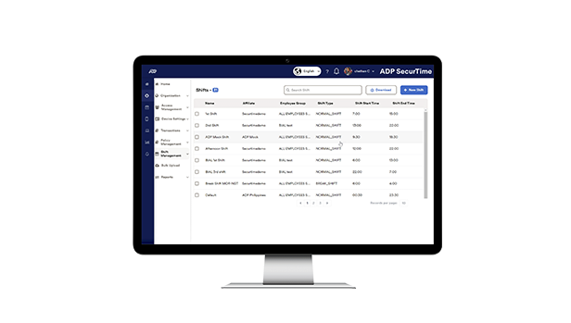
The Solution: ADP SecurTime
• Achieve real-time visibility into workforce data to optimize labor costs and enhance productivity.
• Ensure regulatory compliance and reduce administrative overhead through automated time, attendance, and leave management.
4
Notes:
• Emphasize the transformation from manual, error-prone processes to an automated, data-driven strategy for managing the organization's workforce.
• Connect the solution's capabilities directly to primary executive concerns: controlling labor costs, mitigating compliance risks, and improving operational efficiency.

Slide 5
Achieve Greater Control and Drive Strategic Growth
• Protect Profitability by Eliminating Payroll Inflation:
• Enhance Strategic Oversight with Real-Time Data:
• Increase Operational Agility for Modern Workforces:
• Safeguard the Organization from Compliance Risks:
• Strengthen Business Resilience and Employee Trust:
5
Notes:
• Share a customer success story where a similar-sized company reduced payroll errors by over 90% and reallocated administrative headcount to more strategic roles.
• Quantify the impact: 'Based on your current workforce size, a conservative 2% savings on payroll could translate to an estimated $[X] in annual bottom-line impact.'
• Discuss the peace of mind that comes from knowing your organization is protected against wage and hour lawsuits, which have become increasingly common and costly.
• Explain how real-time visibility empowers leaders to address productivity or attendance issues proactively, rather than discovering them weeks later.

Slide 6
The ADP SecurTime Advantage
• Unmatched Hardware Flexibility and Advanced Biometric Security:
• Secure, Mobile-First Management for Distributed Workforces:
• Unified, Industry-Tailored Platform for Strategic Optimization:
6
Notes:
• When compared to other time and attendance providers, it is important to note the strategic difference in scope. While many systems offer effective point solutions for time tracking, ADP SecurTime is engineered as a comprehensive workforce management platform. Our ability to unify scheduling, leave, and compliance on a single system provides a single source of truth for critical labor data. Furthermore, our unique flexibility in hardware integration and our specialized, industry-specific solutions deliver a level of operational efficiency and risk mitigation that standalone systems cannot match.

Slide 7
Enhance Your Workforce Efficiency
• Schedule a personalized demonstration to see ADP SecurTime in action.
• Request a detailed overview of our tiered pricing and relevant case studies.
7
Notes:
• Ask for a brief 15-minute executive briefing to demonstrate how ADP SecurTime directly addresses their top-line goals for labor cost control and operational efficiency.
• If they are not available for a demonstration, offer to send a concise information package including our tiered pricing model and a one-page case study relevant to their industry, making it easy for them to delegate the initial review.

Slide 8
Next Steps
Schedule a personalized demonstration to see ADP SecurTime in action.
8

Slide 9
The 30-Second Pitch
"ADP SecurTime provides complete, real-time visibility into your workforce by automating everything from attendance to payroll. This eliminates costly time theft and inaccuracies, allowing you to significantly reduce labor costs and improve overall productivity."
Key Messages:
• Eliminate time theft and payroll errors with advanced biometrics.
• Manage time, schedules, and leave on one simple, unified platform.
• Securely track your entire workforce, from the office to the field.
9

Slide 10
Thank You
Effortlessly manage employee time, attendance, and payroll in one simple solution.
https://in.adp.com/what-we-offer/products/adp-securtime.aspx

