Slide 1
ADP SecurTime: ADP SecurTime tracks employee attendance with fingerprint verification and connect...
Get the right people in the right place, at the right time for the right cost
ADP SecurTime

Slide 2

Opening Hook
• While your competitors are losing 2-4% of gross annual payroll to time theft and administrative inefficiencies, what if you could reclaim those millions overnight—and transform workforce management...
2
Notes:
• Pause after 'millions overnight' to let the financial impact resonate
• This positions time and attendance as a strategic issue, not just an HR concern
• The hook immediately quantifies the problem in terms CEOs care about—bottom-line impact
• Sets up the narrative that this isn't just about fixing a problem, but gaining competitive advantage

Slide 3
The Challenge
• Time theft and buddy punching cost companies 2.2% of gross payroll annually—that's $2.2M for every $100M in payroll
• Non-compliance with labor regulations exposes organizations to average penalties of $1,900 per violation, with class-action lawsuits averaging $11.7M
• Payroll errors affect 1 in 2 employees, damaging morale and increasing turnover costs that can exceed 150% of annual salary per departure
3
Notes:
• Ask: How confident are you that every hour you're paying for is actually worked? What would a 2% reduction in payroll costs mean for your EBITDA?
• Explore: Have you calculated the true cost of your current timekeeping system, including manual corrections, compliance risks, and employee dissatisfaction?
• Challenge: In an era where every competitive advantage matters, can you afford to let outdated time management systems drain profits and productivity?

Slide 4
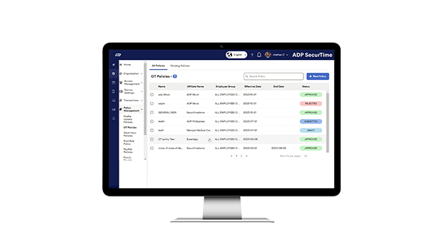
The Solution: ADP SecurTime
• Unified platform providing real-time workforce visibility across all locations and work models
• Enterprise-grade security with biometric authentication ensuring compliance and eliminating time theft
• Intelligent automation reducing administrative overhead by up to 75% while improving accuracy
• Seamless integration with existing systems delivering immediate ROI without disruption
4
Notes:
• Emphasize transformation from reactive workforce management to proactive strategic optimization
• Connect back to pain points around compliance risk, labor cost overruns, and lack of visibility
• Highlight the competitive advantage of having real-time workforce intelligence for rapid decision-making
• Stress the importance of a unified solution versus point solutions that create data silos

Slide 5
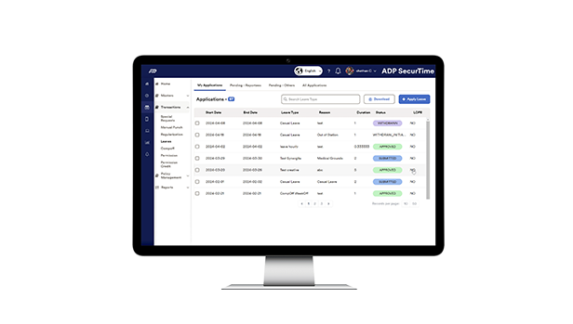
Strategic Capabilities That Drive Bottom-Line Results
• Real-Time Workforce Intelligence:
• Eliminate Time Theft & Fraud: Advanced biometric authentication including facial recognition stops buddy punching and time fraud, recovering 2-5% of payroll costs typically lost to these practices
• Mobile Workforce Optimization:
• Automated Compliance & Risk Mitigation: Built-in overtime management and labor law compliance features prevent costly violations and litigation, while reducing administrative burden by 70%
• Project Profitability Insights: Precise project-based time tracking delivers accurate client billing and real-time project margin analysis, improving project profitability by 10-20%
5
Notes:
• Demonstrate real-time executive dashboard showing labor cost trends and compliance alerts
• Show ROI calculator with typical savings from fraud elimination and productivity gains
• Present case study showing 30-day implementation and immediate cost savings

Slide 6
What You'll Achieve
• Drive immediate bottom-line impact with 5% payroll cost reduction through elimination of time fraud and automated compliance—typically delivering ROI within 90 days
• Accelerate business growth with 35% productivity gains while seamlessly managing operations across 1,000+ locations from a single command center
• Transform HR from administrative burden to strategic enabler with real-time workforce analytics that inform critical business decisions
• Ensure business continuity with enterprise-grade security, contactless biometric technology, and zero infrastructure investment required
6
Notes:
• Share how a Fortune 500 retailer eliminated $2.3M in annual time fraud while reducing payroll processing time by 75% across 800 locations
• Quantify the competitive advantage of having real-time visibility into labor costs and productivity metrics compared to competitors still using manual processes
• Emphasize the strategic value of freeing HR teams from 20+ hours weekly of administrative tasks to focus on talent development and retention
• Highlight how the pay-as-you-go model eliminates capital risk while providing the flexibility to scale with business growth or seasonal demands

Slide 7
How Industry Leaders Transform Operations with ADP SecurTime
• Manufacturing leaders reduce overtime costs by 23% through intelligent shift optimization while maintaining 99.8% production uptime
• Transport companies achieve 35% improvement in route efficiency by connecting workforce data with operational metrics
• Healthcare organizations eliminate scheduling conflicts and reduce agency staffing costs by $2.4M annually
• Construction firms cut project delays by 40% through real-time workforce visibility across multiple sites
• Financial services improve field productivity by 28% while ensuring 100% regulatory compliance
7
Notes:
• Customize the conversation by asking about their specific workforce challenges - remote workers, compliance requirements, or operational complexity
• Highlight how peer companies in their industry have transformed similar challenges into competitive advantages
• Emphasize the strategic value of real-time workforce intelligence for faster decision-making
• Connect workforce optimization directly to their growth objectives and market expansion plans
• Position ADP SecurTime as a strategic investment that pays for itself within 6 months through efficiency gains alone

Slide 8
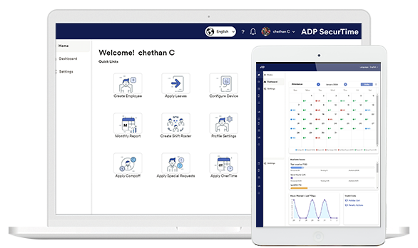
Why ADP SecurTime
• Only solution combining enterprise-scale biometric management across 1,000+ locations with integrated health safety screening, delivering both operational efficiency and workplace safety in a singl...
• Unique capability to manage all workforce types - permanent, contingent, and gig workers - through one unified system, reducing administrative overhead by up to 40%
• Industry's first plug-and-play biometric integration platform that protects existing infrastructure investments while delivering cloud-scale capabilities, reducing total cost of ownership by 60%
• Exclusive industry-specific workforce solutions that address unique sector challenges, delivering 3x faster time-to-value compared to generic platforms
• Comprehensive health-safety ecosystem with contactless biometric tracking, temperature detection, and mask compliance - the only solution addressing post-pandemic workplace requirements at enterpri...
8
Notes:
• If asked about competitor solutions, emphasize: 'While others offer point solutions, only ADP SecurTime delivers a comprehensive platform that scales from 10 to 10,000 locations without compromising functionality or requiring infrastructure replacement'
• When discussing ROI: 'Our clients typically see 25-30% reduction in time theft, 50% decrease in compliance violations, and complete ROI within 6-9 months - results unmatched in the industry'
• For health safety concerns: 'We're the only provider offering integrated biometric and health screening that meets both operational and safety requirements, eliminating the need for multiple vendors and reducing complexity'
• Regarding implementation: 'Unlike solutions requiring complete infrastructure overhaul, SecurTime integrates with your existing biometric investments, accelerating deployment by 70% while preserving capital investments'

Slide 9
Proven Results Across Industries
• Fortune 500 retailer eliminated $2.3M in annual time fraud across 1,000+ locations
• Global manufacturer reduced unplanned absenteeism by 42%, saving $4.7M annually
• Healthcare network achieved 100% labor law compliance while cutting overtime costs by 28%
• Multi-state employer prevented ghost employee fraud, recovering 5% of gross payroll
9

Slide 10

Strategic Investment in Workforce Excellence
• Enterprise Solution:
• Scalable Architecture: Modular pricing structure that grows with your business, ensuring cost-effectiveness at every stage while maintaining enterprise security and compliance standards
10
Notes:
• Transform workforce management from a cost center to a strategic advantage - our clients typically see 15-25% reduction in labor costs through optimized scheduling and reduced overtime, delivering immediate impact to your bottom line
• Consider the true cost of non-compliance and operational inefficiency - ADP SecurTime provides comprehensive risk mitigation that protects against costly violations while positioning your organization for sustainable growth and competitive advantage

Slide 11
The Value
• 5% reduction in payroll costs—$500K savings per 1,000 employees annually
• 35% productivity improvement through optimized attendance—$1.6M value per 1,000 employees
• 4-month payback period with 300% first-year ROI
• 70% reduction in administrative costs through automation
• Zero infrastructure investment with immediate cloud deployment
11
Notes:
• Calculate your specific ROI: multiply your annual payroll by 5% to see immediate fraud prevention savings
• Assess productivity gains: each 1% attendance improvement typically yields $45K per 100 employees
• Quantify compliance risk mitigation: avoid penalties averaging $250K per violation
• Evaluate administrative savings: 20 hours weekly per HR staff member freed for strategic initiatives
• Consider scalability benefits: expand to new locations without infrastructure costs or deployment delays

Slide 12
Strategic Investment Considerations
• ROI typically achieved within 6-9 months through reduced labor costs and compliance risk mitigation
• Implementation designed for minimal business disruption with phased rollout options
• Total cost of ownership 40% lower than maintaining multiple point solutions
• Switching investment offset by immediate operational efficiencies and risk reduction
12
Notes:
• If they say 'The price seems high compared to our current solution,' respond with: 'I appreciate that perspective. However, when you factor in the hidden costs of compliance failures, which average $14,000 per violation, plus the 2-5% payroll leakage most companies experience with manual systems, ADP SecurTime typically delivers net savings within the first year. Would you like to see a customized ROI analysis based on your workforce size?'
• If they say 'We're concerned about implementation disrupting our operations,' respond with: 'That's a valid concern we've addressed through our Executive FastTrack program. We've implemented SecurTime for Fortune 500 companies without a single day of operational disruption. Our phased approach and dedicated transition team ensure your business continues running smoothly while we handle the technical complexity behind the scenes.'
• If they say 'The switching costs seem prohibitive,' respond with: 'I understand the concern about transition investment. Our analysis shows that companies continuing with outdated systems lose an average of $1,500 per employee annually through time theft and processing inefficiencies. We also provide switching incentives and assume data migration costs, making your net switching investment minimal compared to the immediate operational gains.'
• If they say 'How does this compare to competitors like Kronos or Workday?' respond with: 'While those are capable platforms, ADP SecurTime uniquely combines three critical advantages: seamless integration with the most widely-used payroll infrastructure, reducing implementation time by 60%; our unmatched compliance guarantee that protects you from regulatory risk; and the scale economies that come from processing one in six American paychecks, allowing us to deliver enterprise capabilities at mid-market pricing.'

Slide 13
Transform Your Workforce Management Today
• Schedule a 30-minute executive demo focused on your industry's compliance challenges
• Request a workforce efficiency assessment to quantify potential savings
13
Notes:
• Ask for the meeting: 'Can we schedule 30 minutes next week to show you how similar organizations achieved 20% reduction in overtime costs?'
• Offer to send materials: 'I'll send our executive brief on mitigating wage-and-hour litigation risk - it includes benchmarks from your industry.'

Slide 14
In Summary
• Immediate ROI through reduced labor costs and compliance risk
• Competitive advantage through real-time workforce intelligence
• Proven enterprise-grade solution trusted by industry leaders
• Seamless integration with existing systems ensures rapid deployment
14
Notes:
• Pause briefly after 'every minute counts' to let the urgency resonate
• Emphasize 'strategic advantage' to reinforce transformation beyond mere efficiency
• Make eye contact when delivering the final question to create personal connection
• Be prepared to share specific ROI metrics from similar organizations
• Have implementation timeline ready to address time-to-value concerns

Slide 15
Next Steps
Schedule a 30-minute executive demo focused on your industry's compliance challenges
15

Slide 16
The 30-Second Pitch
"ADP SecurTime is a comprehensive workforce management solution that eliminates time fraud and reduces payroll costs by up to 5% through biometric authentication and real-time attendance tracking across your entire organization. Our platform has helped companies boost productivity by 35% while effortlessly managing distributed workforces across 1,000+ locations with seamless payroll integration and automated compliance."
Key Messages:
• Real-time attendance tracking with biometric authentication
• Mobile and cloud-based solution supporting diverse workforce types
• Reduces time fraud and increases workforce productivity
• Supports multiple industries with flexible scheduling options
• Seamless integration with payroll and HR systems
16

Slide 17
Thank You
ADP SecurTime tracks employee attendance with fingerprint verification and connects directly to payroll systems.
https://in.adp.com/what-we-offer/products/adp-securtime.aspx

