Slide 1

Voice Based Forms
SMART VIRTUAL
HACKATHON
A Lex chatbot for filling forms
Team Name: Hop101
Team Members: 1. Mohankrishna 2. Rajkrishna 3. Vikranth
Sathyabama Institute of Science and Technology
mohankrishna@ieee.org

Slide 2
Introduction
The objective of this project is to build a voice based form filling applications in which voice gets recognized and converted into text. Voice search is the technology underlying many spoken dialog systems (SDSs) that provide users with the information they request with a spoken query.
The information normally exists in a large database, and the query has to be compared with a field in the database to obtain the relevant information. Such an interface makes the user to fill the form in an easy and precise manner without any confusion.

Slide 3
Objectives
Building a Chatbot in which Voice gets recognised and translated into text format.
This chatbot makes an interactive way of filling the forms.
Chatbot takes the user input’s and saves them in different languages in dynamodb.
Building a Serverless Architecture in Cloud for filling the Voice Forms.

Slide 4
Technologies & Languages Used
AWS
Html/CSS/JS
Python
S3
CloudFront
Lex
Dynamodb
Lambda
Translate

Slide 5
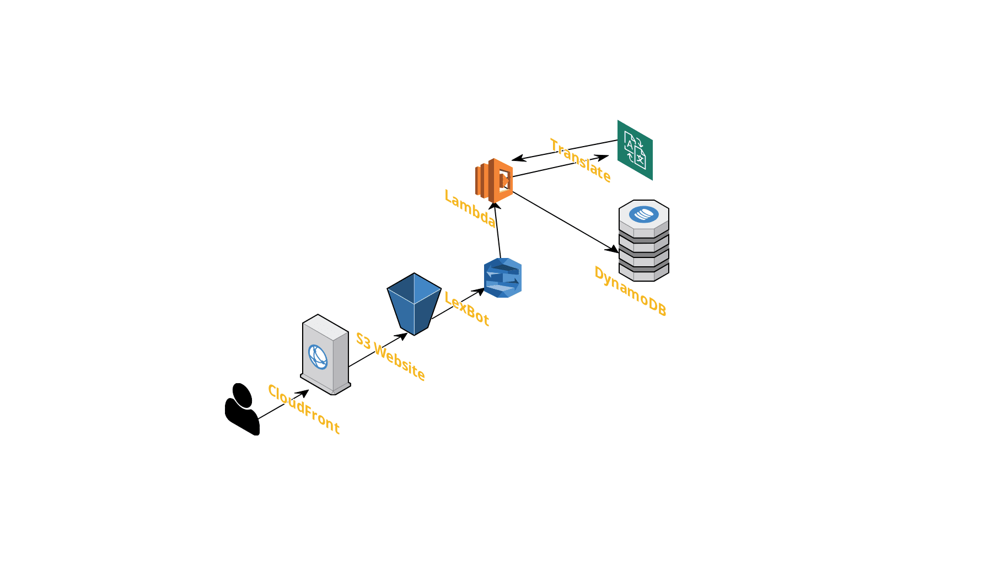
Solution
Sprint 1
AWS Serverless Architecture
mohankrishna@ieee.org

Slide 6
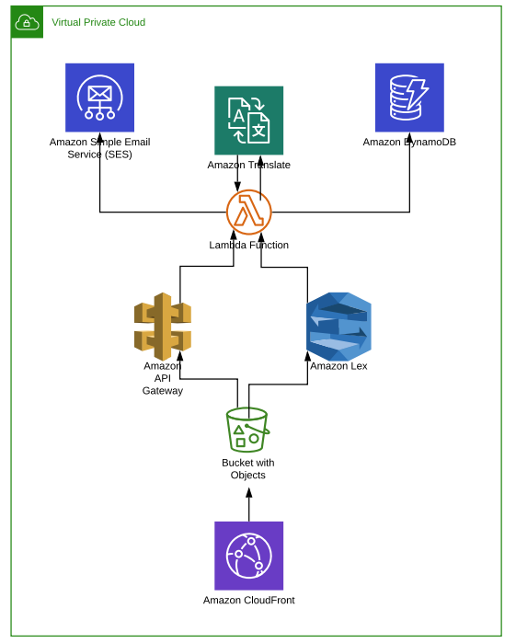
Sprint 2

Slide 7
Deliverables
IAAC Code
Developed IAAC with Serverless Framework except for the lex service.
Single Click await to deploy the template and use it the very next minute you create your form
Notes:
We already had cloud formation for deployment of lexbot actually that’s why we focussed on automation of the remaining services

Slide 8
Product Completion.
About 93%

Slide 9
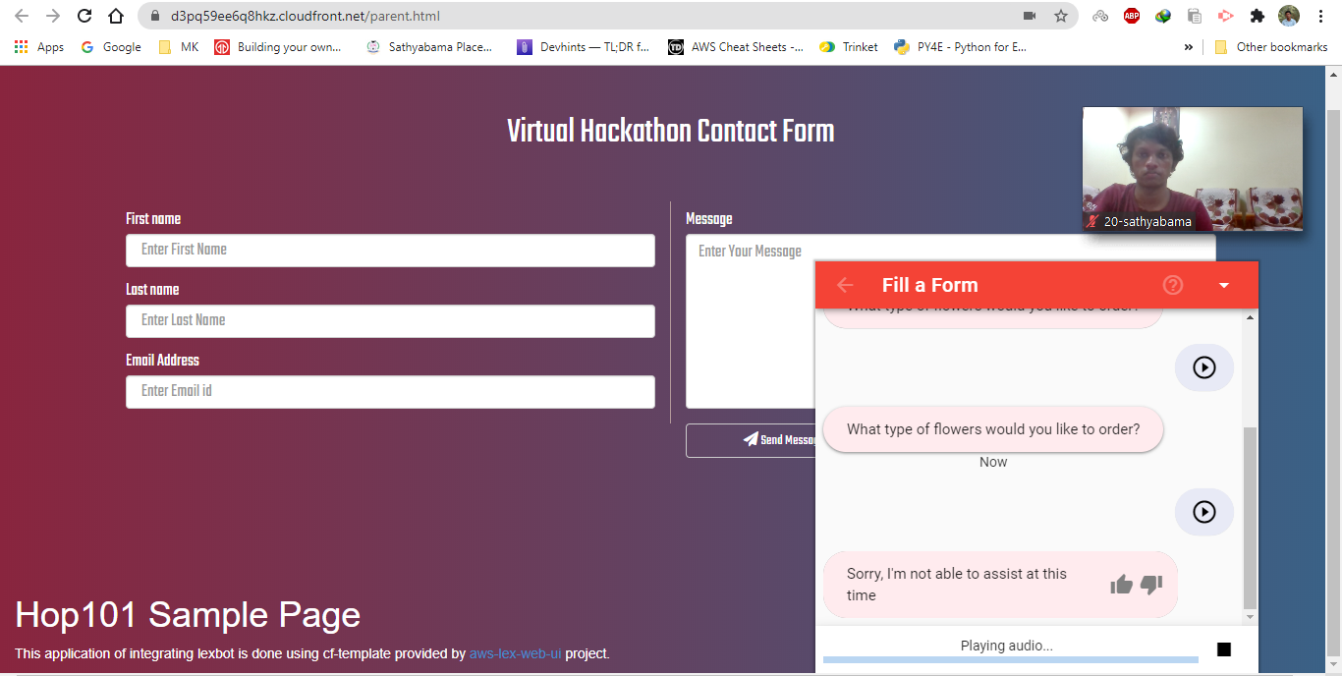

Slide 10
Thank You
Insights we got and would like to include from Virtual Hackathon
Feature for uploading photos from the Chat bot itself.
Feature for converting speech to Text from different languages.

