Slide 1



Enterprise Web Services (EWS)
Campaign Portability Via APIs
Preeti Jain: EWS Product Manager
Yahoo! Proprietary and Confidential

Slide 2
Campaign Portability
Problem Statement
  Cumbersome conversion flow for all advertisers independent of their size and level of sophistication
  Advertisers need to follow two different flows for conversion and import
  There are multiple applications and teams supporting the conversions for the Online and Direct channels
Solution
  The capability allowing advertisers to import and convert third party campaign into yahoo format
  Consolidate the Yahoo! import and the conversion flow in one flow
  Campaign Portability access via AdUI and EWS
Launch Markets
  All markets
Reference/Twiki:
  http://twiki.corp.yahoo.com/view/AdApps/CampaignPortability

Slide 3
Availability of CPT
In November 09, CPT was launched for internal Yahoo customers in DTS
EWS v6.1 will provide CPT APIs for all 23 markets on January 19, 2010
AdUI will provide CPT in all 23 markets on January 19, 2010

Slide 4
Assumptions And Rules
Account-Level Excluded Words are supported and converted
  Campaign-level excluded words will not be supported in AdUI and EWS in v6.1 so they will be ignored
Campaign Budgets are converted
Assumptions – Wherever possible, logic has been added to allow us to still convert files that have missing data or data that does not map directly to the available Yahoo! structure by making assumptions as to what those settings should be. This will result in fewer errors during the conversion process

Slide 5
Enhanced Output Files
The output of each conversion task is three files as given below:
  CONVERTED_FILE – the bulk upload sheet with all the rows that were successfully converted
  FEEDBACK_FILE – all rows including those with assumptions, warnings, and errors
  ERROR_FILE – only includes rows with errors
You have the option of receiving these files in Excel format which allows for highlighting of cells for easier interpretation
Converted file returned from conversion task can be directly imported using Bulk Service

Slide 6
Duplicate Campaign Name Handling
Advertisers will get four options to handle campaign names that exist in both the Google spreadsheet as well as in the actual Yahoo! account:
  Create New – This option leaves the existing campaign in Yahoo! as is but creates a new campaign from the Google conversion. For example, if you have “Campaign XYZ” in both Google and Yahoo!, the Yahoo! version will remain and the conversion file will include a new campaign called something similar to “Campaign XYZ_2” with the Google Ad Groups, Keywords, and Ads.
  Ignore – This option leaves the campaign in Yahoo! as is and does not convert the Google campaign with the same name
  Overwrite – This option deletes the campaign in Yahoo! and replaces it with the Google campaign sharing the same name
  Merge – This option combines the two campaigns
    Components that are only in Google will be added to the campaign in Yahoo!.
    Components that are in both will be updated with the Google information
    Components that are in Yahoo! only will remain untouched.

Slide 7
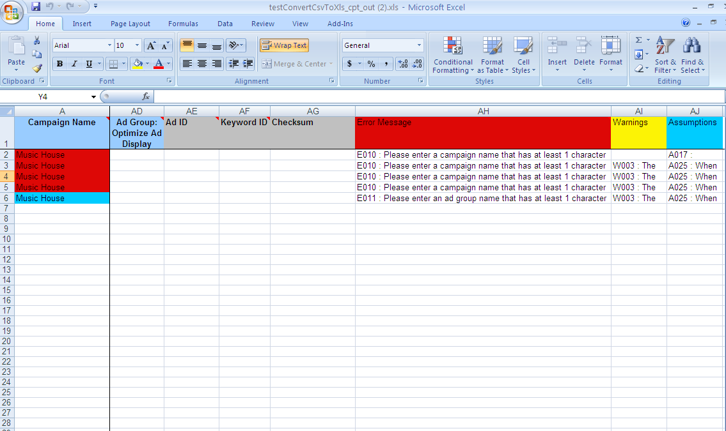
Campaign Portability – Feedback File

Slide 8
New Service For CPT In EWS
A new Service "ConverterService" will be introduced in EWS.
This service will contain the following APIs.
  public Token convert(DuplicateCampaignOption, Preferences)
  public Token convertImport(DuplicateCampaignOption, Preferences)
  public ProcessStatus getStatus(Long jobID)
  public Response getResponse(Long jobID, DownloadFile)
Convert, convertImport and getResponse APIs will be part of bulk command group
getStatus will be part of marketing command group
Notes:
Demo is a preference targeting. Ads are not guaranteed to be displayed as per demo targeting but best effort will be made to meet the criteria.

Slide 9
Appendix
How Campaign Portability Works In Panama AdUI

Slide 10
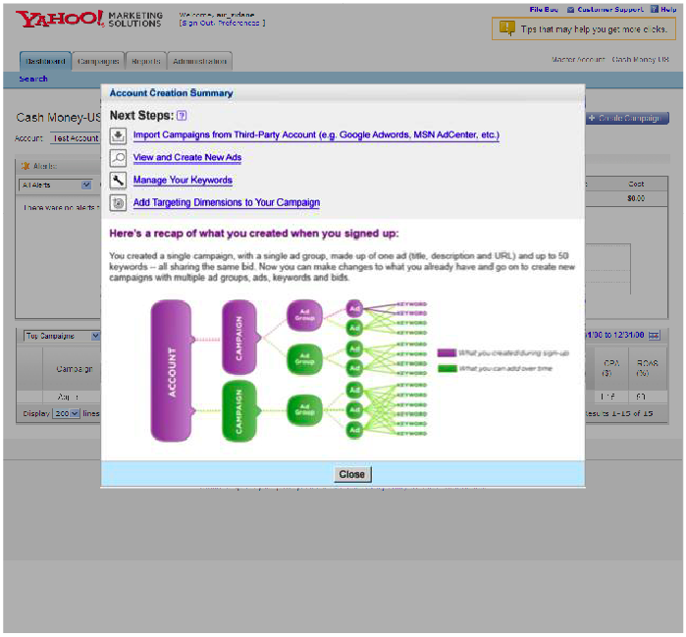
AdUI Campaign Portability – Landing Page
Shown to new advertisers
Call out to import campaigns

Slide 11
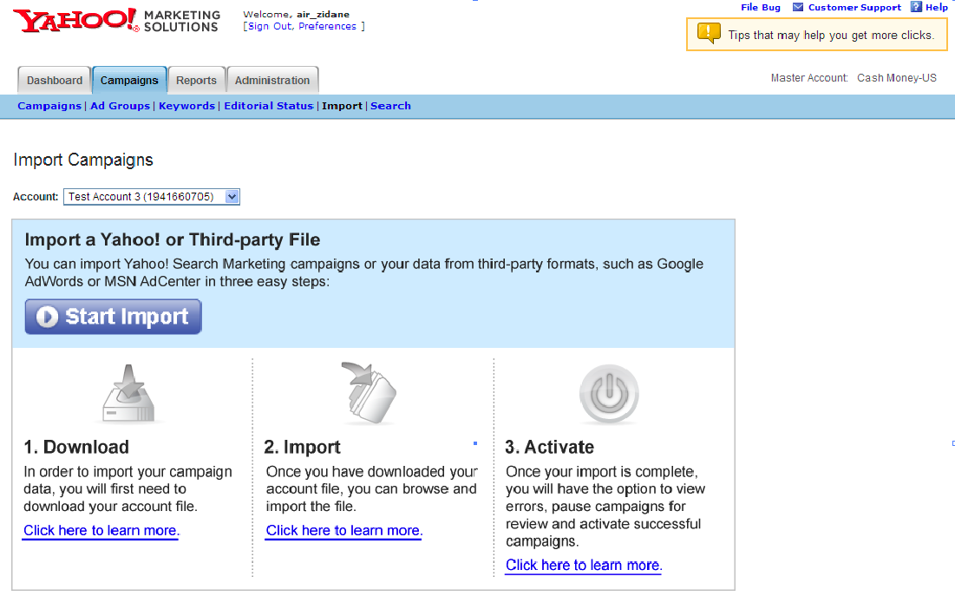
AdUI – Import Overview Page
This page provide overview of how to
Download campaign from third party (e.g. G ad words)
Import into Yahoo! (this flow was more complex earlier)

Slide 12
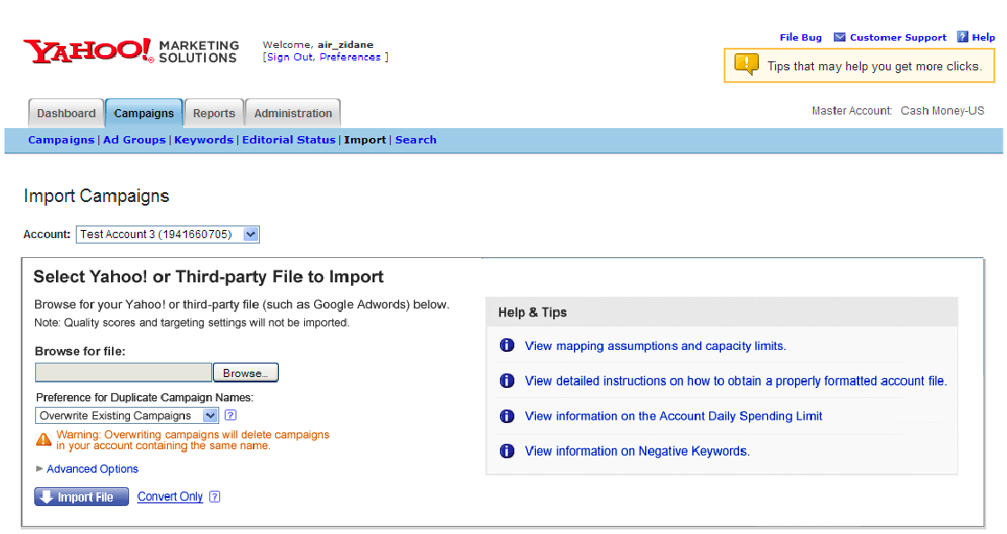
AdUI Campaign Portability – Import Page
The Import wizard. The most basic interaction is to point to a file and click the ‘import’ button

Slide 13
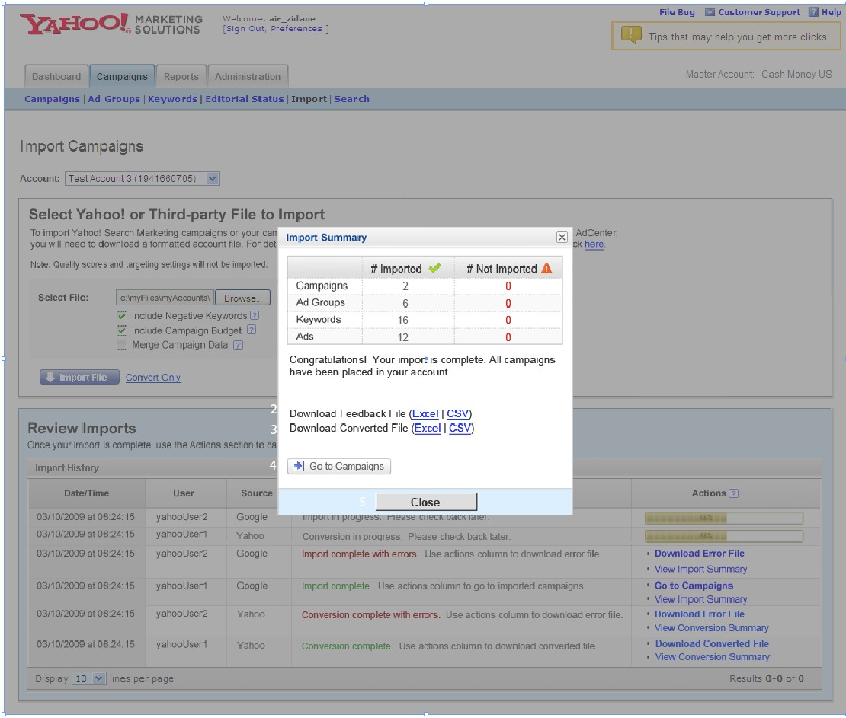
Campaign Portability – Import Results Page
Quick summary of the import process with links to feedback/error and converted files as applicable

