Slide 1

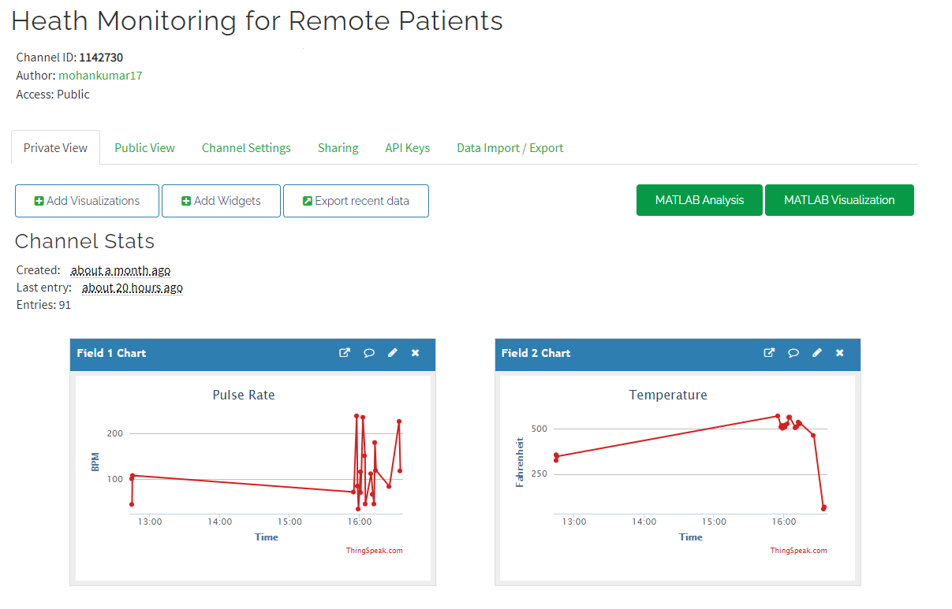
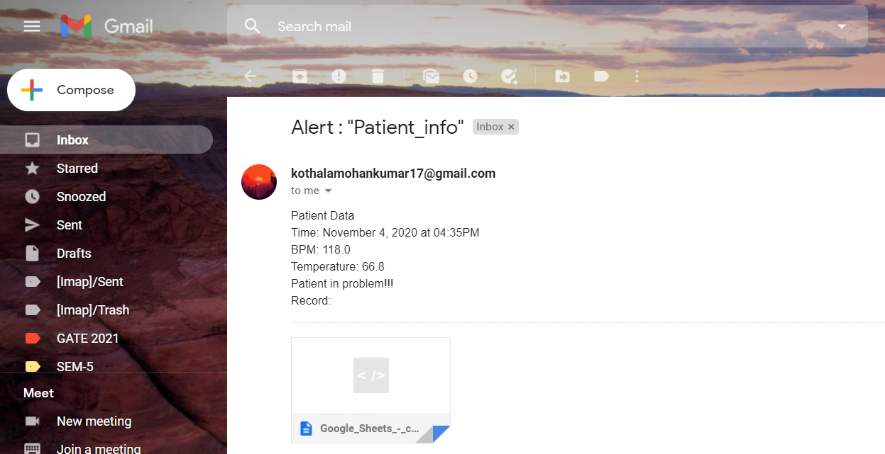
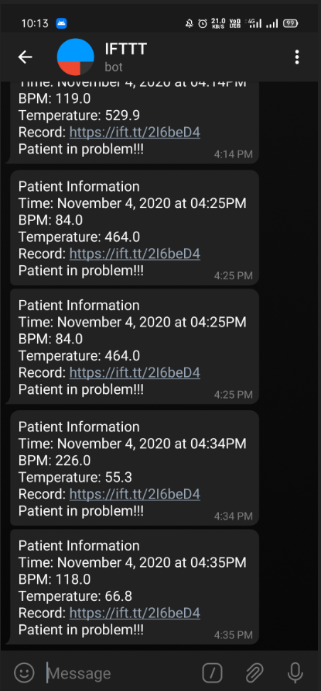
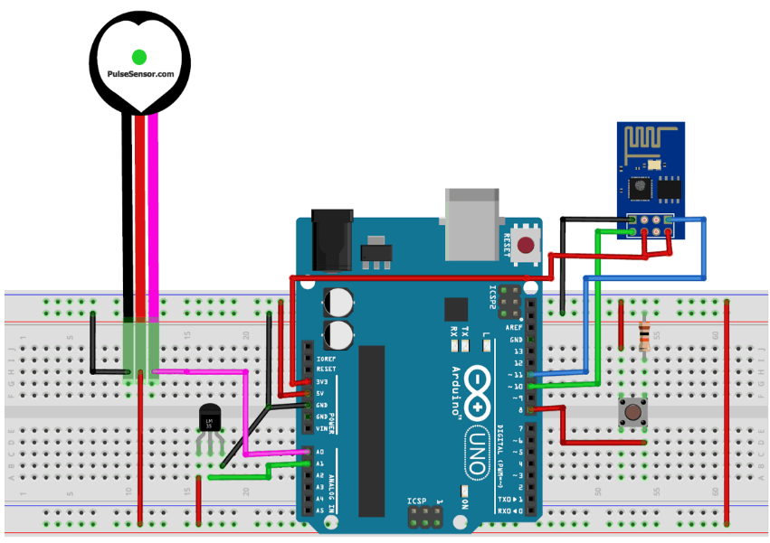
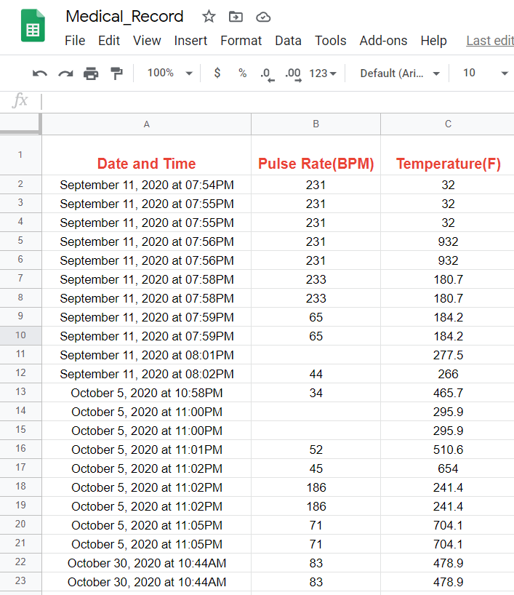
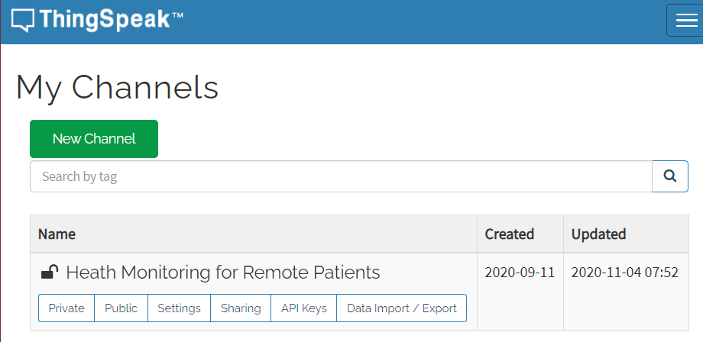
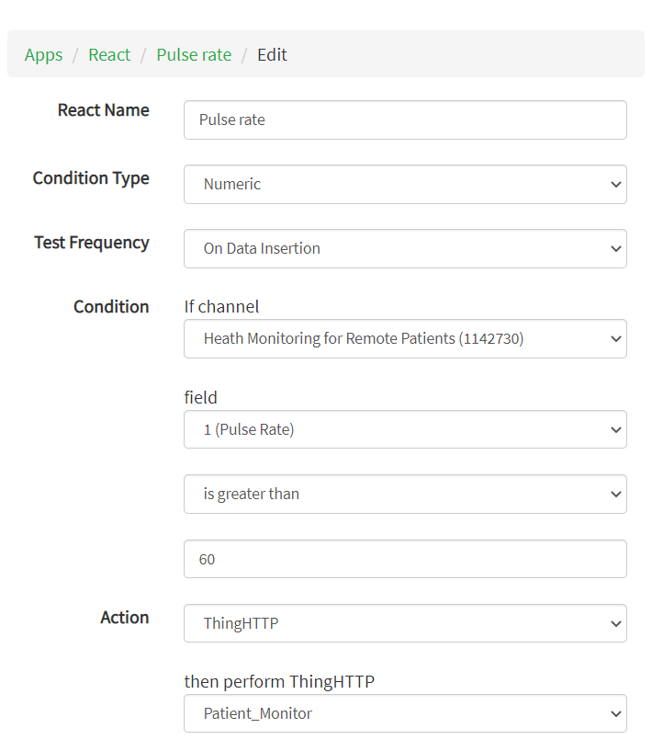
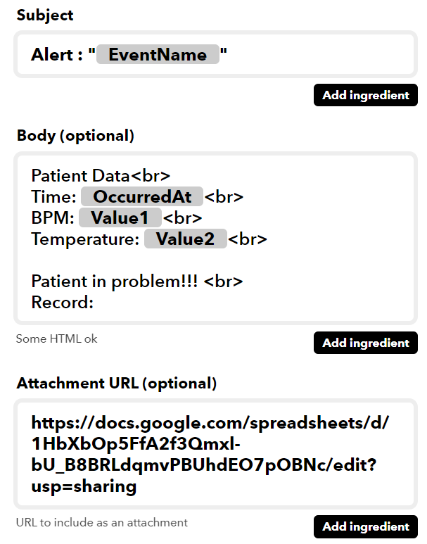
DESIGN OF REAL-TIME HEALTH MONITORING SYSTEM FOR REMOTE PATIENTS USING IoT
Kothala Mohan Kumar | ECE | 17BEC7034 |
Introduction
Results
Remote Patient Health Monitoring is a medical technology to monitor the patient’s health remotely to enhance the medical care and reduce the health-care costs. The designed system collects the patient’s data and transmits the data to a server using a microcontroller with internet services. Health experts can take the benefits of the system to keeps an eye on their patient’s health. The designed system is equipped to alert the care taker through e-mail and telegram messenger services during emergency situations. In addition, medical data will be stored in Google sheets for treatment recommendations.
ThingSpeak Channel View
Gmail Alert
Telegram Alert
Google Sheets
The Gmail and telegram message body contains the date, time, temperature, pulse rate and Google sheets URL of the medical record.
Objectives
Data Acquisition: Collecting the temperature and pulse rate.
Data Transmission: Transmitting the collected data to an IoT server.
Alerting: Alerting the caretakers through Gmail and telegram messenger during emergency situations.
Cloud Storage: Storing the data in Google Sheets
Methodology
Tools: ATMEGA328P microcontroller, ESP8266 Wi-Fi module , Pulse sensor module, LM35 temperature sensor, ThingSpeak Server, IFTTT Server, Gmail, Telegram and Google Sheets.
Circuit Connections
ThingSpeak Channel Configuration with Pulse rate and temperature fields
ThingHTTP React App and IFTTT Web-Hooks Applets Configuration for alerting.
Conclusion
The main objective of the experiment was successfully achieved. All the individual modules like Heartbeat detection module, temperature sensor, ThingSpeak Server, Gmail, Telegram and Google Sheets gave out the desired results. This Remote Health Care system utilizes embedded systems and Internet of Things for better quality of life for people in society.
Contact
mohankumar.kothala@vitap.ac.in

