Slide 1

Media Streaming with cloud

Slide 2

Introduction
Perform an exploratory data analysis (EDA) and data visualization project using data from Spotify using Python.
Data analysis exploring the relationship between the audio features of a song and how positive or negative its lyrics are, involving sentiment analysis.
Includes data collection script that scrapes audio feature data from the Spotify API, as well as lyrical data from the LyricWikiAPI
Spotify Data Analysis makes use of secondary data from Spotify. Learners will use data to identify patterns and relationships between different characteristics. The activity will support learners in developing their ability to review and interpret a dataset. The activity starts by encouraging learners to think of questions that the dataset might answer and thus develop their “Problem” skills. Once the dataset has been analysed learners will have the opportunity to reorganise and restructure data to help them answer their questions

Slide 3

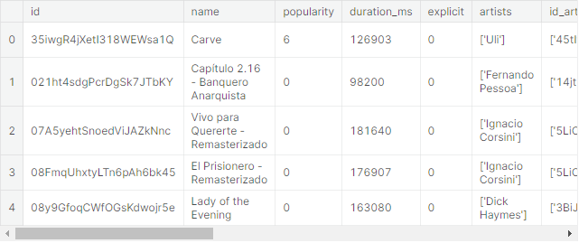
Importing Datasets
import numpy as np import pandas as pd import matplotlib.pyplot as plt import seaborn as sns
# Reading Data Set tracks = pd.read_csv('../input/spotify-datasets/tracks.csv') genre = pd.read_csv('../input/ultimate-spotify-tracks-db/SpotifyFeatures.csv')
tracks.head()

Slide 4
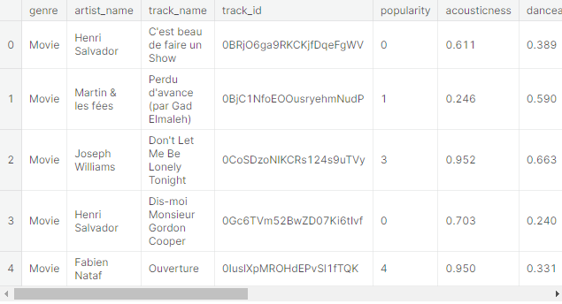
genre.head()

Slide 5

Spotify Tracks Dataset Analysis
# checking null values pd.isnull(tracks).sum()
Out: id 0 name 71 popularity 0 duration_ms 0 explicit 0 artists 0 id_artists 0 release_date 0 danceability 0 energy 0 key 0 loudness 0 mode 0 speechiness 0 acousticness 0 instrumentalness 0 liveness 0 valence 0 tempo 0 time_signature 0 dtype: int64
In [7]:

Slide 6

tracks.info()
<class 'pandas.core.frame.DataFrame'> RangeIndex: 586672 entries, 0 to 586671 Data columns (total 20 columns): # Column Non-Null Count Dtype --- ------ -------------- ----- 0 id 586672 non-null object 1 name 586601 non-null object 2 popularity 586672 non-null int64 3 duration_ms 586672 non-null int64 4 explicit 586672 non-null int64 5 artists 586672 non-null object 6 id_artists 586672 non-null object 7 release_date 586672 non-null object 8 danceability 586672 non-null float64 9 energy 586672 non-null float64 10 key 586672 non-null int64 11 loudness 586672 non-null float64 12 mode 586672 non-null int64 13 speechiness 586672 non-null float64 14 acousticness 586672 non-null float64 15 instrumentalness 586672 non-null float64 16 liveness 586672 non-null float64 17 valence 586672 non-null float64 18 tempo 586672 non-null float64 19 time_signature 586672 non-null int64 dtypes: float64(9), int64(6), object(5) memory usage: 89.5+ MB

Slide 7
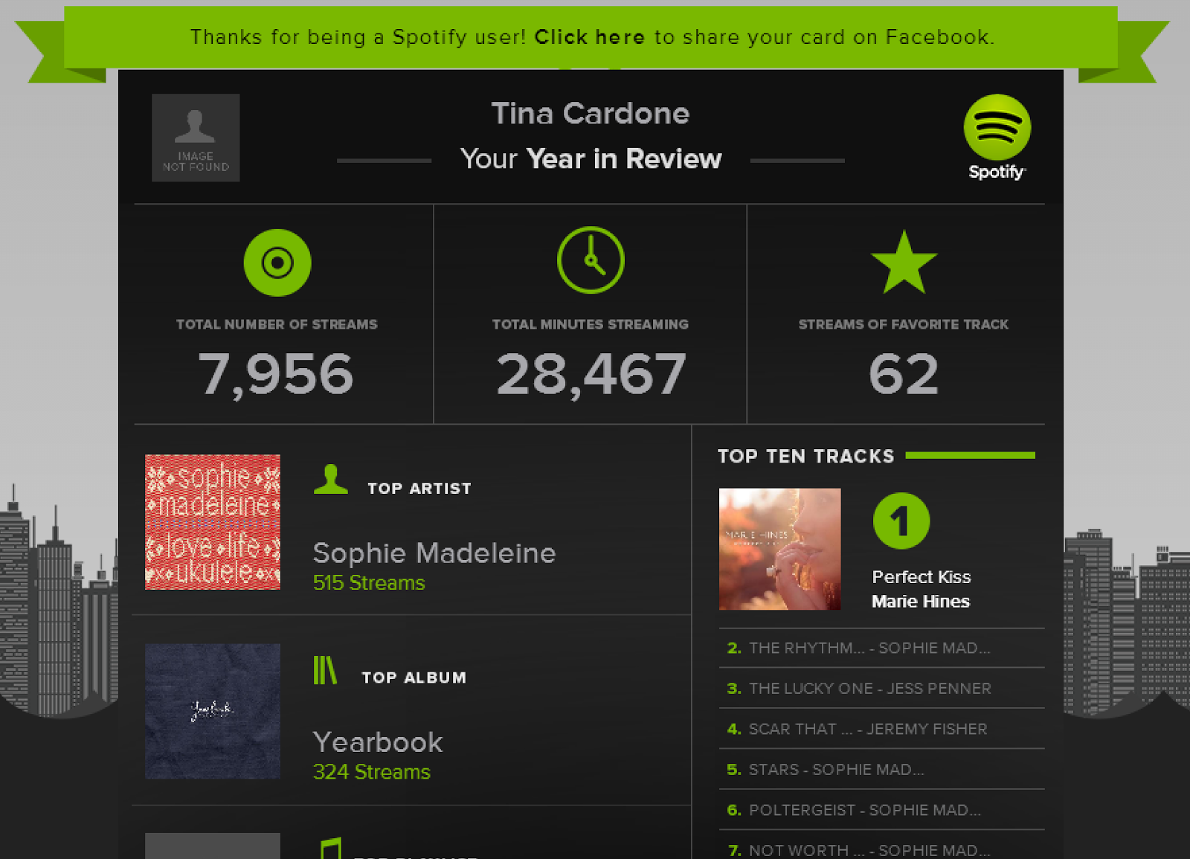
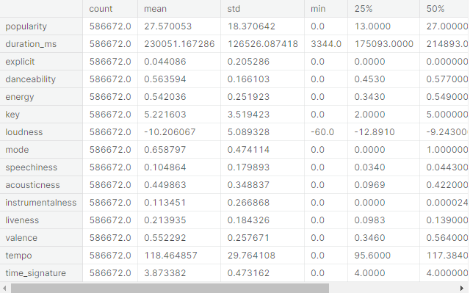
Descriptive Statistics of Spotify Tracks
tracks.describe().transpose()

Slide 8

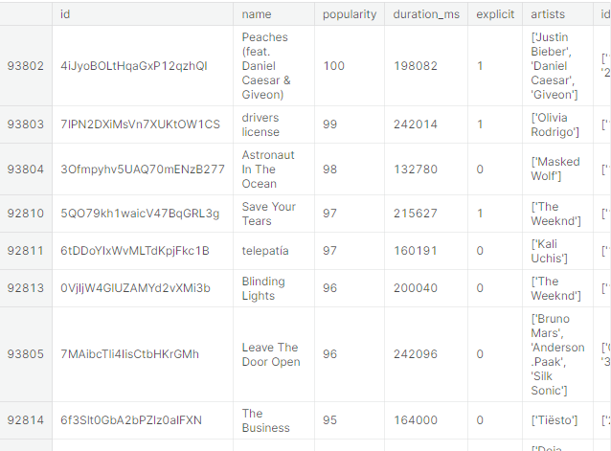
Top 10 Most Popular Songs On Spotify
most = tracks.query('popularity > 90',
inplace = False).sort_values('popularity', ascending = False) most[:10]

Slide 9

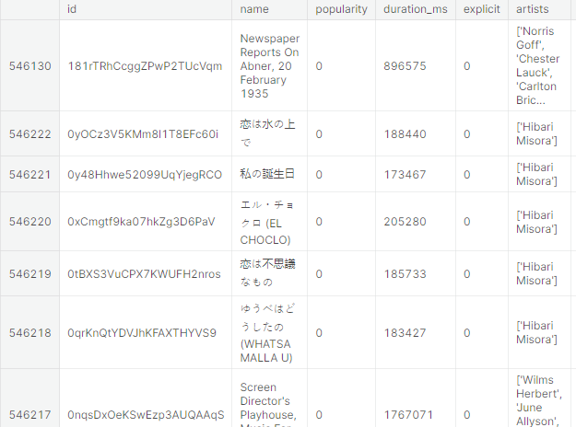
Top 10 Least Popular Songs On Spotify
least = tracks.sort_values('popularity', ascending = True).head(10) least

Slide 10

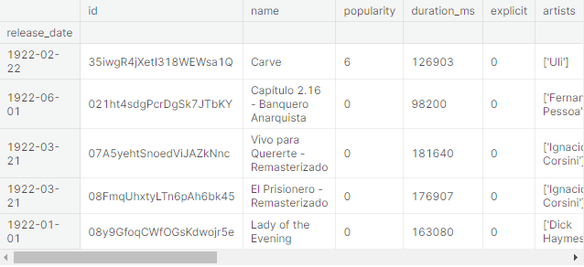
Changing Index to Release Date
tracks.set_index('release_date', inplace = True) tracks.index=pd.to_datetime(tracks.index) tracks.head()

Slide 11
Check Artist At 18th Row Of Spotify Tracks Dataset
tracks[['artists']].iloc[18] Out:
artists ['Victor Boucher'] Name: 1922-01-01 00:00:00, dtype: object
Converting Duration From Milliseconds to Seconds On Spotify Tracks Dataset
tracks['duration'] = tracks['duration_ms'].apply (lambda x : round(x/1000)) tracks.drop('duration_ms', inplace = True, axis=1) tracks.duration.head() Out:
release_date 1922-02-22 127 1922-06-01 98 1922-03-21 182 1922-03-21 177 1922-01-01 163 Name: duration, dtype: int64

Slide 12

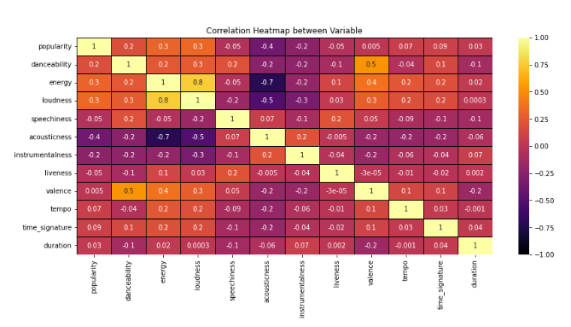
Correlation Heatmap Between Variable Using Pearson Correlation Method
cm = tracks.drop(['key','mode','explicit'], axis=1).corr(method = 'pearson') plt.figure(figsize=(14,6)) map = sns.heatmap(cm, annot = True, fmt = '.1g', vmin=-1, vmax=1, center=0, cmap='inferno', linewidths=1, linecolor='Black') map.set_title('Correlation Heatmap between Variable') map.set_xticklabels(map.get_xticklabels(), rotation=90) Out:
[Text(0.5, 0, 'popularity'), Text(1.5, 0, 'danceability'), Text(2.5, 0, 'energy'), Text(3.5, 0, 'loudness'), Text(4.5, 0, 'speechiness'), Text(5.5, 0, 'acousticness'), Text(6.5, 0, 'instrumentalness'), Text(7.5, 0, 'liveness'), Text(8.5, 0, 'valence'), Text(9.5, 0, 'tempo'), Text(10.5, 0, 'time_signature'), Text(11.5, 0, 'duration')]

Slide 13
Considering 0.4% Of The Dataset To Create Regression Plots
sam = tracks.sample(int(0.004 * len(tracks))) len(sam) Out:
2346
Regression Plot – Correlation Between Loudness And Energy
plt.figure(figsize=(10,6)) sns.regplot(data=sam, y='loudness', x='energy', color='c').set(title='Loudness vs Energy Correlation') Out:
[Text(0.5, 1.0, 'Loudness vs Energy Correlation')]

Slide 14
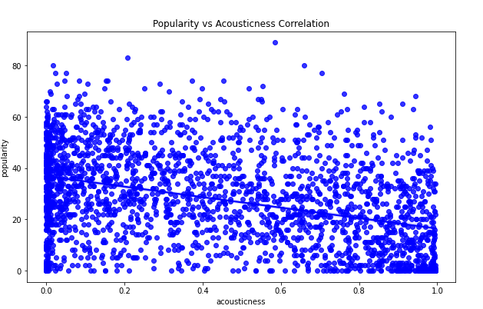
Regression Plot – Correlation Between Popularity And Acousticness
plt.figure(figsize=(10,6)) sns.regplot(data=sam, y='popularity', x='acousticness', color='b').set(title='Popularity vs Acousticness Correlation') Out[17]:
[Text(0.5, 1.0, 'Popularity vs Acousticness Correlation')]

Slide 15
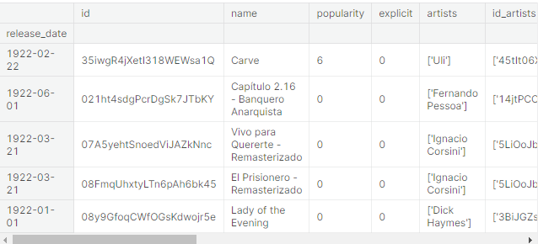
Creating New Column In Tracks Dataset (Year, Release Date)
tracks['dates']=tracks.index.get_level_values('release_date') tracks.dates=pd.to_datetime(tracks.dates) years=tracks.dates.dt.year
tracks.head()

Slide 16
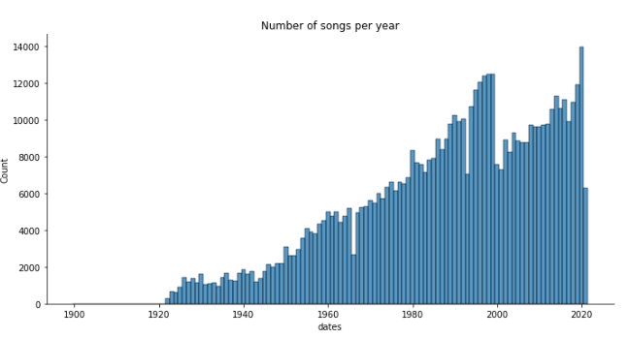
Distribution Plot – Visualize Total Number Of Songs On Spotify Since 1992
sns.displot(years, discrete=True, aspect=2, height=5, kind='hist').set(title='Number of songs per year') Out:
<seaborn.axisgrid.FacetGrid at 0x7f0c52ed6610>

Slide 17
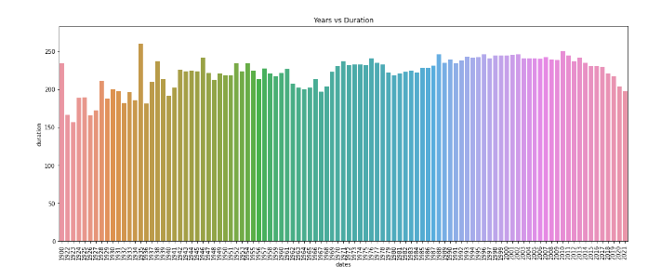
Change in Duration Of Songs wrt Years
total_dr = tracks.duration
fig_dims = (18,7)
fig, ax = plt.subplots(figsize=fig_dims)
fig = sns.barplot(x = years, y = total_dr, ax = ax, errwidth = False).set(title='Years vs Duration')
plt.xticks(rotation=90)

Slide 18

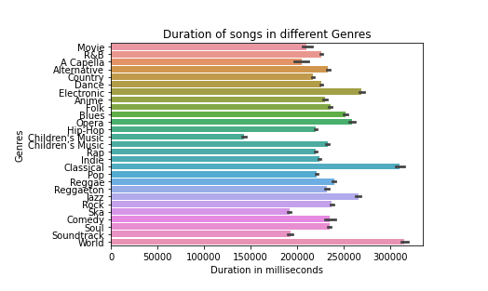
Spotify Features Dataset Analysis
Duration Of Songs In Different Genres
plt.title('Duration of songs in different Genres') sns.color_palette('rocket', as_cmap=True) sns.barplot(y='genre', x='duration_ms', data=genre) plt.xlabel('Duration in milliseconds') plt.ylabel('Genres') Out:
Text(0, 0.5, 'Genres')

Slide 19
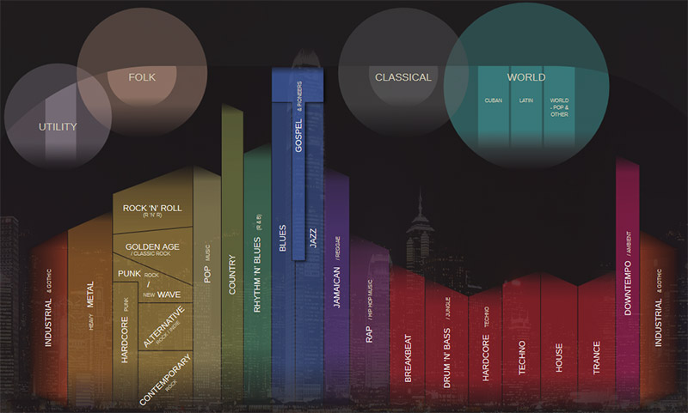
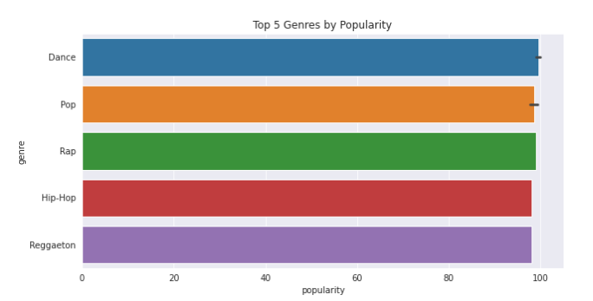
Top 5 Genres By Popularity
sns.set_style(style='darkgrid') plt.figure(figsize=(10,5)) popular = genre.sort_values('popularity', ascending=False).head(10) sns.barplot(y = 'genre', x = 'popularity', data = popular).set(title='Top 5 Genres by Popularity') Out:
[Text(0.5, 1.0, 'Top 5 Genres by Popularity')]
This Photo by Unknown author is licensed under CC BY.

Slide 20

Conclusion
To preprocess the dataset for Media Streaming, you can consider steps like removing duplicates, handling missing values, scaling the data, and splitting it into training and testing sets. We can observe that the accuracy achieved by the state-of-the-art ML model is no better than simply guessing with a probability of 50%.

