Slide 1



Media Streaming With cloud

Slide 2
Intoduction
1.1 Background
This dataset contains the information about the songs . For a song track to be commercial success , it depends on various factors like Artist, Lyrics ,critic reviews and viewers reaction.

Slide 3
LIBRARIES
import matplotlib.pyplot as plt import seaborn as sns import numpy as np import pandas as pd import warnings warnings.filterwarnings("ignore",category = DeprecationWarning) warnings.filterwarnings("ignore",category = FutureWarning) import os for dirname, _, filenames in os.walk('/kaggle/input'): for filename in filenames: print(os.path.join(dirname, filename))

Slide 4
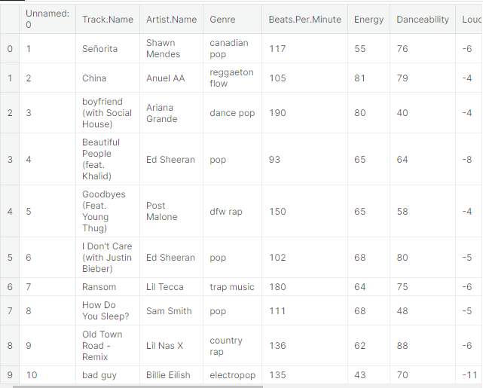
1.2 Import Libraries filename='/kaggle/input/top50spotify2019/top50.csv' spoti=pd.read_csv(filename,encoding='ISO-8859-1') spoti.head(10) # It shows first 10 row information in data

Slide 5
spoti = spoti.drop(columns = ['Unnamed: 0'])
spoti.info() #It gives information about data.
<class 'pandas.core.frame.DataFrame'> RangeIndex: 50 entries, 0 to 49 Data columns (total 13 columns): Track.Name 50 non-null object Artist.Name 50 non-null object Genre 50 non-null object Beats.Per.Minute 50 non-null int64 Energy 50 non-null int64 Danceability 50 non-null int64 Loudness..dB.. 50 non-null int64 Liveness 50 non-null int64 Valence. 50 non-null int64 Length. 50 non-null int64 Acousticness.. 50 non-null int64 Speechiness. 50 non-null int64 Popularity 50 non-null int64 dtypes: int64(10), object(3) memory usage: 5.2+ KB

Slide 6
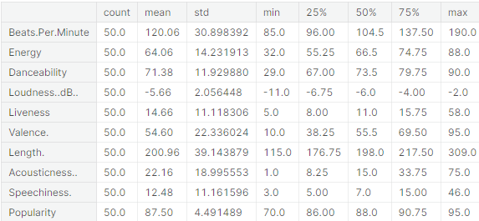
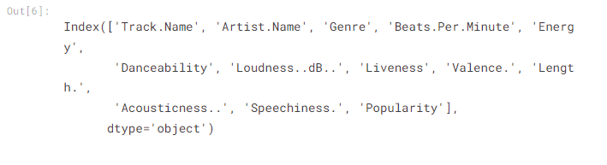
# Show some statistics about dataset spoti.describe().T
spoti.columns #It gives what we have columns

Slide 7
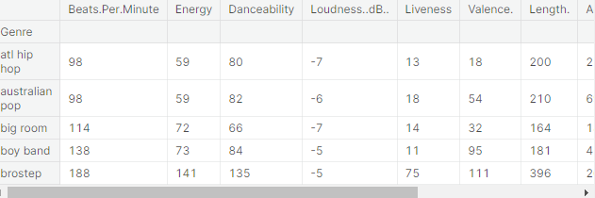
gb_genre =spoti.groupby("Genre").sum() #It classified by genre variable gb_genre.head()
#Calculates the number of rows and columns print(spoti.shape)
Out: (50, 13)

Slide 8
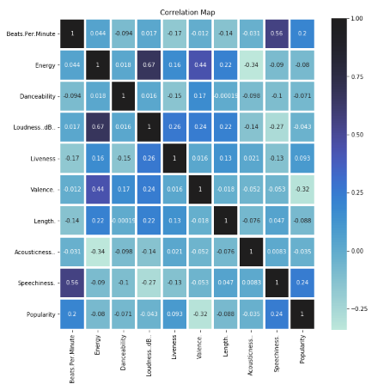
2. Visualization of Data
#Heatmap plt.figure(figsize=(10,10)) plt.title('Correlation Map') ax=sns.heatmap(spoti.corr(), linewidth=3.1, annot=True, center=1)

Slide 9
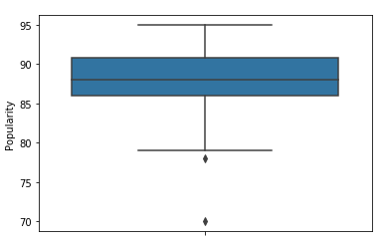
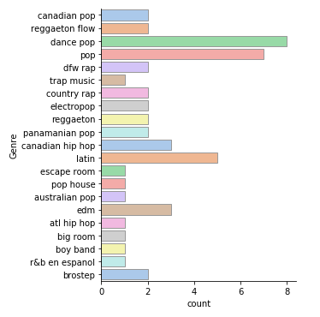
#Boxplot #It shows outlier values and value of popularity sns.boxplot( y = spoti["Popularity"]) plt.show()
#Catplot #It gives count of genre in spotify top 50 list. sns.catplot(y = "Genre", kind = "count", palette = "pastel", edgecolor = ".6", data = spoti) plt.show()

Slide 10
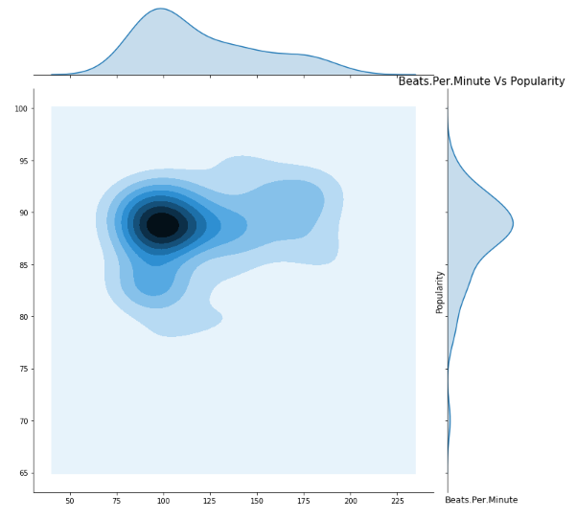
plt.figure(figsize=(12,12)) sns.jointplot(x=spoti["Beats.Per.Minute"].values, y=spoti['Popularity'].values, size=10, kind="kde",) plt.ylabel('Popularity', fontsize=12) plt.xlabel("Beats.Per.Minute", fontsize=12) plt.title("Beats.Per.Minute Vs Popularity", fontsize=15) plt.show(); #The purpose of this graph is to show connection among Beats and Popularity

Slide 11
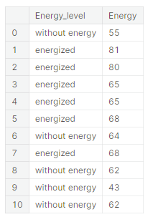
threshold = sum(spoti.Energy)/len(spoti.Energy) print(threshold) spoti["Energy_level"] = ["energized" if i > threshold else "without energy" for i in spoti.Energy] spoti.loc[:10,["Energy_level","Energy"]] #This caught my attention to the effect of energy level on music in here and i calcuted it. It classified according to mean of value

Slide 12
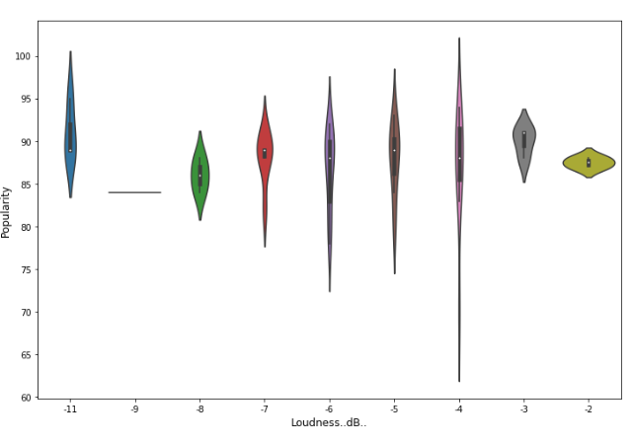
plt.figure(figsize=(12,8)) sns.violinplot(x='Loudness..dB..', y='Popularity', data=spoti) plt.xlabel('Loudness..dB..', fontsize=12) plt.ylabel('Popularity', fontsize=12) plt.show() # I want to show relationship loudness and popularity. From there we can learn to contribution of loudness level to popularity

Slide 13
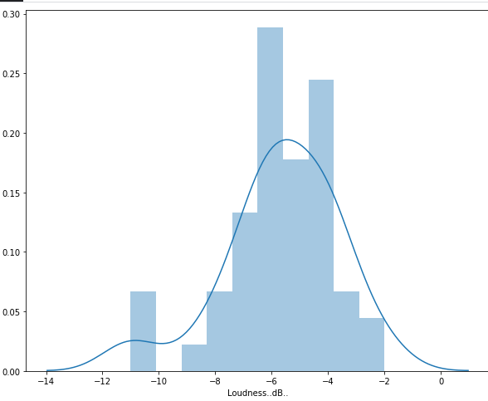
# Some kind of Histogram Plot f, ax = plt.subplots(figsize=(10,8)) x = spoti['Loudness..dB..'] ax = sns.distplot(x, bins=10) plt.show()

Slide 14
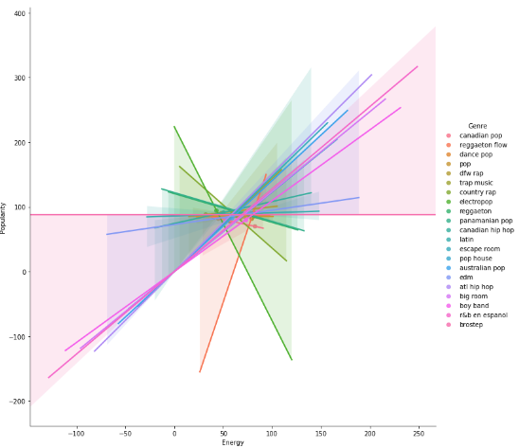
sns.lmplot(x="Energy",y="Popularity",data=spoti,size=10,hue="Genre") plt.show() #this graph is so attractive because of different from other. My target in there is to show to Excellence of connection of Energy and Poularity
/opt/conda/lib/python3.6/site-packages/seaborn/regression.py:546: UserWarning: The `size` paramter has been renamed to `height`; please update your code. warnings.warn(msg, UserWarning)

Slide 15

3.Conclusion
The excellence of Connection of Energy and Popularity is show in this dataset

