Slide 1
Machine Learning - Regression Algorithms

Slide 2
Agenda
Ada Boost Algorithm
XG Boosting Algorithm
LG Boosting Algorithm

Slide 3
Ada Boost Algorithm
An AdaBoost regressor is a meta-estimator
It begins by fitting a regressor on the original dataset
It fits additional copies of the regressor on the same dataset
weights of instances are adjusted according to the error of the current prediction
Procedure:
from sklearn.ensemble import AdaBoostRegressor
regr = AdaBoostRegressor(random_state=0, n_estimators=100)

Slide 4
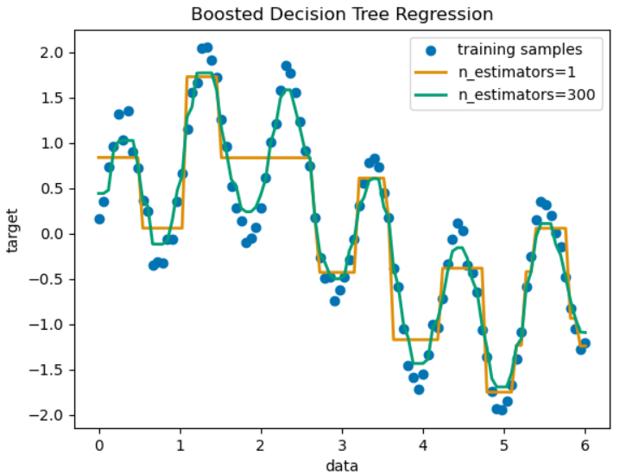
Ada Boost Algorithm

Slide 5
XG Boosting Algorithm
XGBoost is an optimized distributed Gradient Boosting Library
it solve many data science problems in a fast and accurate way.
Building an ensemble of decision trees sequentially where each new tree corrects the errors made by the previous one.
Procedure:
from xgboost import XGBClassifier
bst = XGBClassifier(n_estimators=2, max_depth=2, learning_rate=1, objective='binary:logistic')

Slide 6
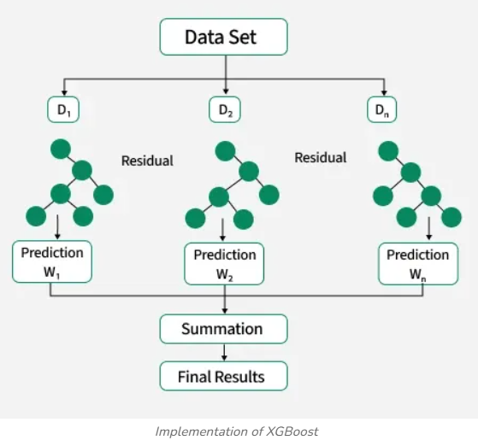
XG Boosting Algorithm

Slide 7
LG Boosting Algorithm
LG Boosting (OR) Light Gradient Boosting Machine (OR) LightGBM
It is an ensemble learning framework that uses gradient boosting, It’s a Decision tree structure used to predict outcomes
It constructs a strong learner by sequentially adding weak learners in a gradient descent manner.
It's designed for efficiency, scalability and high accuracy particularly with large datasets.
Procedure:
from lightgbm import LGBMClassifier
lgbm_model = LGBMClassifier(random_state=42, verbosity=-1)

Slide 8
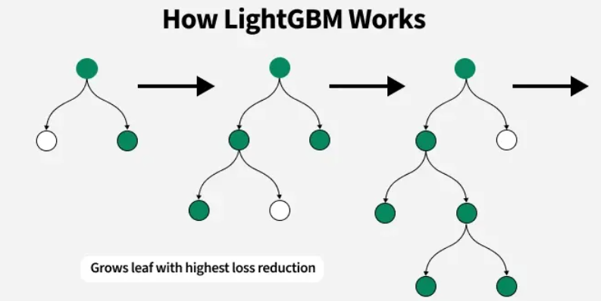
LG Boosting Algorithm

Slide 9
Thank You...☺

