Slide 1
PQAC Test Automation Estimation

Slide 2
PQAC Test Automation Estimation
Objectives
Activities of Test Automation
Evaluating Complexity Factors
Factors Affecting Test Automation Estimation
Use of Test Estimation Tool
Implementation

Slide 3
Objectives
Create a unified automation test estimation methodology across QA&C.
Use various complexity factors applicable to Test automation
Have a pre-defined estimate (effort in hours) corresponding to the complexity of test automation

Slide 4
Activities of Test Automation
The following 4 activities have been identified as being done by the Automation QA team:
Test Preparation
Analyze Functional Specification of Test case
Analysis of Automation Scope
Define Pre, Post condition for repeatable execution
Design High Level Flows
Define Automation design strategy
Framework Preparation
Create and maintain low-level Keyword and Flows
Create and maintain unit, acceptance tests for Keyword
Test Scripting
Identify locators
Automation synchronization points
Documentation
Test Execution / Re-execution
Run script on Jenkins

Slide 5
Evaluating Complexity Factors
The complexity is defined in 3 main levels:
L1 – Low
L2 – Medium
L3 – High
01-10 Lines of Actions or Verifications => Low
11-20 Lines of Actions or Verifications => Med
21-30 Lines of Actions or Verifications => High
Notes:
This slide explains the definition of the rating of the factors

Slide 6
Example of RF Actions
Example of Lines Of Actions
#Reusable Flows
RLMVD Login ${MVD_UID} menu=${Module_Name}
RLMVD Logoff
#Actions on GUI Elements
RLMVD Click Link Add Attainment
RLMVD Select Dropdown Group ${Group_Value}
RLMVD Set Textbox Attainment Date ${Attainment_Date}
RLMVD Set Textarea Notes ${Notes}
#Synchronization statements
RLMVD Wait Until Element Is Present Attainment Employee Post
RLMVD Wait Until Loaded | timeout=20.0
Notes:
This slide explains the definition of the rating of the factors

Slide 7
Example of RF Verifications
Example of Lines Of Verification
#Verification on GUI Elements
RLMVD Verify Dropdown Group ${Group_Value}
RLMVD Verify Textbox Attainment Date ${Attainment_Date}
RLMVD Verify Textarea Notes ${Notes}
RLMVD Verify Labels Displayed Open
RLMVD Verify Button Enabled Ok index=0 required=True
RLMVD Verify Link Button Displayed Next
Notes:
This slide explains the definition of the rating of the factors

Slide 8
Factors Affecting Test Automation Estimation
Sl. No | Factor | Type | Impact | Remarks
1 | Framework | Availability | High | Good framework makes scripting, debugging and maintenance easier. Framework needs continuous updating across the script development
2 | Scripter | Skill | High | The right skill packages of the scripter are very essential for any good test automation
3 | Project | Test Scope | High | If the complexity of application as well as the test scope is complex in nature, then it would consume huge efforts to automate each test case.
4 | Application | UI Design, Application Developed Language | High | The HTML UI design and use of custom objects in the application matters a lot as it becomes overhead for the test automation team to built and maintain the libraries for them.
5 | Application | Repeat Functionality | Medium | It is quite easier to automate incase the functionality repeats across the application (Recommend to use keyword driven in such cases, as you do not end up in writing more action/verification based methods). If NOT, then the effort of building libraries and/or scripts is more linear in nature.
6 | Browser | FF, Chrome, IE | Medium | Type of browser and version support is additional factor to the complexity of automation
Notes:
This slide explains the definition of the factors and how to estimate/evaluate them

Slide 9
Factors Affecting Test Automation Estimation (Cont.)
Application Complexity - The type of application design affect the complexity of test automation.
RL WebView Application is designed in PROIV Language and it is quite difficult to locate element based on labels displayed on UI. Also the Payroll screen UI Operation are complex which involves data in grid operations
RL MVD Application design is relatively simpler than WebView as it is built on AngularJS. This makes Automation easier.
RL Web Recruitment is lot easier than above two as it’s based on standard HTML Objects used in Application
2. Test Scope – The Scope of test affect the test complexity test automation
If the scope of test includes operations such as PDF, Excel, XML report verification, data verification in Pay Advise, Gross and NI screens then it requires low level Python keyword for such operations
If the scope include more repeated functionality then automation of tests would be easier
3. Framework – Framework design is directly proportional to Application complexity and Test scope
Pure Webpage or require file generation, file comparison etc.
Automation software upgrade
Jenkins Job Maintenance
Documentation and Training
4. Skill Level – Skill level of Automator can be Junior, Mid Senior and Senior.
5. Browser – Browser Compatibility testing is additional factor
Notes:
This slide explains the definition of the factors and how to estimate/evaluate them

Slide 10
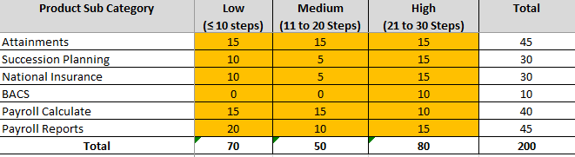
Use Of Estimation Tool - Detail Sheet
Open the estimation tool, got to details worksheet. For a given Product Subcategory; enter Number of Tests cases fall as Low, Medium and High complexity

Slide 11
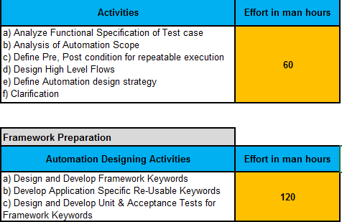
Use Of Estimation Tool– Summary Sheet
Go to Summary Sheet and Enter Number of Hours for
Test Preparation
Framework Preparation

Slide 12
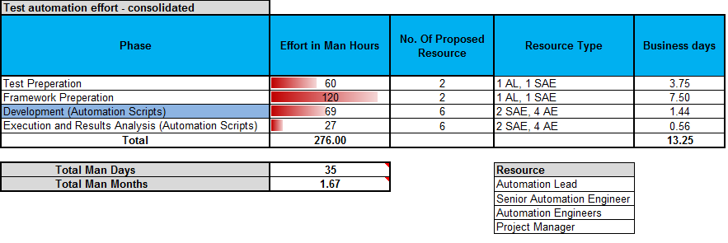
Use Of Estimation Tool – Summary Sheet
Go to Summary Sheet and Enter Number of Resources available with their skill level and finally Verify “Total Man Days” and “Total Business Days”

Slide 13
Implementation
Once agreed by the PQA&C Management, the latest version of the tool shall be cascaded to all Product Automation teams
Each managers of the teams above shall cascade the tool to their respective team leads / teams
The tool will be used in their next release under test
Monthly meetings can be set-up to get feedback and re-calibrate the tool
Notes:
This slide explains the definition of the rating of the factors

Slide 14
Thank You!
Mohan Kumar Panigrahi
Mohan.Panigrahi@gmail.com
Date: 30 July 2017

