Slide 1
Eclipse
Robot Framework Automation IDE

Slide 2
Eclipse and RF Scripting
Quality Assurance and Control

Slide 3
Eclipse Introduction
Eclipse is an Integrated Development Environment for Java Developers
Java Runtime Environment (JRE) is required to run Eclipse IDE for Java Developers
Eclipse provides a number of aids that make writing Java code much quicker and easier than using a text editor
Eclipse is independent of development platform
Its plug-in development feature which makes Eclipse an IDE platform rather than an IDE only
Debugging and managing check points is easy in Eclipse
Control space on method('cnt-space' will fill in the methods vars. Huge advantage!)
Auto suggestion to fixing, like a object type rename objecta ob = getObjectB();

Slide 4
Eclipse Installation
To Install Eclipse:
Go to http://www.eclipse.org/downloads/
Select “Eclipse Standard X.X” and download 32 bit or 64 bit which ever is applicable
There is no need to install Eclipse again. Just run Eclipse.exe itself used as application

Slide 5
List of plug-in to install in Eclipse
Following plug-ins to be installed in Eclipse
PyDev (http://PyDev.org/updates)
RobotIDE (http://sourceforge.net/projects/robotide/files/stable/)
eGIT (http://download.eclipse.org/egit/updates)

Slide 6
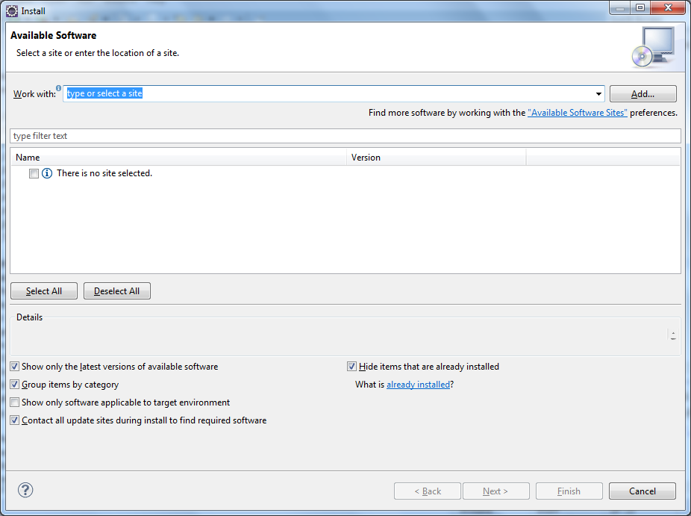
1. Install PyDev plug-in
Launch Eclipse
Go to Help menu-Install New Software…
Click on Add
Enter Name as “PyDev” and Location as “http://PyDev.org/updates”
Click Ok

Slide 7
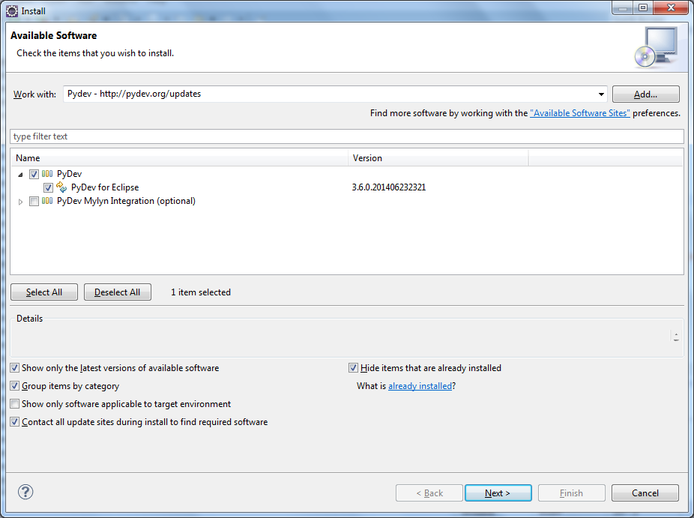
PyDev plug-in
Select “PyDev” check box and click Next

Slide 8
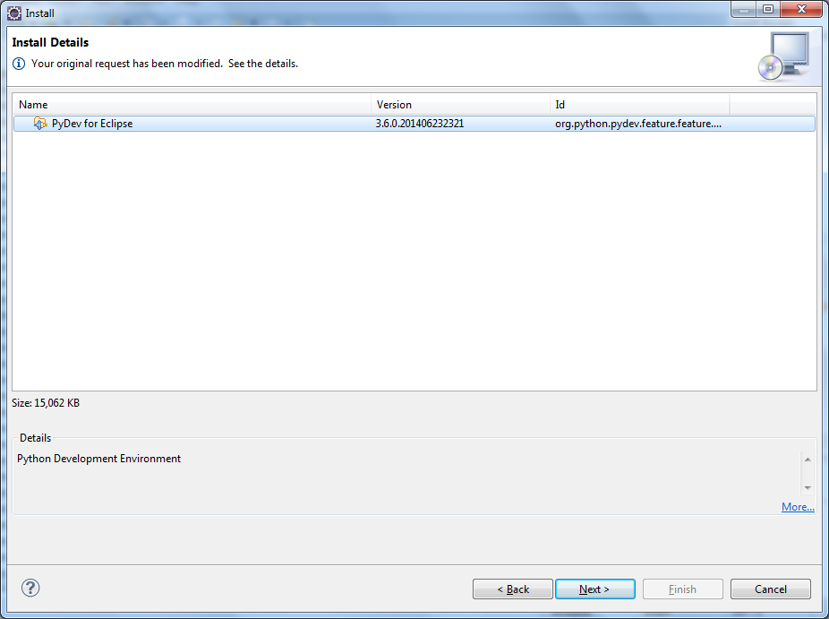
PyDev plug-in
Select “PyDev for Eclipse” and click Next

Slide 9
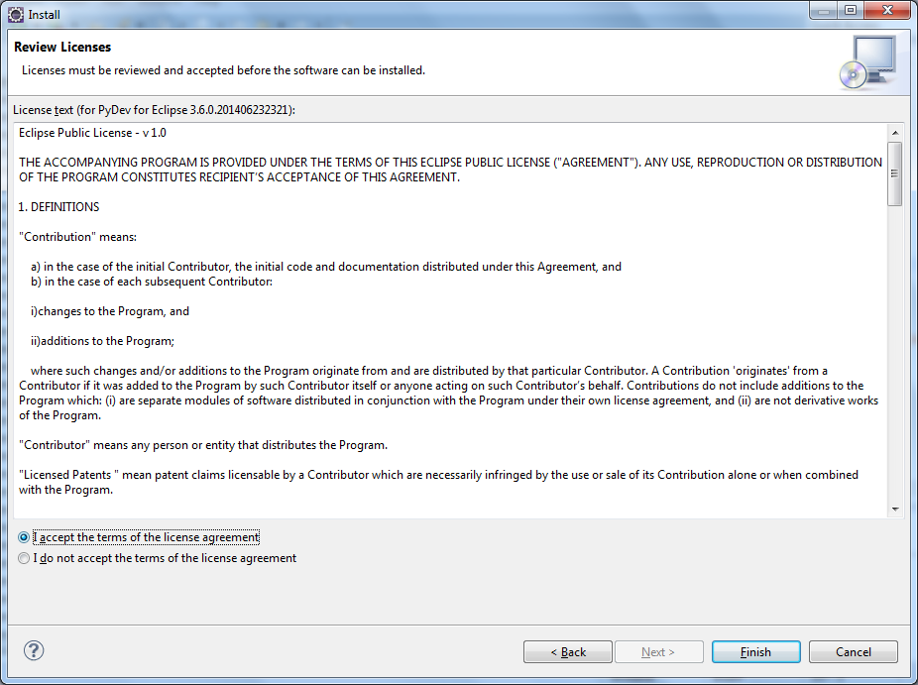
PyDev plug-in
Accept the terms of the license agreement and hit Finish

Slide 10
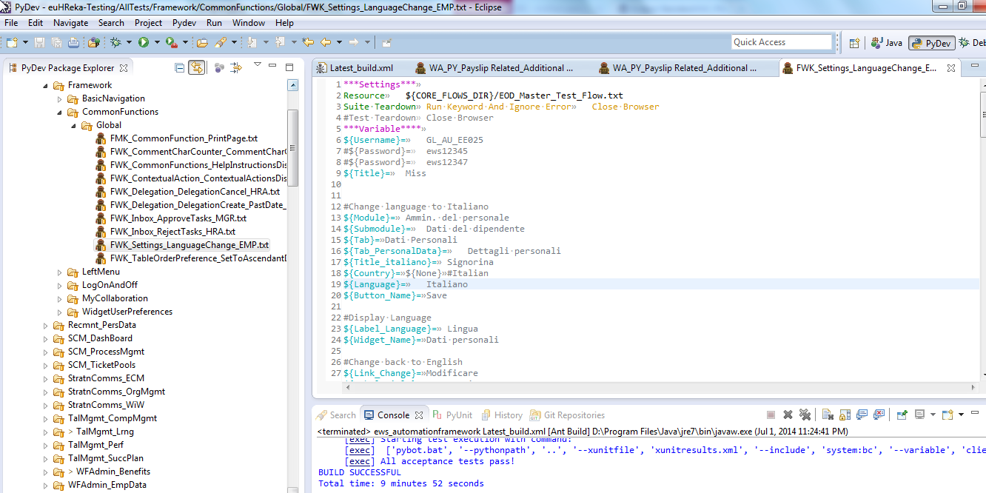
PyDev plug-in
Once PyDev get installed, will prompt for restart eclipse perspective.
After restart, check PyDev perspective will be added into Eclipse
PyDev will also be displayed in Menu bar

Slide 11
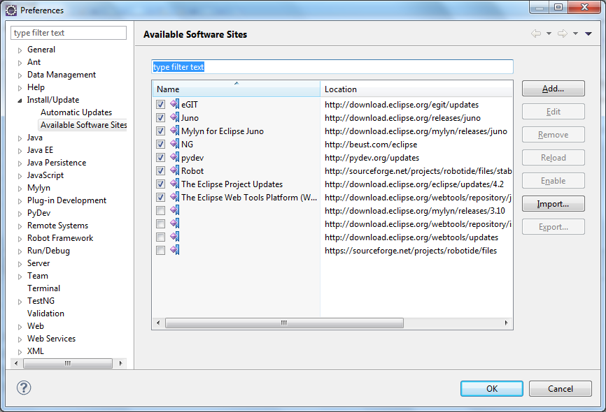
PyDev plug-in
Installed plug-ins can be checked by Help-Install New Software… and Click on “Available Software Sites”

Slide 12
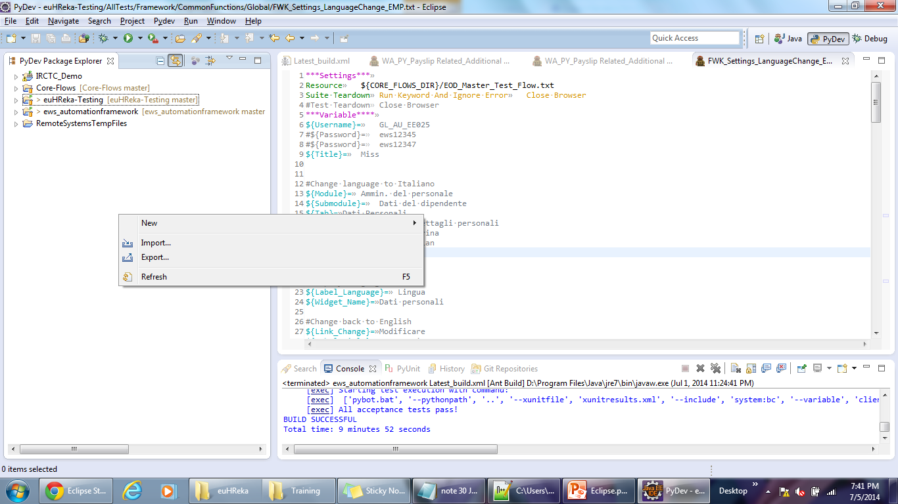
2. Install eGit and Import euHReka automation project
Go to Help menu- “Install New Software…”
Click on Add - Enter Name as “eGit” and Location as http://download.eclipse.org/egit/updates and Click Ok to install eGit
Once eGit plug-in installed, go to “PyDev Package Explorer”- Right Click and Select “Import..”

Slide 13
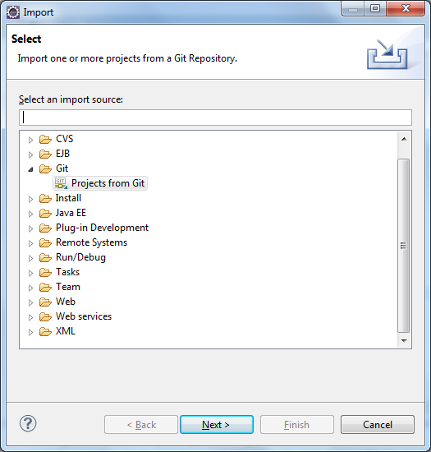
eGit plug-in
Select “Project from Git”- Next

Slide 14
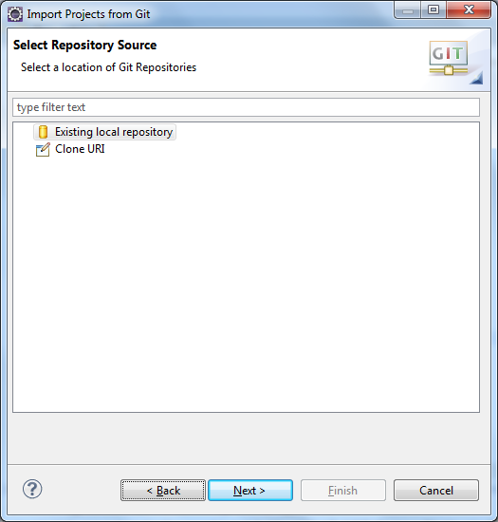
eGit plug-in
Select “Existing local repository” - Next

Slide 15
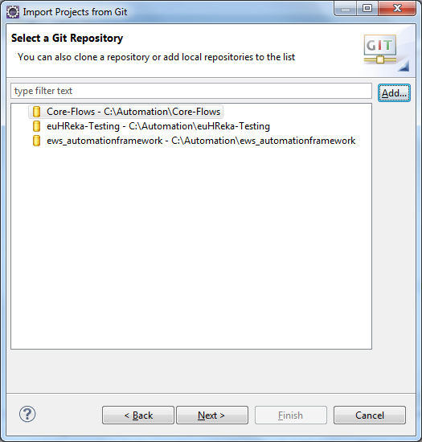
eGit plug-in
Add repository which are already cloned in your local drive. For eg “C:\Automation\ews_automationframework” and Hit Next
See the image below for already imported repositories

Slide 16
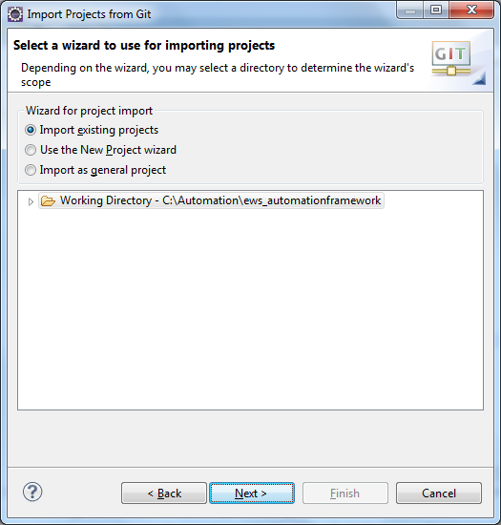
eGit plug-in
Select “Import Existing Project” – Next and Finish
Similarly perform above steps for “Core-Flows” and “euHReka-Testing” repository folders

Slide 17
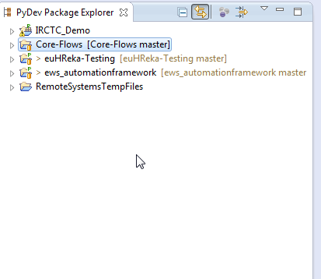
eGit plug-in
Once All repository are imported, PyDev Package Explorer would look like below Image
Note: I am preferably not using eclipse to pull/push/commit/fetch/rebase rather from windows explorer (Tortoise Git) which is more convenient. ☺ --Mohan

Slide 18
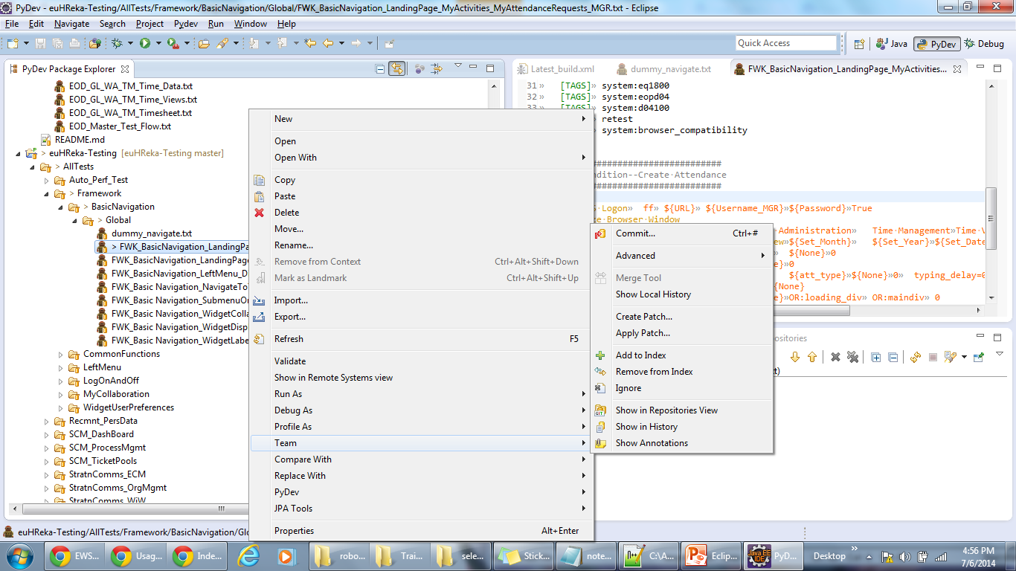
eGit plug-in
All version control commands (commit/pull/push) can be performed though Team Menu- Right click on changed file and select Team

Slide 19
eGit plug-in
Getting access to the automation framework and scripting repository
Importing required repositories into your workspace from URI
Right click on the empty space in the “Pydev Project Explorer” and click on “Import”
Select “Project from Git” and click “Next”
Select “URI” if you want to clone from GitHub (otherwise select local) and click “Next”
Copy the URL of the repository from GitHub’s Code section and paste it into the URI field
Fill in your username and password and click “Next”
Select the branch “master” and click “Next”
Click “Next” again
Select “Import as general project” and click “Next”
Finally, click “Finish

Slide 20
eGit plug-in
To download changes from the server, right click on the root project folder then in Team > Pull
To send changes to the server, right click on the root project folder then in
Team > Fetch from Upstream
Team > Rebase
Team > Commit
Team > Push to Upstream

Slide 21
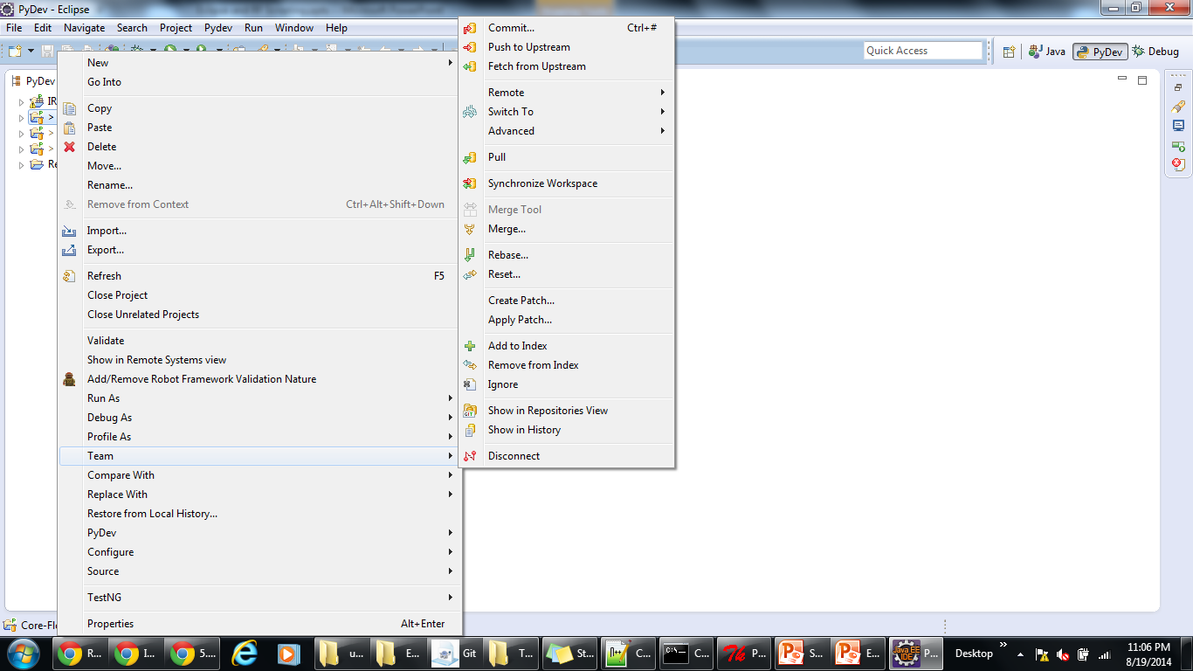
eGit plug-in

Slide 22
3. Install latest RobotIDE plug-in
Go to Help menu- “Install New Software…”
Click on Add - Enter Name as “RobotIDE” and Location as http://sourceforge.net/projects/robotide/files/stable/ and Click Ok
Once RobotIDE plug-in installed- open any script and you can see it opens in a text editor file Without any colored text.
Select Windows menu-Preference-General-Editors-File Associations-
Select file type as *.txt and select Associated Editor as “Robot Framework Textfile Editor” and click Default. Click Ok
Now close the last opened file and reopen. You can see now Colored text with different region of RF scripting style.
Image on next slide

Slide 23
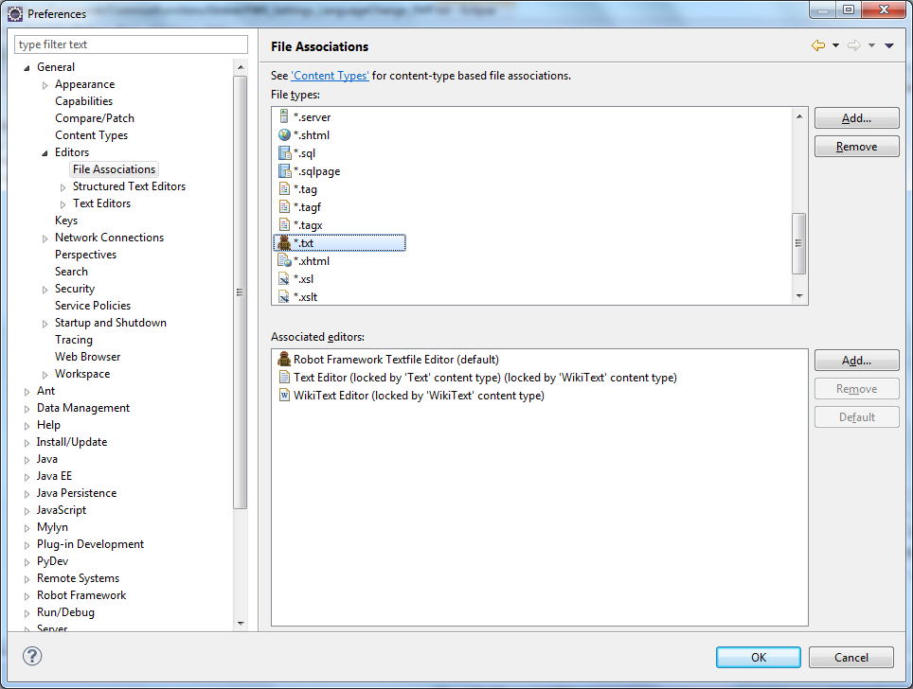
RobotIDE plug-in

Slide 24
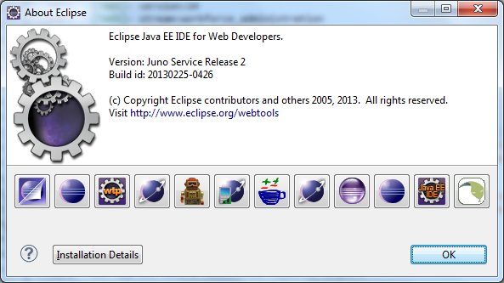
RobotIDE plug-in
To check version of Installed plug-ins in Eclipse
Click –Help-About Eclipse- to see list of installed plug-ins
Click on plug-in icon to see Installation details

Slide 25
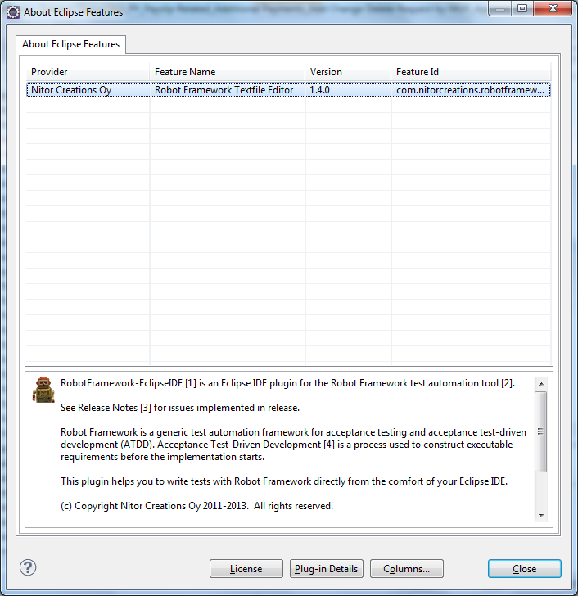
RobotIDE plug-in
Click on Robot Icon to see installation details.

Slide 26
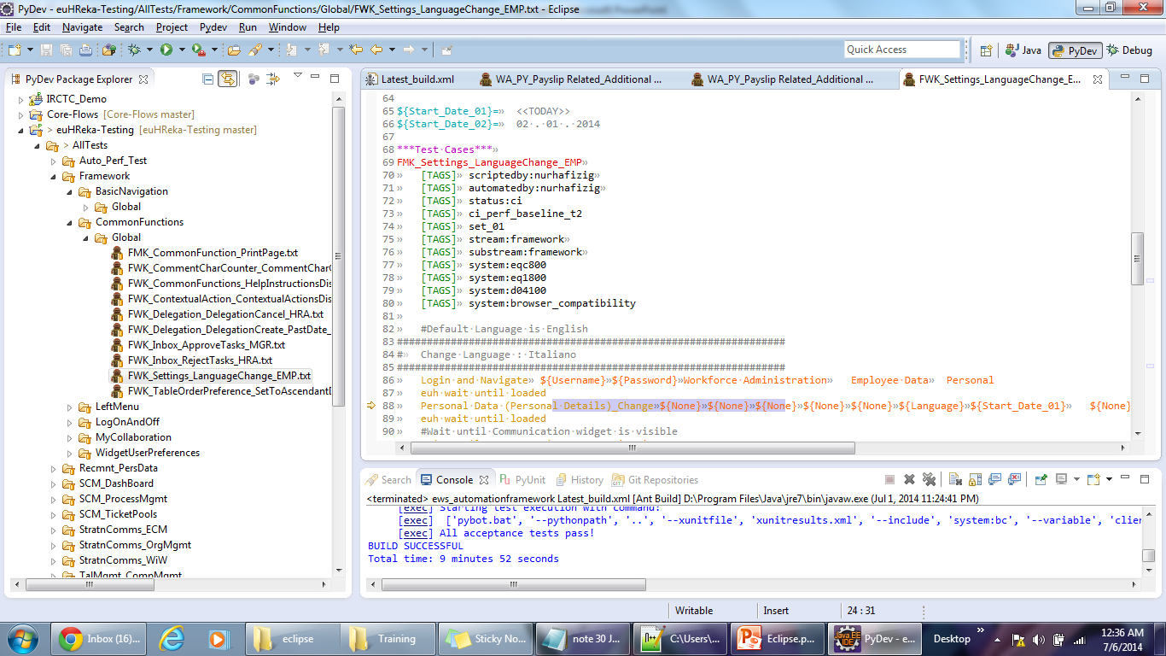
RobotIDE plug-in – RF script file

Slide 27
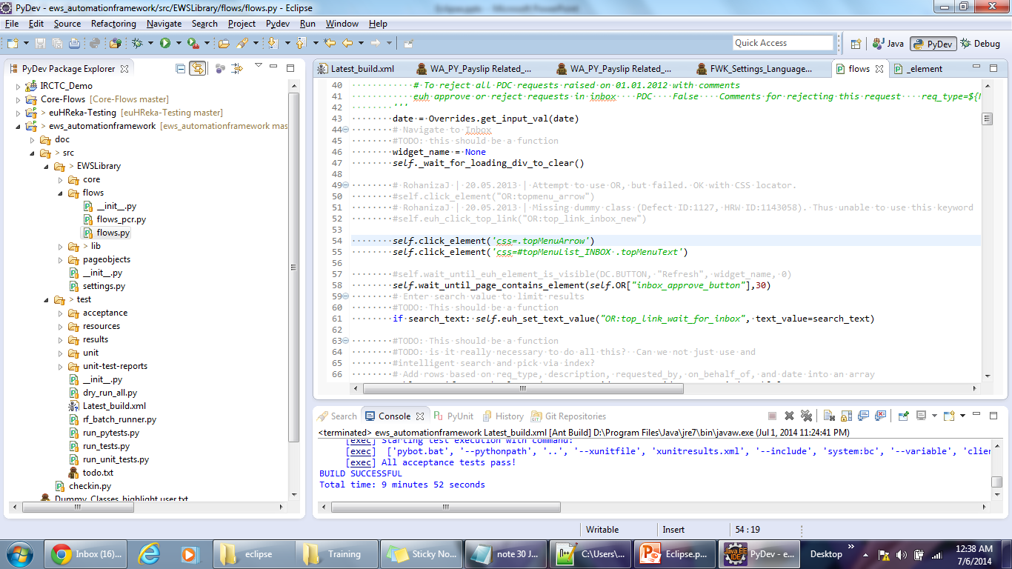
RobotIDE plug-in – Python File

Slide 28
RobotIDE plug-in Usage
Support for .txt and (since 1.4.0) .robot files using the "two spaces or tab" format
Syntax coloring (colors configurable since 1.2.0)
Hyperlinks to keyword definitions
Hyperlinks to global variable definitions
Hyperlinks to resource files
Hyperlinks to variable files
Code completion for keyword calls
Code completion for global variables
Code completion for missing keyword definitions (since 1.3.0)
Code completion for tables, formatting configurable (since 1.3.0)
Code completion for Setting table keys (since 1.3.0)
Refer:
https://github.com/NitorCreations/RobotFramework-EclipseIDE/wiki/Usage
https://github.com/NitorCreations/RobotFramework-EclipseIDE/wiki

Slide 29
RobotIDE plug-in Usage
Currently the robot editor does not automatically detect available keywords and variables imported from libraries in robot test suites. However by including index files listing per-library keywords and variables it can complete those too. In the future hope to be able to get rid of this manual step.
The index file format is simply a text file with one keyword or variable per line. They should be put in a directory called "robot-indices" directly below the root of the eclipse project your robot test suite files reside in (C:\Automation\euHReka-Testing\robot-indices). The file name should be LibraryName.index. For supporting keywords and variables built into the Robot Framework itself the filename should be BuiltIn.index.
Note:-According to the Web site we can create a index file like "LibraryName.index" and put it under folder "robot-indices". But actually, only the BuiltIn.index worked. Index files with other name won't work. Need to investigate. But for now I added all keywords into one Builtin.index file.
--Mohan

Slide 30
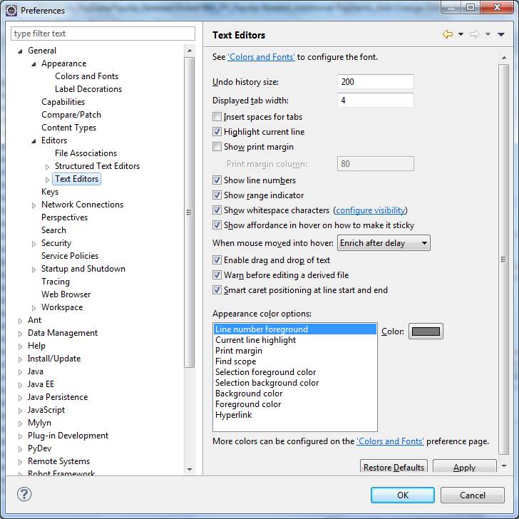
Show White Space and Tab Character
Select Windows-Preference- General- Editors- Text Editors
Check Show Line number
Configure White space as .
Configure Tab as >>

Slide 31
How To Run RF Script?
Create a Build.xml, Ant script with following lines
Place the configuration file into base folder where run_tests.py present (C:\Automation\ews_automationframework\src\test)
Right click on script and select Run As – 1 Ant Build
You can see running log in Console window. See image in next slide
<project name="Robot Framework" default="ews" basedir=".">
<!-- ========== Initialize Properties =============== -->
<property name="ws.home" value="${basedir}" />
<target name="ews">
<exec executable="python" dir="${ws.home}">
<arg line="run_tests.py --project euHReka-Testing --tag system:bc"/>
</exec>
</target>
</project>

Slide 32
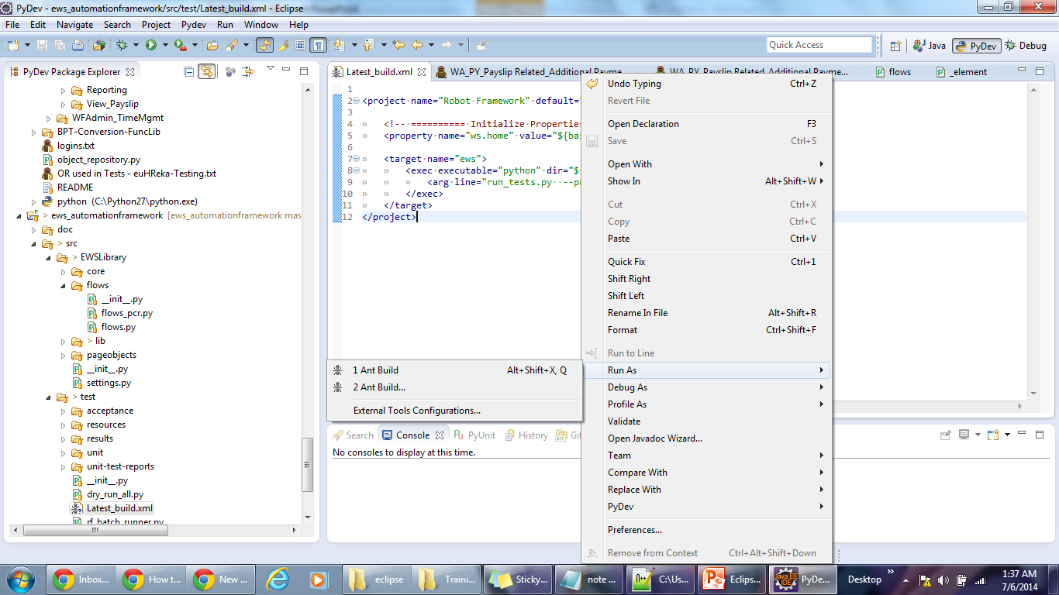
Run RF Script

Slide 33
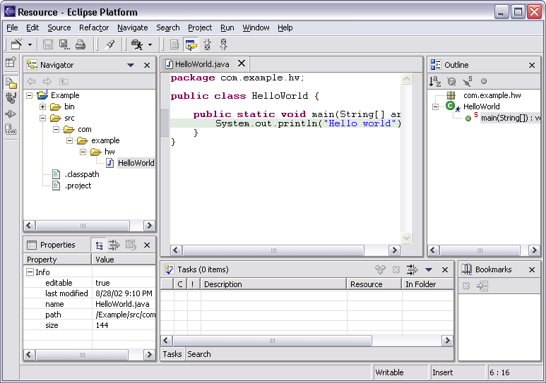
Eclipse View
Menu Bar
Tool Bar
Outline View
Resource Navigation View
Text Editor

Slide 34
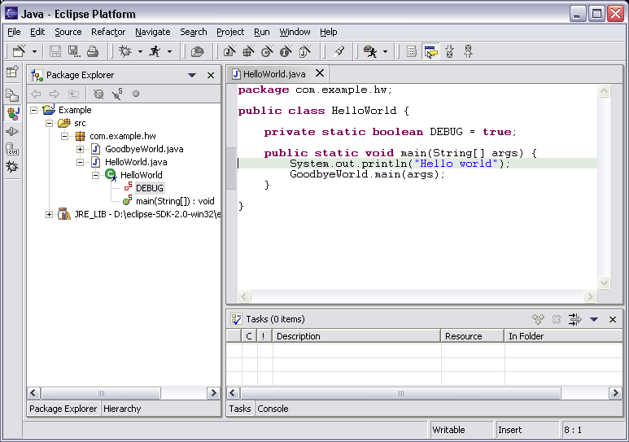
Eclipse in Java Perspective
Java Project
Package
Class
Java Editor

Slide 35
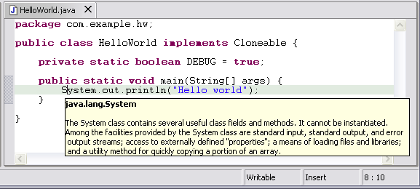
Java Editor
Hovering over identifier shows Java doc spec

Slide 36
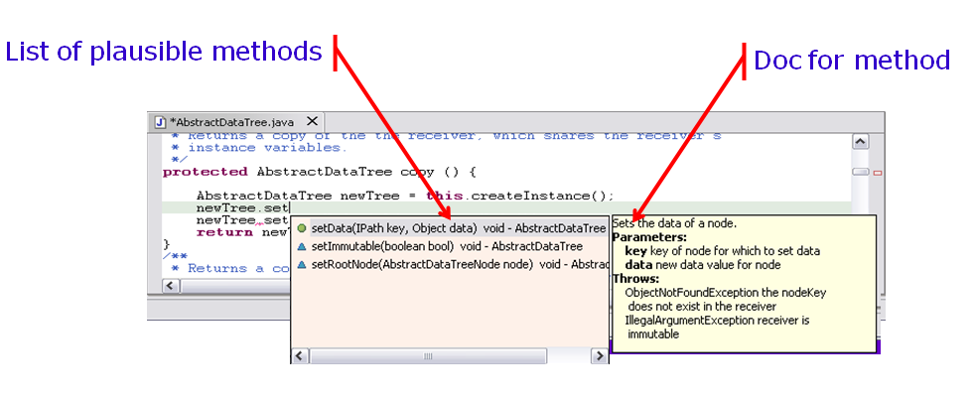
Java Editor
Method completion in Java editor

Slide 37
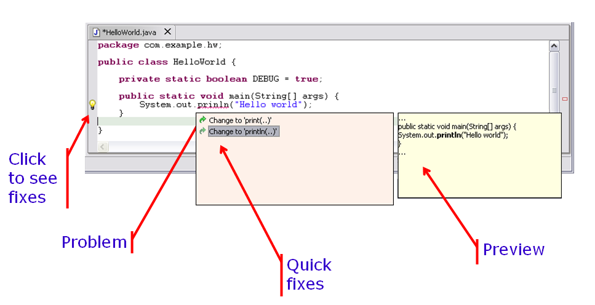
Java Editor
On-the-fly spell check catches errors early

Slide 38

Thank you!
Mohan K Panigrahi
Mohankumar.panigrahi@ngahr.com

