Slide 1
OOPS and Python
Object Oriented Programming using Python

Slide 2
Agenda
Modules and Packages
Functions
Classes and Objects
Constructors and Destructors
Static and class method
Inheritance
Overloading and Overriding
Public and Private Data

Slide 3
References
OOPS, virtualenv, Modules : http://anandology.com/python-practice-book/object_oriented_programming.html#state
Abstract Class : https://www.jeffknupp.com/blog/2014/06/18/improve-your-python-python-classes-and-object-oriented-programming/
Import : https://docs.python.org/3/reference/import.html
Multiple Inheritance: http://www.python-course.eu/python3_multiple_inheritance.php
Private, Public, Protected : http://radek.io/2011/07/21/private-protected-and-public-in-python/
Learn Python the hard way : http://learnpythonthehardway.org/book/
Learn Python with Interpreter: http://www.learnpython.org/
Tutorials Point (Interesting FAQ and Basic) : http://www.tutorialspoint.com/python/index.htm

Slide 4
Module
Modules are reusable libraries of code in Python. Python comes with many standard library modules.
A module is imported using the import statement.
Modules in Python can be simply Python files with the .py extension, which implement a set of functions.
Module act as a "singleton" : The first time a module is loaded into a running Python script, it is initialized by executing the code in the module once. If another module in your code imports the same module again, it will not be loaded twice but once only - so local variables inside the module are initialized only once.
To import a module, we use the from or import command.
from module import function
function()
import module
module.function()

Slide 5
Packages
Packages are namespaces which contain multiple packages and modules themselves
Each package in Python is a directory which MUST contain a special file called __init__.py. This file can be empty, and it indicates that the directory it contains is a Python package, so it can be imported the same way a module can be imported.
To help organize modules and provide a naming hierarchy, Python has a concept of packages.
It’s important to keep in mind that all packages are modules, but not all modules are packages. Or put another way, packages are just a special kind of module. Specifically, any module that contains a __path__ attribute is considered a package.
Python defines two types of packages, regular packages and namespace packages

Slide 6
Functions
Just like a value can be associated with a name, a piece of logic can also be associated with a name by defining a function.
The body of the function is indented. Indentation is the Python’s way of grouping statements.
The ... is the secondary prompt, which the Python interpreter uses to denote that it is expecting some more input.
The functions can be used in any expressions.
>>> square(2) + square(3) 13
>>> square(square(3)) 81
Functions are just like other values, they can assigned, passed as arguments to other functions etc.
>>> f = square
>>> f(4) 16

Slide 7
Scope of the variables used in functions
Variables assigned in a function, including the arguments are called the local variables to the function. The variables defined in the top-level are called global variables.
Changing the values of x and y inside the function incr won’t effect the values of global x and y. But, we can use the values of the global variables.
When Python sees use of a variable not defined locally, it tries to find a global variable with that name. However, you have to explicitly declare a variable as global to modify it.
numcalls = 0 def square(x):
global numcalls
numcalls = numcalls + 1
return x * x

Slide 8
Functions with Lambda operator
There is another way of creating functions, using the lambda operator. This is also called as anonymous functions.
>>> def cube (x): return x**3
>>> print cube(2) //normal function
>>> cube = lambda x: x ** 3
>>> print cube(2) //anonymous function
Notice that unlike function definition, lambda doesn’t need a return. The body of the lambda is a single expression.
The lambda operator becomes handy when writing small functions to be passed as arguments etc.

Slide 9
Local and Global Variables
Variables assigned in a function, including the arguments are called the local variables to the function. The variables defined in the top-level are called global variables.
But, we can use the values of the global variables. When Python sees use of a variable not defined locally, it tries to find a global variable with that name.
However, you have to explicitly declare a variable as global to modify it.

Slide 10
Classes and Objects
Classes is a blueprints for creating objects.
class BankAccount:
def __init__(self): #constructor
self.balance = 0
def withdraw(self, amount):
self.balance -= amount
return self.balance
def deposit(self, amount):
self.balance += amount
return self.balance
>>> a = BankAccount()
>>> b = BankAccount()
>>> a.deposit(100)
>>> b.deposit(50)
>>> b.withdraw(10)
>>> a.withdraw(10)

Slide 11
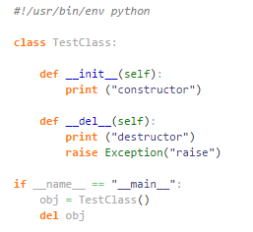
Constructor and Destructor
The constructor is implemented using __init__(self) which you can define parameters that follows the self. The destructor is defined using __del__(self).
In the example, theobj is created and manually deleted, therefore, both messages will be displayed. However, if you comment out the last line ‘del obj’, the destructor will not be called immediately. Instead, the Garbage Collector (GC) will take care of the deletion automatically, which you never know when for sure. For example, if you press F5 in the IDLE, only the first message will be displayed. However, if you run the program in the command line using python interpreter, both messages will be displayed no matter if you add ‘del obj’ or not.

Slide 12
Static and class method
Though classmethod and staticmethod are quite similar, there's a slight difference in usage for both entities: classmethod must have a reference to a class object as the first parameter, whereas staticmethod can have no parameters at all.
Though classmethod and staticmethod are quite similar, there's a slight difference in usage for both entities: classmethod must have a reference to a class object as the first parameter, whereas staticmethod can have no parameters at all.
@classmethod means: when this method is called, we pass the class as the first argument instead of the instance of that class (as we normally do with methods). This means you can use the class and its properties inside that method rather than a particular instance.
@staticmethod means: when this method is called, we don't pass an instance of the class to it (as we normally do with methods). This means you can put a function inside a class but you can't access the instance of that class (this is useful when your method does not use the instance).

Slide 13
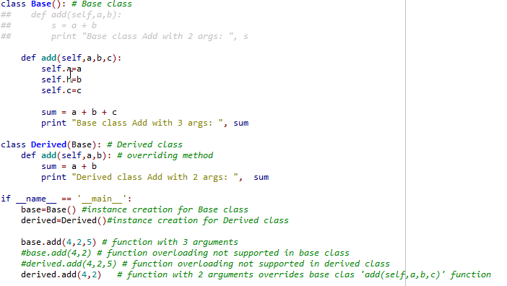
Overloading and Overriding
Python does not support overloading
Python supports overriding : Any derived class with same function name as base class (irrespective of change in signature) tends to default override

Slide 14
Private, protected and public in Python-1
In C++ and Java, things are pretty straight-forward. There are 3 magical and easy to remember access modifiers, that will do the job (public, protected and private). But there’s no such as thing in Python. That might be a little confusing at first, but it’s possible too. We’ll have look at how do it right in Python.
Python doesn’t have any mechanisms, that would effectively restrict you from accessing a variable or calling a member method. All of this is a matter of culture and convention.
Public: All member variables and methods are public by default in Python. So when you want to make your member public, you just do nothing.
Protected: Protected member is (in C++ and Java) accessible only from within the class and it’s subclasses. How to accomplish this in Python? The answer is – by convention. By prefixing the name of your member with a single underscore (_), you’re telling others “don’t touch this, unless you’re a subclass”

Slide 15
Private, protected and public in Python-2
Private: By declaring your data member private you mean, that nobody should be able to access it from outside the class, i.e. strong you can’t touch this policy. Python supports a technique called name mangling. This feature turns every member name prefixed with at least two underscores

Slide 16
How to call base Class method?
super(<derivedclass>, <derivedObj>).<method>()

Slide 17
Multiple Inheritance-1
The widespread prejudice that multiple inheritance is something "dangerous" or "bad" is mostly nourished by programming languages with poorly implemented multiple inheritance mechanisms and above all by improper usage of it. Java doesn't even support multiple inheritance, while C++ supports it. Python has a sophisticated and well-designed approach to multiple inheritance.
The "diamond problem" (sometimes referred to as the "deadly diamond of death") is the generally used term for an ambiguity that arises when two classes B and C inherit from a superclass A, and another class D inherits from both B and C. If there is a method "m" in A that B or C (or even both of them) )has overridden, and furthermore, if does not override this method, then the question is which version of the method does D inherit? It could be the one from A, B or C
every class has to inherit from the class "object"
multiple inheritance is governed by two rules: depth-first and then left-to-right

Slide 18
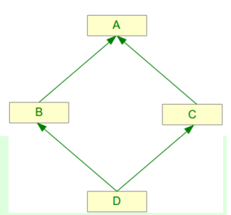
Multiple Inheritance-2
http://www.python-course.eu/python3_multiple_inheritance.php

Slide 19
Appendix

Slide 20
Thank you!
Mohan Kumar Panigrahi

