Slide 1
Python & Robot Framework
Introduction

Slide 2
Agenda
Introduction to Python and Robot Framework
Installation and Configuration

Slide 3
Introduction
Python is a high-level, interpreted, interactive and object-oriented scripting language. Python is designed to be highly readable. It uses English keywords frequently where as other languages use punctuation, and it has fewer syntactical constructions than other languages.
Python is Interpreted: Python is processed at runtime by the interpreter. You do not need to compile your program before executing it. This is similar to PERL and PHP.
Python is Interactive: You can actually sit at a Python prompt and interact with the interpreter directly to write your programs.
Python is Object-Oriented: Python supports Object-Oriented style or technique of programming that encapsulates code within objects.

Slide 4
History of Python
Python is a general-purpose interpreted, interactive, object-oriented, and high-level programming language. It was created by Guido van Rossum during 1985- 1990. Like Perl, Python source code is also available under the GNU General Public License (GPL). This tutorial gives enough understanding on Python programming language.
Python 1.4, documentation released on 25 October 1996.
Python 2.7.11, documentation released on 5 December 2015
Python 3.4.3, documentation released on 25 February 2015.
Robot Framework 2.9 supports Python 2.6 and 2.7, and upcoming Robot Framework 3.0 supports those and also Python versions 3.3 and up

Slide 5
Configuring PATH and Package Manager
What directories you need to add to the PATH depends on the interpreter and the operating system. The first location is the installation directory of the interpreter (e.g. C:\Python27) and the other is the location where scripts are installed with that interpreter. Both Python and IronPython install scripts to Scripts directory under the installation directory on Windows (e.g.C:\Python27\Scripts)
Package Managers : easy_install, Pip
Installing pip for Python : Python package managers make installation trivial.
easy_instal pip
For example, pip users just need to execute:
pip install robotframework
Starting from Python 2.7.9, The standard Windows installer by default installs and activates pip

Slide 6
Python Interpreter
Python : Core Interpreter
Jython : is a Python implementation that compiles Python code to Java bytecode which is then executed by the JVM (Java Virtual Machine). Additionally, it is able to import and use any Java class like a Python module.
IronPython : is an implementation of Python for the .NET framework. It can use both Python and .NET framework libraries, and can also expose Python code to other languages in the .NET framework.
Cpython : is the reference implementation of Python, written in C. It compiles Python code to intermediate bytecode which is then interpreted by a virtual machine.
PyPy : is a Python interpreter implemented in a restricted statically-typed subset of the Python language called RPython. The interpreter features a just-in-time compiler and supports multiple back-ends (C, CLI, JVM)

Slide 7
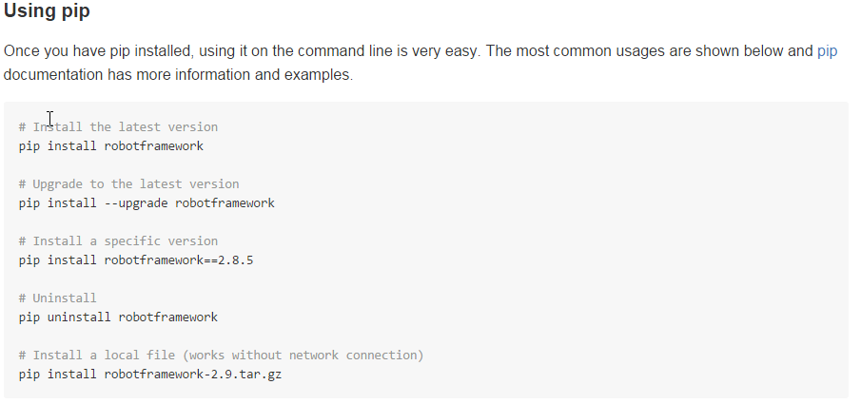
Robot Framework Install manager

Slide 8
Programming Languages & Frameworks
Programming languages are supported through Selenium "drivers." These are libraries made for each language that expose commands from the Selenium API natively in the form of methods/functions.
Selenium is often used for automating web applications for testing purposes, but it does not include a testing framework. Some testing frameworks that can be used with Selenium are listed below.
C# : Frameworks available: NUnit
Java Frameworks available: JUnit, TestNG
JavaScript
Frameworks available: WebdriverJS, WebdriverIO, NightwatchJS
PHP: Frameworks available: Behat + Mink
Python
Frameworks available: unittest, pyunit, py.test, robot framework
Ruby Frameworks available: RSpec, Test::Unit

Slide 9
Thank You
Mohan Panigrahi

Slide 10
Appendix

