Slide 1
Test Automation & Scripting Training using Robot Framework & Selenium
roberto.galman@ngahr.com
July 30, 2014

Slide 2

Course Overview
At the end of this course, You will know/have:
Basic understanding of Test Automation Frameworks
Knowledge on Keyword-driven Testing
Functional knowledge of Robot Framework including its architecture
How to use BuiltIn & Selenium Library Keywords in your test data
How to use Robot Framework & Selenium to Automate Web Application Testing
The students will be assessed by:
Automating the test cases identified by
manual exploratory testing of a Parking Calculator
Find at least 3 bugs per Lot Type & 2 Passed tests
per Lot Type
Implement using Keyword-driven & Data-driven
approach in RF (Optional)

Slide 3
Course Overview
0. Course Overview
7. Settings & Variables
1. Parking Calculator
8. User Keywords
2. Test Automation Framework
9. Resource Files
3. Keyword-Driven Testing
10. Loops & Conditions
4. Robot Framework Overview
11. Selenium2Library
5. Creating Test Data
12. Templates
6. Creating Test Cases

Slide 4
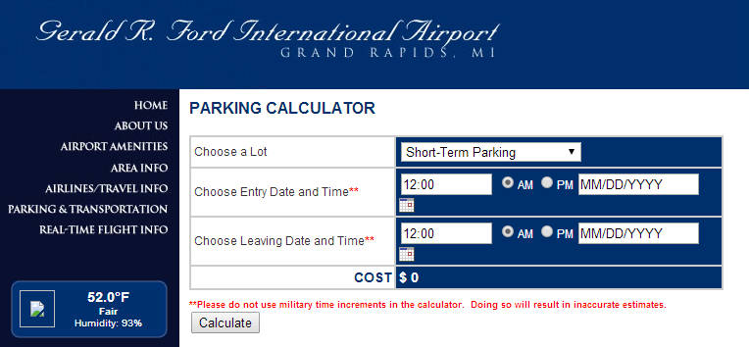
PARKING CALCULATOR
Gerald R. Ford International Airport Parking Calculator
http://www.grr.org/ParkCalc.php

Slide 5
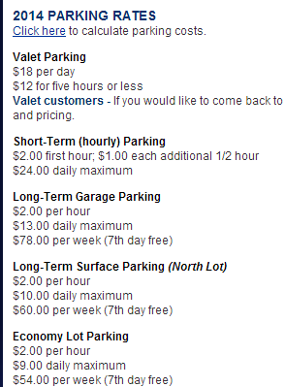
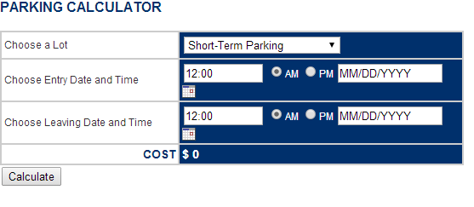
“BUGGY” PARKING CALCULATOR
http://adam.goucher.ca/parkcalc/

Slide 6

TEST AUTOMATION FRAMEWORK
Web Server
Web Application
<Parking Calculator>
Database
HTTP
Test Automation Framework
Defined Format (csv,tsv,txt)
Drive the Application
Execute the test
Report the results
Test Libraries

Slide 7
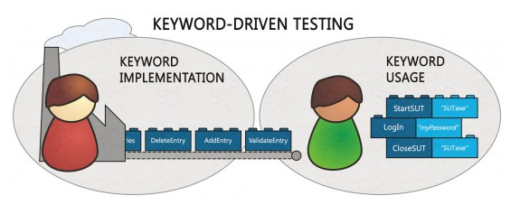
KEYWORD-DRIVEN TESTING
Keyword – function or method that is used to test an aspect of the
System Under Test (SUT)
Keyword Hierarchy
High-Level Keywords - keyword to test an aspect of the business logic of SUT
Lower-level Keywords - breakdown High-level to a decent size for modularity
& reusability
Technical Keywords - technical implementation of the keywords

Slide 8
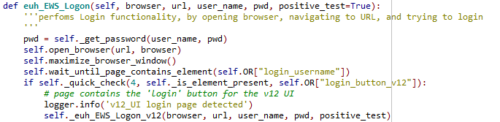
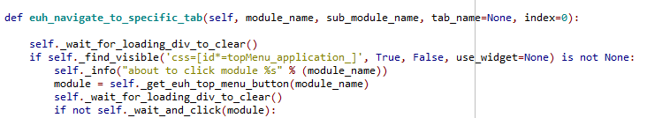
KEYWORD-DRIVEN TESTING
Login and Navigate
Input: URL, user, pword, menu
Login
Input: URL, user, pword
euh EWS Logon
Input: URL, user, pword
Navigate
Input: menu
euh navigate to specific tab
Input: menu

Slide 9
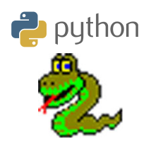
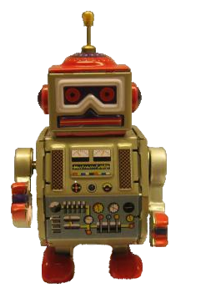
ROBOT FRAMEWORK
PYTHON-BASED KeyWORD-DRIVEN
TEST AUTOMATION FRAMEWORK

Slide 10
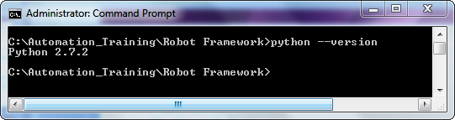
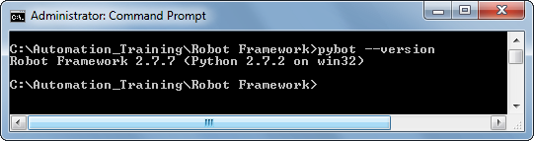
ROBOT FRAMEWORK OVERVIEW
PRECONDITION:
Python 2.7.X
To verify Installation:
> python --version
To check robot framework installation:
> pybot --version

Slide 11
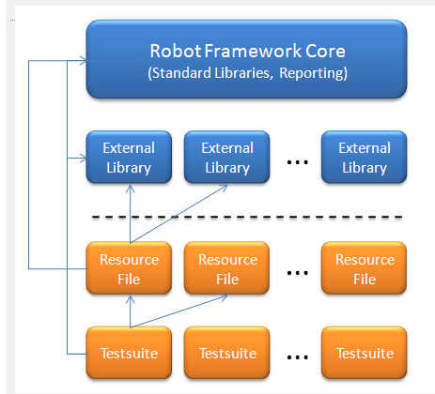
ROBOT FRAMEWORK OVERVIEW
Technical Keywords
HL/LL Keywords
Actual Test Cases

Slide 12
ROBOT FRAMEWORK OVERVIEW
Testsuites: This is where testcases (checks) are implemented
Resource Files: This is where High-level/Low-level keywords can
be defined for modularity and reusability
Test Library: This is where technical keywords are defined
ROBOT FRAMEWORK
TEST LIBRARY
RESOURCE FILE
TEST SUITE
Test Data (.txt/.html/.tsv)
Test library API to drive the Application
Pybot to execute the test
Generate log.html as test result

Slide 13
Creating Test Data
Supported File Formats
Robot Framework test data is defined in tabular format, using:
hypertext markup language (HTML)
tab-separated values (TSV)
plain text(TXT)
Robot Framework selects a parser for the test data based on the file extension. The extension is case-insensitive, and the recognized extensions are .html, .htm and .xhtml for HTML, .tsv for TSV, and .txt for plain text

Slide 14
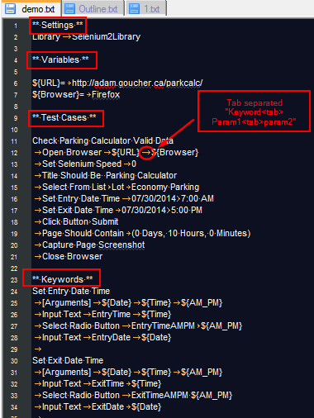
Creating Test Data
Sample Test Case File

Slide 15
Creating Test Data
Test Data Tables
Test data is structured in four types of tables listed below. These test data tables are identified by the first cell of the table, and the last column in the table below lists different aliases that can be used as a table name.
Table name | Used for | Aliases
Settings | Importing test libraries, resource files | Setting, Settings, Metadata
Variable | Defining variables that can be used elsewhere in the test data | Variable, Variables
Test cases | Creating test cases from available keywords | Test Case, Test Cases
Keyword | Creating user keywords from existing lower-level keywords | Keyword, Keywords, User Keyword, User Keywords

Slide 16
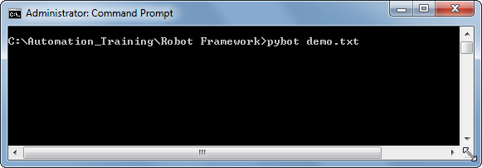
Creating Test Data
For the plain text format, test data tables are recognized from one or more asterisks ( ), followed by a normal table name and an optional closing asterisks.
Executing Robot Framework Test Cases
To run the tests in “demo.txt" navigate to the directory that contains it in the command line and type:

Slide 17
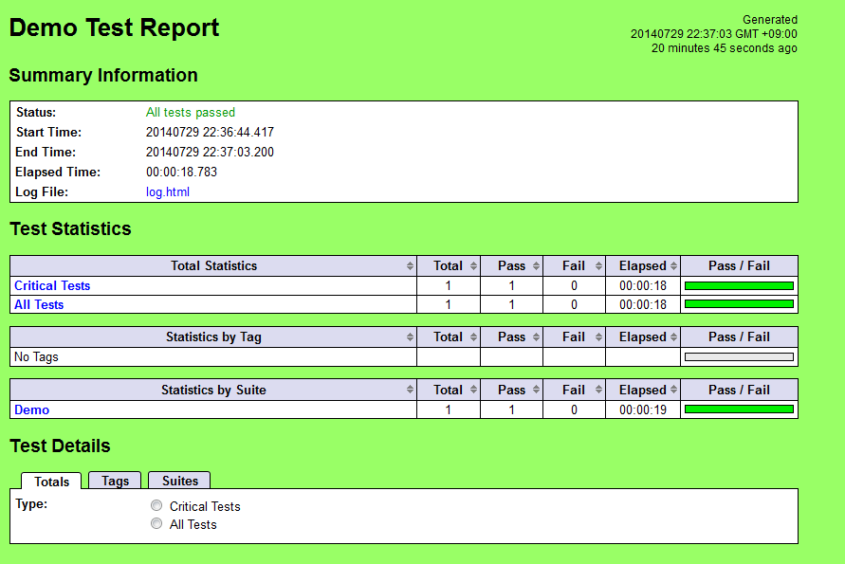
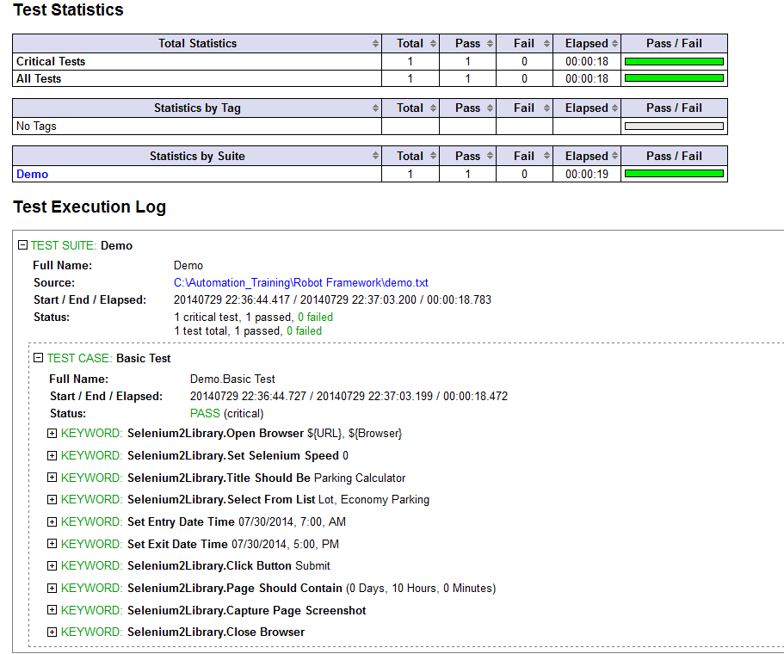
Creating Test Data
Reading the Results
Robot Framework will generate report.html & log.html in the current directory showing the results of the execution

Slide 18
Creating Test Data
Structure
The hierarchical structure for arranging test cases is built as follows:
Test cases are created in test case files.
A test case file automatically creates a test suite containing the test cases in that file.
A directory containing test case files forms a higher-level test suite. Such a test suite directory has suites created from test case files as its sub test suites
A test suite directory can also contain other test suite directories, and this hierarchical structure can be as deeply nested as needed

Slide 19
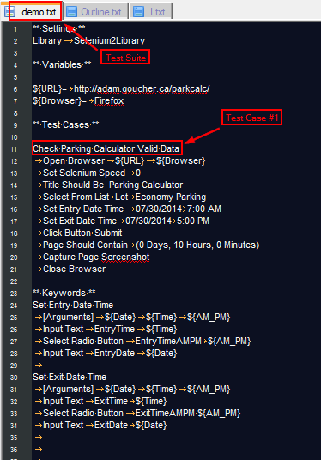
Creating Test Data

Slide 20
Using Test Libraries in Settings Table
Using Custom Libraries
Test libraries contain those lowest-level keywords, often called technical keywords, which actually interact with the system under test.
To import a Library in the Test Data:
** Settings **
Library | Selenium2Library
# Here “|” or pipe character represents a tab for plain txt format
Standard Libraries
Some test libraries are distributed with Robot Framework and these libraries are called standard libraries. These are the available standard libraries:
BuiltIn - http://robotframework.googlecode.com/hg/doc/libraries/BuiltIn.html?r=2.7.7
OperatingSystem
String
Dialogs

Slide 21
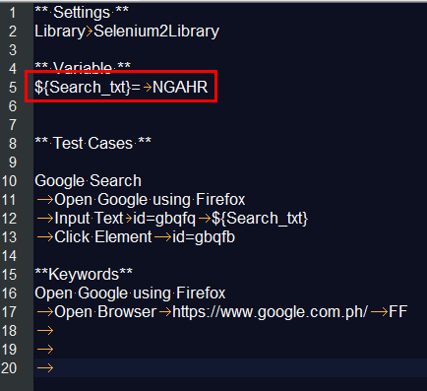
Using Scalar Variables
When scalar variables are used in the test data, they are replaced with the value they are assigned to.

Slide 22
Creating a Test Case
Basic Syntax
Test cases are constructed in test case tables from the available keywords. Keywords can be imported from:
test libraries
resource files
or created in the keyword table of the test case file itself.
Tagging Test Cases
Using tags in Robot Framework is a simple, yet powerful mechanism for classifying test cases.
Tags are shown in test reports, logs and, of course, in the test data
Statistics about test cases (total, passed, failed are automatically collected based on tags).
With tags, you can include or exclude test cases to be executed.

Slide 23

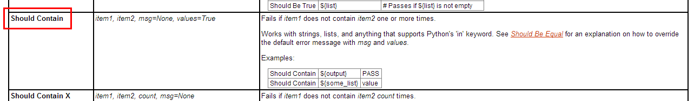
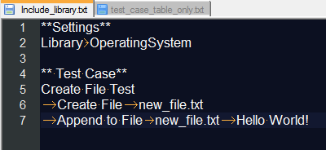
Examples
Test Case Table Only :
Including Library:

Slide 24
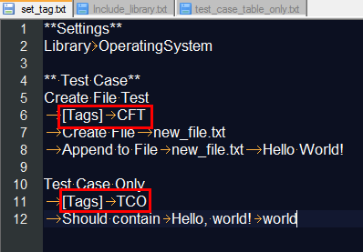
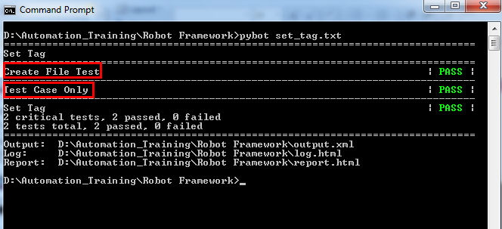
Examples
Set Tag:

Slide 25
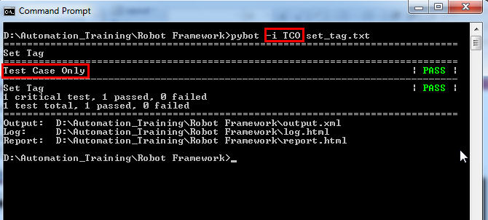
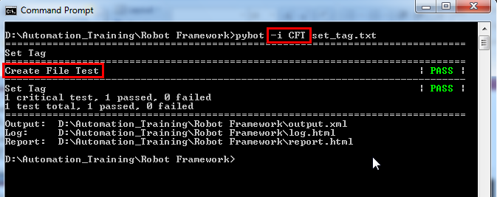
Examples

Slide 26
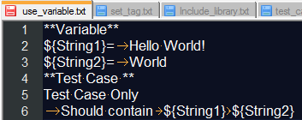
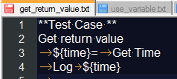
Examples
Use a Variable:
Store a return value to a Variable:

Slide 27
User Keywords
In many ways, the overall user keyword syntax is identical to the test case syntax. User keywords are created in keyword tables which differ from test case tables only by the name that is used to identify them
User Keyword Arguments
Arguments are normally specified with the [Arguments] setting, and argument names use the same syntax as variables, for example ${arg}.
Return Values
Return values are defined with the [Return] setting. The values can then be assigned to variables in test cases or other user keywords.

Slide 28
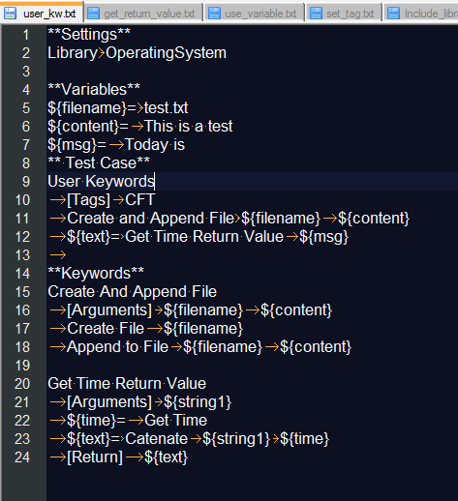
Examples
Using user keywords:

Slide 29
Exercises
1. Using Test Case Table only, create 3 test cases:
1.1 TC#1 Create File A.txt in the current directory with text “This is File A”
1.2 TC#2 Create “Folder A”
1.3 TC#3 Move A.txt to Folder A
Library: OperatingSystem
Name the test data file Exec_Day1_1.txt
2. Modify Exercise 1 by using variable for the filename, folder name, text. Add
tags “create file”, “create folder”, “move file”
Initialize the variable to: B.txt, Folder B, This is File B
Name the test data file Exec_Day1_2.txt
Create a keyword which takes as input filename, folder name, text and creates
filename, folder then moves filename to folder. (Exec_Day1_3.txt)
3.1 TC#1 – Call the keyword and input C.txt, Folder C, “This is File C”
3.2 TC#2 - Call the keyword and input D.txt, Folder D, “This is File D”
3.3 TC#3 – Count the number of folders in the current directory –i.e. 4 (Folder A-D)
Output: “There are 4 Folders in directory - <path>”

Slide 30
Exercises
Create test case that: (Exec_Day1_4.txt)
4.1 Defines 2 Variables as directory path
4.2 A keyword that counts the number of files in the directory & Get current time.
Input: directory
Output: Log – At ${time} path ${path} had ${count} items
4.3 Create a Test Case that calls the keyword twice using the 2 Variables as input
5. Implement #4 using a Resource File (res.txt). – Exec_Day1_5.txt
6. Create a resource file that implements the Keyword in Exercise 3 & 4.
6.1 TC#1 Call the keywords used in the resource file. Use variables for:
E.txt, This is File E, Folder E

Slide 31
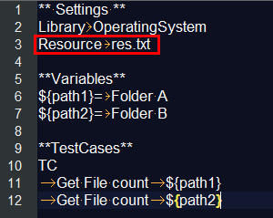
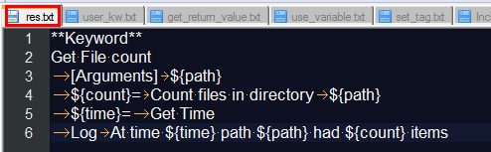
Resource File
User keywords and variables in test case files and test suite initialization files can only be used in files where they are created, but resource files provide a mechanism for sharing them.

Slide 32
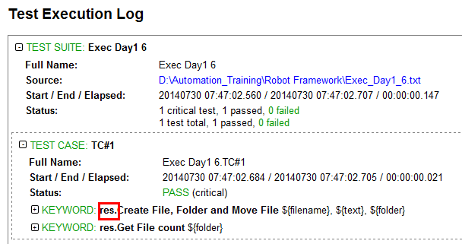
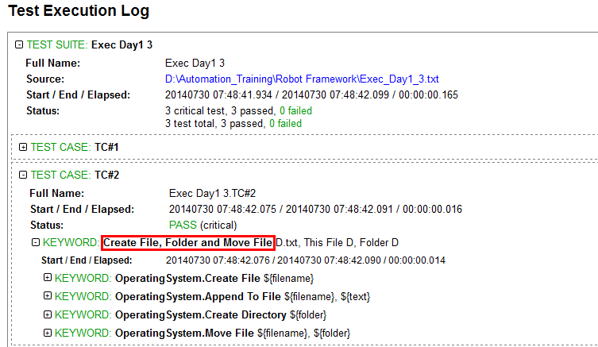
Resource File

Slide 33
Course Overview
0. Course Overview
7. Settings & Variables
1. Parking Calculator
8. User Keywords
2. Test Automation Framework
9. Resource Files
3. Keyword-Driven Testing
10. Loops
4. Robot Framework Overview
11. Selenium2Library
5. Creating Test Data
12. Templates
6. Creating Test Cases

Slide 34
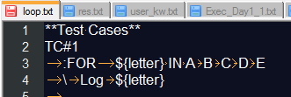
LOOPS
In a normal For loop, one variable is assigned from a list of values, one value per iteration. The syntax starts with :FOR, where colon is required to separate the syntax from normal keywords. The next cell contains the loop variable, the subsequent cell must have IN, and the final cells contain values over which to iterate.
Normal Loop

Slide 35
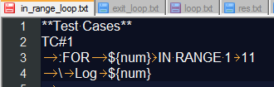

LOOPS
IN RANGE
Loop indexes start from one and increase by one until, but excluding, the limit. It is also possible to give both the start and end limits. Then indexes start from the start limit, but increase similarly as in the simple case. Finally, it is possible to give also the step value that specifies the increment to use
Loops over odd numbers between 1 to 20:

Slide 36
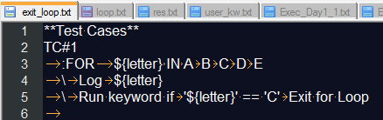
LOOPS
Exiting for loop
Normally for loop is executed until all the elements of the loop have been looped through or an error occurs and the test case or keyword fails. However sometimes execution of a for loop needs to be stopped before all elements of the loop have been gone through.

Slide 37
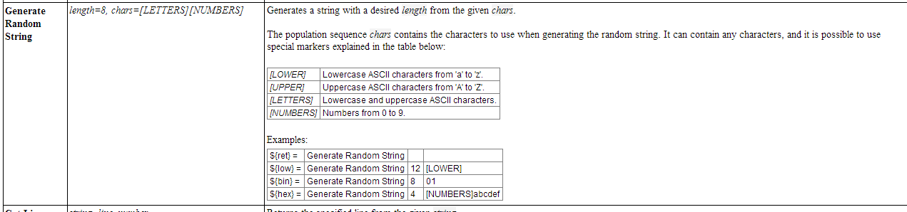
Exercise
Implement the following:
1.1 Create a keyword which generates random employee name (firstname lastname)
e.g. abcd efgh (Use Generate Random String) – String Library
Place keyword in res.txt
1.2 Create a test case which calls the keyword in 1.1 and creates folder
for 5 employees using the format lastname-firstname. Use Loops
1.3 In each folder, create a file with format lastname.txt containing “I am firstname”

Slide 38
Course Overview
0. Course Overview
7. Settings & Variables
1. Parking Calculator
8. User Keywords
2. Test Automation Framework
9. Resource Files
3. Keyword-Driven Testing
10. Loops
4. Robot Framework Overview
11. Selenium2Library
5. Creating Test Data
12. Templates
6. Creating Test Cases

Slide 39
END OF DAY 1
Manual Exploratory testing of ParkCalc
Identify at least 10 Test Cases
At least 5 PASSED & 5 FAILED

Slide 40
Test Libraries
BuiltIn
http://robotframework.googlecode.com/hg/doc/libraries/BuiltIn.html?r=2.7.6
String
https://robotframework.googlecode.com/hg-history/2.1.3/doc/libraries/String.html
Operating System
http://robotframework.googlecode.com/svn/trunk/doc/libraries/OperatingSystem.html
Selenium
http://rtomac.github.io/robotframework-selenium2library/doc/Selenium2Library.html?r=1.1.0#Introduction

Slide 41
Thank you
Roberto Galman
roberto.galman@ngahr.com

Slide 42
Appendix

Slide 43
References
http://www.ranorex.com/blog/keyword-driven-test-automation-framework
https://twiki.cern.ch/twiki/bin/view/EMI/RobotFrameworkAdvancedGuide
https://blog.codecentric.de/en/2012/03/robot-framework-tutorial-overview/
http://www.virtuousprogrammer.com/?p=264
http://www.shino.de/2010/06/20/parkcalc-automation-getting-started/
http://robotframework.googlecode.com

