Slide 1
Test Automation & Scripting Training using Robot Framework & Selenium (DAY 2)
roberto.galman@ngahr.com
July 31, 2014

Slide 2

Course Overview
At the end of this course, You will know/have:
Basic understanding of Test Automation Frameworks
Knowledge on Keyword-driven Testing
Functional knowledge of Robot Framework including its architecture
How to use BuiltIn & Selenium Library Keywords in your test data
How to use Robot Framework & Selenium to Automate Web Application Testing
The students will be assessed by:
Automating the test cases identified by
manual exploratory testing of a Parking Calculator
Find at least 3 defects per Lot type & 2 PASSED
test case per lot type – i.e. 5 TC per Lot type
Implement using Keyword-driven & Data-driven
approach in RF (Optional)

Slide 3
Course Overview
0. Course Overview
7. Settings & Variables
1. Parking Calculator
8. User Keywords
2. Test Automation Framework
9. Resource Files
3. Keyword-Driven Testing
10. Loops
4. Robot Framework Overview
11. Selenium2Library
5. Creating Test Data
12. Templates
6. Creating Test Cases

Slide 4
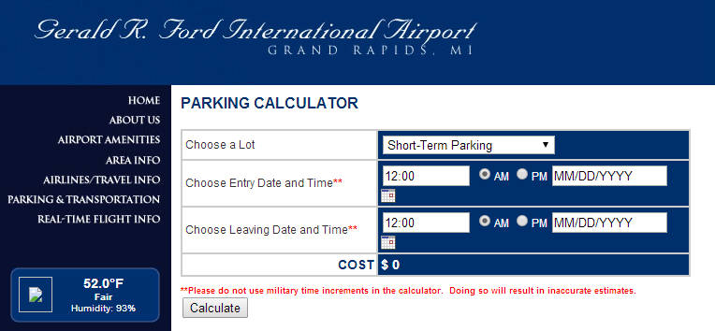
PARKING CALCULATOR
Gerald R. Ford International Airport Parking Calculator
http://www.grr.org/ParkCalc.php

Slide 5
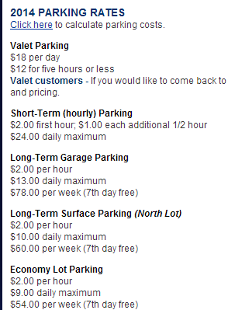
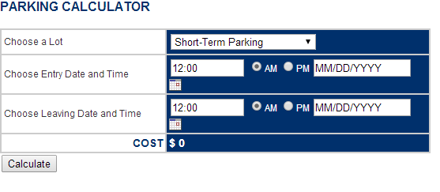
“BUGGY” PARKING CALCULATOR
http://adam.goucher.ca/parkcalc/

Slide 6

Selenium2Library
Selenium2Library is a web testing library for Robot Framework
Uses the Selenium WebDriver library internally to control a
web browser
Before running tests
Prior to running test cases using Selenium2Library, Selenium2Library must be imported into your Robot test suite.
** Settings **
Library -> Selenium2Library
Open Browser keyword must be used to open a browser to the desired location.
** Test Case **
Launch Browser
-> Open Browser-> https://www.google.com.ph

Slide 7
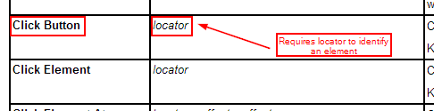
Selenium2Library
Locating elements
All keywords in Selenium2Library that need to find an element on the page take an argument, locator. By default, when a locator value is provided, it is matched against the key attributes of the particular element type – e.g. id, name
Locators can be determined by launching Firebug/Firepath and inspecting
the Element or by using Selenium IDE
Common Locators:
id
name
css
xpath

Slide 8
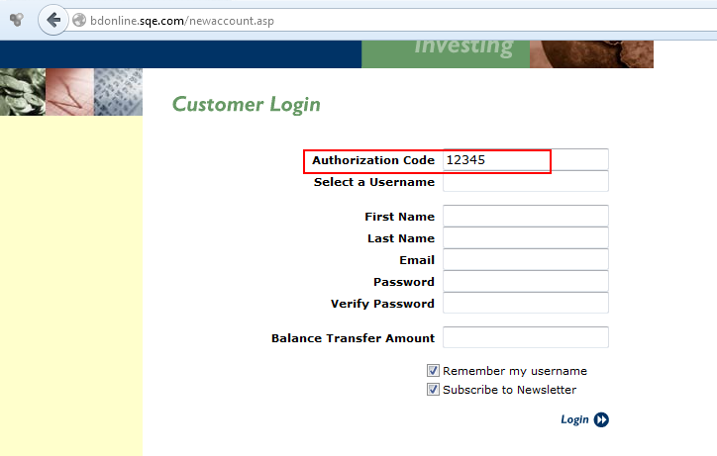
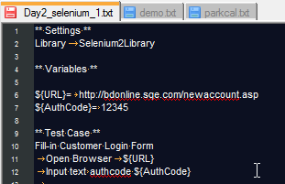
Selenium2Library
Selenium Keywords :
http://rtomac.github.io/robotframework-selenium2library/doc/Selenium2Library.html
Example:
Go to http://bdonline.sqe.com/newaccount.asp
Set All the fields. You may assign a value for each field from a variable.

Slide 9
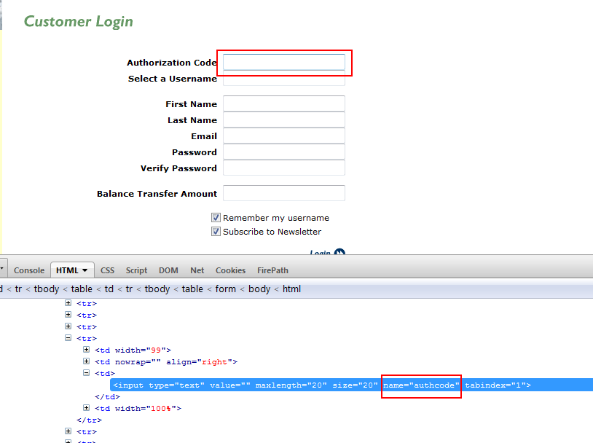
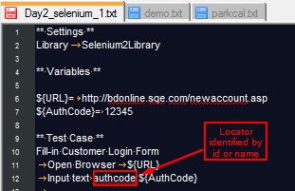
Locators

Slide 10
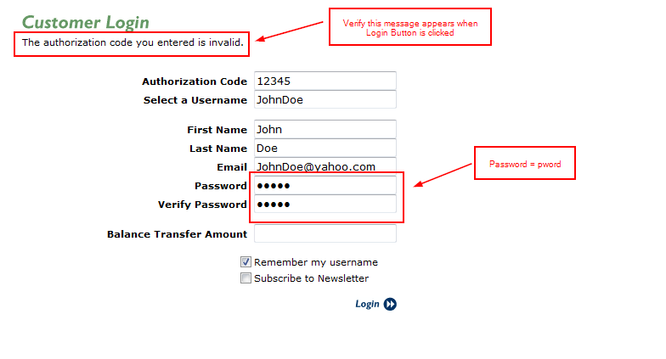
Exercises
Create test script that will verify the error message on Login. Use the values
below for each field. Use variables & add “Capture Page Screenshot” to get
screenshot during run time

Slide 11
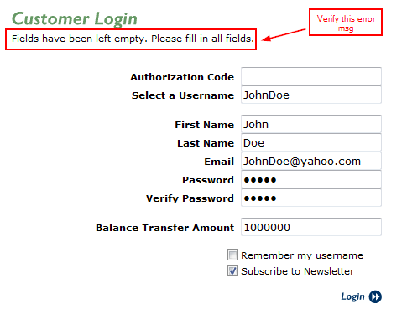
Exercise
2. Create test script that will verify the error message on Login. Use the values
below for each field. Use variables & add “Capture Page Screenshot” to get
screenshot during run time

Slide 12
Exercise
Create a keyword – “Fill-in Registration Form – Empty Fields”. This function will have
10 input arguments representing each field in the form including the 2 checkboxes
(ON/OFF)
3.1 Create the Keyword
3.2 Create Test Case name “No Authorization Code”
3.3 In the Test Case in 3.2, call the keyword and set Authorization Code value to
${EMPTY} while setting the other field values similar to exercise 2.
Use variables to assign value to the fields
3.4 Verify that the Error appears as part of the Keyword

Slide 13
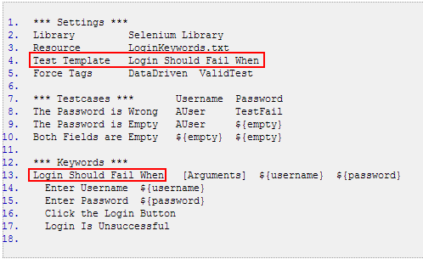
Data-driven Tests
Data driven tests are designed to repeatedly run the same test with changes in the data is being used for inputs. This allows the person writing the tests to create a large number of tests scenarios with minimal effort.
Robot Framework has a special setting called Test Template
that lets you create files that are dedicated to Data Driven test suites:

Slide 14
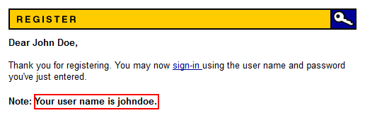
Exercise
Use the keyword in Exercise 3: “Fill-in Registration Form” as test template.
Create multiple testcases using data driven approach when:
4.1 Firstname is Empty
4.2 Lastname is Empty
4.3 Email is Empty
5. Implement the following:
5.1 Go to http://newtours.demoaut.com/mercurywelcome.php
5.2 Click Link Register
5.3 Fill-in the form as shown in the next page
5.4 Click Submit
5.5 Verify that registration is successful

Slide 15
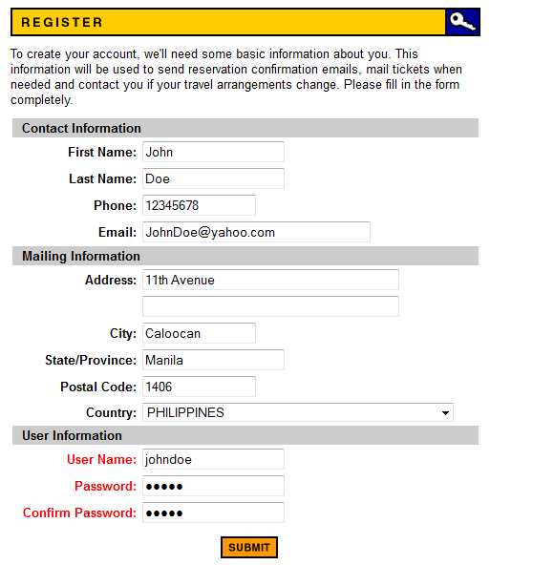
Exercise

Slide 16
END OF DAY 2
You may now complete
Exercise on Parking Calculator

Slide 17
Thank you
Roberto Galman
roberto.galman@ngahr.com

Slide 18
Sites to practice Web application Testing
http://newtours.demoaut.com/mercurysignon.php
http://bdonline.sqe.com/newaccount.asp

Slide 19
Test Libraries
BuiltIn
http://robotframework.googlecode.com/hg/doc/libraries/BuiltIn.html?r=2.7.6
String
https://robotframework.googlecode.com/hg-history/2.1.3/doc/libraries/String.html
Operating System
http://robotframework.googlecode.com/svn/trunk/doc/libraries/OperatingSystem.html
Selenium
http://rtomac.github.io/robotframework-selenium2library/doc/Selenium2Library.html?r=1.1.0#Introduction

Slide 20
Appendix

Slide 21
References
http://www.ranorex.com/blog/keyword-driven-test-automation-framework
https://twiki.cern.ch/twiki/bin/view/EMI/RobotFrameworkAdvancedGuide
https://blog.codecentric.de/en/2012/03/robot-framework-tutorial-overview/
http://www.virtuousprogrammer.com/?p=264
http://www.shino.de/2010/06/20/parkcalc-automation-getting-started/
http://robotframework.googlecode.com

