Slide 1
Robot Framework
roberto.galman@ngahr.com
March 2, 2015

Slide 2

Course Overview
At the end of this presentation, you should be familiar with:
Basic understanding of Test Automation Frameworks
Functional knowledge of Robot Framework(RF) including its architecture
How to use BuiltIn RF & Selenium Library to Automate Web Application Testing
For your practice:
Automate the test cases identified by
manual exploratory testing of a Parking Calculator

Slide 3
Course Overview
0. Course Overview
7. Settings & Variables
1. “Buggy” Parking Calculator
8. User Keywords
2. Test Automation Framework
9. Resource Files
3. Keyword-Driven Framework
10. Selenium2Library
4. Robot Framework Overview
5. Creating Test Data
6. Creating Test Cases

Slide 4
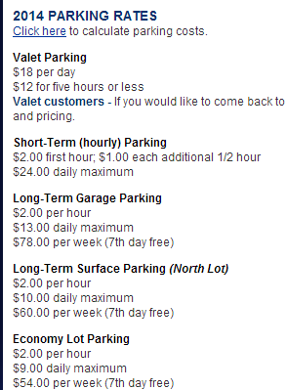
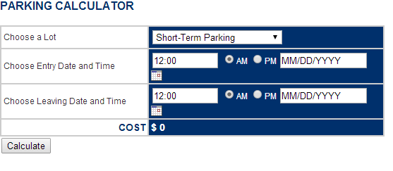
“BUGGY” PARKING CALCULATOR
Gerald R. Ford International Airport Parking Calculator
http://adam.goucher.ca/parkcalc/

Slide 5
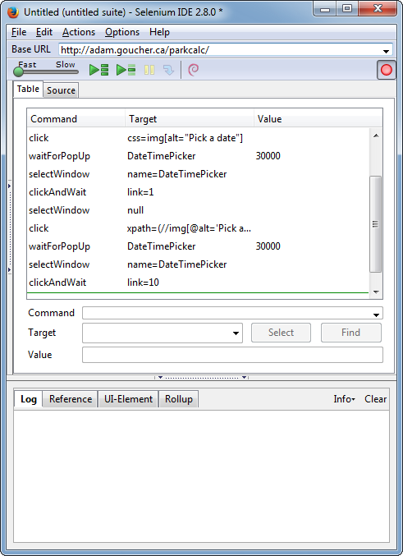



How do you Automate the ParkingCalc Tests?
Record & Playback Tool

Slide 6
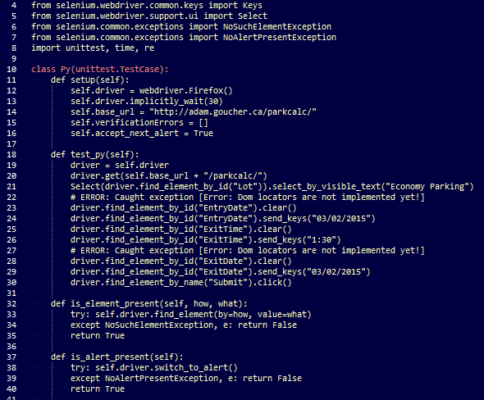

Learn the Recording Tool Language
Convert the Recorded Tests to a Code

Slide 7



Learn the Recording Tool Language
Page changes, build breaks! e.g. Workflow
Test code is written like Production Code
If Build breaks, it will be difficult to
maintain & probably, end up dropping the automated test script!

Slide 8
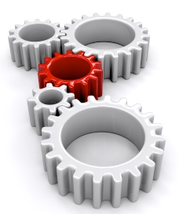


What can we do?
Test Automation Framework
WebApp
Tests
I can Fix it!!
Reduce Complexity of Test Script:
Non-Technical members of the organization can understand the tests
If the Build breaks, it is easier to identify & fix the issue
Easy to increase number of Test scripts & Automation coverage

Slide 9
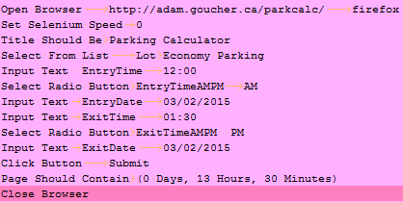
Test Script Comparison
Test → WebApp:
Test → TAF → WebApp:

Slide 10
Test Automation Framework Architecture
Tests
Test Automation Framework
Selenium
WebApp
Each layer only interacts to the layer immediately below it

Slide 11
TEST AUTOMATION FRAMEWORK
Test Automation Framework
Test Automation Frameworks can be:
Module-Driven
Data-Driven
Keyword-Driven
Hybrid
Defined Format
Execute the test
Drive the Application
Report the results
Test Libraries

Slide 12
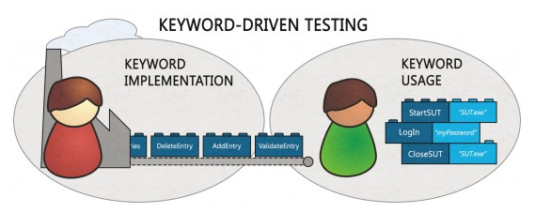
KEYWORD-DRIVEN TEST Framework
Keyword Driven Test Framework – uses self-explanatory keywords to describe the action to be performed on the Application under test
Keyword Hierarchy
High-Level Keywords - keyword to test an aspect of the business logic of SUT
Lower-level Keywords - breakdown High-level to a decent size for modularity
& reusability
Technical Keywords - technical implementation of the keywords

Slide 13
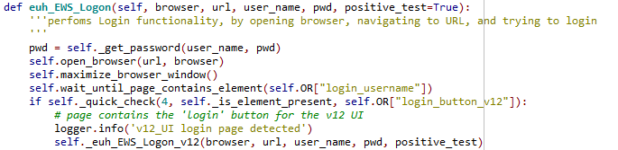
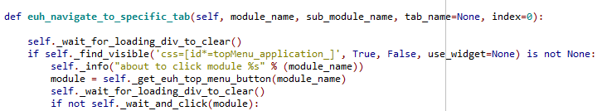
KEYWORD Hierarchy
Login and Navigate
Params: URL, user, pword, menu
Login
Params: URL, user, pword
euh EWS Logon
Params: URL, user, pword
Navigate
Params: module,submodule
euh navigate to specific tab
Params: module,submodule

Slide 14
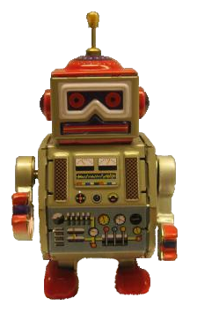
ROBOT FRAMEWORK
Generic Test Automation Framework utilizing Keyword-driven testing approach
Operating System & Application Independent
Implemented in Python
Can be extended natively using Java or Python
Free and Open Source
Hosted on GitHub
Sponsored by Nokia Networks

Slide 15
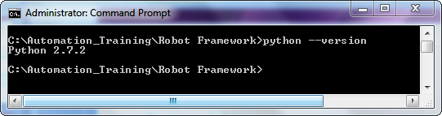
ROBOT FRAMEWORK INSTALLATION
PRECONDITION:
Python 2.7.X
To verify Installation:
> python --version
To install Robot Framework:
If you have “setup_tools” installed, you can use “easy_install” to install “pip” then:
> pip install robotframework
We’ll also be using Selenium Library:
> pip install selenium

Slide 16
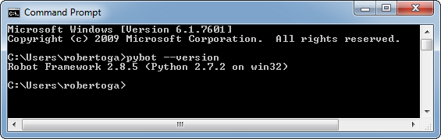
ROBOT FRAMEWORK INSTALLATION
To check robot framework installation:
> pybot --version

Slide 17
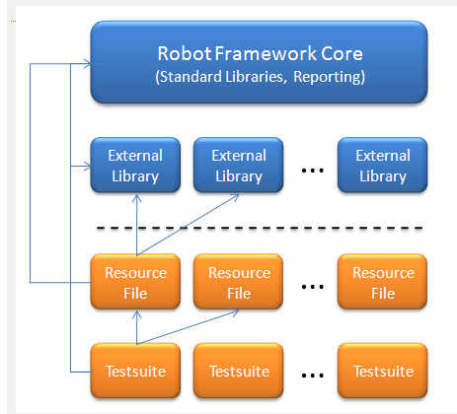
ROBOT FRAMEWORK OVERVIEW
Technical Keywords
3rd Party , User Libraries
HL/LL Keywords
Actual Test Cases

Slide 18
ROBOT FRAMEWORK STRUCTURE
Item | Description
Testsuite | Tests are created from Testsuites. Testsuites are created from Tables
Resource Files | This is where High-level/Low-level keywords can be defined for modularity and reusability
Test Library | This is where technical keywords are defined. It can refer to builtIn, third-party, & user developed libraries.

Slide 19
Creating Test Data
Supported File Formats
Robot Framework test data is defined in tabular format, using:
hypertext markup language (HTML)
tab-separated values (TSV)
plain text(TXT)
Robot Framework selects a parser for the test data based on the file extension. The extension is case-insensitive, and the recognized extensions are .html, .htm and .xhtml for HTML, .tsv for TSV, and .txt for plain text

Slide 20
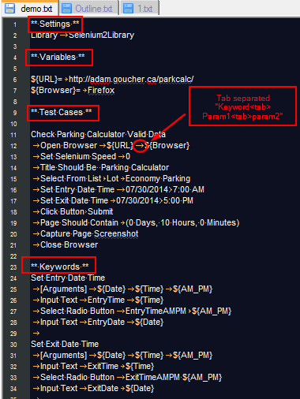
Creating Test Data
Sample Test Case File

Slide 21
Creating Test Data
Test Data Tables
Test data is structured in four types of tables listed below. These test data tables are identified by the first cell of the table, and the last column in the table below lists different aliases that can be used as a table name.
Table name | Used for | Aliases
Settings | Importing test libraries, resource files | Setting, Settings, Metadata
Variable | Defining variables that can be used elsewhere in the test data | Variable, Variables
Test cases | Creating test cases from available keywords | Test Case, Test Cases
Keyword | Creating user keywords from existing lower-level keywords | Keyword, Keywords, User Keyword, User Keywords

Slide 22
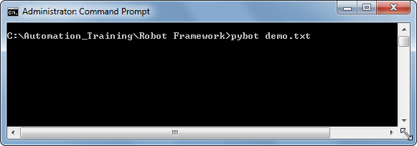
Creating Test Data
For the plain text format, test data tables are recognized from one or more asterisks ( ), followed by a normal table name and an optional closing asterisks.
Executing Robot Framework Test Cases
To run the tests in “demo.txt" navigate to the directory that contains it in the command line and type:

Slide 23
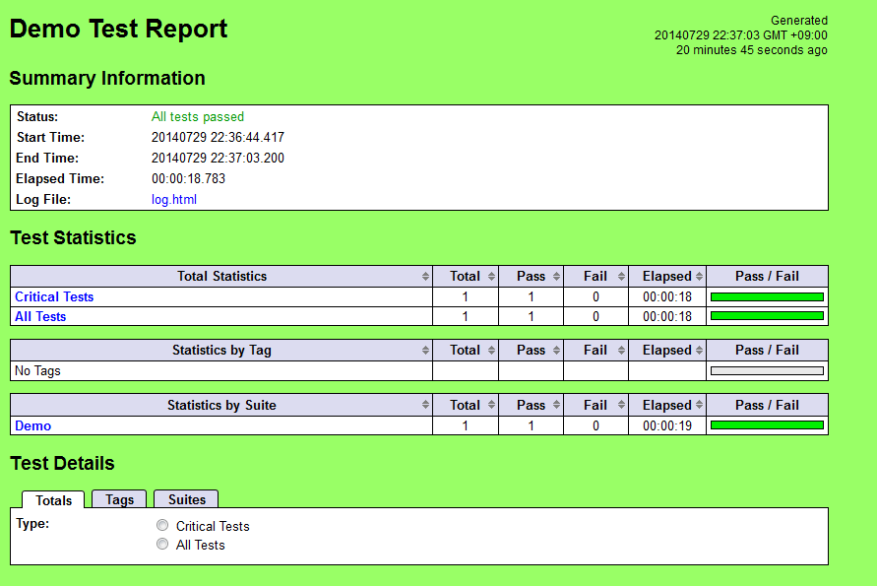
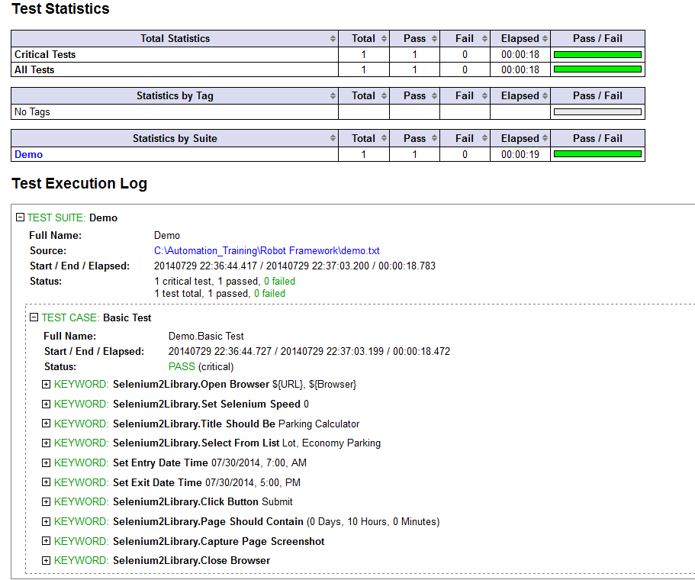
Creating Test Data
Reading the Results
Robot Framework will generate report.html & log.html in the current directory showing the results of the execution

Slide 24
Creating Test Data
Structure
The hierarchical structure for arranging test cases is built as follows:
Test cases are created in test case files.
A test case file automatically creates a test suite containing the test cases in that file.
A directory containing test case files forms a higher-level test suite. Such a test suite directory has suites created from test case files as its sub test suites
A test suite directory can also contain other test suite directories, and this hierarchical structure can be as deeply nested as needed

Slide 25
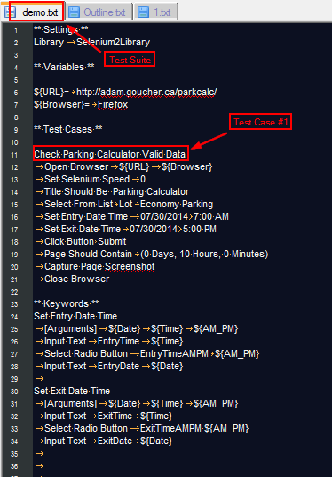
Creating Test Data

Slide 26
Using Test Libraries in Settings Table
Using Custom Libraries
Test libraries contain those lowest-level keywords, often called technical keywords, which actually interact with the system under test.
To import a Library in the Test Data:
** Settings **
Library | Selenium2Library
# Here “|” or pipe character represents a tab for plain txt format
Standard Libraries
Some test libraries are distributed with Robot Framework and these libraries are called standard libraries. These are the available standard libraries:
BuiltIn
OperatingSystem
String
Dialogs

Slide 27
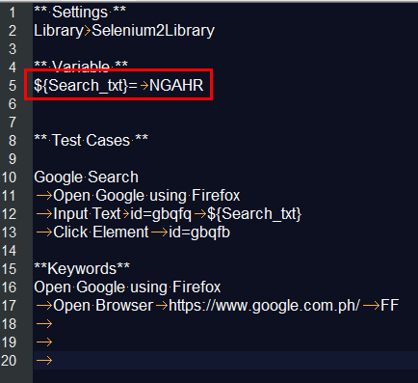
Using Scalar Variables
When scalar variables are used in the test data, they are replaced with the value they are assigned to.

Slide 28
Creating a Test Case
Basic Syntax
Test cases are constructed in test case tables from the available keywords. Keywords can be imported from:
test libraries
resource files
or created in the keyword table of the test case file itself.
Tagging Test Cases
Using tags in Robot Framework is a simple, yet powerful mechanism for classifying test cases.
Tags are shown in test reports, logs and, of course, in the test data
Statistics about test cases (total, passed, failed are automatically collected based on tags).
With tags, you can include or exclude test cases to be executed.
To use tags, Add [TAGS] <tagname> in your TestCase

Slide 29

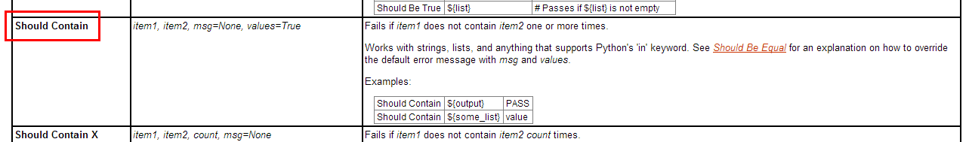

Examples
Test Case Table Only (Using BuiltIn Library) :
tconly.txt
Including Library:
UseLibrary.txt

Slide 30
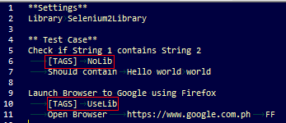
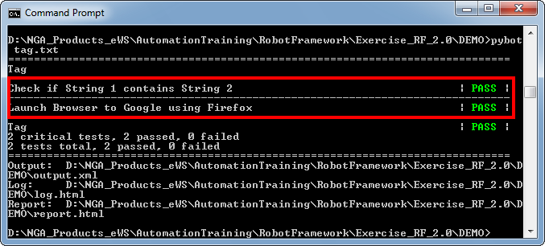
Examples
Using Tags:
Tag.txt

Slide 31
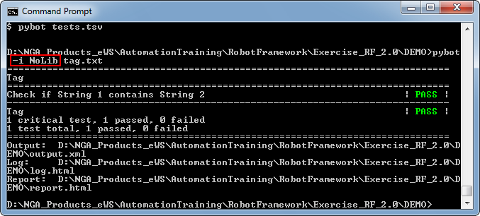
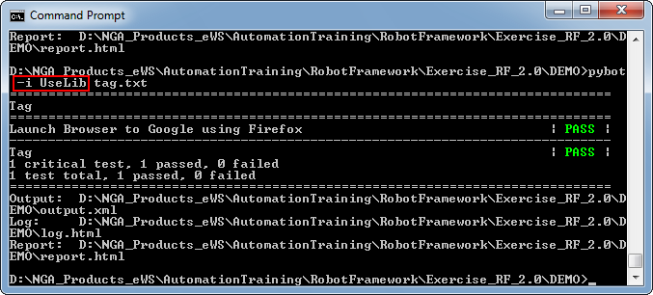
Examples

Slide 32
User Keywords
In many ways, the overall user keyword syntax is identical to the test case syntax. User keywords are created in keyword tables which differ from test case tables only by the name that is used to identify them. You can define Keywords from the Resource File or from the TestCase itself.
User Keyword Arguments
Arguments are normally specified with the [Arguments] setting, and argument names use the same syntax as variables, for example ${arg}.
Return Values
Return values are defined with the [Return] setting. The values can then be assigned to variables in test cases or other user keywords.

Slide 33
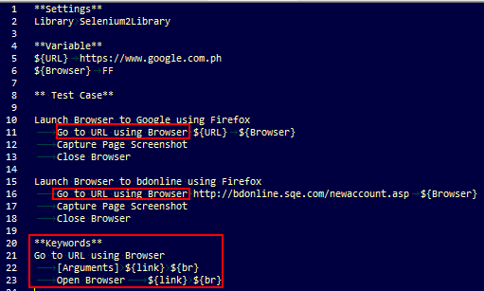
Examples
Using user keywords
keyword.txt:

Slide 34
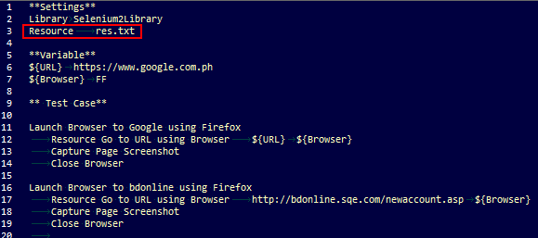

Resource File
User keywords and variables in test case files and test suite initialization files can only be used in files where they are created, but resource files provide a mechanism for sharing them.
res_keyword.txt
res.txt

Slide 35

Selenium2Library
Selenium2Library is a web testing library for Robot Framework
Uses the Selenium WebDriver library internally to control a
web browser
Before running tests
Prior to running test cases using Selenium2Library, Selenium2Library must be imported into your Robot test suite.
** Settings **
Library -> Selenium2Library
Open Browser keyword must be used to open a browser to the desired location.
** Test Case **
Launch Browser
-> Open Browser-> https://www.google.com.ph

Slide 36
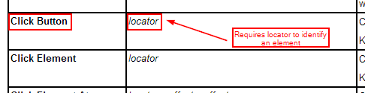
Selenium2Library
Locating elements
All keywords in Selenium2Library that need to find an element on the page take an argument, locator. By default, when a locator value is provided, it is matched against the key attributes of the particular element type – e.g. id, name
Locators can be determined by launching Firebug/Firepath and inspecting
the Element or by using Selenium IDE
Common Locators:
id
name
css
xpath

Slide 37
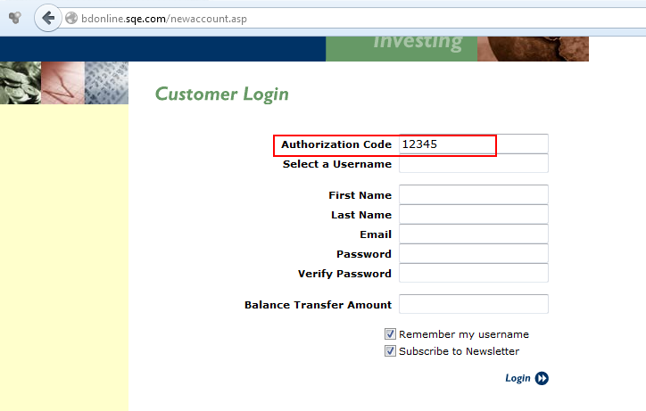
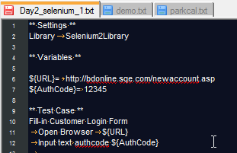
Selenium2Library
Selenium Keywords :
http://rtomac.github.io/robotframework-selenium2library/doc/Selenium2Library.html
Example:
Go to http://bdonline.sqe.com/newaccount.asp
Set All the fields. You may assign a value for each field from a variable.

Slide 38
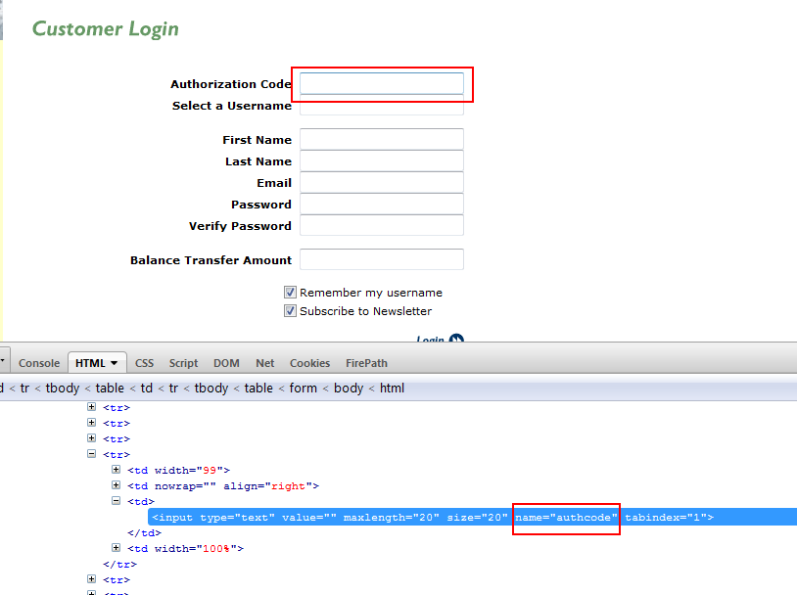
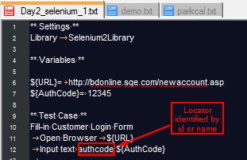
Locators

Slide 39
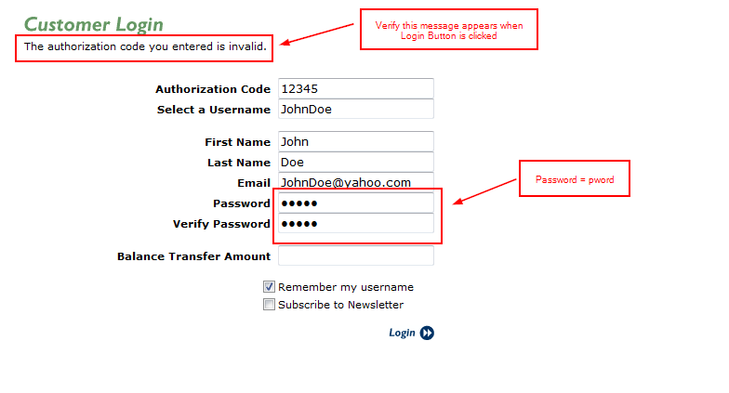
Exercises
Create test script that will verify the error message on Login. Use the values
below for each field. Use variables & add “Capture Page Screenshot” to get
screenshot during run time

Slide 40
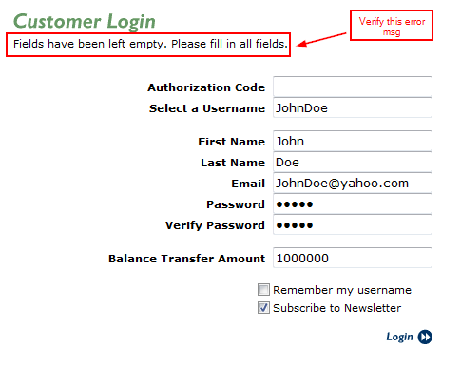
Exercise
2. Create test script that will verify the error message on Login. Use the values
below for each field. Use variables & add “Capture Page Screenshot” to get
screenshot during run time

Slide 41
Exercise
Create a keyword – “Fill-in Registration Form”. This function will have
10 input arguments representing each field in the form including the 2 checkboxes
(ON/OFF)
3.1 Create the Keyword
3.2 Create Test Case name “No Authorization Code”
3.3 In the Test Case in 3.2, call the keyword and set Authorization Code value to
${EMPTY} while setting the other field values similar to exercise 2.
Use variables to assign value to the fields
3.4 Verify that the Error is displayed

Slide 42
Course Overview
0. Course Overview
7. Settings & Variables
1. “Buggy” Parking Calculator
8. User Keywords
2. Test Automation Framework
9. Resource Files
3. Keyword-Driven Framework
10. Selenium2Library
4. Robot Framework Overview
5. Creating Test Data
6. Creating Test Cases

Slide 43
Thank you
Roberto Galman
roberto.galman@ngahr.com

Slide 44
Appendix

Slide 45
Test Libraries
BuiltIn
http://robotframework.googlecode.com/hg/doc/libraries/BuiltIn.html?r=2.7.6
String
https://robotframework.googlecode.com/hg-history/2.1.3/doc/libraries/String.html
Operating System
http://robotframework.googlecode.com/svn/trunk/doc/libraries/OperatingSystem.html
Selenium
http://rtomac.github.io/robotframework-selenium2library/doc/Selenium2Library.html?r=1.1.0#Introduction

Slide 46
References
http://www.ranorex.com/blog/keyword-driven-test-automation-framework
https://twiki.cern.ch/twiki/bin/view/EMI/RobotFrameworkAdvancedGuide
https://blog.codecentric.de/en/2012/03/robot-framework-tutorial-overview/
http://www.virtuousprogrammer.com/?p=264
http://www.shino.de/2010/06/20/parkcalc-automation-getting-started/
http://robotframework.googlecode.com
https://www.youtube.com/watch?v=DO8KVe00kcU

