Slide 1
TCP LOAD BALANCER
Distributed System Design Using Least-Connections Algorithm
Computer Networks Project | B.E. Semester VI

Slide 2
Problem Statement
• A single server handling all client requests creates a bottleneck
• If that server fails, all clients lose service (single point of failure)
• As traffic grows, one server cannot scale to meet demand
Objective:
• Build a central load balancer that distributes clients across worker servers
• Implement the Least-Connections algorithm for intelligent routing
• Demonstrate distributed system design principles using TCP sockets in C

Slide 3
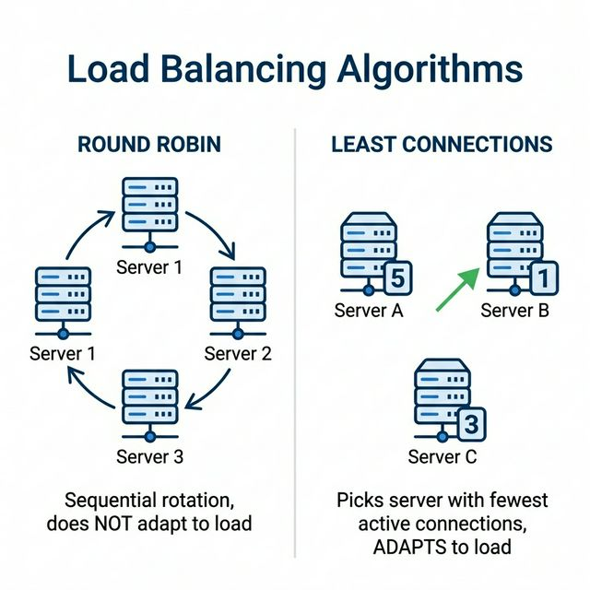
What is Load Balancing?
Load balancing distributes network traffic across
multiple servers to prevent overload on any single one.
Benefits:
• Reliability — if one server fails, others continue
• Scalability — add more servers as traffic grows
• Performance — requests served faster
Used by: Google, Amazon, Netflix, and every
large-scale web service.

Slide 4
Least-Connections Algorithm
The load balancer tracks the number of active connections on each worker.
When a new client arrives, it routes to the worker with the FEWEST active connections.
Why it's better than Round-Robin:
Feature | Round-Robin | Least-Connections
Selection | Sequential rotation | Fewest active connections
Adapts to load? | No | Yes
Handles slow clients? | Poorly | Well
Complexity | O(1) | O(n) — still fast

Slide 5
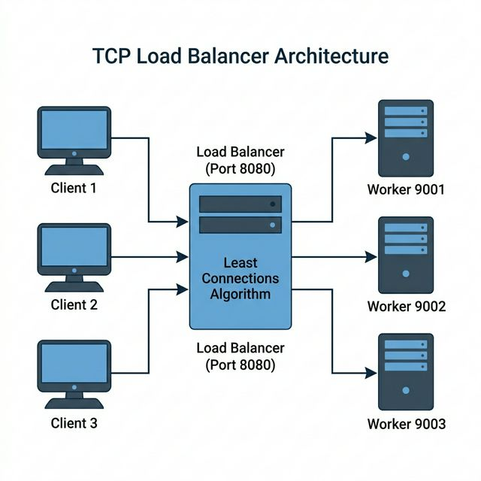
System Architecture

Slide 6
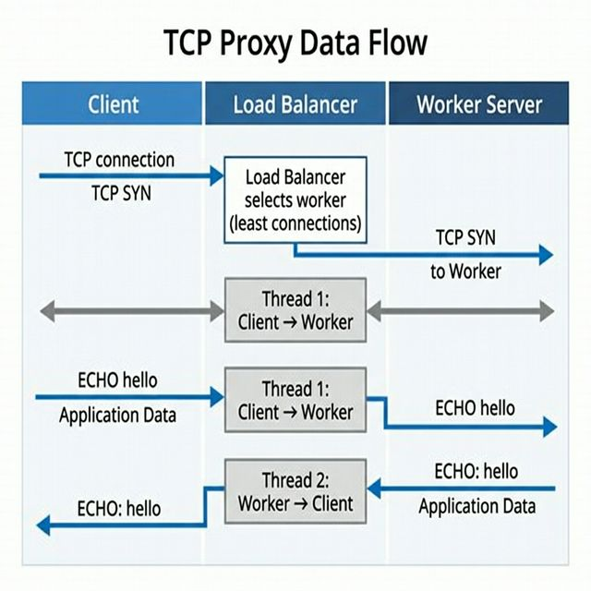
TCP Proxy — Data Flow
Step-by-step flow:
1. Client connects to Load Balancer (port 8080)
2. LB selects worker with fewest connections
3. LB opens TCP connection to chosen worker
4. Two relay threads are spawned:
• Thread 1: Client → Worker
• Thread 2: Worker → Client
5. Data flows transparently in both directions
6. On disconnect, worker's count is decremented

Slide 7
Fault Tolerance & Failure Recovery
Resilient Design:
• Transparent Failover:
If a worker server crashes mid-session, the client is seamlessly re-routed to
the next healthy worker without the client needing to reconnect manually.
• Proactive Health Checks:
The load balancer periodically probes 'DOWN' workers and automatically marks
them as 'ALIVE' when they come back online.
• Auto-spawning Workers:
The load balancer automatically spawns the required number of background
worker processes upon startup using process creation APIs.

Slide 8
Implementation — File Structure
File | Purpose | Key Feature
common.h | Cross-platform abstractions | Socket, thread, mutex wrappers
load_balancer.c | Central load balancer | Least-connections routing + TCP proxy
worker_server.c | Backend worker server | ECHO / TIME / UPPER / QUIT service
client.c | Interactive test client | Async receive thread + stdin input
Makefile | Build system | Windows (Winsock) + Linux (POSIX)

Slide 9
Key Code — Worker Selection
How it works:
1. Acquire mutex lock for thread safety
2. Scan all workers to find the one
with fewest active_conns
3. Increment that worker's count
4. Release mutex and return index
Time complexity: O(n)
where n = number of workers
Thread-safe via mutex lock
static int select_worker(void) { int best, i; MUTEX_LOCK(worker_mutex); best = 0; for (i = 1; i < num_workers; i++) { if (workers[i].active_conns < workers[best].active_conns) best = i; } workers[best].active_conns++; workers[best].total_served++; MUTEX_UNLOCK(worker_mutex); return best; }

Slide 10
Key Concepts
TCP (Transmission Control Protocol)
Multi-Threading
• Connection-oriented protocol
• 3-way handshake (SYN → SYN-ACK → ACK)
• Reliable, ordered delivery
• Stream-oriented byte transfer
• Used for all communication in this project
• Functions: socket(), bind(), listen(),
accept(), connect(), send(), recv()
• Each client handled in separate thread
• Worker: 1 thread per client
• Load Balancer: 2 relay threads per session
(client→worker & worker→client)
• Mutex protects shared worker table
• Windows: CreateThread() API
• Linux: pthread_create() (POSIX)

Slide 11
Demo — How to Run
Step 1: Build
gcc -Wall -O2 -o worker_server.exe worker_server.c -lws2_32 gcc -Wall -O2 -o load_balancer.exe load_balancer.c -lws2_32 gcc -Wall -O2 -o client.exe client.c -lws2_32
Step 2: Start Load Balancer
load_balancer.exe (Terminal 1) Note: This automatically spawns the required worker processes.
Step 3: Connect Clients
client.exe (Terminal 2+) Commands: ECHO <msg> | TIME | UPPER <msg> | QUIT

Slide 12
Conclusion
This project successfully demonstrates:
• Load Balancing — distributing clients across multiple servers
• Least-Connections Algorithm — intelligent, load-aware routing
• TCP Socket Programming — reliable, connection-oriented networking
• Multi-Threaded Server Design — concurrent client handling
• Proxy Architecture — transparent bidirectional data relay
• Fault Tolerance — seamless worker failover and health checking
• Cross-Platform C Development — Windows and Linux support
The system is resilient: handles ungraceful server terminations effectively.
Thank You

