Slide 1
Project 7: Self-Driving Lab Simulator
Can RL discover the best chemical reaction conditions by itself?
Agent chooses: Temperature + Concentration
Goal: Maximise reaction yield, minimise wasted experiments
Algorithm: Tabular Q-Learning vs Random & Heuristic baselines
Notes:
Chemists normally guess-test-adjust. We replaced guessing with Q-learning.

Slide 2
Method: MDP + Q-Learning
State: (temperature, concentration) - 63 grid settings
Actions: Temp +/-10C, Concentration +/-0.3M (4 actions)
Reward: yield/100 - 0.01 per experiment
Hidden simulator: peak at 65C / 1.15M, penalty >85C, + noise
Q-learning: alpha=0.1, gamma=0.95, epsilon 1.0 -> 0.05, 800 episodes
Notes:
Agent never sees the formula - only measured yield.

Slide 3
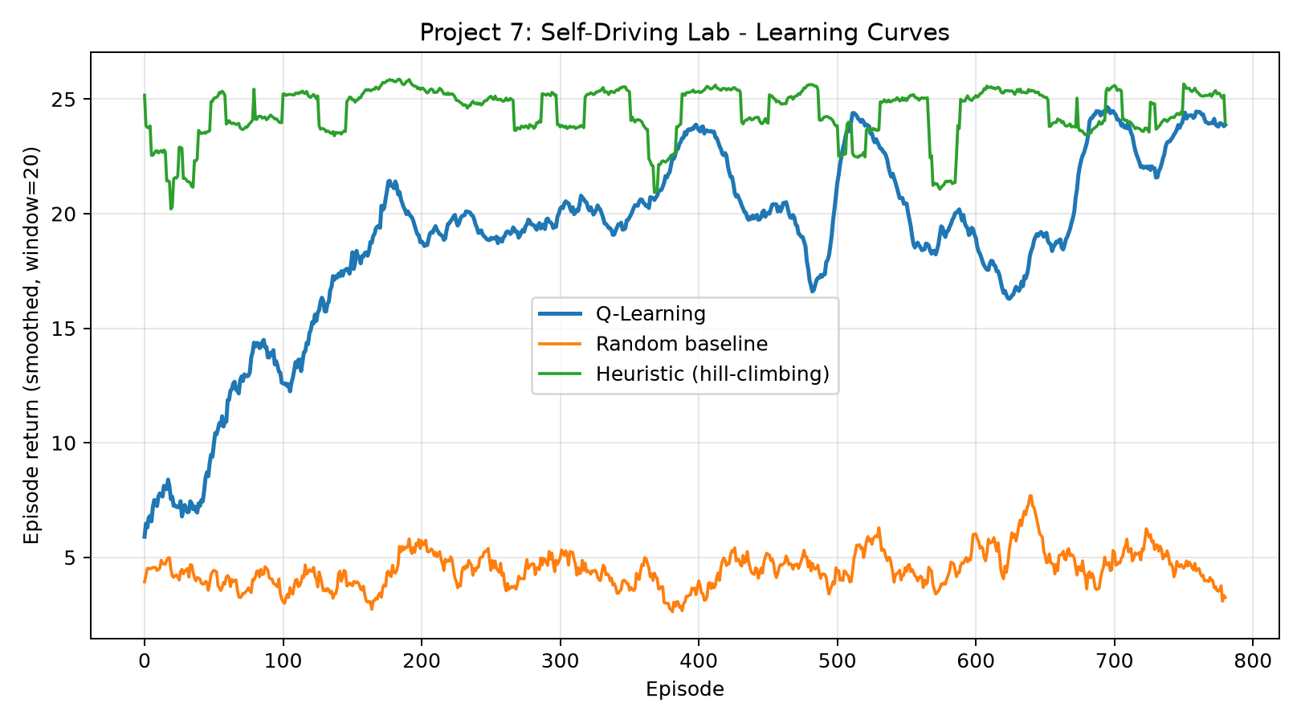
Results: Learning Curves
Q-Learning return climbs 6 -> 24 over 800 episodes
Random baseline stays flat at ~4 (never learns)
Heuristic starts high (~25) but probes 4 neighbours/step (costly)
Q-Learning catches up with a reusable, probing-free policy
Notes:
Show learning_curve.png full screen if projector allows.

Slide 4
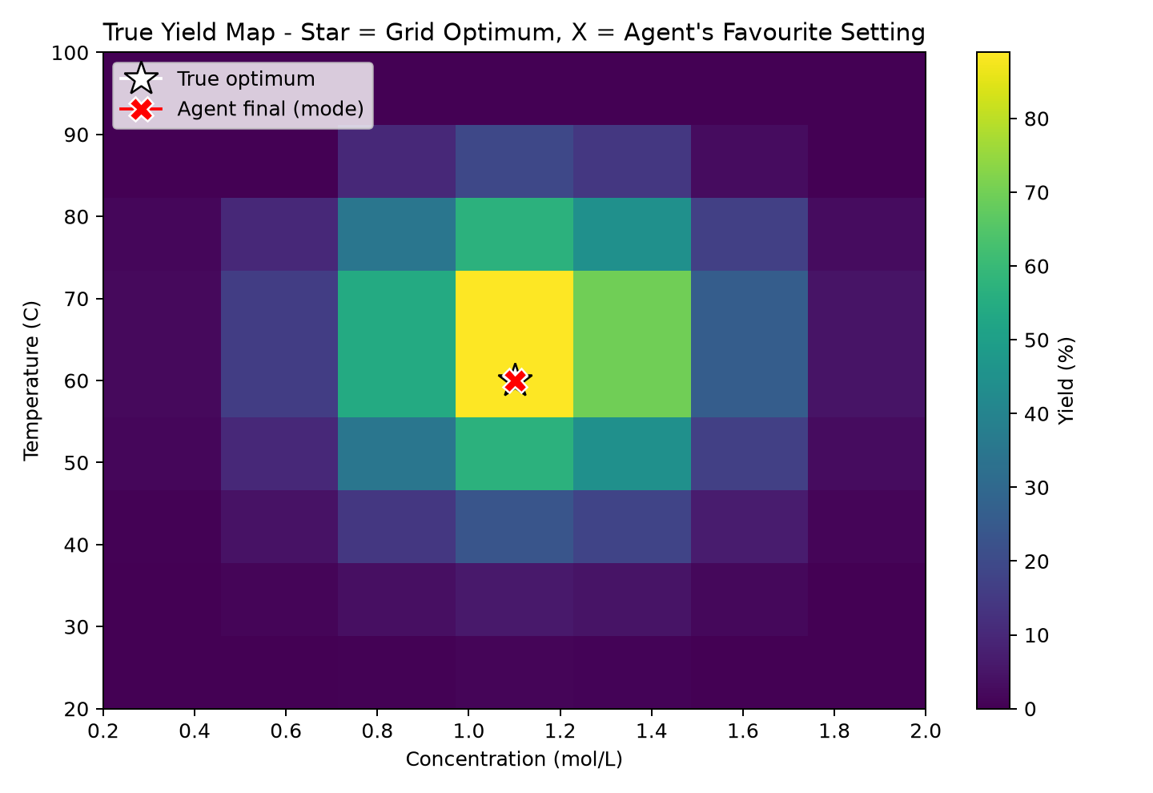
Results: Found the Optimum
Agent favourite: 60C, 1.1M = exact true grid optimum (89.0%)
Best yield: Q-Learning 91.9% | Heuristic 90.1% | Random 58.6%
Measured > true due to +/-1.5% lab noise (averaged out in eval)
Agent found the peak without ever seeing the hidden formula
Notes:
Red X lands exactly on the star - point this out, it is the money slide.

Slide 5
Limitations, Ethics & Conclusion
Limitations: 2 discrete variables only; Q-table won't scale (next: DQN/PPO)
Safety: yield-only reward could seek unsafe temps - need hard limits
Ethics: human approval before scaling any agent-found recipe
Conclusion: simplest RL turns random search into directed discovery
Notes:
Backup: why not deep learning? Only 63 states - Q-table is exact and interpretable.

