Slide 1

ALY6000- Project 4 Independent Data Analysis
Done By: - VSN Sai Krishna Mohan Kocherlakota

Slide 2
Data Cleaning
> glimpse(elec_vehicles_clean) Rows: 2,845 | Columns: 9
$ county <chr> "King", "King", "Yakima", "King", "Thurston", "Snohomish",…
$ city <chr> "Seattle", "Bothell", "Yakima", "Kirkland", "Olympia", "Ma…
$ model_year <dbl> 2020, 2022, 2023, 2018, 2018, 2020, 2017, 2020, 2018, 2023…
$ make <chr> "HYUNDAI", "JEEP", "JEEP", "TESLA", "BMW", "TESLA", "CHRYS…
$ model <chr> "KONA", "GRAND CHEROKEE", "GRAND CHEROKEE", "MODEL 3", "I3…
$ electric_vehicle_type <chr> "Battery Electric Vehicle (BEV)", "Plug-in Hybrid Electric…
$ clean_alternative_fuel_vehicle_cafv_eligibility <chr> "Clean Alternative Fuel Vehicle Eligible", "Not eligible d…
$ electric_range <dbl> 258, 25, 25, 215, 97, 266, 33, 291, 215, 0, 215, 19, 25, 2…
$ electric_utility <chr> "CITY OF SEATTLE - (WA)|CITY OF TACOMA - (WA)", "PUGET SOU…
Notes:
I have taken Electric Vehicles in Washington State from data.gov.
Cleansed the data set using janitor package using clean_names() function, slice() and subset() function. After which I have checked the data types of each columns.
Changes the model_year I have changed to year type using lubridate package, and rest of the data frame is good and doesn’t require to change the data types.

Slide 3
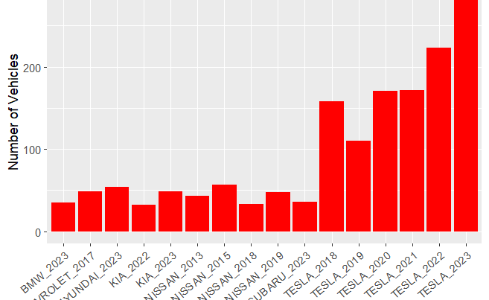
Bar Plot-1
Notes:
Created bar plot using new data set name “elec_vehicles_count” , used various functions pipeline operation, group_by(), summarise(), arrange functions, etc. in the data set used a new function using paste() function, in which combined two columns which company car(make) and which year model(model_year). Plotted bar plot using ggplot and ggeasy package. The aim of this plot is to know most purchased brand of EV in Washington, it shows us the top 6 are Tesla cars from 2018 to 2023.

Slide 4
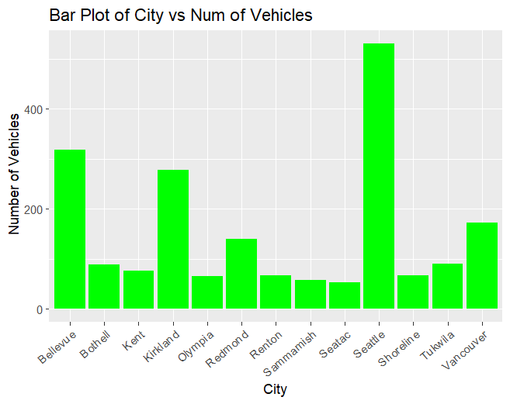
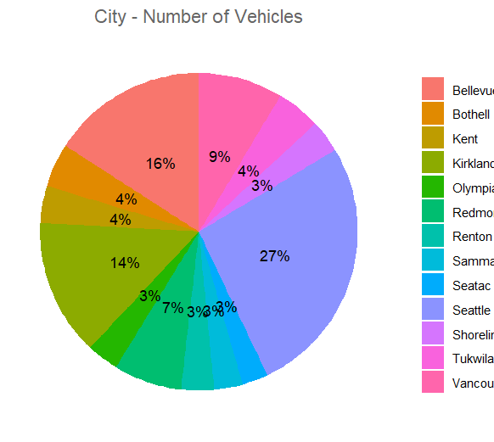
Bar Plot& Pie Chart
Notes:
Created bar plot using new data set name “elec_vehicles_city” , used various functions pipeline operation, group_by(), summarise(), arrange(), filter() functions, etc.. Plotted bar plot using ggplot and ggeasy package, taken the new dataset variables and plotted in which city highest number of electric vehicles are present, after checking the plot it seems like Seattle has more than Electric vehicles than any other city in Washington.
Created pie chart using new data set name “elec_vehicles_pie” it like “elec_vehicles_city”, used various functions pipeline operation, group_by(), summarise(), arrange(), filter() functions, etc. but in addition calculated the percent by using converting the number of vehicles into percentage. Plotted pie chart using ggplot and various other function in ggeasy() and ggthemes() package.
It is similar the bar chart above, but it shows in percentage of total vehicles in each city respective percentage.

Slide 5
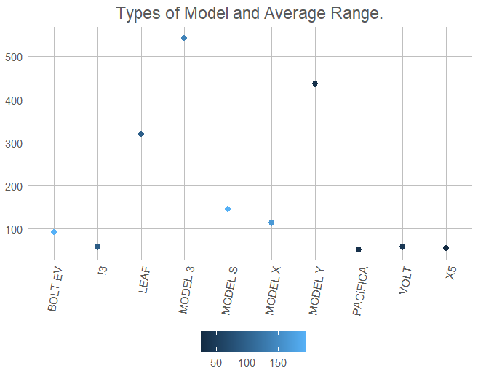
Line Chart
Notes:
Created line plot using new data set , used various functions pipeline operation, group_by(), summarise(), mean() functions, etc.
Plotted line chart using ggplot and various other function in ggeasy() and ggthemes() package. Used geom_line() and theme_excel_new() function for plotting and theme of the plot. The objective of the plot is to know most electrical range of the vehicle. Due to which I have taken the mean of all model. The Model 3 & Model Y is most efficient but seeing the plot.

Slide 6
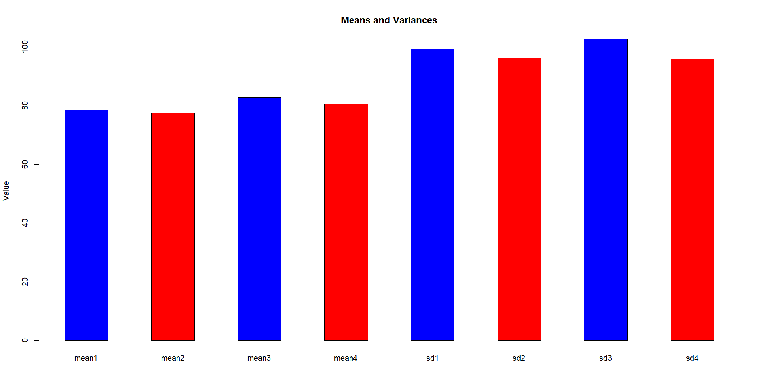
Statistical Analysis with Bar Plots
Notes:
Done few statistical analysis created sample data of 100 using set.seed() function. Calculated complete data sets mean, variance and standard deviation also samples we created and after which we have created multiple bar plots in one frame of mean and standard deviation.

Slide 7

Conculsion
In this project, I aim to understand the usage of a dataset and how to clean and change data types. I want to learn how to create data visualizations effectively, as a single dataset can offer a wealth of information in the form of charts. By analyzing, cleaning, and manipulating a single dataset, I aim to convert it into various datasets. Additionally, I want to explore how to visualize the data to derive meaningful insights.

Slide 8
Citations
Zach. (2020). How to Combine Two Columns into One in R (With Examples). Statology.
https://www.statology.org/r-combine-two-columns-into-one/
Ali, T. (2020, December 7). How to make a pie chart in R - Displayr.
https://www.displayr.com/how-to-make-a-pie-chart-in-r/
R - pie charts. (n.d.).
https://www.tutorialspoint.com/r/r_pie_charts.htm
Coder, R. (2020). Barplot in r. R CODER.
https://r-coder.com/barplot-r/
GeeksforGeeks. (2021). Multiple barplots in R. GeeksforGeeks.
https://www.geeksforgeeks.org/multiple-barplots-in-r/

