Slide 1
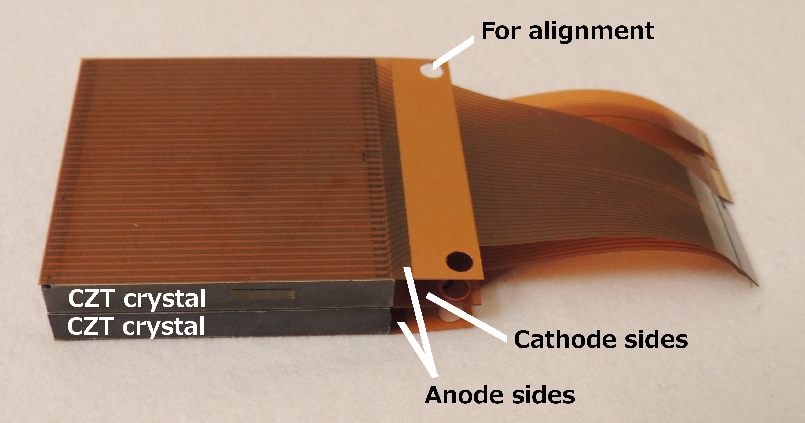
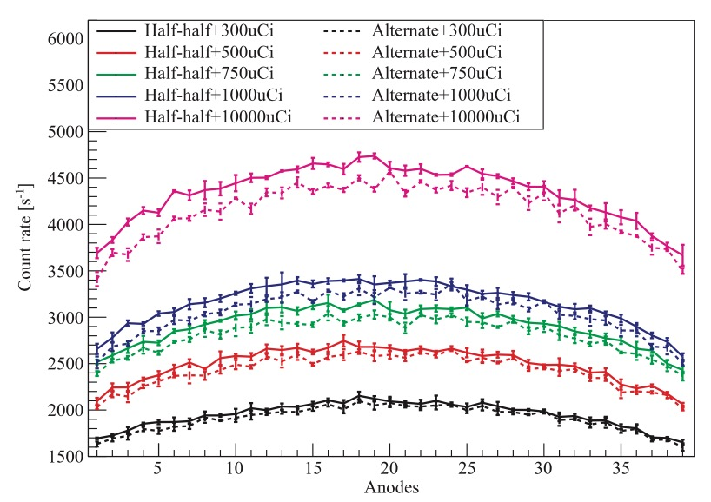
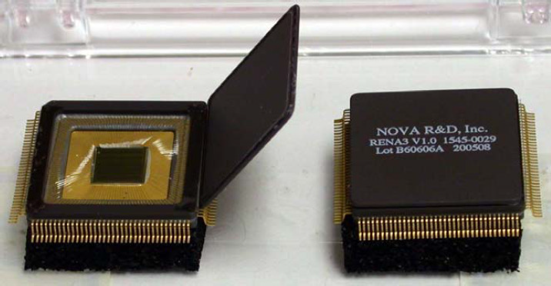
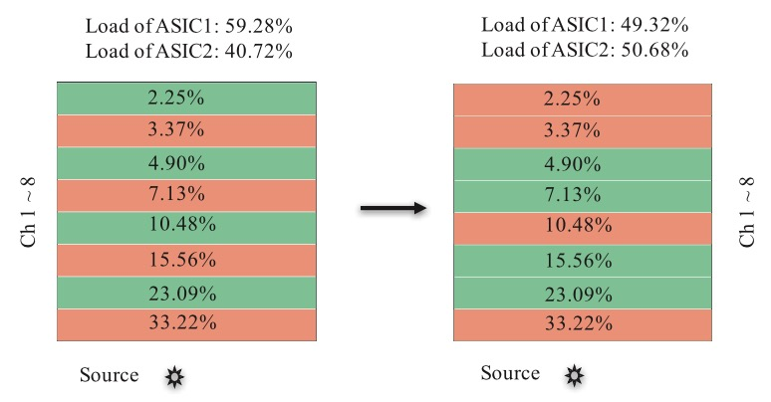
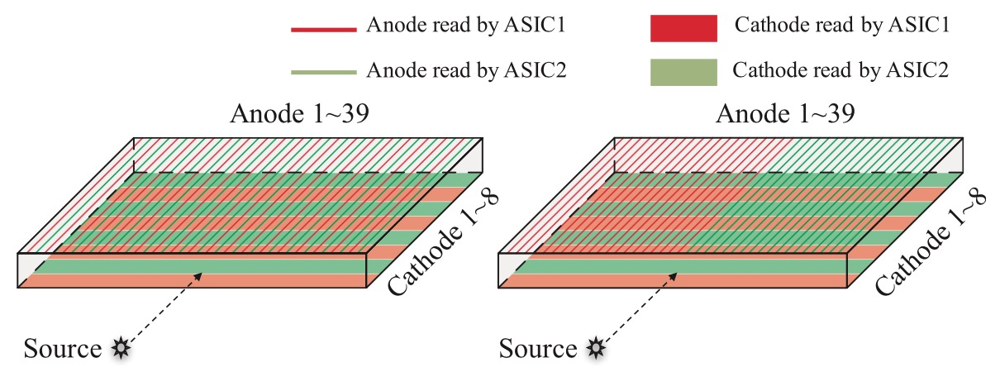
CZT detector bandwidth optimization
CZT and RENA-3 ASIC
Results
Two anode patterns
Notes:
The goal of this project is to improve the bandwidth of a cross-strip CZT detector, as shown here. One crystal has 39 anodes and 8 cathodes, while one RENA-3 ASIC only has 36 channels, thus two RENA-3 ASIC to readout its signal. I simulated the detector response in GATE and wrote a program to mimic the ASIC performance, taking Compton scattering and charge sharing into consideration. My work showed that half-half anode pattern had a larger bandwidth than alternate anode pattern and cathode pattern could be further optimized based on the load.

