Slide 1
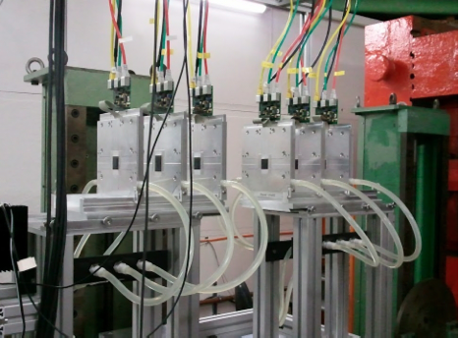
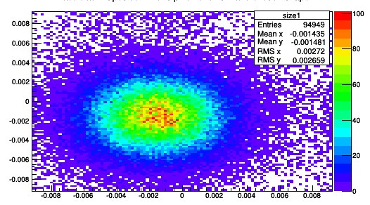
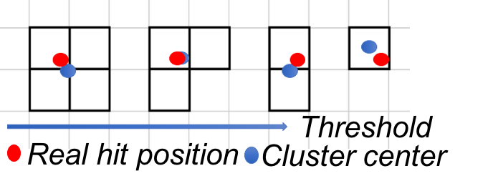

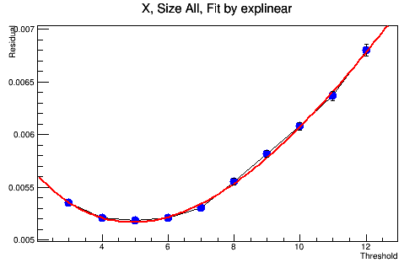
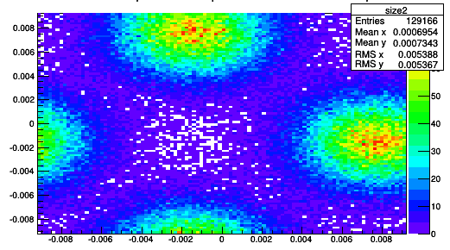
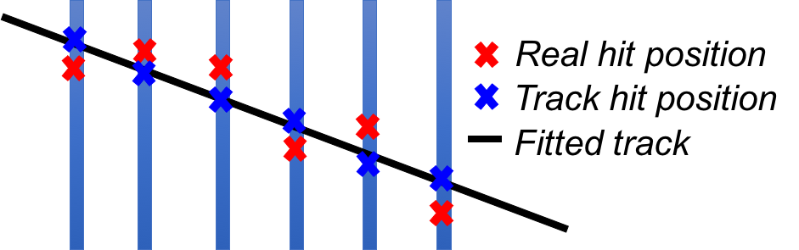


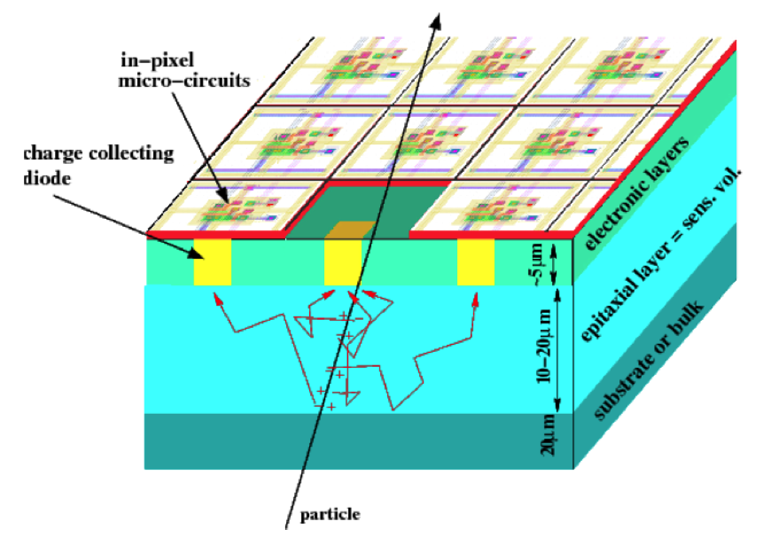
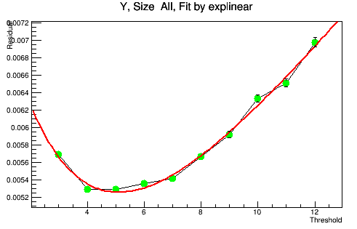
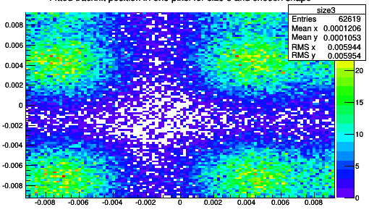
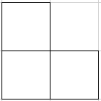
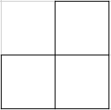
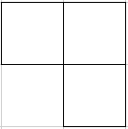
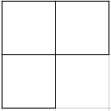
Implement particle hit error in EUTelescope
EUTelescope
Estimate hit error
Verify hit error
Notes:
Here is the telescope. It is made up of 6 sensors. When a particle hit one sensor, it will activate pixels with a specific size and shape called cluster. Because the real hit position is unknown, we assume it is located in the center of a cluster, and hit error is defined as the distance between the real hit position and cluster center. Because cluster depends on pixel activation threshold, the threshold affects the particle hit errors, and I put forward a model to describe the dependence relationship. I further check the cluster center in different clusters and verify my model.

Slide 2
Real hit position
Track hit position
Fitted track

Slide 3
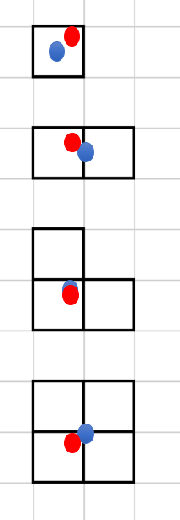
Threshold
Real hit position
Cluster center

Slide 4
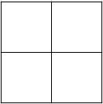
Size 1
Size 2
Size 3
Size 4

