Slide 1
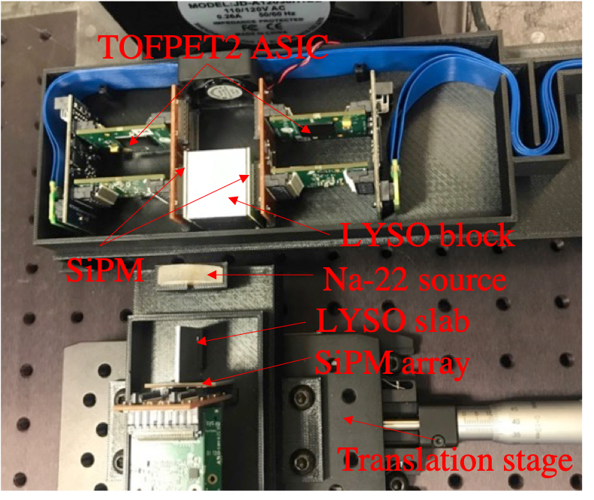
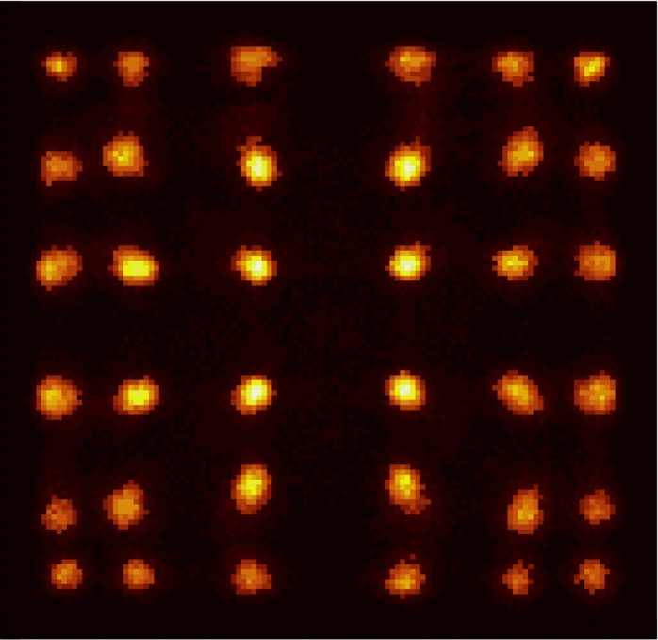
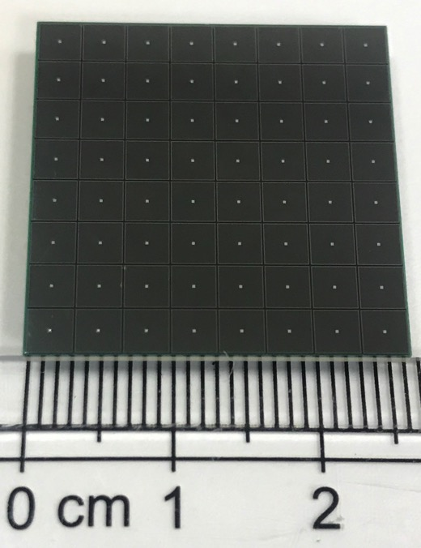
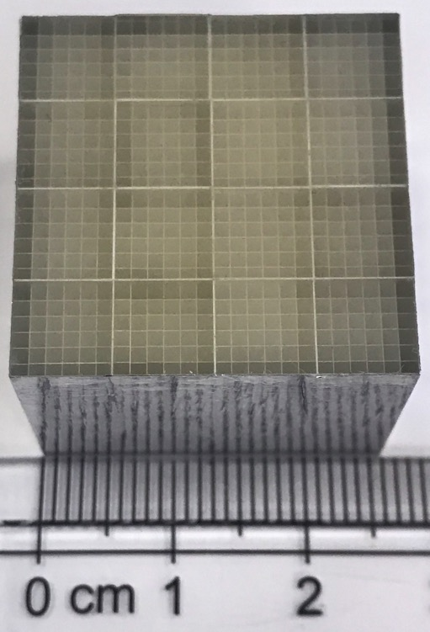
High-resolution dual-ended readout PET detector
Experiment setup
Results

Slide 2
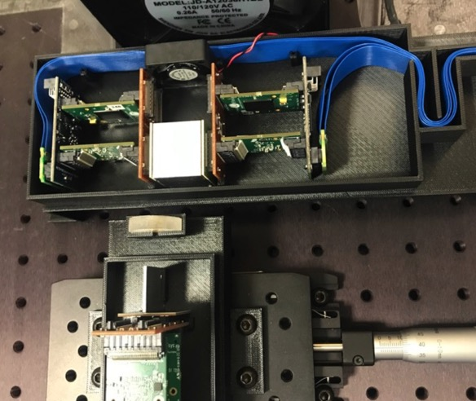
TOFPET2 ASIC
LYSO block
SiPM
Na-22 source
LYSO slab
SiPM array
Translation stage

