Slide 1
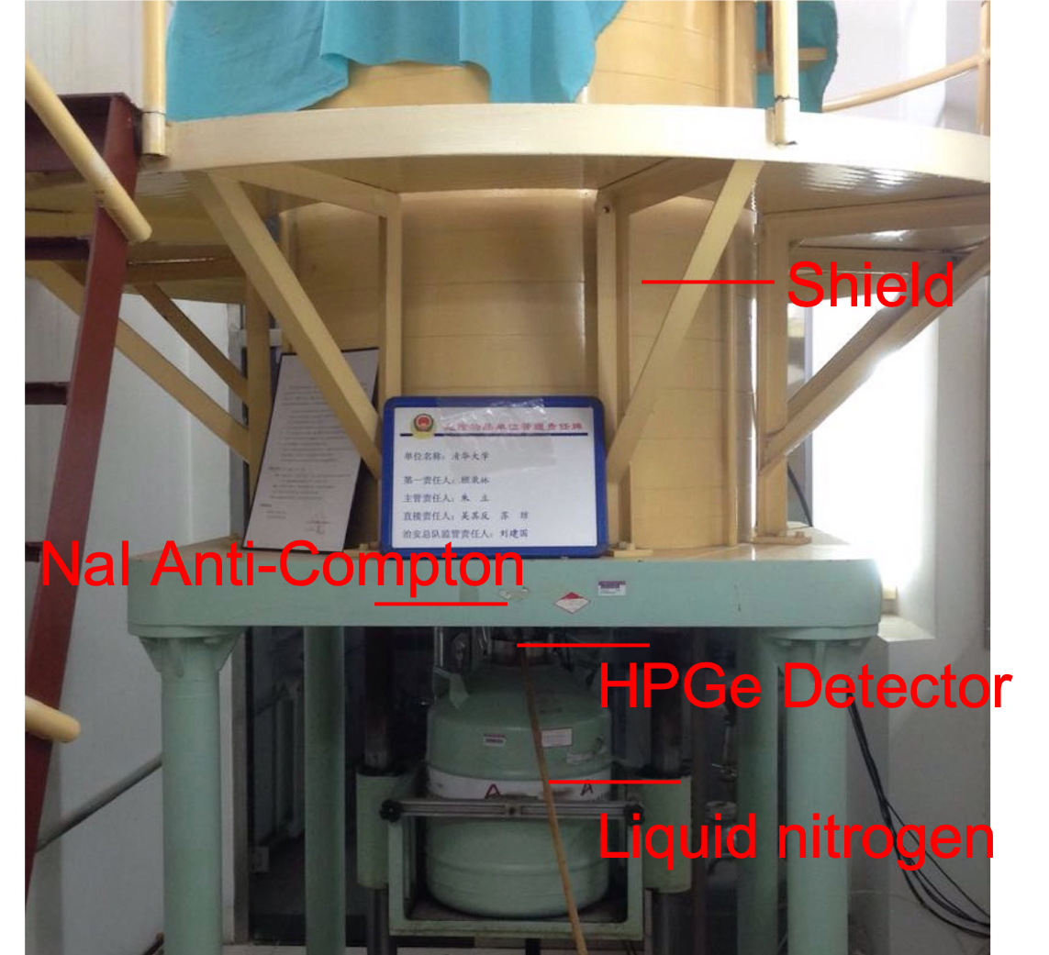
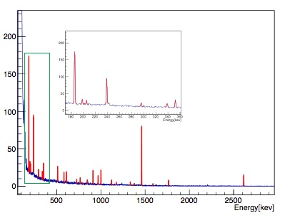
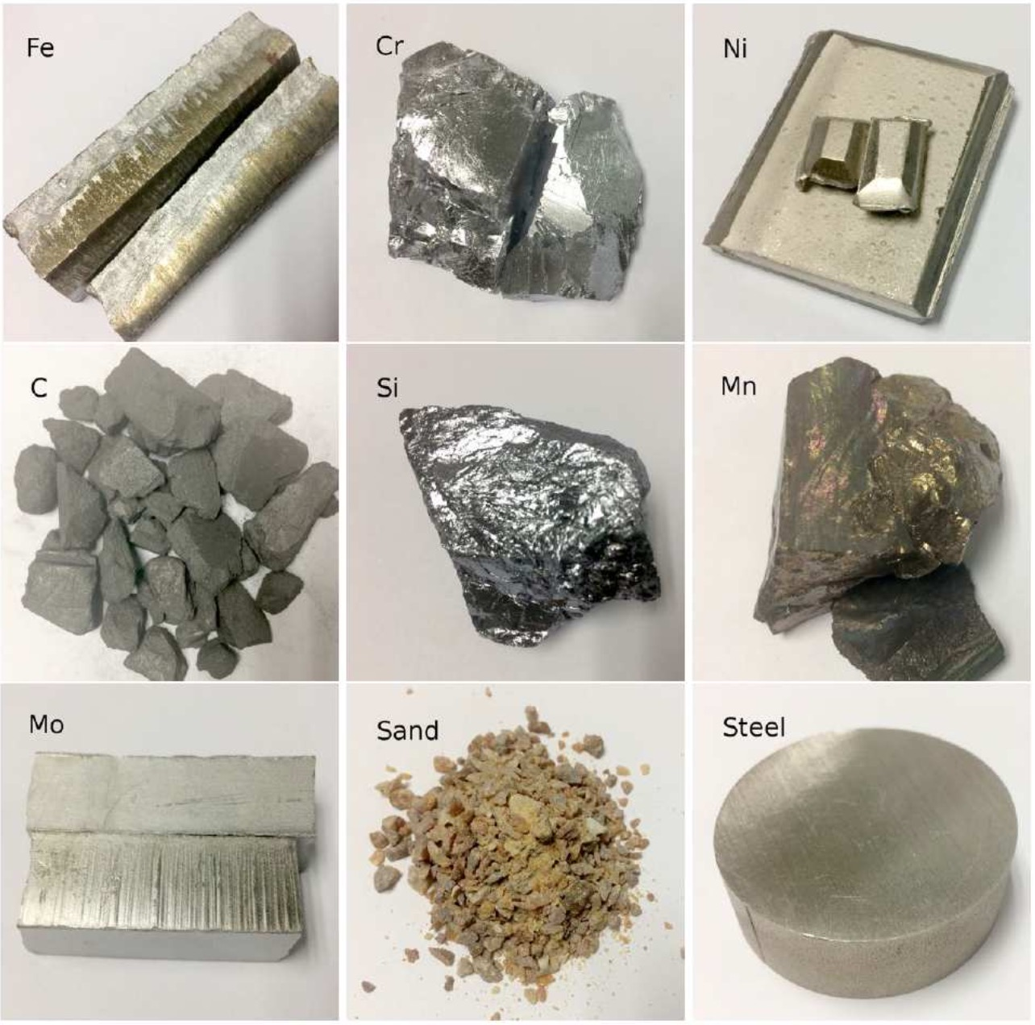
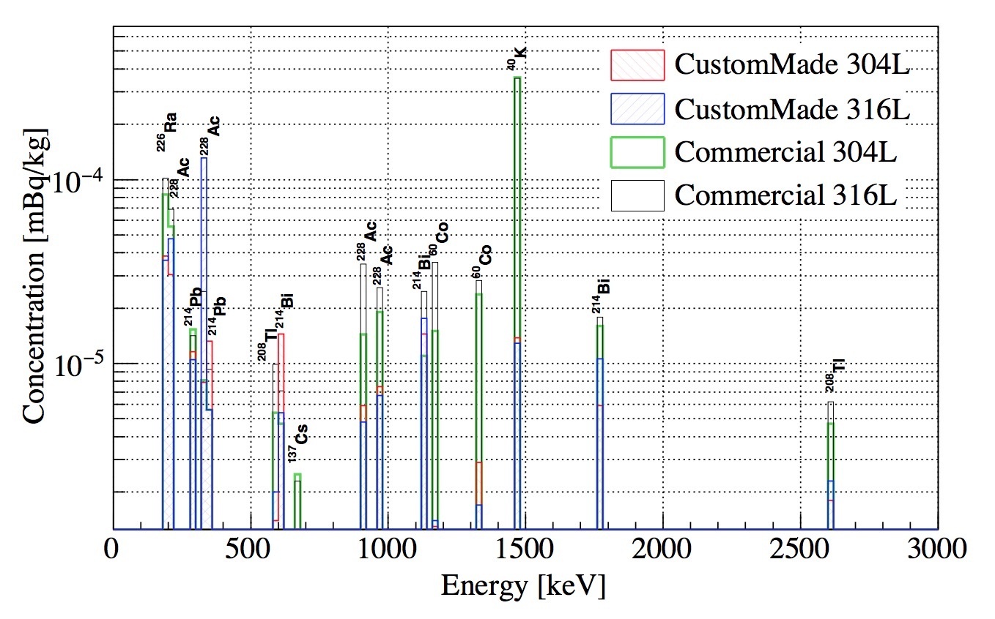
Radioactivity measurement with HPGe
HPGe detector
Fitted spectrum
Raw samples
Custom-made sample
Notes:
The goal of this project is to smelt low-radioactivity stainless steel (SST) that is compatible with the ultra-low background requirement in Jinping Neutrino Experiment. I used a high-purity germanium detector to measure the radioactivity of raw materials and commercial samples of SST and wrote a program that could automatically identify radionuclide type and compute its radioactivity. My work helped to identify contamination sources such as C and Si and promoted to contributed to the smelting of custom-made SST samples whose radioactivity was comparable to thoes used in other neutrino expeirments such as Borexino and NEXT.

Slide 2
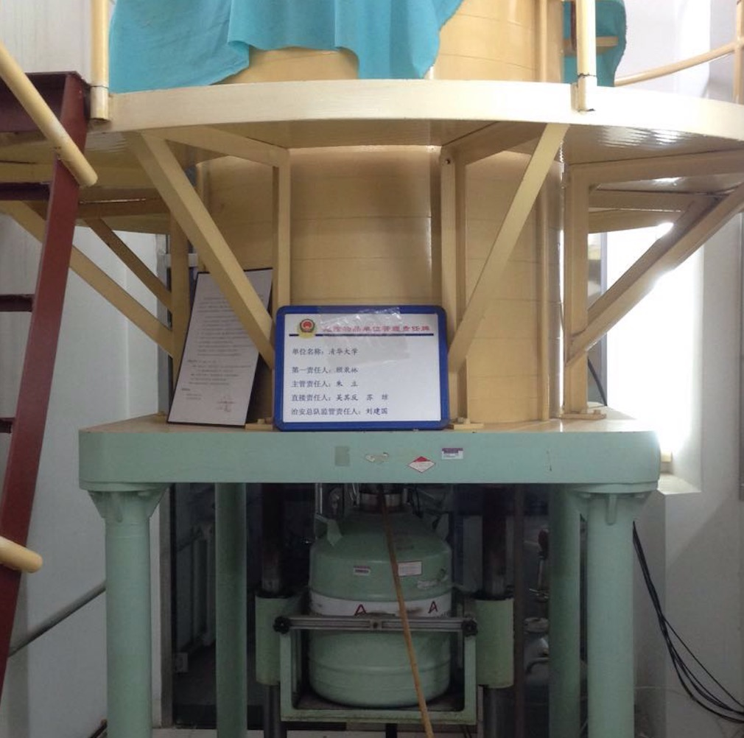
Shield
NaI Anti-Compton
HPGe Detector
Liquid nitrogen

Slide 3


