Slide 1
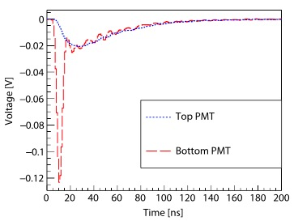
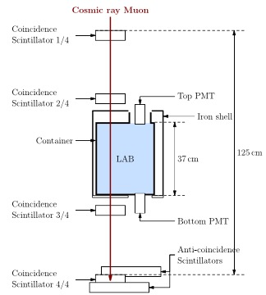
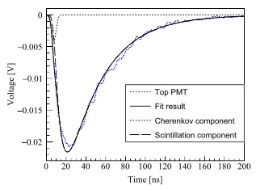
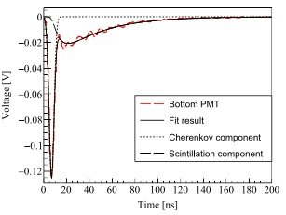
Separation of scintillation and Cherenkov lights
Detector
Measurements
Trigger logic
Scintillation profile
Notes:
Water-based liquid scintillator (WbLS) is a promising detecting material for next generation of neutrino and proton decay experiments. This purpose of this project is to verify the separable measurement of the simultaneous scintillation and Cherenkov lights in linear alkyl benzene (LAB), which is an important component of WbLS. The source is cosmic-ray muon.I participated in the mechanical design of a 20-L capacity detector, which used plastic scintillator as the trigger system. A moun must go down vertically to trigger a signal. Because muon goes down, the bottom PMT is expected to receive both scintillation and Cherenkov lights, while the top PMT only received scintillation lights. The time profile of scintillation and Cherenkov lights were fitted by a biexponential function convoluted with a Gaussian detector response to get the rising and decay constants and light yield of scintillation light of LAB.

Slide 2
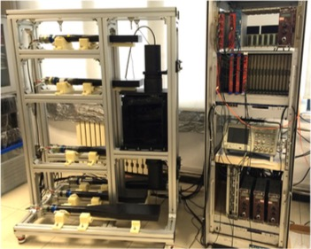
Trigger logic
Liquid scintillator
PMT
Plastic scintillator

Slide 3


