Slide 1
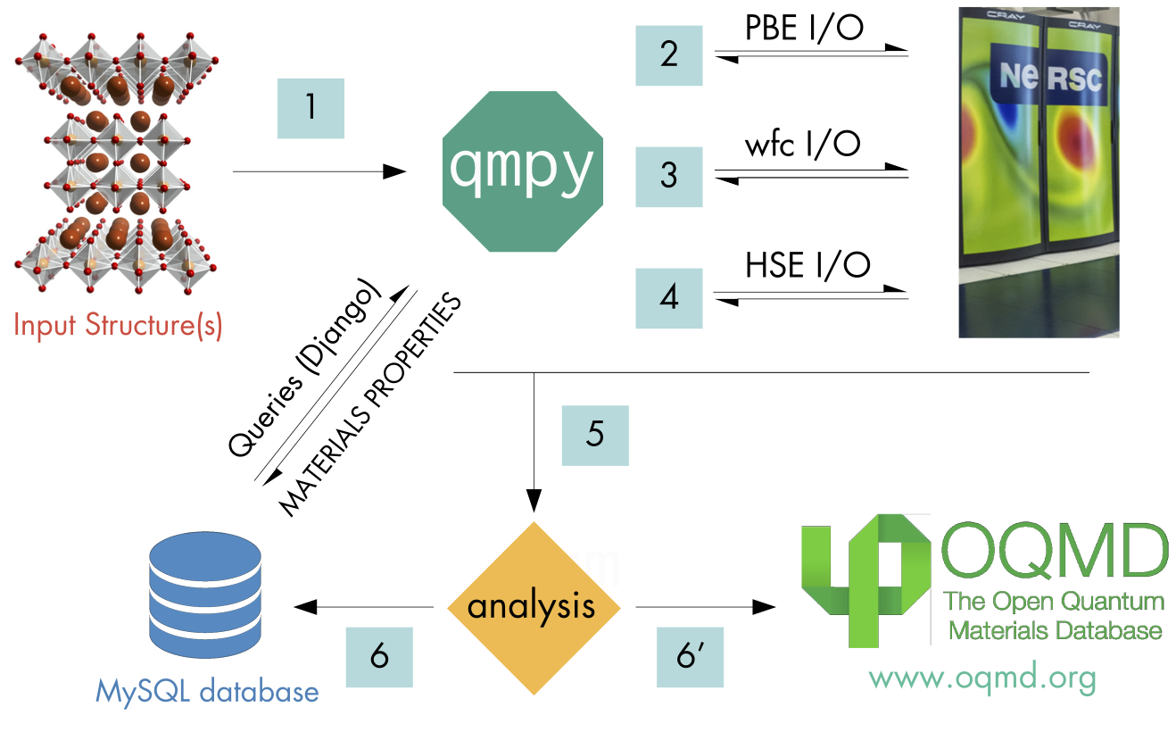
Workflow of OQMD

Slide 2
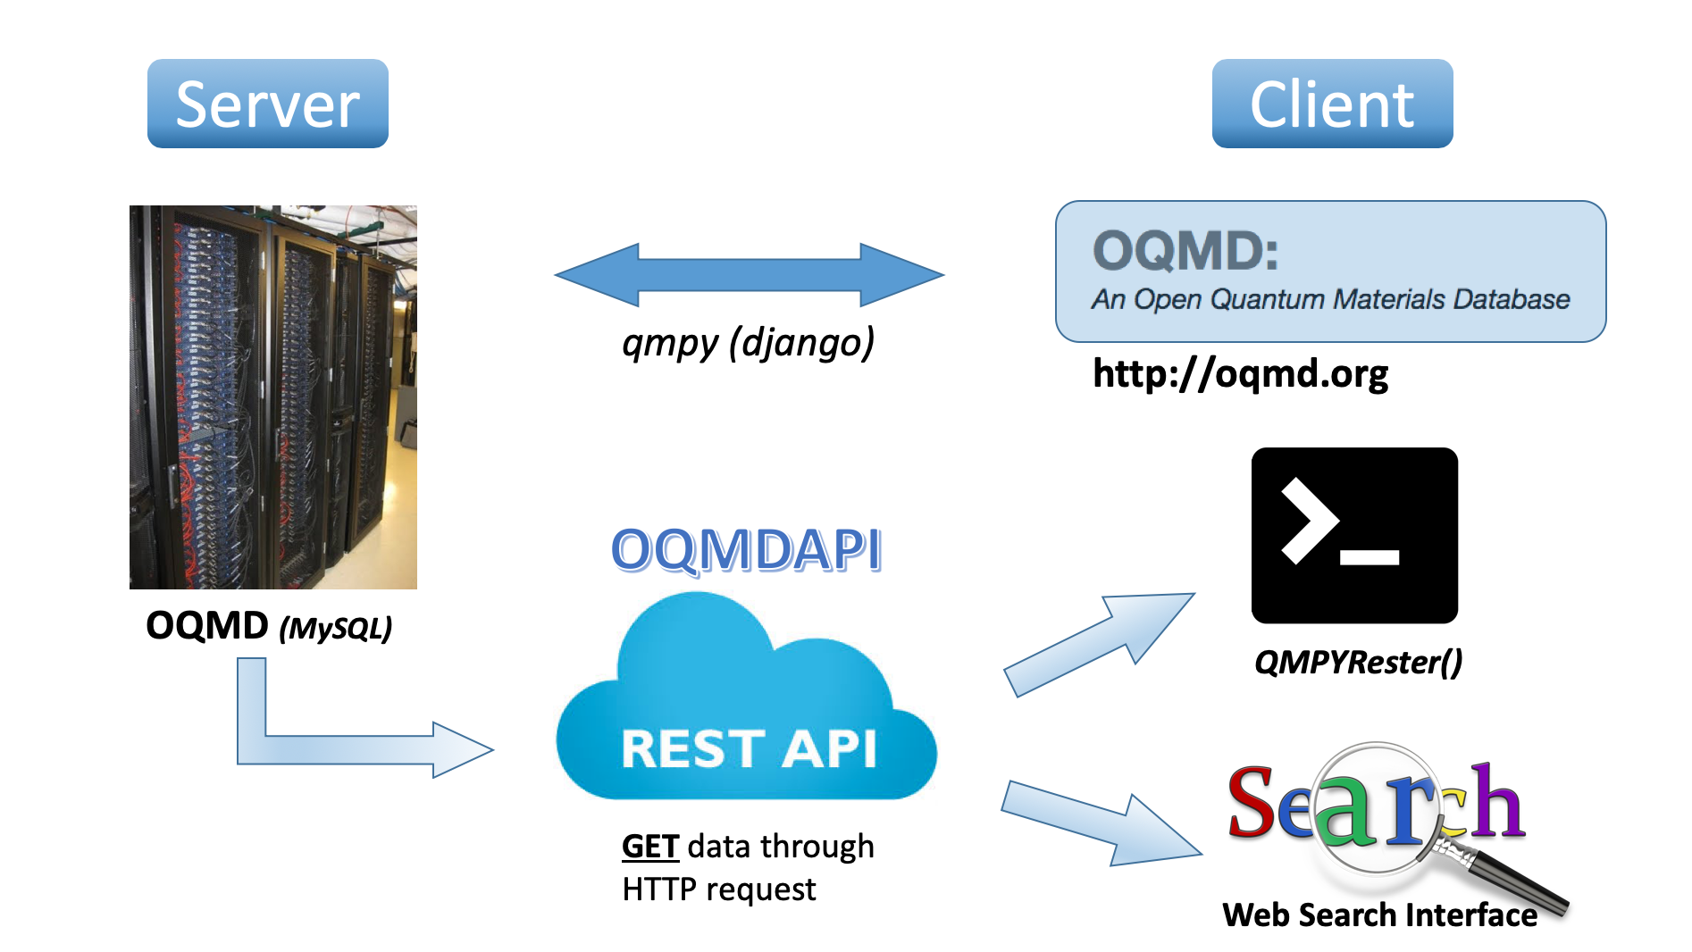
Workflow of OQMDAPI

Slide 3
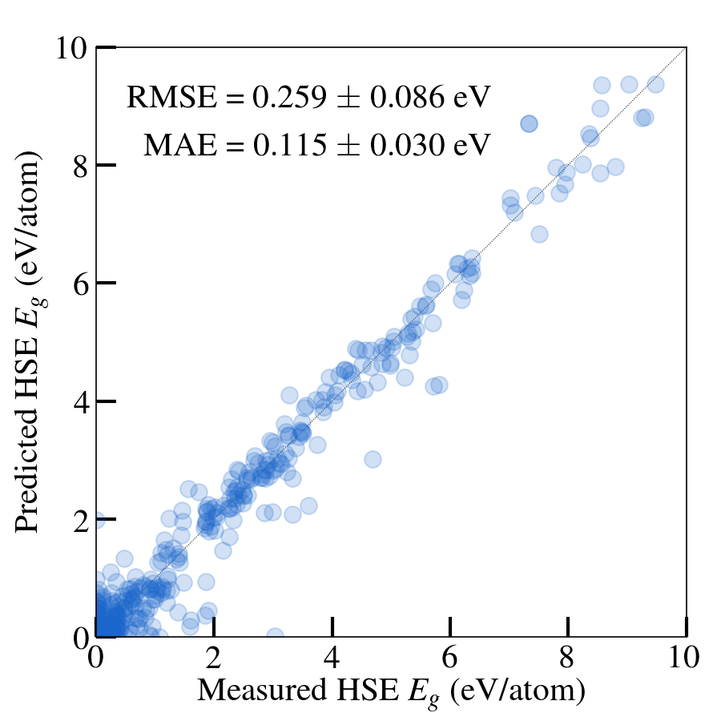
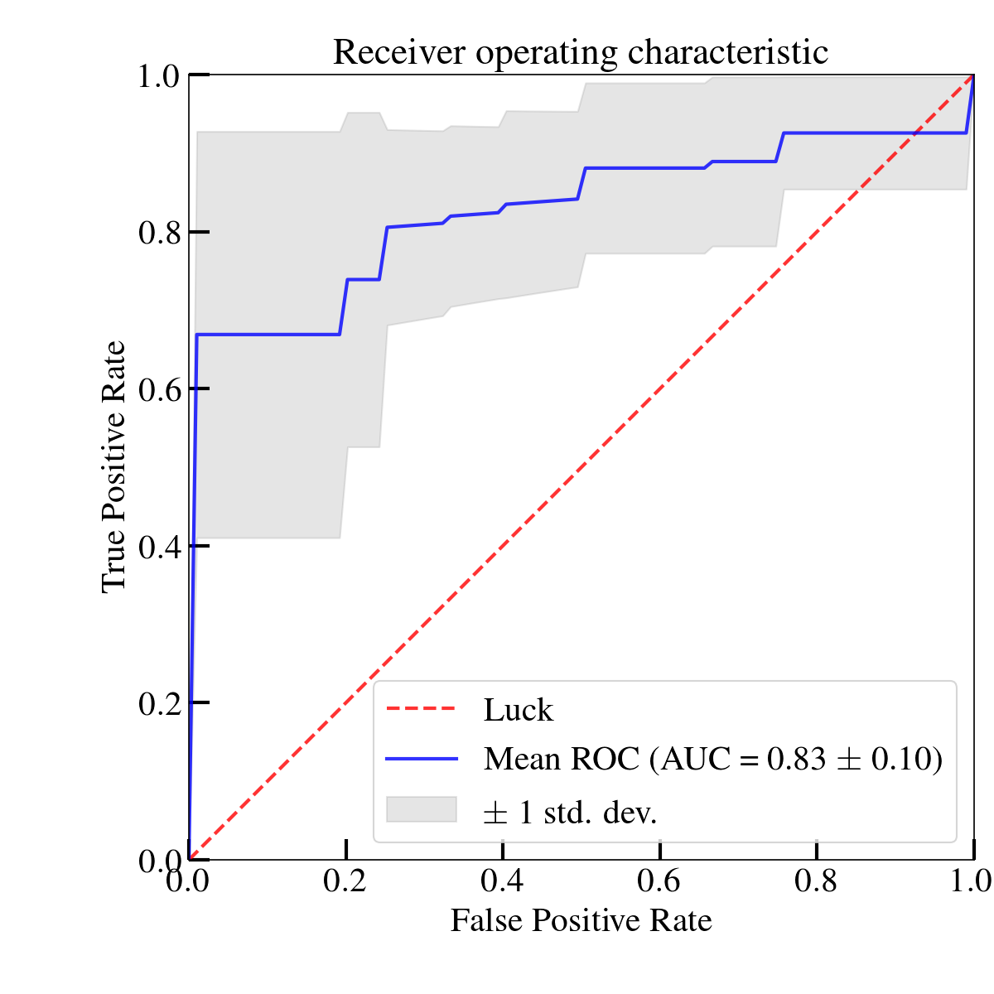
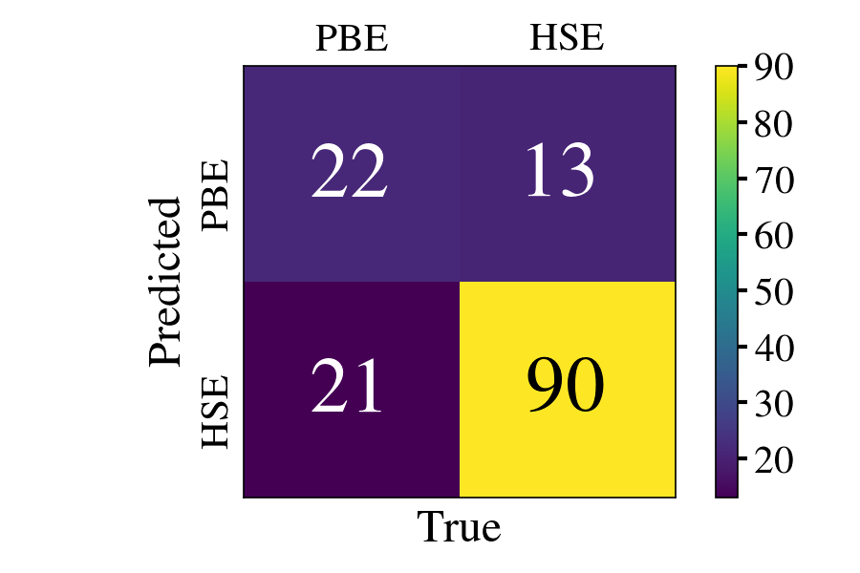
Features
Dataset
Model
Evaluation
Target
﻿LOOCV-RMSE using
KRR = 0.51 eV (Magpie)
LASSO = 0.71 eV (Magpie)
KRR = 0.34 (w/ MP_PBE)
Experimental
bandgaps
Exp from two sources
PBE from MP
Magpie Features
PBE bandgaps
KRR
LASSO

