Slide 1
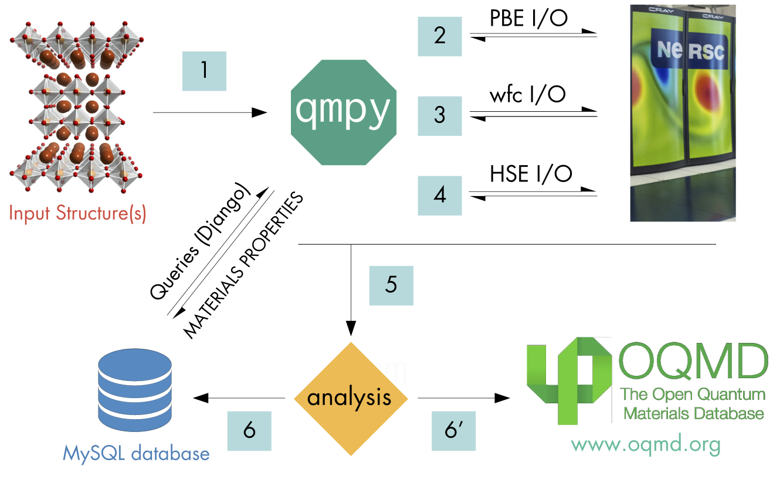
Workflow of OQMD

Slide 2
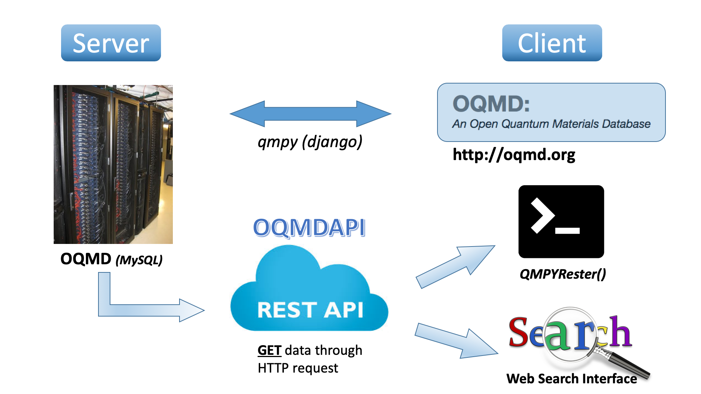
Workflow of OQMDAPI

Slide 3
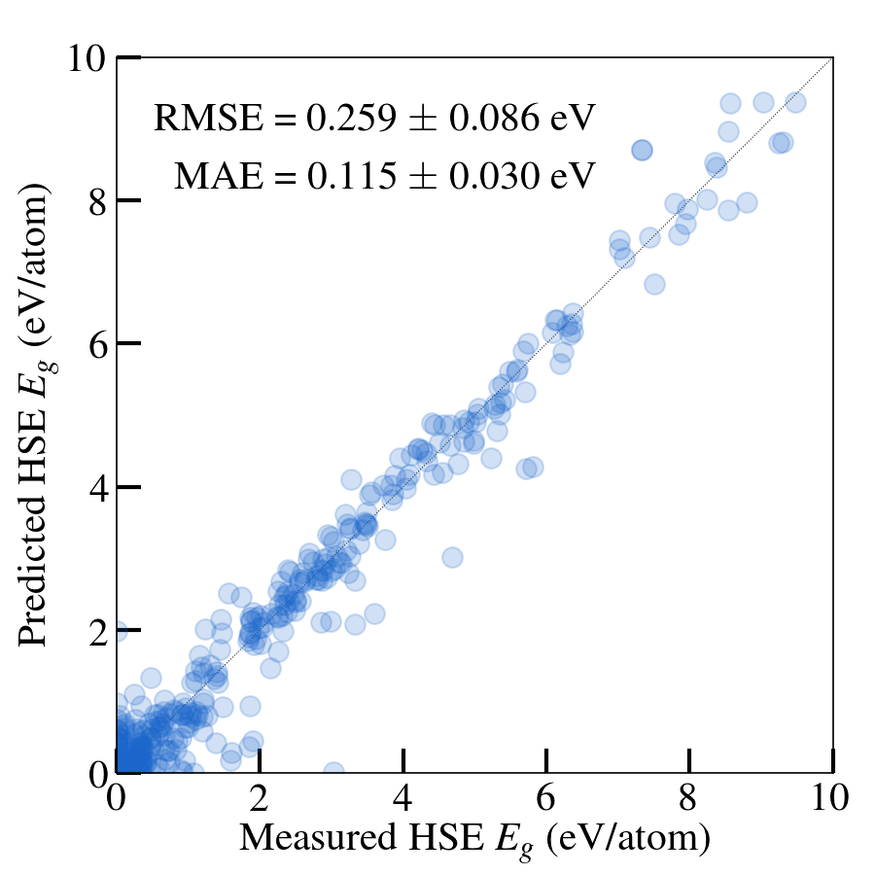
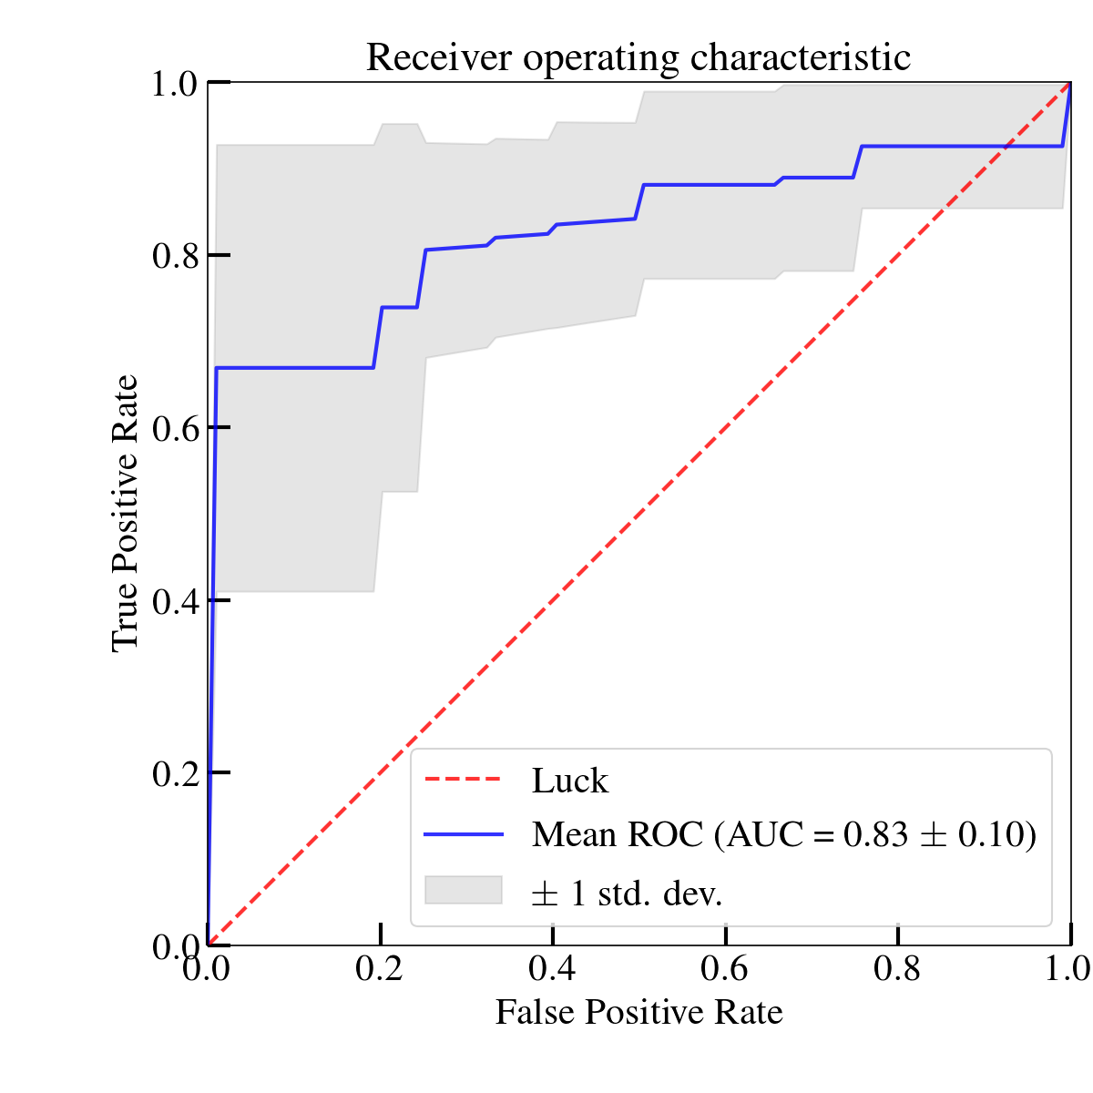
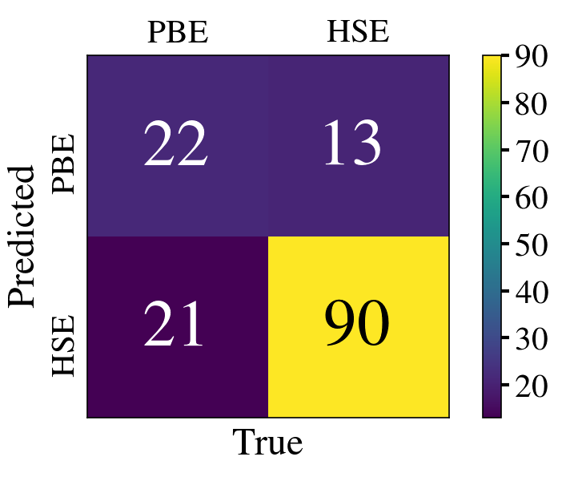
Features
Dataset
Model
Evaluation
Target
Workflow of ML on Materials
Generalized elemental properties (Magpie)
Experiment data
& High-fidelity computational data
Materials properties data stored in OQMD (low-fidelity)
LASSO
SVM
Random Forest
﻿10-fold cross-validation
Both RMSE & MAE
Regression Model on high-fidelity data prediction
Classification Model on whether high-fidelity calculation is needed

