Slide 1

Docker Swarm: Scaling and Orchestrating Containerized Applications
Docker Swarm is an orchestration tool for deploying and managing containerized applications. This platform simplifies the process of scaling and managing complex applications across multiple nodes.

Slide 2
Understanding Docker Swarm Architecture
Manager Nodes
Worker Nodes
Manager nodes are responsible for orchestrating the cluster, scheduling tasks, and managing services.
Worker nodes execute tasks and run containers based on instructions from the manager nodes.

Slide 3
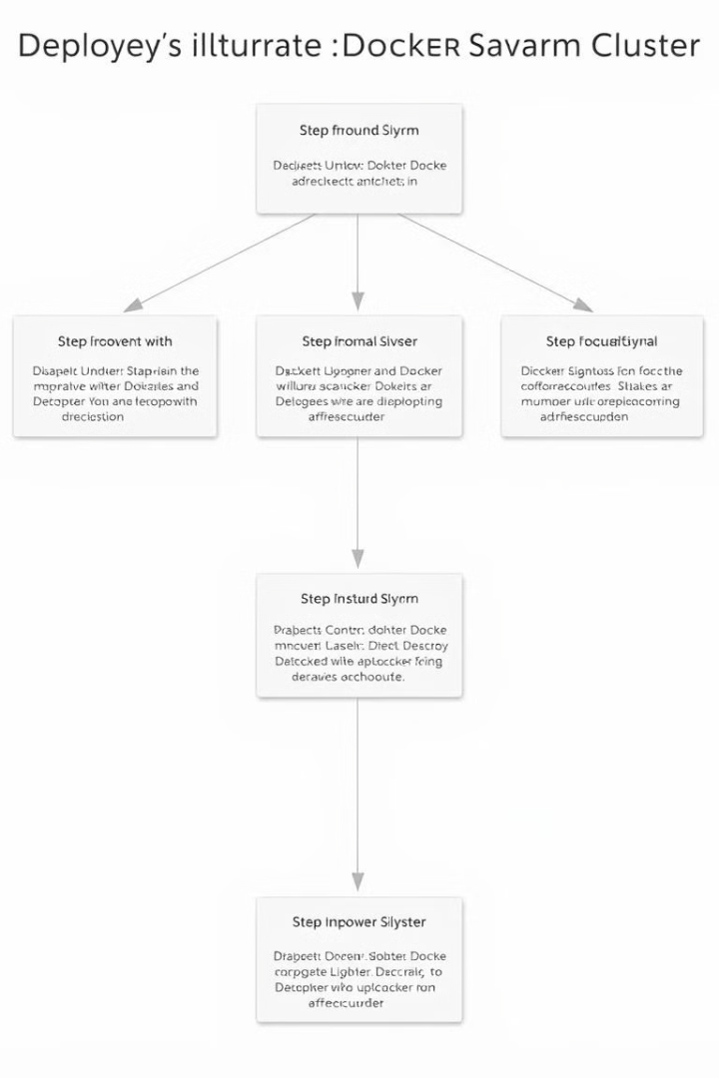
Deploying a Docker Swarm Cluster
1
Initialize a Swarm Manager
Start by launching a manager node, which will initiate the swarm cluster.
2
Join Worker Nodes
Add additional nodes to the cluster as workers, connecting them to the manager node.
3
Deploy Applications
Use Docker Compose or the Docker CLI to deploy your applications as services on the cluster.

Slide 4
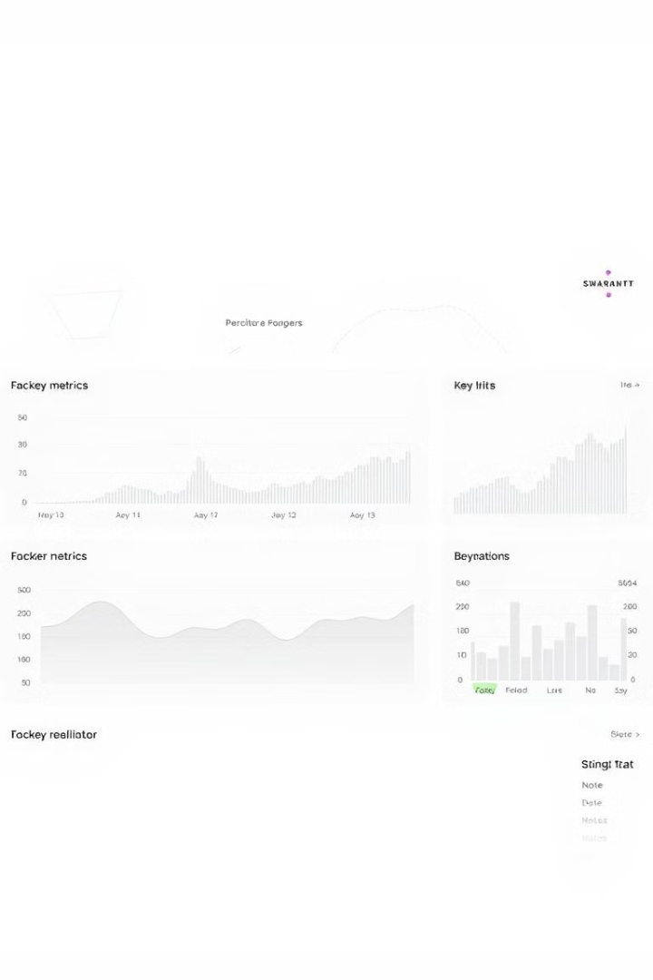
Managing Nodes and Services
Node Management
Service Management
Monitor node status, performance, and resource utilization, ensuring efficient operation.
Deploy, update, scale, and manage services across the cluster, ensuring seamless functionality.

Slide 5
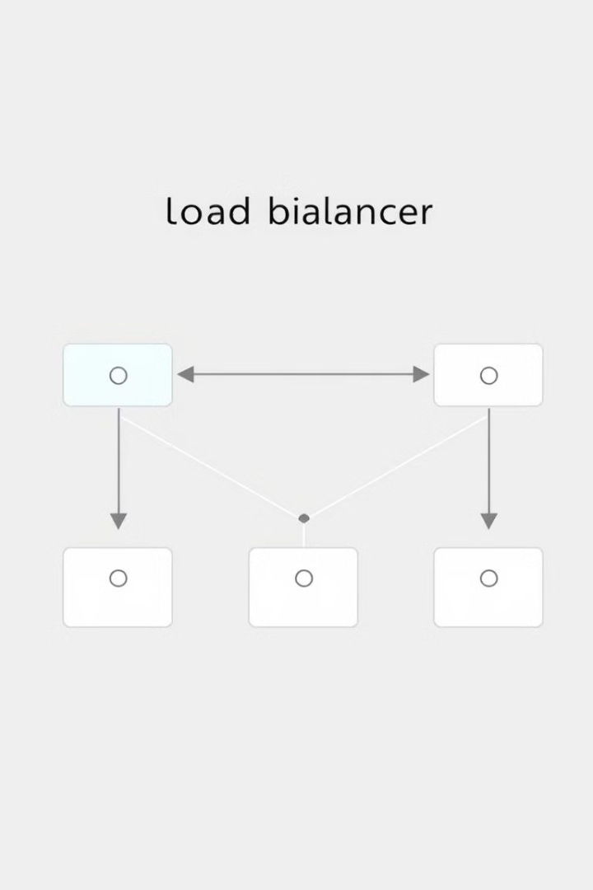
Load Balancing and Service Discovery
1
Load Balancing
2
Service Discovery
Distribute incoming traffic across multiple instances of a service to ensure optimal performance.
Enable communication between services within the cluster, allowing them to dynamically find and connect with each other.

Slide 6
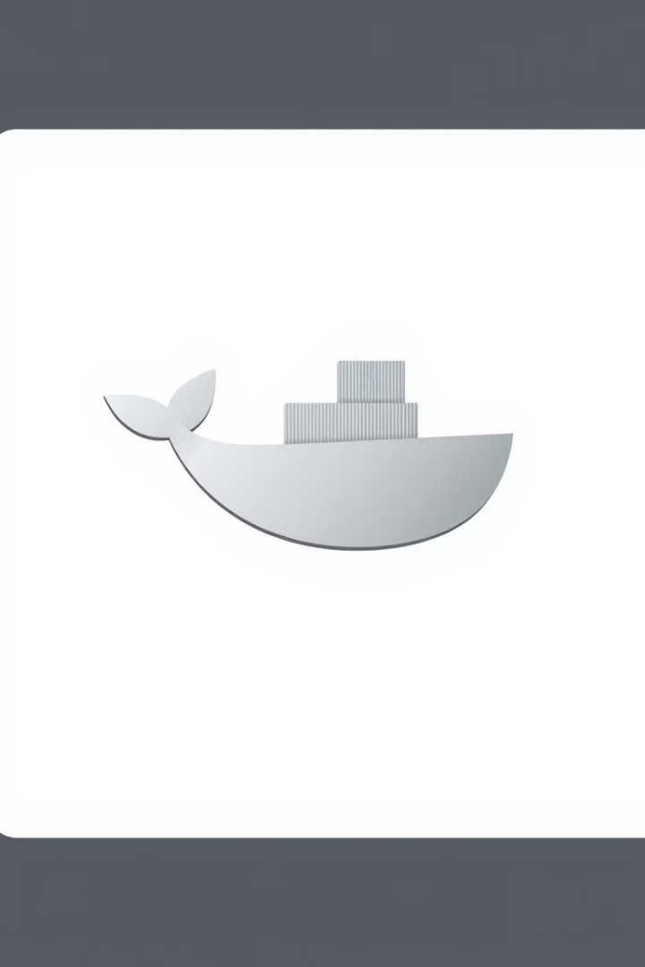



Scaling Swarm Services
Increase Instances
Add more instances of a service to handle increased demand, ensuring consistent performance.
Reduce Instances
Decrease the number of instances to optimize resource consumption when demand declines.
Dynamic Scaling
Leverage automated scaling mechanisms to dynamically adjust service capacity based on real-time usage patterns.

Slide 7
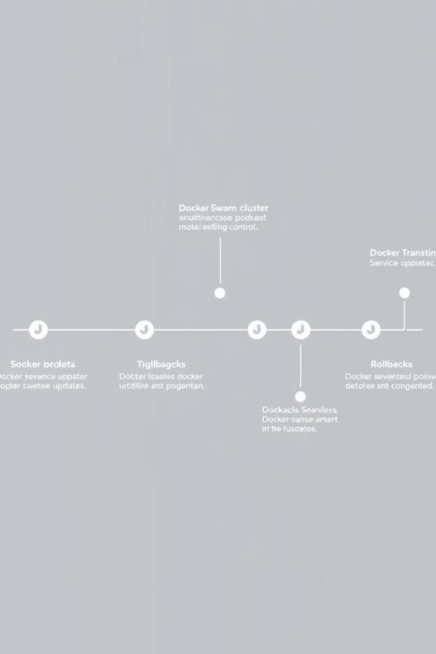
Updating and Rolling Back Services
Updating Services
Deploy new versions of services seamlessly, ensuring minimal downtime and smooth transitions.
Rolling Back
Revert to previous versions of services quickly and easily, simplifying troubleshooting and rollback procedures.

Slide 8
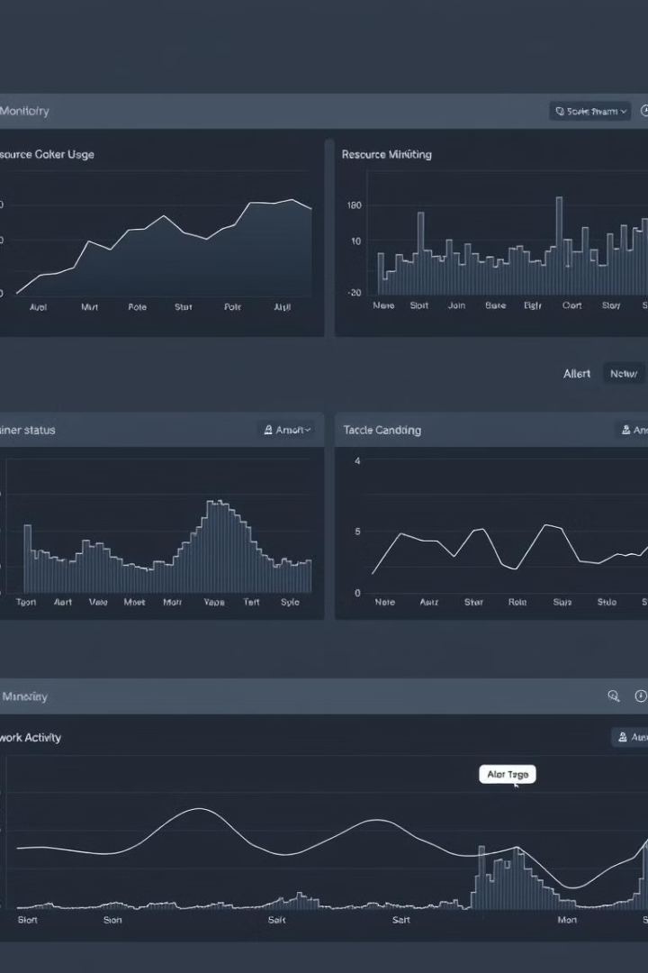



Monitoring and Troubleshooting Docker Swarm
Performance Monitoring
Track key metrics, including CPU, memory, and network usage, to identify performance bottlenecks.
Alerting and Notifications
Receive timely alerts about critical events, enabling prompt response and issue resolution.
Log Analysis
Examine logs from services and nodes to diagnose and troubleshoot issues efficiently.

