Slide 1

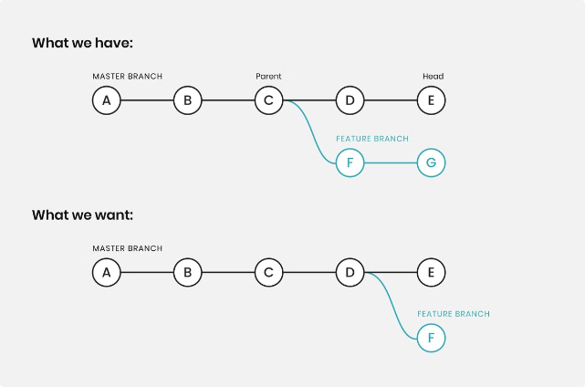
What is Git Rebase?
Git rebase is a powerful tool for rewriting your commit history. It lets you move a branch to a new base, effectively changing its parent. You might choose to use it to clean up your commit history, fix mistakes, or integrate changes from another branch.

Slide 2

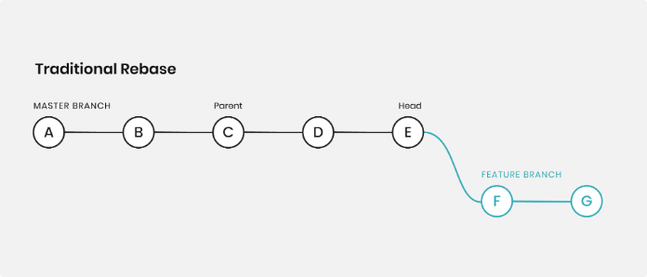
Reasons to use Git Rebase
1
Clean History
2
Fix Mistakes
Rebase can help you create a linear, clean, and easy-to-understand history.
It lets you rearrange, edit, or even remove commits, giving you control over your history.
3
Combine Changes
4
Simplify Merges
You can rebase your branch onto another, incorporating all changes from the other branch.
Rebase can help avoid merge conflicts and make your merge history more concise.

Slide 3
Rebasing vs. Merging
Rebasing
Merging
Rewrites your commit history, making it appear as if your branch was developed directly on top of the new base branch.
Combines two branches, creating a new merge commit that includes the changes from both branches.

Slide 4

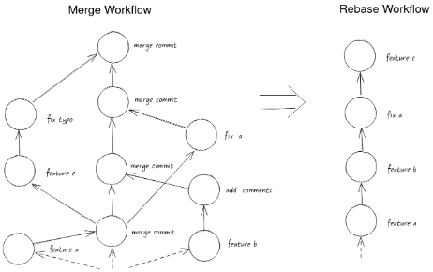




Rebasing Workflow
Start with your Branch
Choose a New Base
Run Git Rebase
Resolve Conflicts
Make sure you're on the branch you want to rebase.
Decide on the branch you want to rebase onto.
Use the `git rebase` command, specifying the target branch.
If any conflicts arise, resolve them and continue the rebase.

Slide 5

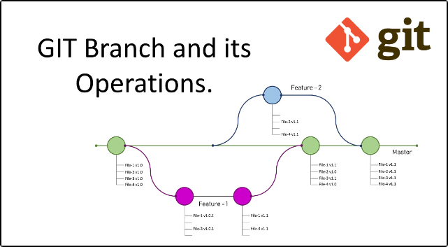
Rewriting Commit History
Command
Action
git rebase -i HEAD~3
Interactive rebase of the last 3 commits
git rebase --onto new-base-branch old-base-branch
Rebase onto a new branch from a specific commit
git rebase --onto new-base-branch old-base-branch ~3
Rebase onto a new branch from a specific commit and exclude the last 3 commits

Slide 6
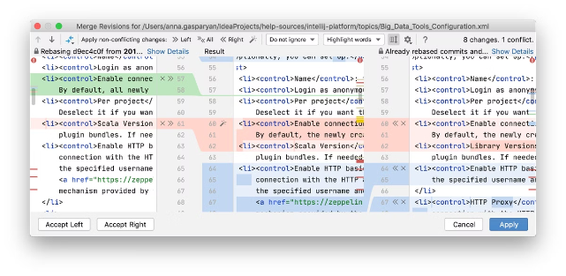
Handling Conflicts During Rebase
Stop the Rebase
Abort the Rebase
Use `git rebase --continue` to continue after resolving conflicts.
Use `git rebase --abort` to abandon the rebase and return to the original state.
Use Git Tools
Use `git diff` to see the conflicts and `git add` to mark them as resolved.

Slide 7


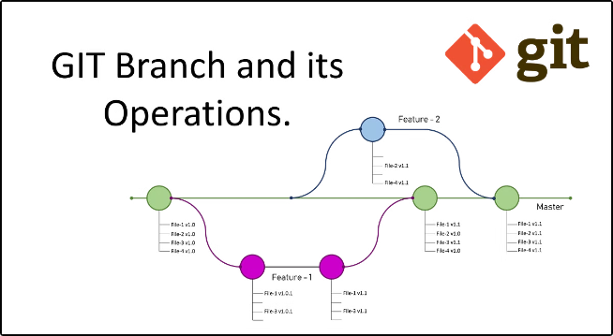


Rebasing Remote Branches
Be Careful
Rebasing remote branches can lead to confusion and unexpected results for collaborators.
Force Push
Rebasing remote branches usually requires a force push, which can overwrite others' work.
Best Practice
Rebasing is typically used for local branches before pushing them to a remote.

Slide 8

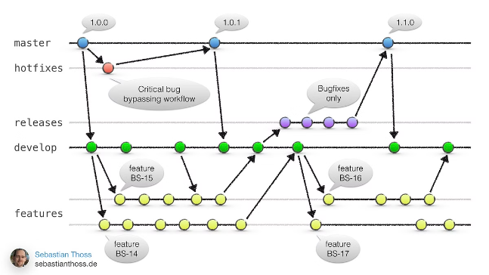
Best Practices for Git Rebase
1
Test Thoroughly
Ensure all functionality works as expected after rebasing.
2
Keep it Local
Rebase on local branches to avoid affecting others.
3
Communicate
Let collaborators know if you rebase a shared branch.
4
Use with Caution
Rebase with care, particularly for remote branches.

