Slide 1


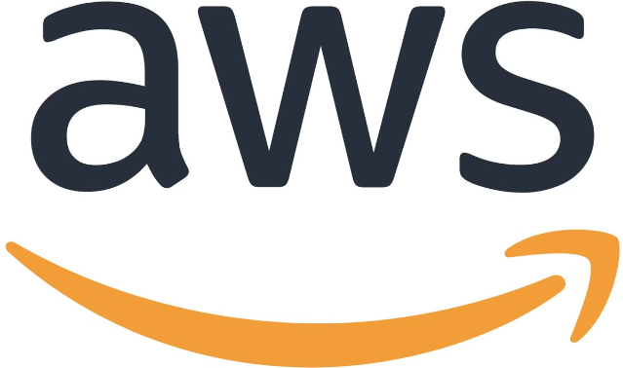
AWS DevOps Demo Class
Welcome to the AWS DevOps Demo Class! This session will introduce you to the fundamentals of DevOps with a focus on leveraging the power of AWS.
ra

Slide 2

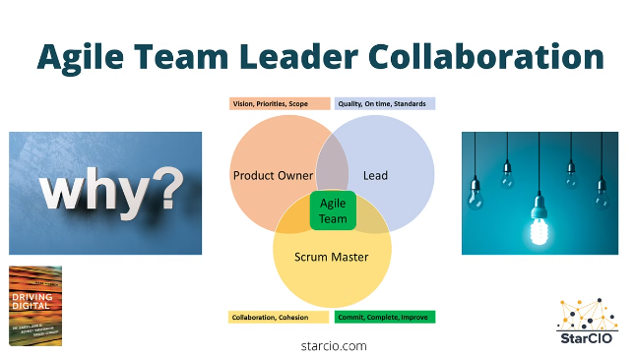
Introduction to DevOps
1
Definition of DevOps
DevOps is a set of practices that combine software development (Dev) and IT operations (Ops) to shorten the systems development life cycle and provide continuous delivery with high software quality.
2
Importance of DevOps
DevOps is essential for modern software development, enabling organizations to deliver software faster, more reliably, and with greater efficiency.
3
Key Practices
Key practices include continuous integration and continuous delivery (CI/CD), automation, and monitoring.

Slide 3
DevOps Lifecycle
Plan
1
Define requirements, user stories, and project scope.
2
Code
Write and manage code using version control systems like Git.
Build
3
Automate the build process using CI/CD tools to create executable code.
4
Test
Conduct thorough testing to ensure code quality and functionality.
Release
5
Automate deployment and release processes for efficient software delivery.
6
Deploy
Deploy applications to production environments using infrastructure as code (IaC).
Operate
7
Monitor and manage application performance, handle incidents, and ensure system stability.
8
Monitor
Continuously analyze system performance, collect feedback, and optimize operations.

Slide 4
Why AWS for DevOps?
Global Infrastructure
Wide Range of Services
Scalability and Flexibility
AWS offers a vast global network of data centers, providing low latency and high availability.
AWS provides a comprehensive suite of services for every stage of the DevOps lifecycle, from development to deployment and operations.
AWS allows for easy scaling of resources to meet changing demands, providing flexibility and agility.

Slide 5

Core AWS Services for DevOps
Service
Description
AWS CodePipeline
Fully managed continuous integration and continuous delivery service.
AWS CodeBuild
Fully managed build service that compiles source code, runs tests, and produces artifacts.
AWS CodeDeploy
Fully managed deployment service that automates application deployments to various environments.
AWS CodeCommit
Fully managed source control service that provides secure and scalable Git repositories.
AWS CloudFormation
Infrastructure as Code service that allows you to model and provision AWS resources using templates.
AWS CloudWatch
Monitoring and logging service that provides comprehensive insights into application performance and infrastructure health.

Slide 6
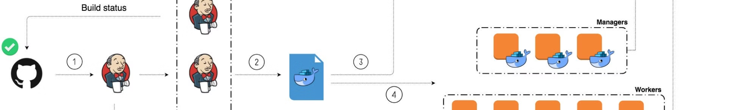




Setting Up a CI/CD Pipeline on AWS
Step 1
Create a CodeCommit repository to store your source code.
Step 2
Configure CodeBuild to automate builds, including compilation and testing.
Step 3
Define a deployment strategy using CodeDeploy to specify how your application will be deployed to different environments.
Step 4
Use CodePipeline to orchestrate the entire workflow, triggering builds, tests, and deployments based on code changes.

Slide 7

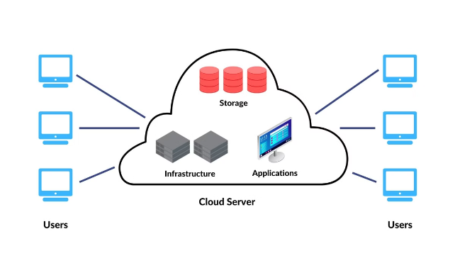
Demo Overview
Objective
Demonstrate the end-to-end process of building, deploying, and monitoring an application using AWS DevOps services.
Application
We'll use a simple web application that displays a message and a counter, showcasing basic application functionality.
Tools
We'll use AWS CodeCommit, CodeBuild, CodeDeploy, CloudFormation, and CloudWatch for this demo.

Slide 8
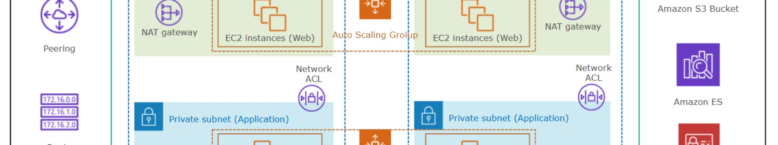




Best Practices in AWS DevOps
Infrastructure as Code
Automated Testing
Continuous Integration and Delivery
Monitoring and Logging
Integrate automated testing into your CI/CD pipeline to ensure code quality and functionality.
Use IaC tools like CloudFormation to define and manage your infrastructure consistently and efficiently.
Use monitoring and logging tools to track application performance and identify potential issues proactively.
Implement CI/CD practices to deliver software frequently and reliably.

