Slide 1



Essential AWS Services
Amazon Web Services (AWS) is a suite of cloud computing services that offers a wide range of tools and resources. This presentation explores key AWS services that are crucial for building and managing robust and scalable cloud-based applications.
ra

Slide 2
Compute Services: EC2 and VPC
Amazon EC2
Amazon VPC
EC2 (Elastic Compute Cloud) provides virtual servers (instances) in the cloud. Choose from a variety of instance types optimized for different workloads.
VPC (Virtual Private Cloud) allows you to create a private network in the cloud, with your own IP address space and security controls. It enables you to build highly secure and isolated environments.

Slide 3
Storage Services: EBS and S3
Amazon EBS
Amazon S3
EBS (Elastic Block Storage) provides persistent block storage volumes that can be attached to EC2 instances. It's ideal for databases, applications, and other data-intensive workloads.
S3 (Simple Storage Service) is an object storage service that is highly scalable and durable. It's perfect for storing files, backups, and other data that doesn't require frequent access.

Slide 4

Managing Your Data: Snapshots and AMIs
1
Snapshots
2
AMIs
Snapshots are point-in-time backups of your EBS volumes. You can restore your data to a previous state or use snapshots to create new EBS volumes.
AMIs (Amazon Machine Images) are templates used to launch EC2 instances. They contain the operating system, software, and configuration settings needed to start a new instance.

Slide 5

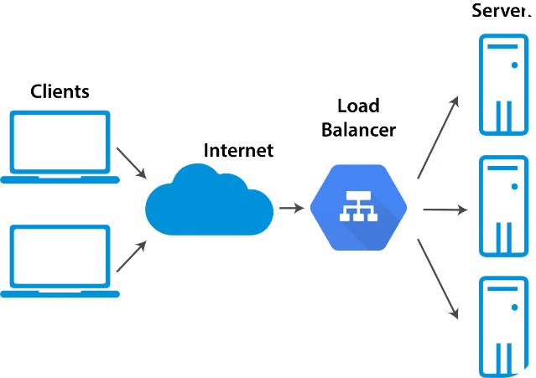


Balancing the Load
Traffic Distribution
Load balancers distribute incoming traffic across multiple EC2 instances, ensuring high availability and preventing single points of failure.
Scalability
By spreading the workload across multiple instances, load balancers enhance the scalability and performance of your applications.

Slide 6


Automating Your Infrastructure
1
Autoscaling
Autoscaling automatically adjusts the number of EC2 instances based on defined metrics, such as CPU utilization or network traffic. It ensures that your applications have the resources they need.
2
AWS CLI
The AWS CLI (Command Line Interface) provides a powerful way to interact with AWS services from the command line. It allows for scripting and automation of common tasks.
3
IAM
IAM (Identity and Access Management) controls access to AWS resources. You can create users, roles, and permissions to manage who can access what and how.

Slide 7

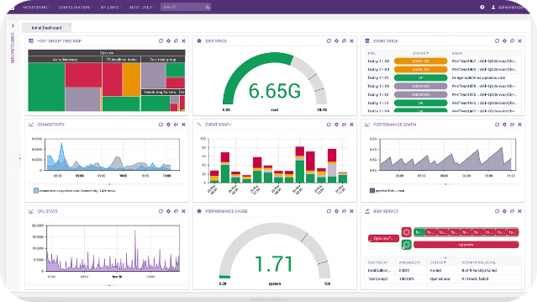
Monitoring and Logging
Cloud Watch
Cloud Watch is a monitoring service that provides real-time insights into your AWS resources. You can track metrics, logs, and events to identify and troubleshoot issues.
Logging
AWS provides logging services that capture and store events and errors from various AWS services. You can use these logs for debugging, analysis, and security auditing.

Slide 8


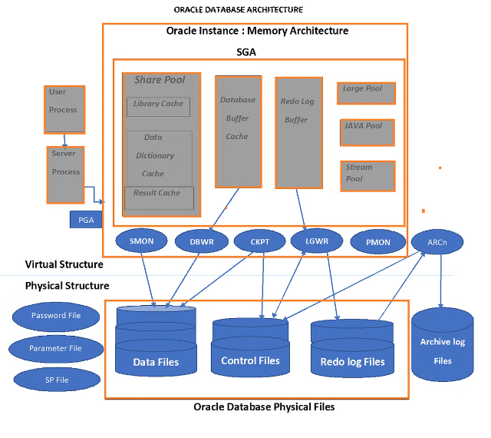

Building Your Database
Amazon RDS
RDS (Relational Database Service) provides managed relational databases, including MySQL, PostgreSQL, Oracle, and SQL Server. It simplifies database administration and scaling.
Route 53
Route 53 is a DNS (Domain Name System) service that allows you to route traffic to your AWS resources. It offers features like domain registration, health checks, and load balancing.

