Slide 1


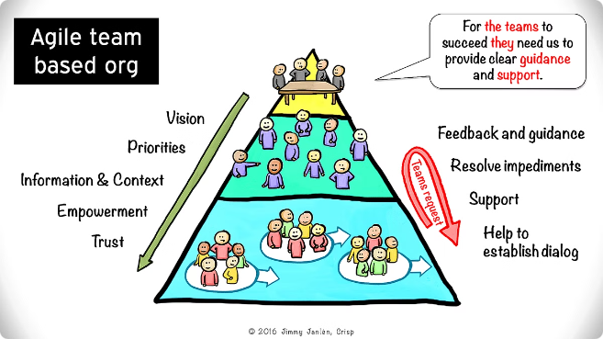
Agile Methodology: A Modern Approach to Software Development
Agile methodology has revolutionized the way software is developed. It emphasizes flexibility, collaboration, and continuous improvement, making it a popular choice for modern software development projects. Unlike the traditional Waterfall model, which follows a linear, sequential process, Agile embraces an iterative approach, allowing teams to adapt to changing requirements and deliver value to customers faster.
ra

Slide 2

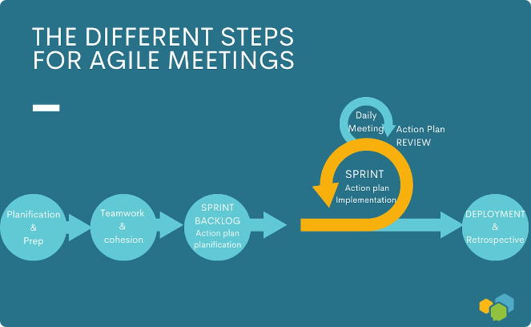
Key Principles of Agile Methodology
1
Customer Collaboration
Agile prioritizes constant communication with customers and stakeholders throughout the development process. This ensures the final product meets their needs and expectations, fostering a shared understanding and transparency.
2
Responding to Change
Agile embraces changes in requirements, even late in the development cycle. This adaptability allows teams to pivot and adjust to evolving business needs, staying relevant and responsive to market dynamics.
3
Iterative Development
Agile breaks down projects into smaller iterations, typically lasting 1-4 weeks, known as sprints. Each sprint delivers a functional piece of software, enabling rapid feedback and continuous improvement.
4
Continuous Feedback
Regular feedback from customers, stakeholders, and team members is crucial in Agile. This feedback loop helps identify issues early, refine the product, and improve the development process.

Slide 3

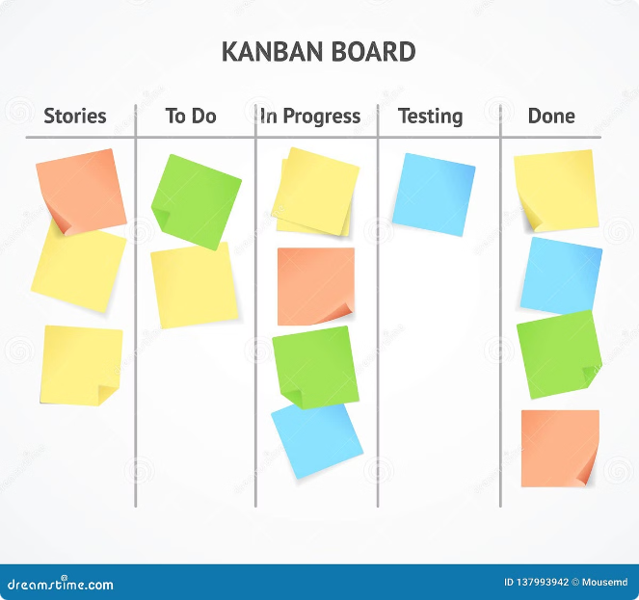
Agile Methodology Frameworks
Scrum
Scrum is a popular framework that utilizes time-boxed iterations called sprints, typically lasting 2-4 weeks. It emphasizes specific roles (Scrum Master, Product Owner, Development Team) and key ceremonies like daily stand-ups, sprint planning, sprint review, and sprint retrospective, fostering efficient teamwork and continuous improvement.
Kanban
Kanban employs a visual workflow, using a Kanban board to track tasks through stages like "To Do," "In Progress," and "Done." It implements Work in Progress (WIP) limits, controlling the number of tasks in progress to enhance efficiency. Kanban prioritizes continuous delivery, delivering value as soon as it's ready, rather than in fixed iterations.
Extreme Programming (XP)
XP emphasizes rapid releases of small, incremental changes, promoting frequent feedback and adaptation. It emphasizes Test-Driven Development (TDD), where automated tests are written before coding to ensure quality. XP utilizes Pair Programming, where two developers work together at one workstation, writing and reviewing code simultaneously, improving code quality and collaboration.

Slide 4
Advantages of Agile Methodology
Flexibility
Customer Satisfaction
Improved Quality
Agile can adapt to changing requirements and priorities, making it suitable for projects with evolving needs or unpredictable environments.
Frequent delivery of functional software ensures customers see progress and can provide feedback, leading to a product that truly meets their needs.
Regular testing and feedback help to identify and fix issues early in the development process, resulting in higher quality software.

Slide 5


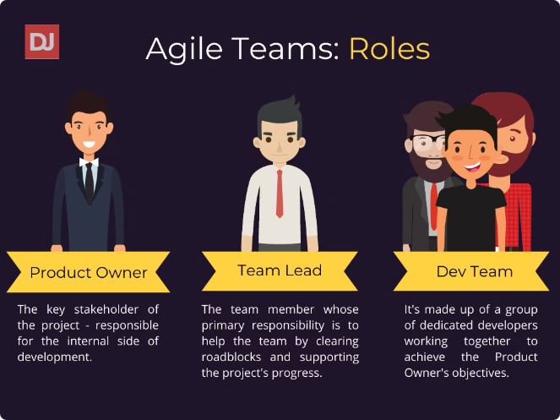


Disadvantages of Agile Methodology
Less Predictability
Agile's flexibility can make it challenging to predict timelines and costs upfront, as requirements may change throughout the project.
Requires Discipline
Agile demands strong team collaboration and discipline to adhere to its practices and principles, requiring effective communication and shared commitment.
Scope Creep
Continuous changes in requirements can lead to scope creep, potentially extending the project timeline and increasing costs if not managed effectively.

Slide 6

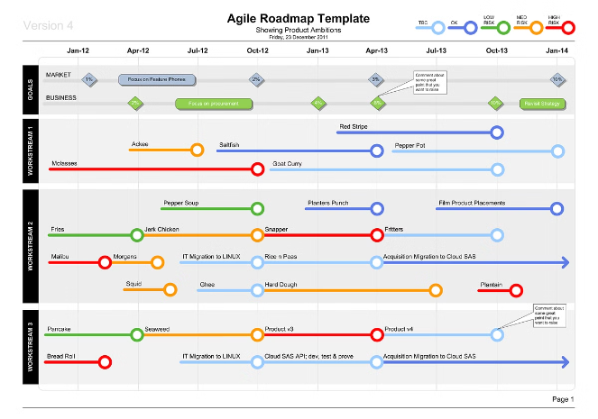
When to Use Agile Methodology
1
Changing Requirements
Agile is ideal for projects where requirements are expected to change frequently, allowing for flexibility and adaptability to evolving needs.
2
Rapid Delivery
When a functional product needs to be delivered quickly, Agile's iterative approach allows for incremental releases and faster time-to-market.
3
Customer Feedback
Agile thrives on continuous customer feedback, making it suitable for projects where customer involvement and input are crucial for success.
4
Innovation
Agile encourages experimentation and innovation, making it well-suited for projects that require exploring new technologies or approaches.

Slide 7

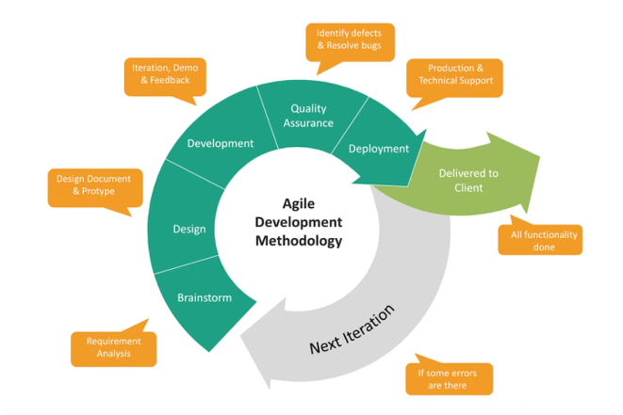
Agile Methodology in Practice
Industry
Examples
Benefits
Software Development
Web applications, mobile apps, enterprise software
Faster time-to-market, customer-centric development, adaptability to evolving technology
Product Design
Iterative product design, user interface design
Faster prototyping, user-centered design, improved user experience
Marketing and Advertising
Campaign optimization, content creation
Data-driven decision-making, agility in adapting to market trends

Slide 8





The Future of Agile Methodology
Continued Evolution
Agile is not static, but continually evolving to meet the demands of modern software development. New frameworks and practices are emerging, incorporating advancements in technology and user expectations.
Increased Adoption
Agile is becoming increasingly popular across industries, as organizations recognize its benefits for improving productivity, efficiency, and customer satisfaction.
Integration with AI
Artificial intelligence is playing a growing role in software development, and Agile is adapting to integrate AI-powered tools and processes for enhanced automation and efficiency.

