Slide 1



f
Introduction to AWS EC2
Amazon Elastic Compute Cloud (EC2) is a web service that provides resizable compute capacity in the cloud. EC2 is one of the most popular cloud computing services in the world.

Slide 2

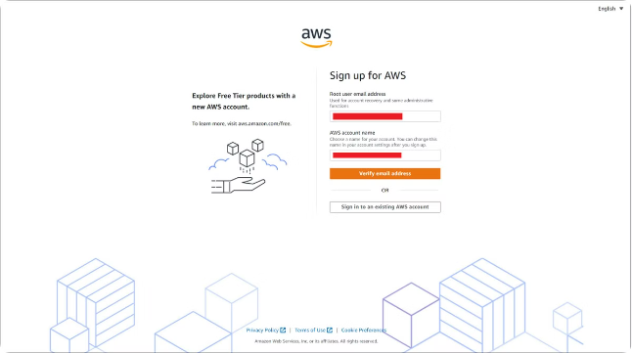
Signing up for AWS
Create an Account
Enter Your Information
Visit the AWS website and click the "Sign Up" button.
Fill out the required information, including your email address, name, and payment details.
Verify Your Account
AWS will send you an email to verify your email address. Click the verification link in the email.

Slide 3

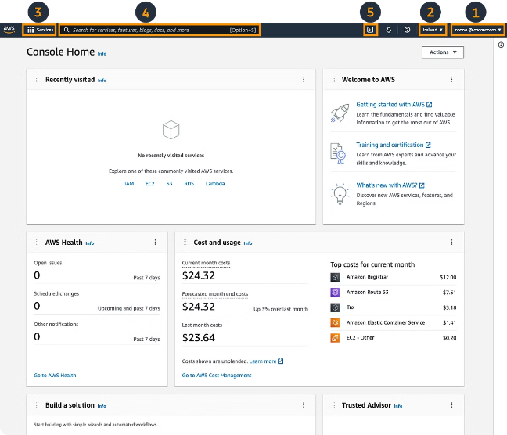




Navigating the AWS Management Console
Login
Access the AWS Management Console by entering your AWS credentials.
Find EC2
Locate the "EC2" service in the navigation menu.
Launch Instance
Click the "Launch Instance" button to start creating a new EC2 instance.

Slide 4

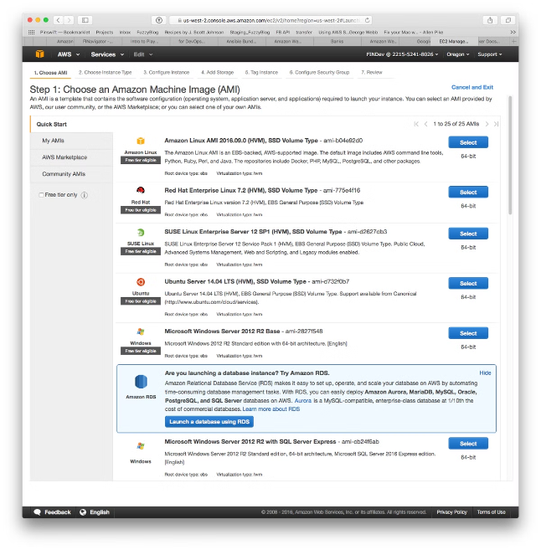
Selecting an Amazon Machine Image (AMI)
1
Linux
2
Windows
Use an Amazon Linux or Ubuntu AMI for general-purpose computing.
Choose a Windows Server AMI if your application requires a Windows operating system.
3
Other OS
Explore other AMIs based on specific needs, like Red Hat Enterprise Linux or Fedora.

Slide 5

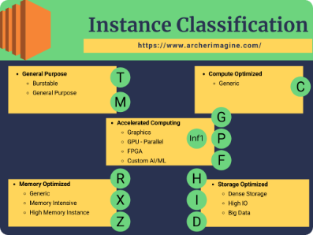
Choosing an Instance Type
Type
CPU
Memory
Storage
t2.micro
1 vCPU
1 GiB
8 GiB EBS
m5.large
2 vCPUs
8 GiB
16 GiB EBS
c5.xlarge
4 vCPUs
16 GiB
32 GiB EBS

Slide 6
Configuring Instance Details
Network
Storage
Tags
Select a VPC, subnet, and security group for your instance.
Choose an EBS volume size and type. You can also configure additional volumes.
Add tags to your instance for easy organization and management.

Slide 7

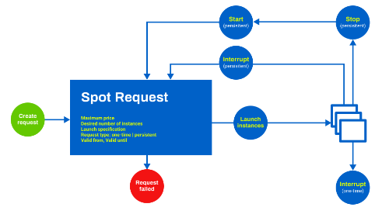
Reviewing and Launching the Instance
Review Configuration
Connect to Instance
Carefully review all the settings you have chosen.
After launching, establish a connection to your EC2 instance.
1
2
3
Launch Instance
Click "Launch" to initiate the instance creation process.

Slide 8

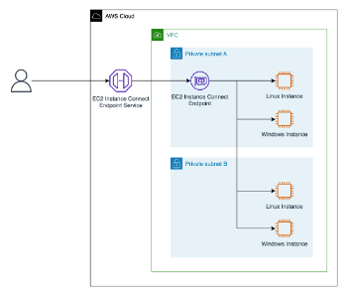


Connecting to the EC2 Instance
SSH Key
RDP
Use an SSH key pair to connect to Linux instances securely.
Connect to Windows instances using Remote Desktop Protocol (RDP).

