Slide 1


What is Git?
Git is a version control system that lets you track changes to your code over time. It's essential for collaborative software development, allowing teams to work on the same project without stepping on each other's toes.

Slide 2

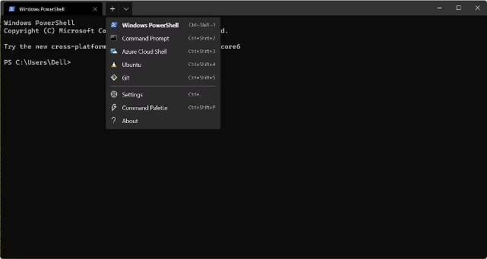
Git Basics
1
Initialization
2
Staging
Use `git init` to create a Git repository within a directory. This turns your project into a Git-tracked space.
Use `git add` to select files for inclusion in the next commit. This prepares the files for being versioned.
3
Committing
4
Cloning
Use `git commit` to record the current state of the project. This captures a snapshot of the files you've staged.
Use `git clone` to copy a remote Git repository onto your computer. This creates a local copy for working with the project.

Slide 3
Git Repositories
Local Repository
Remote Repository
Git Hosting
A local repository is a copy of the project on your computer. It contains all the files and history of the project.
A remote repository is a copy of the project hosted on a server. It's used to share code with others and synchronize changes.
Platforms like GitHub, GitLab, and Bitbucket provide a space for hosting Git repositories and collaborating on projects.
Working Directory
Staging Area
.git Directory

Slide 4

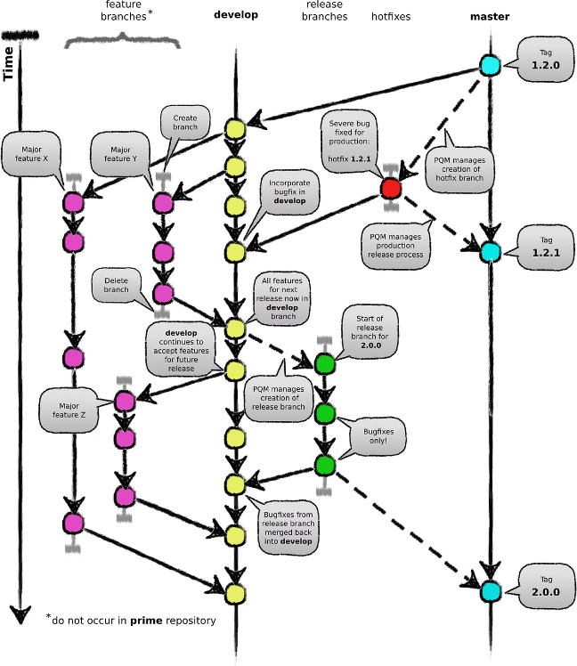



Git Branches
Main Branch
The main branch, often called `master` or `main`, is the primary line of development. It's used for stable releases.
Feature Branch
A feature branch is created to work on a new feature, bug fix, or other isolated changes. This allows developers to work independently without affecting the main branch.
Merge Branch
After completing work on a feature branch, you merge it back into the main branch to integrate the changes.

Slide 5

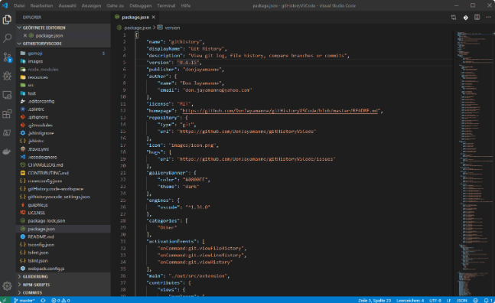
Git Commits
1
Commit Message
Each commit is associated with a message describing the changes made in that commit. This helps track the project's evolution.
2
Commit ID
Each commit is assigned a unique ID, typically a 40-character hash, to identify it within the repository.
3
Commit History
The commit history shows the sequence of changes made to the project, allowing developers to understand the evolution of the codebase.

Slide 6

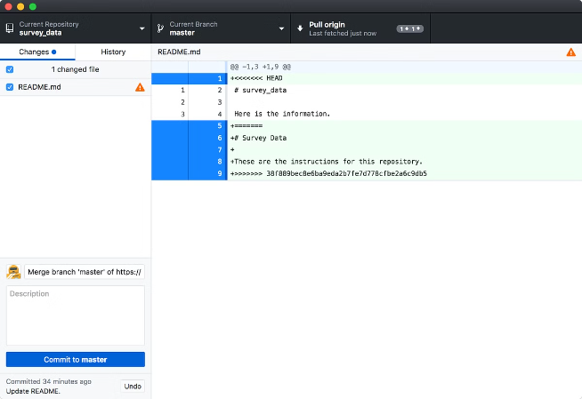
Git Merging
Type
Description
Fast-Forward Merge
Used when the branches have a linear history and the changes can be applied in order.
Merge Commit
Used when branches have diverged and changes cannot be applied in order. It creates a new commit that combines the changes from both branches.
Conflict Resolution
Occurs when both branches have modified the same lines of code. Requires manual intervention to resolve the conflicts before merging.

Slide 7


Git Collaboration
Pull Request
Forking
A pull request is a mechanism to propose changes to a remote repository. It allows developers to review and discuss changes before merging them into the main branch.
Forking creates a copy of a repository on your own account. This allows you to make changes without affecting the original repository.
Remote Tracking Branches
Remote tracking branches allow you to track the progress of branches on a remote repository. They're named `origin/branch_name` and mirror the state of the branches on the remote server.

Slide 8

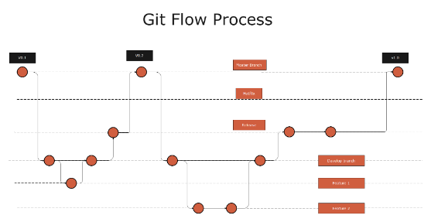




Git Best Practices
Regular Commits
Descriptive Commit Messages
Branching Strategy
Git Tools
Commit often and commit early. This helps track progress and provides a safety net if things go wrong.
Establish a consistent branching strategy for your team. This helps organize development and minimize conflicts.
Utilize Git tools and extensions to streamline your workflow. This includes IDE integrations, command-line tools, and graphical interfaces.
Write clear and concise commit messages that accurately describe the changes made in the commit.

