Slide 1
Dynamic Programming
Lecture 8

Slide 2
Dynamic Programming History
Bellman. Pioneered the systematic study of dynamic programming in the 1950s.
Etymology.
  Dynamic programming = planning over time.
  Secretary of Defense was hostile to mathematical research.
  Bellman sought an impressive name to avoid confrontation.
    "it's impossible to use dynamic in a pejorative sense"
    "something not even a Congressman could object to"
Reference: Bellman, R. E. Eye of the Hurricane, An Autobiography.

Slide 3
Introduction
Dynamic Programming(DP) applies to optimiza- tion problems in which a set of choices must be made in order to arrive at an optimal solution.
As choices are made, subproblems of the same form arise.
DP is effective when a given problem may arise from more than one partial set of choices.
The key technique is to store the solution to each subproblem in case it should appear

Slide 4
Introduction (cont.)
Divide and Conquer algorithms partition the problem into independent subproblems.
Dynamic Programming is applicable when the subproblems are not independent.(In this case DP algorithm does more work than necessary)
Dynamic Programming algorithm solves every subproblem just once and then saves its answer in a table.

Slide 5
Dynamic Programming Applications
Areas.
  Bioinformatics.
  Control theory.
  Information theory.
  Operations research.
  Computer science: theory, graphics, AI, systems, ….
Some famous dynamic programming algorithms.
  Viterbi for hidden Markov models.
  Unix diff for comparing two files.
  Smith-Waterman for sequence alignment.
  Bellman-Ford for shortest path routing in networks.
  Cocke-Kasami-Younger for parsing context free grammars.

Slide 6
The steps of a dynamic programming
Characterize the structure of an optimal solution
Recursively define the value of an optimal solution
Compute the value of an optimal solution in a bottom-up fashion
Construct an optimal solution from computed information

Slide 7
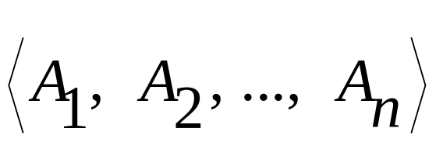
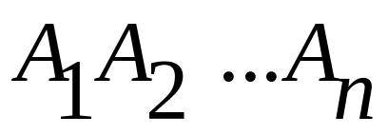
Matrix-Chain multiplication
We are given a sequence
And we wish to compute

Slide 8
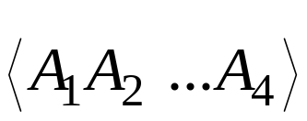
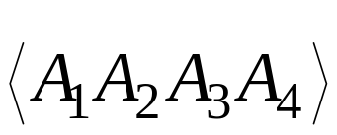
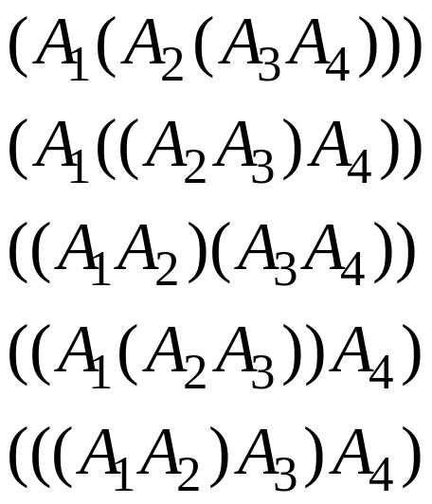
Matrix-Chain multiplication (cont.)
Matrix multiplication is assosiative, and so all parenthesizations yield the same product.
For example, if the chain of matrices is then the product can be fully paranthesized in five distinct way:

Slide 9
Matrix-Chain multiplication
MATRIX-MULTIPLY (A,B)
if columns [A] ≠ rows [B]
then error “incompatible dimensions”
else for i←1 to rows [A]
do for j←1 to columns [B]
do C[i, j]←0
for k←1 to columns [A]
do C[ i, j ]← C[ i, j] +A[ i, k]*B[ k, j]
return C

Slide 10
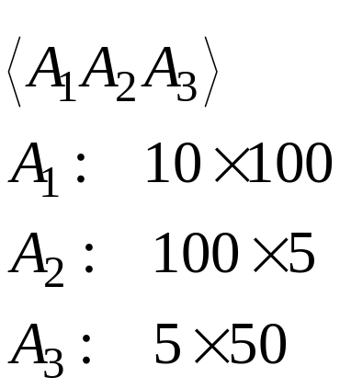
Matrix-Chain multiplication (cont.)
Cost of the matrix multiplication:
An example:

Slide 11
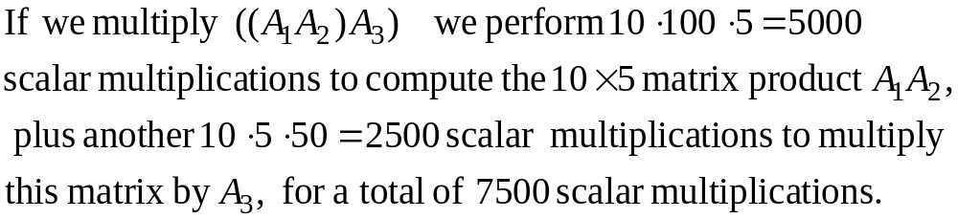
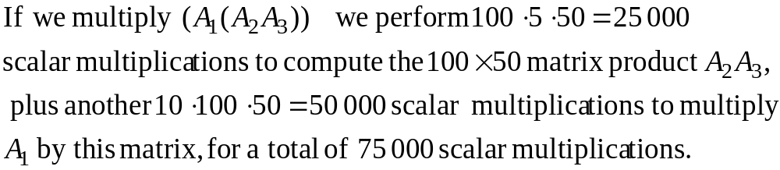
Matrix-Chain multiplication (cont.)

Slide 12
Matrix-Chain multiplication (cont.)
The problem:
Given a chain of n matrices, where matrix A_{i} has dimension p_{i-1}x p_{i}, fully paranthesize the product
in a way that minimizes the number of scalar multiplications.

Slide 13
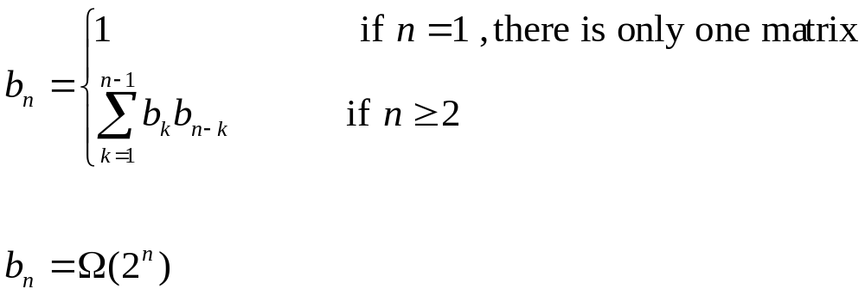
Matrix-Chain multiplication (cont.)
Counting the number of alternative paranthesization : b_{n}

Slide 14
Matrix-Chain multiplication (cont.)
Step 1: The structure of an optimal paranthesization(op)
Find the optimal substructure and then use it to construct an optimal solution to the problem from optimal solutions to subproblems.
Let A_{i...j} where i ≤ j, denote the matrix product A_{i} A_{i+1} ... A_{j}
Any parenthesization of A_{i} A_{i+1} ... A_{j} must split the product between A_{k} and A_{k+1} for i ≤ k < j.

Slide 15
Matrix-Chain multiplication (cont.)
The optimal substructure of the problem:
Suppose that an op of A_{i} A_{i+1} ... A_{j} splits the product between A_{k} and A_{k+1} then the paranthesization of the subchain A_{i} A_{i+1} ... A_{k} within this parantesization of A_{i} A_{i+1} ... A_{j} must be an op of A_{i} A_{i+1} ... A_{k}

Slide 16
Matrix-Chain multiplication (cont.)
Step 2: A recursive solution:
Let m[i,j] be the minimum number of scalar multiplications needed to compute the matrix A_{i...j} where 1≤ i ≤ j ≤ n.
Thus, the cost of a cheapest way to compute A_{1...n} would be m[1,n].
Assume that the op splits the product A_{i...j} between A_{k} and A_{k+1}.where i ≤ k <j.
Then m[i,j] =The minimum cost for computing A_{i...k} and A_{k+1...j} + the cost of multiplying these two matrices.

Slide 17
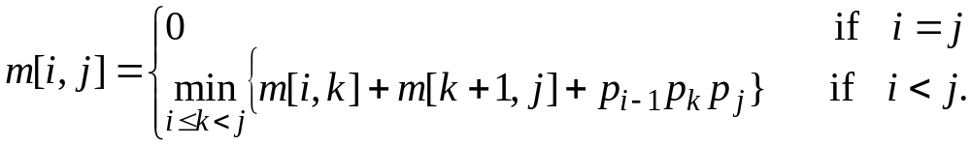
Matrix-Chain multiplication (cont.)
Recursive defination for the minimum cost of paranthesization:

Slide 18
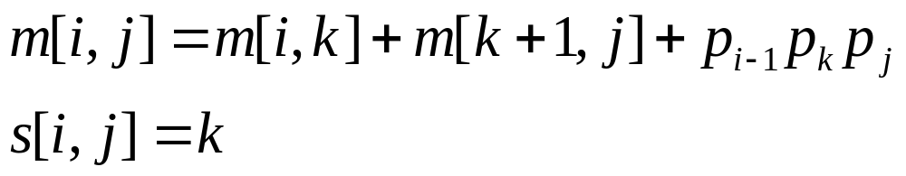
Matrix-Chain multiplication (cont.)
To help us keep track of how to constrct an optimal solution we define s[ i,j] to be a value of k at which we can split the product A_{i...j} to obtain an optimal paranthesization.
That is s[ i,j] equals a value k such that

Slide 19
Matrix-Chain multiplication (cont.)
Step 3: Computing the optimal costs
It is easy to write a recursive algorithm based on recurrence for computing m[i,j].
But the running time will be exponential!...

Slide 20
Matrix-Chain multiplication (cont.)
Step 3: Computing the optimal costs
We compute the optimal cost by using a tabular, bottom-up approach.

Slide 21
Matrix-Chain multiplication (Contd.)
MATRIX-CHAIN-ORDER(p)
n←length[p]-1
for i←1 to n
do m[i,i]←0
for l←2 to n
do for i←1 to n-l+1
do j←i+l-1
m[i,j]← ∞
for k←i to j-1
do q←m[i,k] + m[k+1,j]+p_{i-1} p_{k} p_{j}
if q < m[i,j]
then m[i,j] ←q s[i,j] ←k
return m and s

Slide 22
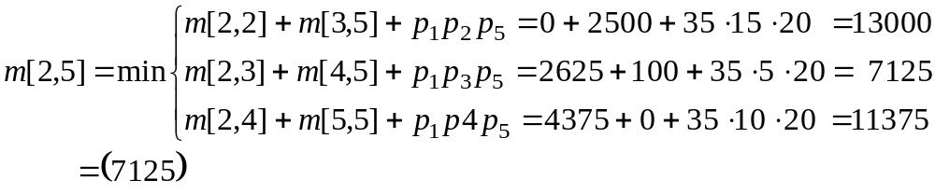
Matrix-Chain multiplication (cont.)
An example: matrix dimension
A₁ 30 x 35
A₂ 35 x 15
A₃ 15 x 5
A₄ 5 x 10
A₅ 10 x 20
A₆ 20 x 25

Slide 23
Matrix-Chain multiplication (cont.)
s
m
6
1
6
1
5
3
2
i
j
5
15125
2
4
3
3
3
j
i
11875
10500
3
3
3
4
4
3
3
9375
7125
575
4
3
3
5
5
3
2
1
4375
2500
3500
5
7875
2500
1
2
3
4
5
2
2625
750
1000
5000
6
15750
1000
1
0
0
0
0
0
0
A₁
A₂
A₃
A₄
A₅
A₆

Slide 24
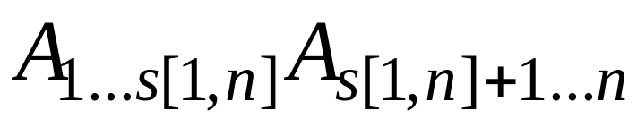
Matrix-Chain multiplication (cont.)
Step 4: Constructing an optimal solution
An optimal solution can be constructed from the computed information stored in the table s[1...n, 1...n].
We know that the final matrix multiplication is
The earlier matrix multiplication can be computed recursively.

Slide 25
Matrix-Chain multiplication (Contd.)
PRINT-OPTIMAL-PARENS (s, i, j)
1 if i=j
then print “A_{i}”
else print “ ( “
PRINT-OPTIMAL-PARENS (s, i, s[i,j])
PRINT-OPTIMAL-PARENS (s, s[i,j]+1, j)
6 Print “ ) ”

Slide 26
Matrix-Chain multiplication (Contd.)
RUNNING TIME:
Recursive solution takes exponential time.
Matrix-chain order yields a running time of O(n³)

Slide 27
Elements of dynamic programming
When should we apply the method of Dynamic Programming?
Two key ingredients:
- Optimal substructure
- Overlapping subproblems

Slide 28
Elements of dynamic programming (cont.)
Optimal substructure (os):
A problem exhibits os if an optimal solution to the problem contains within it optimal solutions to subproblems.
Whenever a problem exhibits os, it is a good clue that dynamic programming might apply.
In dynamic programming, we build an optimal solution to the problem from optimal solutions to subproblems.
Dynamic programming uses optimal substructure in a bottom-up fashion.

Slide 29
Elements of dynamic programming (cont.)
Overlapping subproblems:
When a recursive algorithm revisits the same problem over and over again, we say that the optimization problem has overlapping subproblems.
In contrast , a divide-and-conquer approach is suitable usually generates brand new problems at each step of recursion.
Dynamic programming algorithms take advantage of overlapping subproblems by solving each subproblem once and then storing the solution in a table where it can be looked up when needed.

Slide 30
Elements of dynamic programming (cont.)
Overlapping subproblems: (cont.)
1..4
1..1
2..4
1..2
3..4
1..3
4..4
2..2
3..4
2..3
4..4
1..1
2..2
3..3
4..4
1..1
2..3
1..2
3..3
3..3
4..4
2..2
3..3
2..2
3..3
1..1
2..2
The recursion tree of RECURSIVE-MATRIX-CHAIN( p, 1, 4). The computations performed in a shaded subtree are replaced by a single table lookup in MEMOIZED-MATRIX-CHAIN( p, 1, 4).

Slide 31
Matrix-Chain multiplication (Contd.)
RECURSIVE-MATRIX-CHAIN (p, i, j)
1 if i = j
2 then return 0
3 m[i,j] ←∞
4 for k←i to j-1
5 do q←RECURSIVE-MATRIX-CHAIN (p, i, k)
+ RECURSIVE-MATRIX-CHAIN (p, k+1, j)+ p_{i-1} p_{k} p_{j}
6 if q < m[i,j]
7 then m[i,j] ←q
8 return m[i,j]

Slide 32
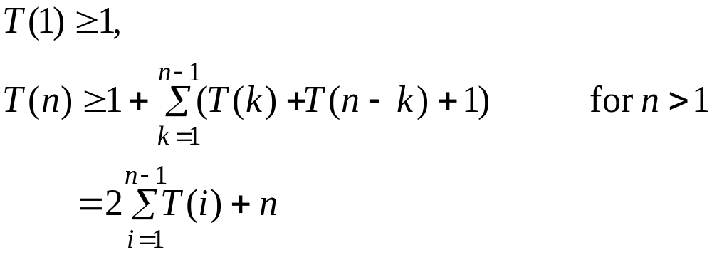
Elements of dynamic programming (cont.)
Overlapping subproblems: (cont.)
Time to compute m[ i,j] by RECURSIVE-MATRIX-CHAIN:
We assume that the execution of lines 1-2 and 6-7 take at least unit time.

Slide 33
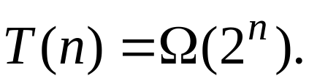
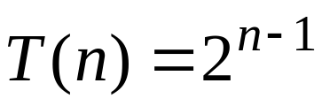
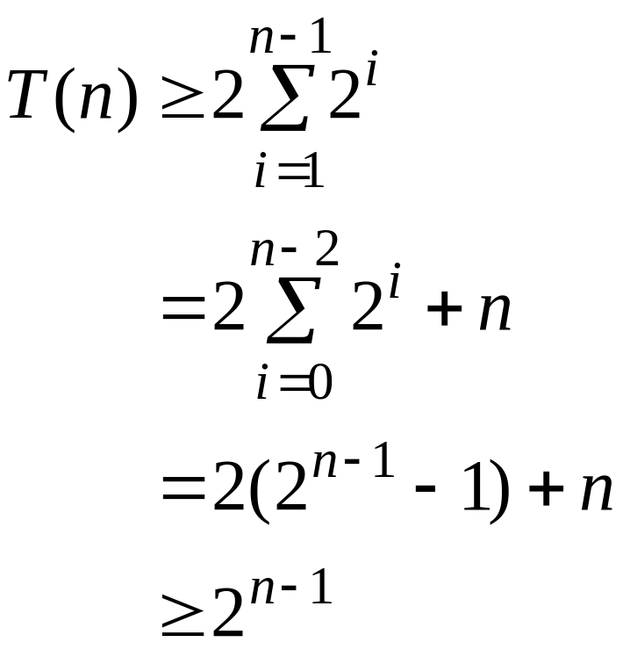
Elements of dynamic programming (cont.)
Overlapping subproblems: (cont.)
WE guess that
Using the substitution method with

Slide 34
Elements of dynamic programming (cont.)
Memoization
There is a variation of dynamic programming that often offers the efficiency of the usual dynamic-programming approach while maintaining a top-down strategy.
The idea is to memoize the the natural, but inefficient, recursive algorithm.
We maintain a table with subproblem solutions, but the control structure for filling in the table is more like the recursive algorithm.

Slide 35
Elements of dynamic programming (cont.)
Memoization (cont.)
An entry in a table for the solution to each subproblem is maintained.
Eech table entry initially contains a special value to indicate that the entry has yet to be filled.
When the subproblem is first encountered during the execution of the recursive algorithm, its solution is computed and then stored in the table.
Each subsequent time that the problem is encountered, the value stored in the table is simply looked up and returned.

Slide 36
Elements of dynamic programming (cont.)
1 MEMOIZED-MATRIX-CHAIN(p)
2 n←length[p]-1
3 for i←1 to n
4 do for j←i to n
do m[i,j] ←∞
return LOOKUP-CHAIN(p,1,n)

Slide 37
Elements of dynamic programming (cont.)
Memoization (cont.)
LOOKUP-CHAIN(p,1,n)
1 if m[i,j] < ∞
2 then return m[i,j]
3 if i=j
4 then m[i,j] ←0
5 else for k←1 to j-1
6 do q← LOOKUP-CHAIN(p,i,k)
+ LOOKUP-CHAIN(p,k+1,j) + p_{i-1} p_{k} p_{j}
7 if q < m[i,j]
8 then m[i,j] ←q
9 return m[i,j]

