Slide 1
Querying the Semantic Web with SPARQL
Emanuele Della Valle
emanuele.dellavalle@polimi.it
http://emanueledellavalle.org

Slide 2



Share, Remix, Reuse — Legally
This work is licensed under the Creative Commons Attribution 3.0 Unported License.
Your are free:
  to Share — to copy, distribute and transmit the work
  to Remix — to adapt the work
Under the following conditions
  Attribution — You must attribute the work by inserting
    “© applied-semantic-web.org” at the end of each reused slide
    a credits slide stating “These slides are partially based on “Querying the Semantic Web with SPARQL” by Emanuele Della Valle http://applied-semantic-web.org/2010/03/05_SPARQL.ppt
To view a copy of this license, visit http://creativecommons.org/licenses/by/3.0/

Slide 3
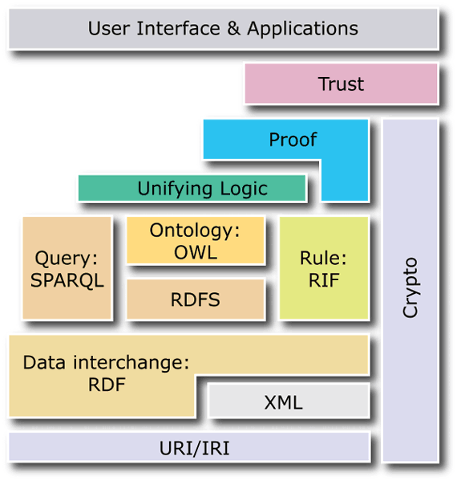
Query: SPARQL

Slide 4
SPARQL in a nutshell
What is SPARQL?
SPARQL
  is the query language of the Semantic Web
  stays for SPARQL Protocol and RDF Query Language
A Query Language ...:
Find names and websites of contributors to PlanetRDF: PREFIX foaf: <http://xmlns.com/foaf/0.1/>
SELECT ?name ?website
FROM <http://planetrdf.com/bloggers.rdf>
WHERE { ?person foaf:weblog ?website ;
foaf:name ?name .
?website a foaf:Document }
... and a Protocol.
http://.../qps?
query-lang=http://www.w3.org/TR/rdf-sparql-query/ &graph-id=http://planetrdf.com/bloggers.rdf &query=PREFIX foaf: <http://xmlns.com/foaf/0.1/...

Slide 5
SPARQL in a nutshell
Why SPARQL?
SPARQL let us
  Pull values from structured and semi-structured data represented in RDF
  Explore RDF data by querying unknown relationships
  Perform complex joins of disparate RDF repositories in a single query
  Transform RDF data from one vocabulary to another
  Develop higher-level cross-platform application

Slide 6
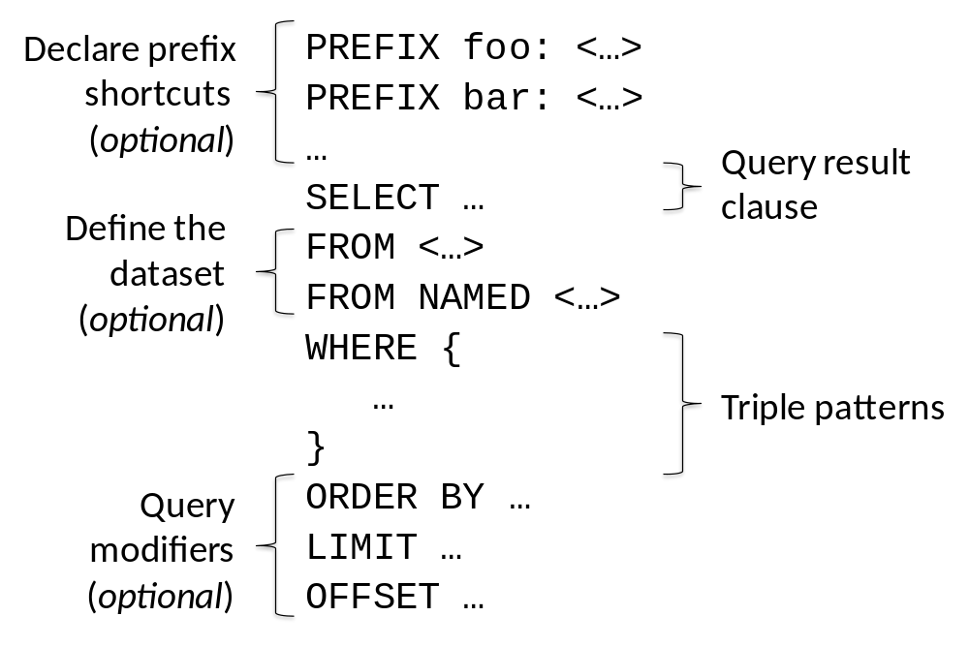
SPARQL in a nutshell
Anatomy of a SPARQL query

Slide 7
SPARQL in a nutshell
Triple Pattern Syntax
Turtle-like: URIs, QNames, literals, convenience syntax.
Adds variables to get basic patterns
  ?var
  Variable names are a subset of NCNames (no "-" or ".")
E.g.,
  simple
    ?s a dbpedia-owl:Drug .
  complex
    ?s a dbpedia-owl:Drug .
    ?s skos:subject category:Anxiolytics .
    ?s ?p dbpedia:Kidney .
Adds
  OPTIONAL to cope with semi-structured nature of RDF
  FILTER to select solution according to some criteria
  UNION operator to get complex patterns
Notes:
PREFIX skos: <http://www.w3.org/2004/02/skos/core#>
PREFIX dbpedia: <http://dbpedia.org/resource/>
PREFIX dbpedia-owl: <http://dbpedia.org/ontology/>
PREFIX category: <http://dbpedia.org/resource/Category:>
select ?s ?p
where { ?s a dbpedia-owl:Drug ;
skos:subject category:Anxiolytics ;
?p dbpedia:Kidney . }
http://dbpedia.org/isparql/view/?query=PREFIX%20skos%3A%20%3Chttp%3A%2F%2Fwww.w3.org%2F2004%2F02%2Fskos%2Fcore%23%3E%0APREFIX%20dbpedia%3A%20%3Chttp%3A%2F%2Fdbpedia.org%2Fresource%2F%3E%20%0APREFIX%20dbpedia-owl%3A%20%3Chttp%3A%2F%2Fdbpedia.org%2Fontology%2F%3E%20%0APREFIX%20category%3A%20%3Chttp%3A%2F%2Fdbpedia.org%2Fresource%2FCategory%3A%3E%20%0A%0Aselect%20%3Fs%20%3Fp%20%0Awhere%20%7B%20%3Fs%20a%20dbpedia-owl%3ADrug%20%3B%0A%20%20%20%20%20%20%20%20skos%3Asubject%20category%3AAnxiolytics%20%3B%0A%20%20%20%20%20%20%20%20%3Fp%20dbpedia%3AKidney%20.%20%7D%0A%20&endpoint=/sparql&maxrows=50&default-graph-uri=http://dbpedia.org

Slide 8
SPARQL in a nutshell
Writing a Simple Query
Query
    PREFIX dbpedia-owl: <http://dbpedia.org/ontology/>
    SELECT ?s
    WHERE { ?s a dbpedia-owl:Drug . }
    Results (click to run query on http://dbpedia.org/isparql/)
?s
http://dbpedia.org/resource/Budesonide
http://dbpedia.org/resource/Aciclovir
http://dbpedia.org/resource/Salbutamol
…

Slide 9
SPARQL in a nutshell
Writing a bit more complex query
Query
    PREFIX skos: <http://www.w3.org/2004/02/skos/core#>
    PREFIX dbpedia-owl: <http://dbpedia.org/ontology/>
    SELECT ?drug ?category
    WHERE { ?drug a dbpedia-owl:Drug ;
    skos:subject ?category . }
    Results (click to run query on http://dbpedia.org/isparql/)
?drug | ?category
http://dbpedia.org/resource/Budesonide | http://dbpedia.org/resource/Category:Glucocorticoids
http://dbpedia.org/resource/Budesonide | http://dbpedia.org/resource/Category:Asthma
http://dbpedia.org/resource/Aciclovir | http://dbpedia.org/resource/Category:Antivirals
http://dbpedia.org/resource/Aciclovir | http://dbpedia.org/resource/Category:Purines
… | …

Slide 10
SPARQL in a nutshell
Basic Patterns
A basic Patter is a set of triple patterns, all of which must be matched.
In this case matches the graph means find a set of bindings such that the substitution of variables for values creates a subgraph that is in the set of triples making up the graph.

Slide 11
SPARQL in a nutshell
Matching RDF literals – Language Tag 1/2
Query
    PREFIX rdfs: <http://www.w3.org/2000/01/rdf-schema#>
    PREFIX dbpedia-owl: <http://dbpedia.org/ontology/>
    SELECT ?drug
    WHERE { ?drug a dbpedia-owl:Drug ;
    rdfs:label "Budesonide" . }
Results (click to run query on http://dbpedia.org/isparql/)
  0 results!!!
Explanation
  All RDF-S label have a language tag

Slide 12
SPARQL in a nutshell
Matching RDF literals – Language Tag 2/2
Query
    PREFIX rdfs: <http://www.w3.org/2000/01/rdf-schema#>
    PREFIX dbpedia-owl: <http://dbpedia.org/ontology/>
    SELECT ?drug
    WHERE { ?drug a dbpedia-owl:Drug ;
    rdfs:label "Budesonide"@en . }
    Results (click to run query on http://dbpedia.org/isparql/)
?drug
http://dbpedia.org/resource/Budesonide

Slide 13
SPARQL in a nutshell
Matching RDF literals – numerical values
As in the case of language tags, if the literals are typed (i.e., "259.34"^^xsd:float), they do not match if they are not given explicitly.
Query
PREFIX xsd: <http://www.w3.org/2001/XMLSchema#>
PREFIX dbpprop: <http://dbpedia.org/property/>
PREFIX dbpedia-owl: <http://dbpedia.org/ontology/>
SELECT ?drug
WHERE { ?drug a dbpedia-owl:Drug ;
dbpprop:chemspiderid "4777"^^xsd:integer . }
    Results (click to run query on http://dbpedia.org/isparql/)
?drug
http://dbpedia.org/resource/Propranolol

Slide 14
SPARQL in a nutshell
RDF Term Constraints
SPARQL allows restricting solutions by applying the FILTER clause.
An RDF term bound to a variable appears in the results if the FILTER expression, applied to the term, evaluates to TRUE.
Query
PREFIX xsd: <http://www.w3.org/2001/XMLSchema#>
PREFIX dbpprop: <http://dbpedia.org/property/>
PREFIX dbpedia-owl: <http://dbpedia.org/ontology/>
SELECT ?drug ?mp
WHERE { ?drug a dbpedia-owl:Drug ;
dbpprop:meltingPoint ?mp .
FILTER ( ?mp < 30 ) }
    Results (click to run query on http://dbpedia.org/isparql/)
?drug | ?mp
http://dbpedia.org/resource/Levorphanol | 23
http://dbpedia.org/resource/Streptomycin | 12
… | …

Slide 15
SPARQL in a nutshell
RDF Term Constraints – regex
SPARQL FILTERs allows also restricting values of strings using the regex()
Query
PREFIX rdfs: <http://www.w3.org/2000/01/rdf-schema#>
PREFIX dbpedia-owl: <http://dbpedia.org/ontology/>
SELECT ?drug ?c
WHERE { ?drug a dbpedia-owl:Drug ;
rdfs:comment ?c .
FILTER( regex(?c, "Asthma")) }
    Results (click to run query on http://dbpedia.org/isparql/)
?drug | ?c
http://dbpedia.org/resource/Budesonide | … örtlichen Behandlung von Asthma bronchiale, ...
http://dbpedia.org/resource/Salbutamol | … Bronchospasmolytikum bei Asthma bronchiale …
… | …

Slide 16
SPARQL in a nutshell
Value Tests
Notation for value comparison: <, >, =, <=, >= and !=
Test functions
  Check if a variable is bound: BOUND
  Check the type of resource bound: isIRI, isBLANK, isLITERAL
Accessing accessories: LANG, DATATYPE
Logic operators: || and &&
Comparing strings: REGEX, langMatches
Constructor functions: bool, dbl, flt, dec, int, dT, str, IRI
Extensible Value Testing
  E.g., FILTER ( aGeo:distance(?axLoc, ?ayLoc, ?bxLoc, ?byLoc) < 10 ) .
  (see http://www.w3.org/TR/rdf-sparql-query/#extensionFunctions )

Slide 17
SPARQL in a nutshell
More Sophisticated Graph Patterns
RDF is "semi structured" and has no integrity constrains
SPARQL addresses this issue with
  Group patterns match if all subpatterns match and all constraints are satisfied
    In SPARQL syntax, groups are { … }
  OPTIONAL graph patterns accommodate the need to add information to a result but without the query failing just because some information is missing.
    In SPARQL syntax, OPTIONAL { … }
  UNION graph patterns allows to match alternatives
    In SPARQL syntax, { … } UNION { … }

Slide 18
SPARQL in a nutshell
Optional Graph Patterns
Query
PREFIX dbpprop: <http://dbpedia.org/property/>
PREFIX dbpedia-owl: <http://dbpedia.org/ontology/>
SELECT ?drug ?mp
WHERE { ?drug a dbpedia-owl:Drug .
OPTIONAL { ?drug dbpprop:meltingPoint ?mp }
}
    Results (click to run query on http://dbpedia.org/isparql/)
?drug | ?mp
http://dbpedia.org/resource/Budesonide
http://dbpedia.org/resource/Aciclovir | 256.5
… | …

Slide 19
SPARQL in a nutshell
Matching alternatives with UNION
Query
PREFIX dbpprop: <http://dbpedia.org/property/>
PREFIX dbpedia-owl: <http://dbpedia.org/ontology/>
PREFIX dbpedia: <http://dbpedia.org/resource/>
SELECT ?drug
WHERE { ?drug a dbpedia-owl:Drug .
{ ?drug dbpprop:metabolism dbpedia:Kidney }
UNION
{ ?drug dbpprop:excretion dbpedia:Kidney }
}
    Results (click to run query on http://dbpedia.org/isparql/)
?drug
http://dbpedia.org/resource/Doripenem
http://dbpedia.org/resource/Alprazolam
http://dbpedia.org/resource/Piroxicam
http://dbpedia.org/resource/Amlodipine
…
dbpprop:metabolism
dbpprop:excretion

Slide 20
SPARQL in a nutshell
Defining the Dataset with the FROM clause
A SPARQL query may specify the dataset to be used for matching by using
  the FROM clause and
  the FROM NAMED clause
Ex.
PREFIX rdfs:<http://www.w3.org/2000/01/rdf-schema#>
PREFIX skos: <http://www.w3.org/2004/02/skos/core#>
SELECT ?label ?graph
FROM <http://dbpedia.org/resource/Category:Anxiolytics>
FROM NAMED <http://dbpedia.org/resource/Propranolol>
WHERE {
?s rdfs:label ?label .
GRAPH ?graph { ?graph skos:subject ?s . }
}
Results below are very different from those of the same query without FROM clauses
?label | ?graph
Anxiolytics@en | http://dbpedia.org/resource/Propranolol

Slide 21
SPARQL in a nutshell
A difficult to solve problem 1/3
Image you don’t know dbpedia SPARQL endpoint, you discovered using Sindice the graph http://dbpedia.org/resource/ Category:Anxiolytics and you want to get the rdfs:labels of the anxiolytics.
If you write the query
PREFIX rdfs:<http://www.w3.org/2000/01/rdf-schema#>
PREFIX skos: <http://www.w3.org/2004/02/skos/core#>
PREFIX dbp-cat: <http://dbpedia.org/resource/Category:>
SELECT ?label
FROM <http://dbpedia.org/resource/Category:Anxiolytics>
WHERE {
?s skos:subject dbp-cat:Anxiolytics .
?s rdfs:label ?label .
}
You get no results because the labels are in different graphs such as
  http://dbpedia.org/resource/Alprazolam
  […]
  http://dbpedia.org/resource/ZK-93423

Slide 22
SPARQL in a nutshell
A difficult to solve problem 2/3
A solution is writing the query
PREFIX rdfs:<http://www.w3.org/2000/01/rdf-schema#>
PREFIX skos: <http://www.w3.org/2004/02/skos/core#>
PREFIX dbp-cat: <http://dbpedia.org/resource/Category:>
SELECT ?label
  FROM <http://dbpedia.org/resource/Category:Anxiolytics>
  FROM <http://dbpedia.org/resource/Alprazolam>
  FROM […]
  FROM <http://dbpedia.org/resource/ZK-93423>
WHERE {
?s skos:subject dbp-cat:Anxiolytics .
?s rdfs:label ?label .
}
But this means knowing the answer already

Slide 23
SPARQL in a nutshell
A difficult to solve problem 3/3
The Semantic Web Client provides a solution to the problem by dynamically retrieving information from the Semantic Web
  It dereferences HTTP URIs,
  It follows rdfs:seeAlso links, and
  it queries the Sindice search engine.
Querying the Semantic Web with the following query …
PREFIX rdfs:<http://www.w3.org/2000/01/rdf-schema#>
PREFIX skos: <http://www.w3.org/2004/02/skos/core#>
PREFIX dbp-cat: <http://dbpedia.org/resource/Category:>
SELECT ?label
  WHERE {
  ?s skos:subject dbp-cat:Anxiolytics .
  ?s rdfs:label ?label .
  }
… gives the correct results even if no FROM clause is given and no specific SPARQL endpoint is used.

Slide 24
SPARQL in a nutshell
Result Forms
Besides selecting tables of values, SPARQL allows three other types of queries:
  ASK - returns a boolean answering, does the query have any results?
  CONSTRUCT - uses variable bindings to return new RDF triples
  DESCRIBE - returns server-determined RDF about the queried resources
SELECT and ASK results can be returned as XML or JSON.
CONSTRUCT and DESCRIBE results can be returned via any RDF serialization (e.g. RDF/XML or Turtle).

Slide 25
SPARQL in a nutshell
SPARQL Resources
SPARQL Frequently Asked Questions
  http://thefigtrees.net/lee/sw/sparql-faq
SPARQL implementations - community maintained list of open-source and commercial SPARQL engines
  http://esw.w3.org/topic/SparqlImplementations
Public SPARQL endpoints - community maintained list
  http://esw.w3.org/topic/SparqlEndpoints
SPARQL extensions - collection of SPARQL extensions implemented in various SPARQL engines
  http://esw.w3.org/topic/SPARQL/Extensions

Slide 26
Querying the Semantic Web with SPARQL
Emanuele Della Valle
emanuele.dellavalle@polimi.it
http://emanueledellavalle.org

