Slide 1

Smart Locker Access Control System Using IoT-Based Remote Authentication and Real-Time Monitoring
An intelligent, IoT-enabled approach to secure locker access, remote authentication, and continuous monitoring.
MOLLI MOHAN
323129520091

Slide 2


Problem Statement
The Challenge
Physical Key Risks
Secure storage is essential across homes, offices, educational institutions, banks, and commercial facilities. Yet most deployed systems fall short of modern security demands.
Keys can be lost, duplicated, or stolen — creating direct unauthorized access vulnerabilities.
Traditional systems leave critical gaps in both security and visibility.
Password Vulnerabilities
Password-based locks are susceptible to guessing, shoulder surfing, and brute-force attacks.
Limited Monitoring
Traditional systems offer no continuous monitoring, access logs, or instant alert capabilities.
User Demand
Users require intelligent systems with secure remote authentication and real-time notifications.

Slide 3

Proposed Solution
The Smart Locker Access Control System leverages IoT to deliver secure remote authentication and real-time locker monitoring through a unified, centralized platform.
IoT-Enabled Authentication
Secure remote authentication powered by IoT communication connects users to lockers seamlessly.
Centralized Platform
A single platform manages locker status, user authentication, and access control in real time.
User-Friendly Interface
A secure and intuitive interface ensures authorized users can access and manage lockers with ease.
Continuous Monitoring
All locker activity is continuously monitored, ensuring visibility and rapid response to events.

Slide 4

Authentication and Access Control
Multi-Modal Authentication Methods
The system supports one or more of the following authentication approaches, ensuring flexibility and robust security:
IoT-based communication connects the locker hardware to the centralized platform, ensuring only verified, authorized users are granted access.
RFID-Based Authentication
Biometric Authentication
Mobile-Based Access Control
Users present an RFID card or tag for fast, contactless identity verification.
Fingerprint or other biometric data provides a high-assurance identity check.
Smartphone-based credentials allow remote and convenient locker access.

Slide 5
System Components
These nine components work together to deliver secure locker management through authentication, connectivity, monitoring, user interaction, and security notifications.
RFID Authentication
Biometric System
Mobile Access Control
Card or tag-based identity verification at the locker.
High-assurance biometric identity confirmation.
Smartphone-based credential management and access.
IoT Communication
Cloud Connectivity
Smart Locker Mechanism
Modules enabling real-time locker-to-platform connectivity.
Secure cloud infrastructure for data storage and access.
Electronically controlled access-control hardware.
Monitoring Platform
User Interface
Alert Mechanism
Centralized platform for locker oversight and management.
Intuitive interface for user interaction and control.
Instant security alerts and notification delivery system.

Slide 6
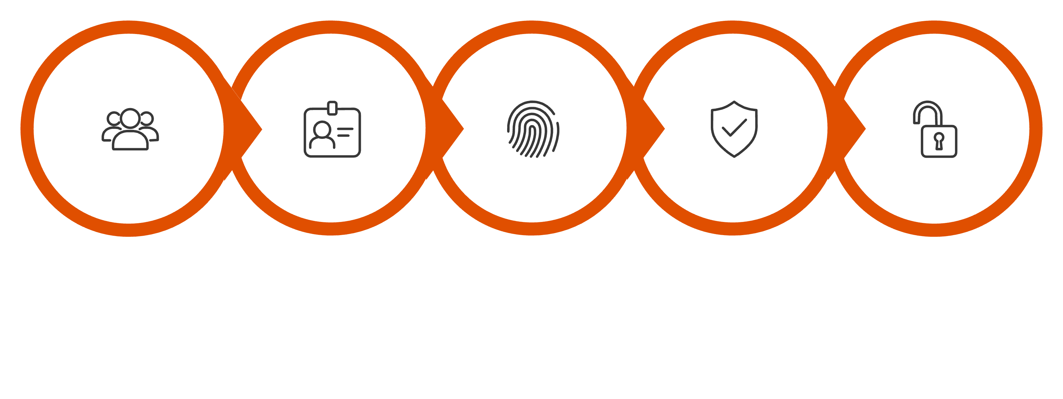
System Working Process
Check Authorization
Attempt Access
Collect Credentials
Verify Identity
Grant Access
The end-to-end workflow ensures every access attempt is authenticated, logged, and monitored — with instant alerts triggered for any unauthorized or forced-entry event.

Slide 7

Real-Time Monitoring and Security Alerts
Continuous Visibility
Real-time monitoring improves security and enables quick response to suspicious activity. The system maintains a comprehensive view of all locker events at all times.
⚠ Unauthorized Access Detection
🔒 Forced Entry Detection
🔔 Instant Alerts
Flags and logs failed or unauthorized authentication attempts immediately.
Physical tampering or forced entry triggers an instant security response.
Security notifications are delivered in real time to administrators and users.
Locker Status Monitoring
Access History & Auth Logs
User Activity Monitoring
Remote Monitoring
Continuous tracking of open, closed, and tampered states.
Full records of every access event and authentication attempt.
Tracks individual user interactions with the locker system.
Administrators manage and observe locker activity from anywhere.

Slide 8
Dashboard and Centralized Management
The centralized interactive dashboard provides a single platform to monitor and manage all aspects of locker security.
Locker Status
Access History
Live view of every locker's current state across all locations.
Complete chronological log of all locker access events.
Authentication Logs
User Activity
Detailed records of all authentication attempts and outcomes.
Per-user interaction tracking for accountability and auditing.
Security Alerts
Auth Management
Centralized view of all triggered alerts and incident history.
Add, modify, or revoke user credentials and access rights remotely.

Slide 9




Benefits and Applications
Key Benefits
Application Domains
Improved Access Control
Multi-modal authentication ensures only verified users gain entry.
Enhanced Asset Protection
Banks
Educational Institutions
Offices & Hotels
Continuous monitoring and instant alerts safeguard stored assets.
High-security safe deposit and document storage.
Student and staff locker management at scale.
Employee and guest secure storage solutions.
Reduced Unauthorized Access Risk
IoT-based authentication eliminates key and password vulnerabilities.
Warehouses & Residential
Remote Monitoring & Scalability
Manage and scale locker security from a single centralized platform.
Asset protection in industrial and home environments.

Slide 10

Conclusion
The Smart Locker Access Control System represents a modern, intelligent approach to IoT-based locker security — directly addressing the limitations of traditional systems.
Integrated Architecture
Combines secure authentication, IoT communication, cloud connectivity, and real-time monitoring in a unified system.
Overcomes Traditional Limitations
Eliminates the vulnerabilities of physical keys and password-based locks with multi-modal, verified authentication.
Comprehensive Security
Improves access control, asset protection, remote monitoring, and incident response across all deployment environments.
Intelligent & Scalable
A forward-looking platform that scales to meet the security demands of diverse institutions and facilities.

