Slide 1
Pediatric Craniofacial Syndromes
Key types, features, and anesthesia considerations

Slide 2
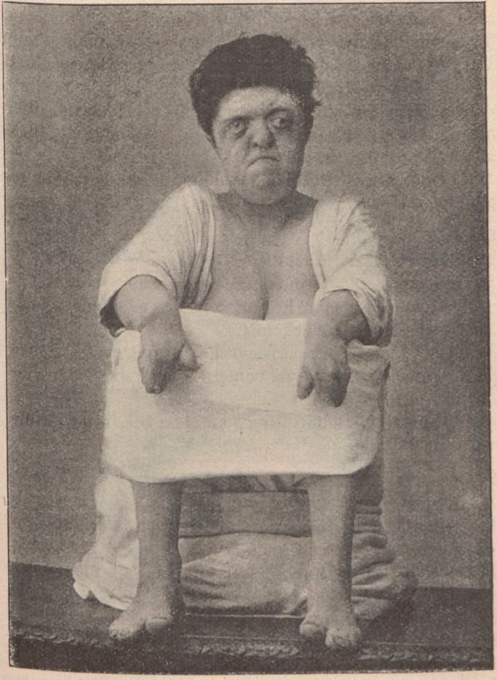
Apert Syndrome
Craniosynostosis with turribrachycephaly, midface hypoplasia, syndactyly; possible cleft palate.
- Anticipate difficult mask/intubation (midface hypoplasia, choanal atresia)
- Screen for CHD; manage ICP if present
- Eye protection for proptosis; careful positioning
Apert syndrome: syndactyly (Wikimedia Commons)

Slide 3
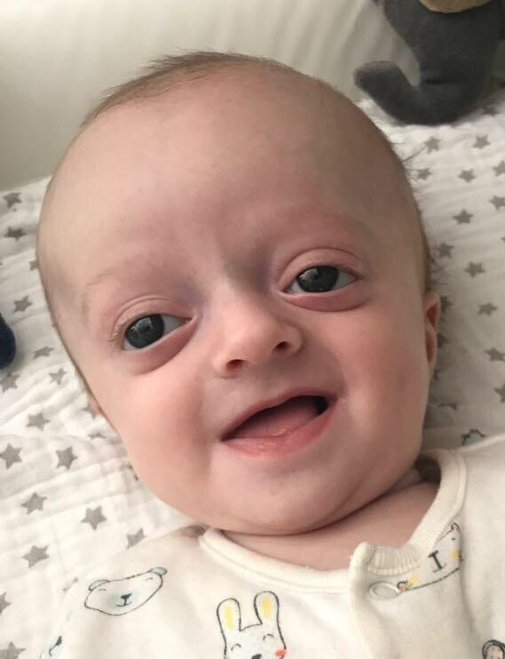
Crouzon Syndrome
Craniosynostosis, midface hypoplasia, beaked nose, proptosis; no limb anomalies.
- Potential difficult airway; consider fiberoptic
- Monitor for increased ICP
- Eye protection due to proptosis
Crouzon syndrome (Wikimedia Commons)

Slide 4
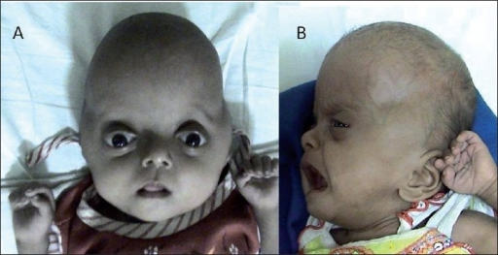
Pfeiffer Syndrome
Craniosynostosis with midface hypoplasia; broad, medially deviated thumbs/toes.
- Airway obstruction risk; prepare for difficult intubation
- Assess for CHD and increased ICP
- Careful positioning and eye protection
Pfeiffer syndrome (Wikimedia Commons)

Slide 5
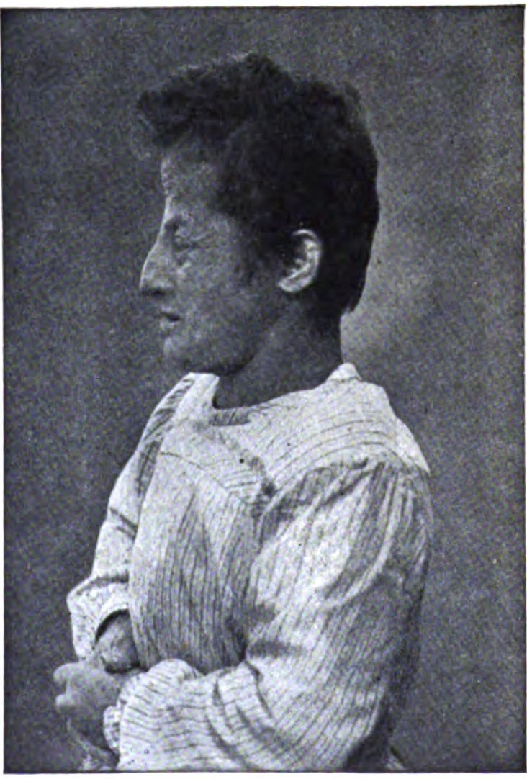
Saethre-Chotzen Syndrome
Craniosynostosis, facial asymmetry, ptosis, mild syndactyly.
- Airway usually manageable; assess individually
- Monitor for ICP and hearing issues
- IV access may be challenging with limb anomalies
Saethre-Chotzen syndrome (Wikimedia Commons)

Slide 6
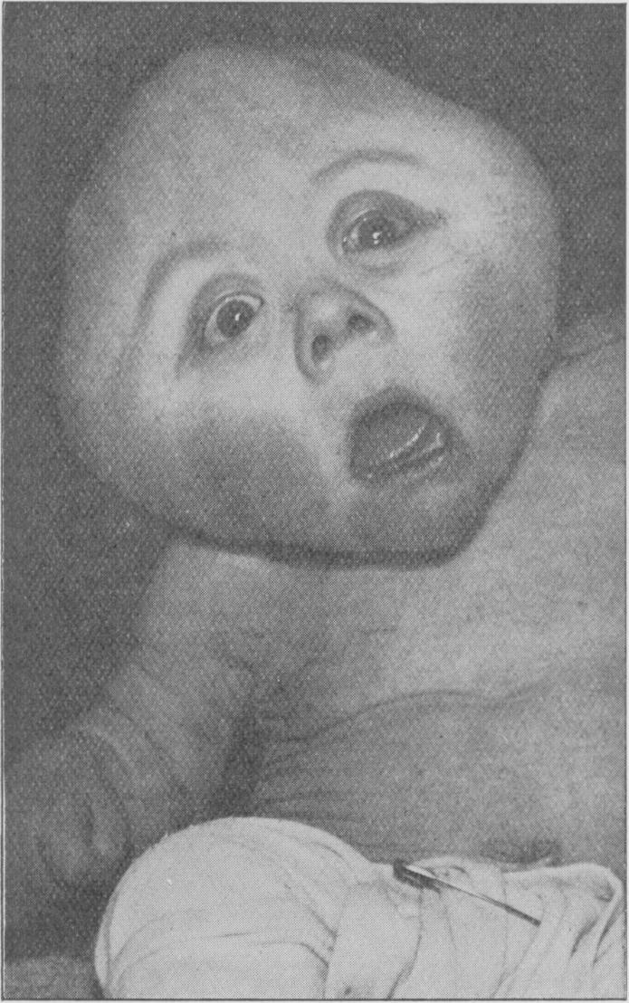
Carpenter Syndrome
Craniosynostosis, syndactyly/polydactyly, obesity; developmental delay.
- Difficult ventilation/intubation (midface hypoplasia, obesity)
- Cardiac defects common; evaluate preop
- Positioning challenges due to habitus and limbs
Carpenter syndrome (Wikimedia Commons)

Slide 7
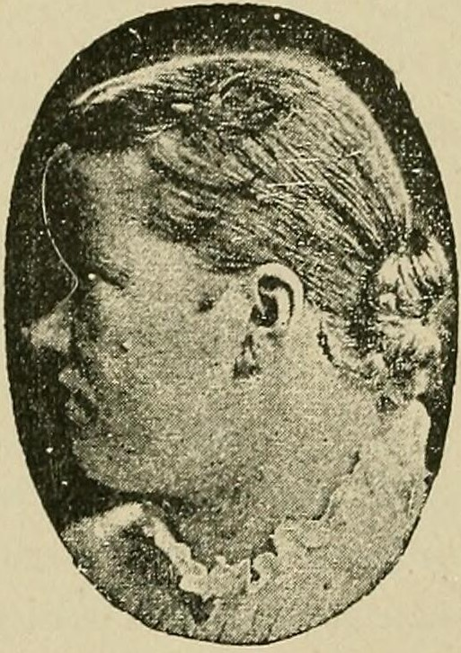
Muenke Syndrome
Coronal craniosynostosis, brachycephaly, midface hypoplasia, hearing loss.
- Prepare for potential difficult airway
- Assess hearing/communication needs
- Monitor for signs of ICP
Muenke syndrome (Wikimedia Commons)

Slide 8
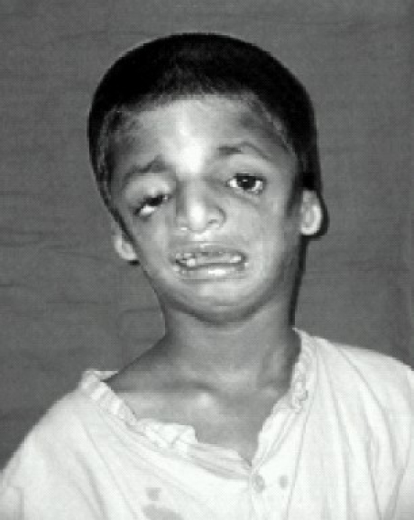
Treacher Collins Syndrome
Mandibulofacial dysostosis: mandibular/malar hypoplasia, downward palpebral fissures, ear anomalies; cleft palate common.
- Very difficult airway; fiberoptic or video techniques
- Consider postoperative airway obstruction; extended monitoring
- Address hearing impairment communication
Treacher Collins syndrome (Wikimedia Commons)

Slide 9
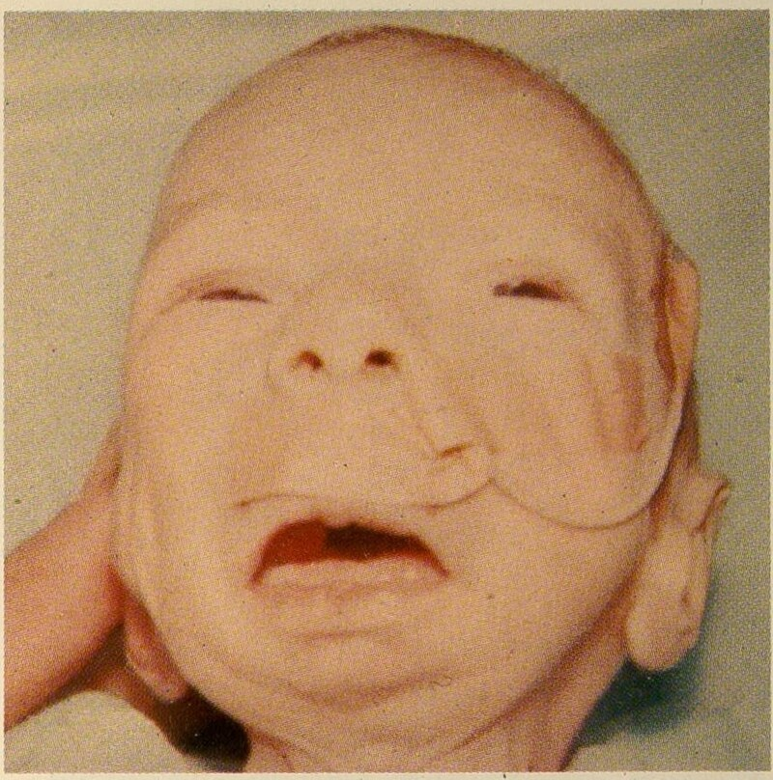
Pierre Robin Sequence
Triad: micrognathia, glossoptosis, cleft palate; significant airway obstruction.
- Maintain spontaneous ventilation until airway secured
- Prepare for difficult intubation; alternative airways
- Postop monitoring for obstruction
Pierre Robin sequence (Wikimedia Commons)

Slide 10
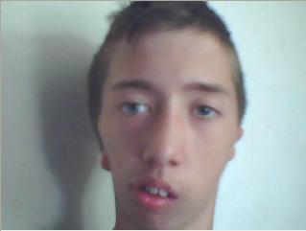
Hemifacial Microsomia / Goldenhar
Unilateral facial underdevelopment; ear anomalies; vertebral +/- cardiac defects.
- Difficult intubation due to asymmetry/mandibular hypoplasia
- Evaluate cardiac/vertebral anomalies
- Careful positioning and padding
Hemifacial microsomia (Wikimedia Commons)

Slide 11
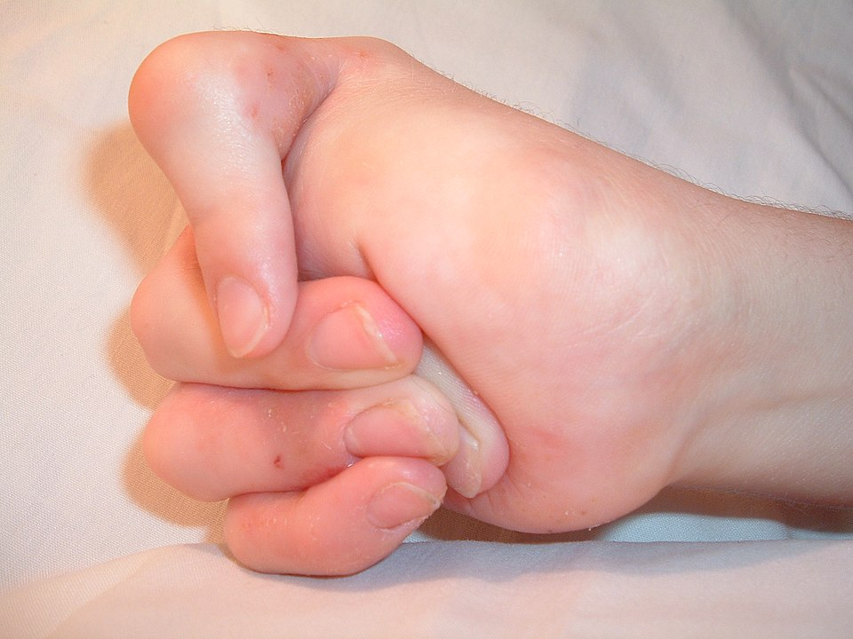
Freeman-Sheldon Syndrome
Whistling face: microstomia, pursed lips; limb contractures; scoliosis.
- Extremely difficult airway; microstomia
- Positioning challenges; consider MH risk per institutional protocol
- Plan postoperative respiratory support
Freeman-Sheldon syndrome (Wikimedia Commons)

Slide 12
References
Image: Apert Syndrome — https://en.wikipedia.org/wiki/Apert_syndrome
Image: Crouzon Syndrome — https://en.wikipedia.org/wiki/Crouzon_syndrome
Image: Pfeiffer Syndrome — https://en.wikipedia.org/wiki/Pfeiffer_syndrome
Image: Saethre-Chotzen Syndrome — https://en.wikipedia.org/wiki/Saethre%E2%80%93Chotzen_syndrome
Image: Carpenter Syndrome — https://en.wikipedia.org/wiki/Carpenter_syndrome
Image: Muenke Syndrome — https://en.wikipedia.org/wiki/Muenke_syndrome
Image: Treacher Collins Syndrome — https://en.wikipedia.org/wiki/Treacher_Collins_syndrome
Image: Pierre Robin Sequence — https://en.wikipedia.org/wiki/Pierre_Robin_sequence
Image: Hemifacial Microsomia / Goldenhar — https://en.wikipedia.org/wiki/Hemifacial_microsomia
Image: Freeman-Sheldon Syndrome — https://en.wikipedia.org/wiki/Freeman%E2%80%93Sheldon_syndrome
General references: IntechOpen, Medscape, NCBI Bookshelf, ClinicalGate, Aneskey
Always verify local protocols and latest guidelines

