Slide 1
Computer Programming 2

Slide 2
Chapter One
Review: Methods

Slide 3
Outline
What is a Method?
Method Declaration
Simple Methods
Parameterized Methods
Calling Methods
Scope of the Variables

Slide 4
What is a Method?
A method is a block that contains a group of statements that perform an operation.
  Remember, that blocks in Java are enclosed between { and }.
Methods are also called:
  Functions.
  Procedures.
  Subroutines.
Java is an OOP language.
  It uses classes as templates to create objects.
  An object has a state and a behavior.
Objects’ behaviors are represented in Java using methods.

Slide 5
Method Declaration
Methods must be declared within classes.
The syntax to declare a method is as follows:
[modifier][static] returnType methodName([parameter_list])
{
// method body
[return something;]
}
Method Signature (Method header) consists of:
Method Name
Parameter List: number of parameters, data types of the parameters, and the order of the parameters.

Slide 6
Return Type
Method Declaration
Return type specifies the data type of the value that the method returns.
For example, if a method has an int return type then it returns an integer value.
If the method does not return a value, its return type is void.
Based on the return type, there are two types of methods:
  Return-value methods:
    Methods that return a value at the end of their execution.
    The return value is used in the main() method.
  2. void methods:
    Methods that perform operations without returning a value at the end of their execution.
    Most often, void methods perform output operations to show execution results.

Slide 7
Method Declaration
Parameter List
The parameter list is the set of values that are passed to the method.
We can pass any number of arguments to a method.
In Java, there are two types of methods based on the parameter list:
  Simple methods: Methods without parameters.
  Parameterized methods: Methods with parameters.

Slide 8
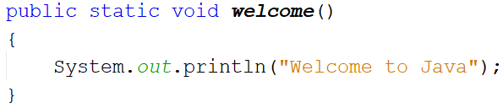
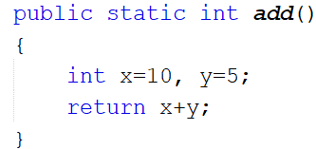
Simple Method
Simple Methods: methods without parameters.
Examples:

Slide 9
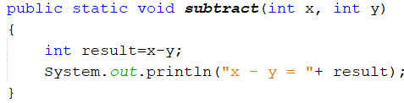
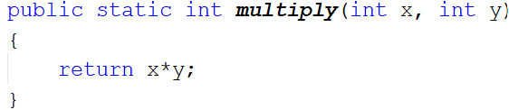
Parameterized Methods
Parameterized Methods: Methods that have parameters.
Parameters are of two types:
  Formal parameters: The parameters that are written in the method signature.
  Arguments: The values that are passed to the parameters and that are written in the method invocation.
Parameters can be thought of as the inputs that the method needs to perform its operations.
Examples:
Methods Signatures

Slide 10
Method Body
Method Declaration
The method body includes the statements, that are used to perform the needed task(s).
The method body is enclosed between the curly braces { and }.
The return Keyword
In order to return a value from a method, we use keyword return.
return is a reserved word that immediately terminates the method’s execution and returns (or transfers) the value to the main() method.
Only non-void methods can return values using the return keyword.
The return keyword IS NOT USED in void methods.
Note: The return keyword returns only one value.

Slide 11
Calling Methods
A Java application consists of several methods.
A method can call itself recursively or can call other methods.
Calling a method is an attempt from one method (the calling method) to transfer control (or execution) to another method (the called method).
The called method has some statements that are required by the calling method.
After a method is called, control is moved to that called method, and we refer to this by method invocation (Jumping inside the method). Or we can say that the called method is invoked.

Slide 12
Calling Methods
When the interpreter reaches a method invocation statement inside the code, it performs the following steps:
  It suspends (or pauses) the execution at that point which the method was called.
  It jumps to the method.
  Control is given to the invoked method, and it starts execution.
  When the method finishes execution by reaching the final statement, if it is a void method, or if it encounters a return keyword, the method exits (or terminates) and control moves back to the calling method.

Slide 13
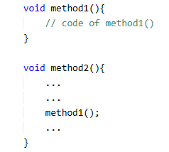
Calling Methods
Method Invocation:
method1() is invoked
3
Method Termination:
method1() finishes execution
4
method2() is suspended
and control is transferred to method1()
2
Control is transferred back to method2()
5
method2() resumes execution at the point where it was suspended
method2() calls method1()
method2(): the calling method
method1(): the called method
6
1

Slide 14
Example
{
int x=10;
int y=12;
int area= findArea(x,y);
System.out.println(“The area is = ”+area);
}
Stop and jump to the method findArea, take the value of actual parameters x and y.
120
Replace the method invocation statement with the result you are carrying
public static int findArea (int a, int b){
int c= a*b;
return c;
}
Pass the value of x and y to the formal parameters a and b respectively
Execute the method.
Oh, find return keyword, carry the result and go back

Slide 15
Calling Methods
There are two ways to call a method, depending on whether the method returns a value or not.
If a method returns a value, the invocation of the method is usually treated as a value and should be written within another statement, such as an assignment statement, or even within a print statement.
If a method is void, the invocation of the method must be issued as a standalone statement.
It is not allowed to use an assignment operator to read the value that is returned from a void method, since void methods DO NOT return values.

Slide 16
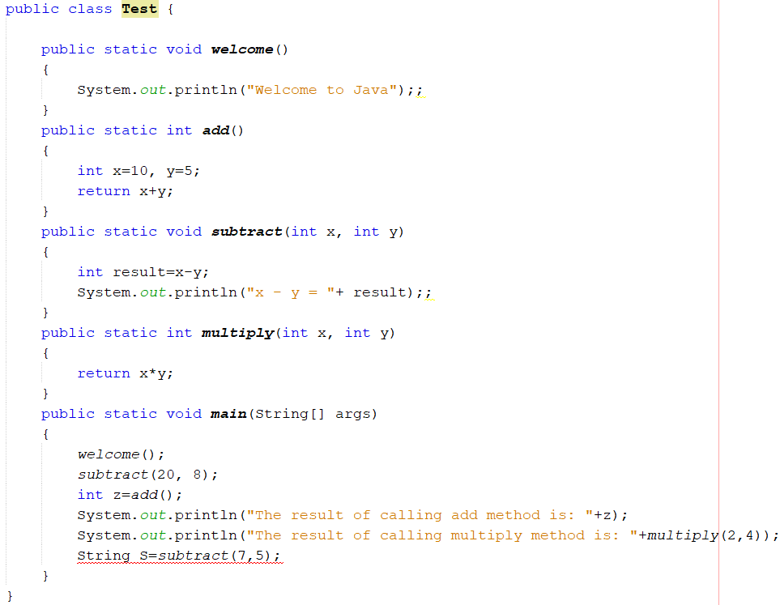

Calling Methods
Example:
Parameters are used to send the required values from the calling method (main()) to the called method (multiply()).
The process of sending the values from the calling to called methods is referred to as passing the parameters.
Void method without parameters
A method with return value without parameters
Void method with parameters
A method with return value with parameters
Calling void methods
Calling parameterized methods
Error

Slide 17
Scope of the Variables
The scope of a variable is the block of the program where the variable can be referenced (used).
A local variable is a variable that is defined inside a method.
The scope of a local variable starts from its declaration and continues to the end of the block that contains that variable.
A local variable must be declared before it can be used.

Slide 18
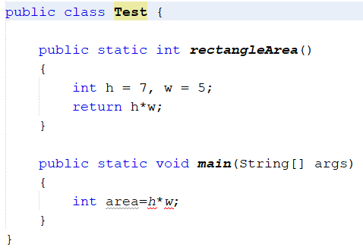
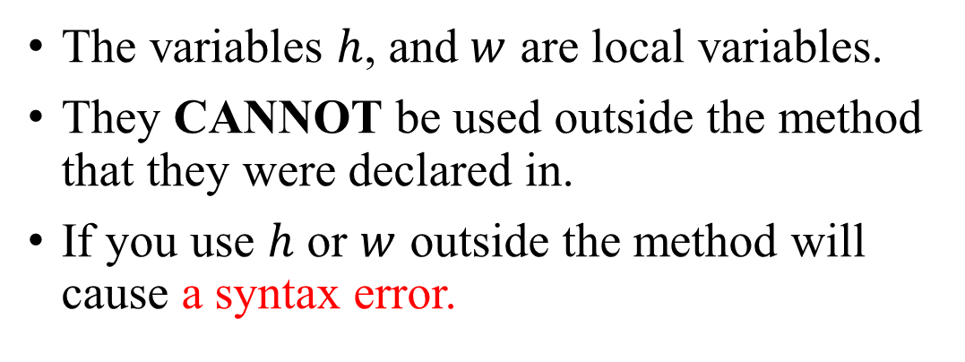
Example
The variables $h$, and $w$ are local variables.
They CANNOT be used outside the method that they were declared in.
If you use $h$ or $w$ outside the method will cause a syntax error.
Syntax Error

