Slide 1
Computer Programming 2

Slide 2
Chapter Two
Object-Oriented Programming (OOP) Concept

Slide 3
Outline
Garbage Collection
Method in a class
Method invocation in the main class
Different Examples of direct calling
toString() Method

Slide 4
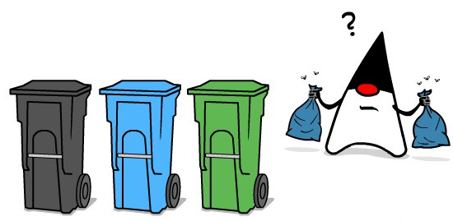
Garbage Collection
Garbage Collection in Java is a process where the Java Virtual Machine (JVM) automatically manages memory by recovering the memory used by objects that are no longer needed or referenced by the program.
A Java virtual machine is a virtual machine that enables a computer to run Java programs as well as programs written in other languages that are also compiled into Java bytecode.

Slide 5
Garbage Collection: Explanation
As shown in the following figure, after the assignment statement c1 = c2, c1 points to the same object referenced by c2.
The object previously referenced by c1 is no longer referenced.
This object is known as garbage. Garbage is automatically collected by JVM.

Slide 6
Method in a class
You may remember earlier when we talked about the state of an object, which consists of both a state (data fields) and behavior (methods), and we explained the data fields.
Now let's talk about methods.
Class Name
List of Attributes …..
Data fields defines the object.
A class
Template
Method₁ name (): return data type or void
Method₂ name (): return data type or void
Method₃ name (): return data type or void
Methods define what the object does.
.
.
.
Method_{n} name (): return data type or void

Slide 7
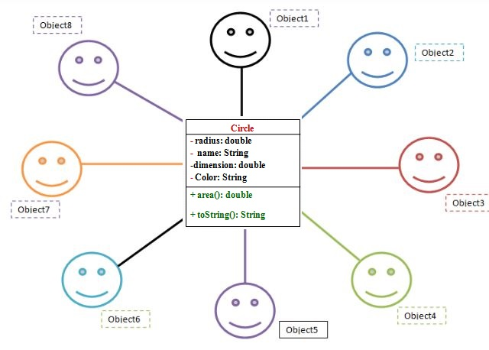
Method in a class
Method: is a block of code that, when called, performs specific actions mentioned in it.
For instance, if you have written instructions to calculate the area of a circle in the method, it will do that task.
You can insert values or parameters into methods, and they will only be executed when called.
Now look at the next (Circle class) example:
Circle
radius: double
name: String
dimension: double
Color: String
+ area(): double
+ printDataFields (): String

Slide 8
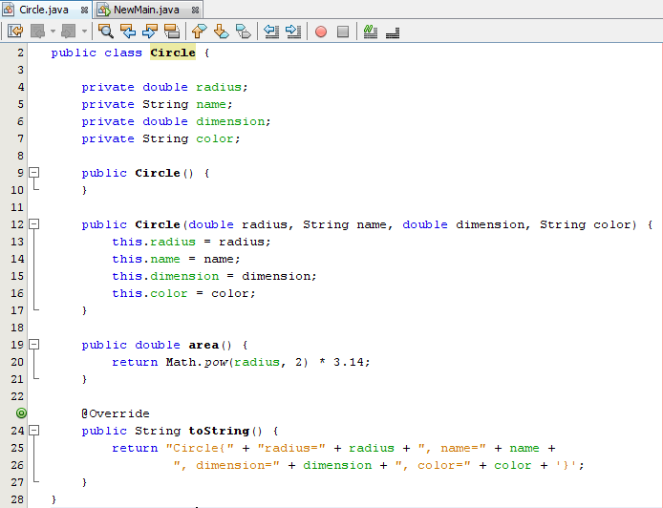
Method in a class
Implementation (programming) Phase using java
Design Phase
Circle
radius: double
name: String
dimension: double
Color: String
+ area(): double
+ printDataFields (): String
A class allows the programmer
to define all the Methods that internally define the behavior of an object..
printDataFields () {

Slide 9
Method invocation in the main class
There are two ways to call methods in Java:
Assuming A(), and B() methods in the same class. The method A() can call method B() directly as shown below:
class x
A(){
B()}
B(){}

Slide 10
Method invocation in the main class
Assuming method A() wants to call method B (), and they are not in the same class.
So, A() should call B() with the object name as follows.
class x
class y
A(){
y obj1= new y();
obj1.B(); }
B(){}

Slide 11
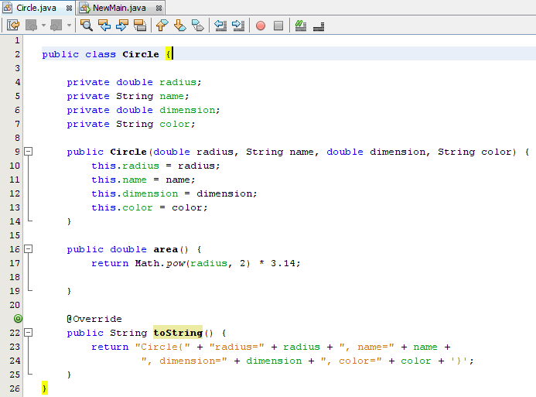
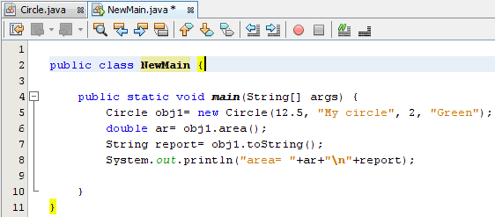
Different Examples of Direct Calling
printDataFields ();
The calling of the method can be made by the object name only as in line 6 and 7 in the Newmain class
printDataFields () {

Slide 12
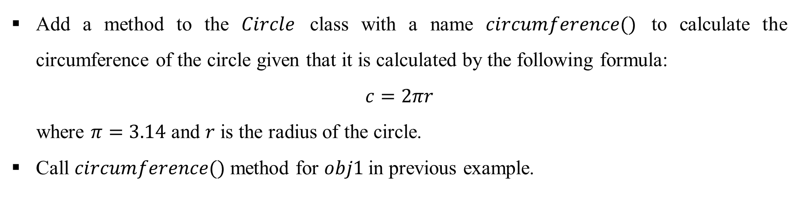
Question
Add a method to the $Circle$ class with a name $circumference()$ to calculate the circumference of the circle given that it is calculated by the following formula:
$$c=2πr$$
where $π=3.14$ and $r$ is the radius of the circle.
Call $circumference()$ method for $obj1$in previous example.

Slide 13
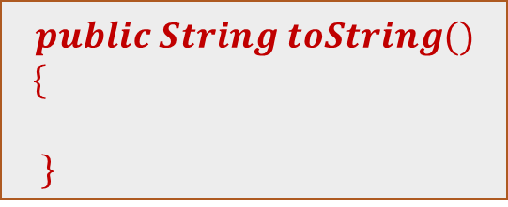
toString() Method
Every class in Java is descended from the (java.lang.Object) class.
The (Object) class has several methods, (toString) method is one of them.
This method normally returns the data fields of a class in (String) format.
The signature of this method is:
$$public String toString()$$
$$\{$$
$$\}$$

Slide 14
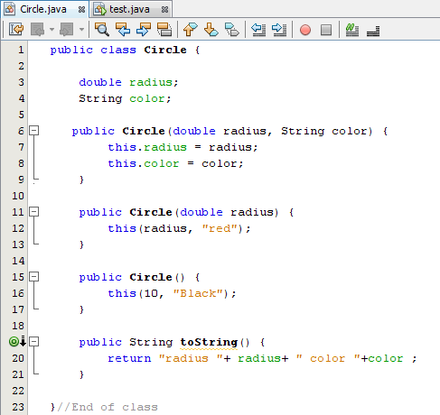
toString() Method

Slide 15
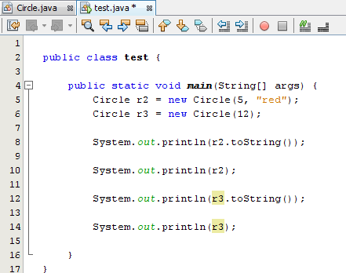
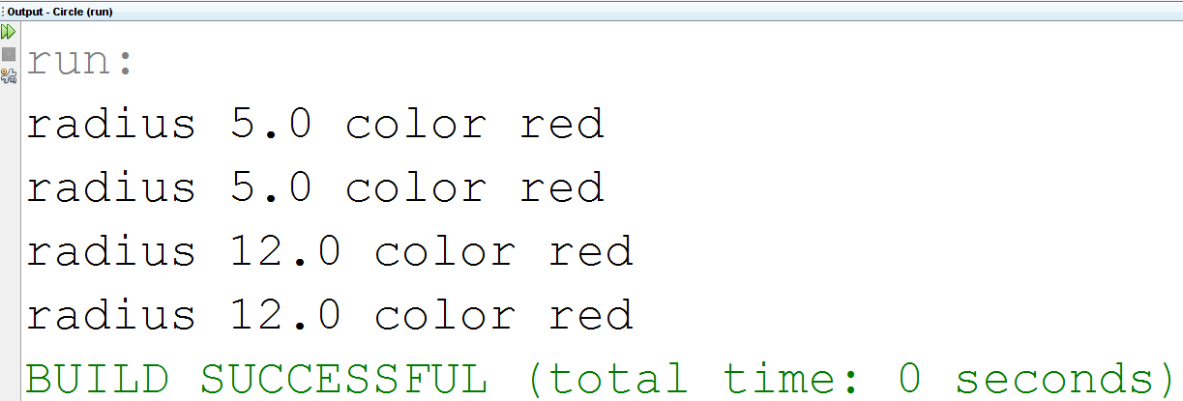
toString() Method
Output:

Slide 16
toString() Method: Explanation
As you can see in line 19 (in the circle class), the toString() method returns the values of the data fields (radius and color) in a specific format.
The calling of the toString() method can be made either directly as in line (8 and line 12) in the main class or by simply write the object name only as in line (10 and 14) in the main class.

Slide 17
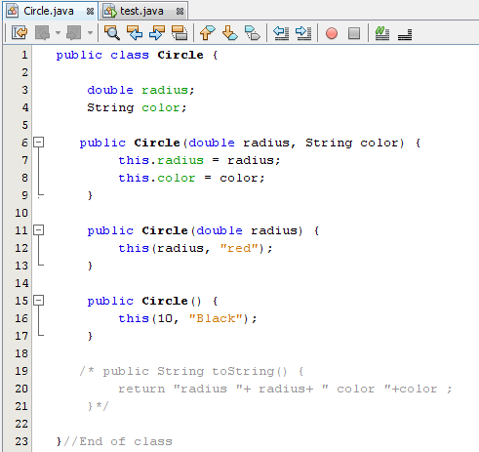
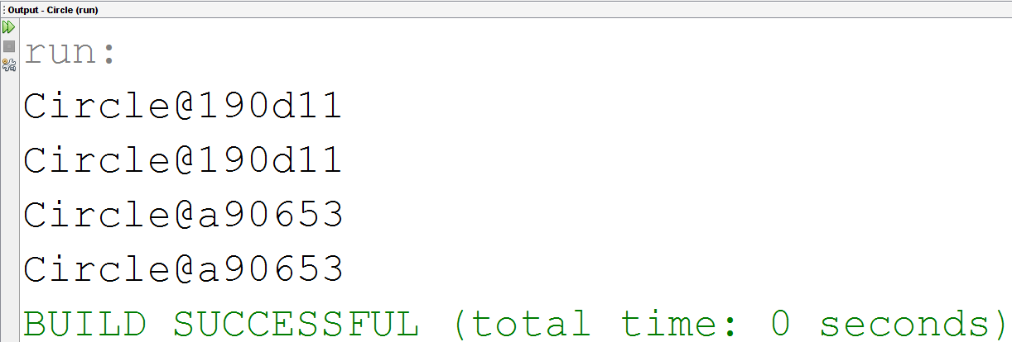
toString() Method
Output:

Slide 18
toString() Method: Explanation
As you can see (in the circle class), the toString() method does not exist!!
Since the toString() method is overridden from the (Object) class, if you did not write the method code in the class, no error could occur when invoking it in another class.
The printout will be the class name and the hexadecimal memory address where the object is stored.
Override is one of the OOP concepts and will be discussed later in detail.

Slide 19
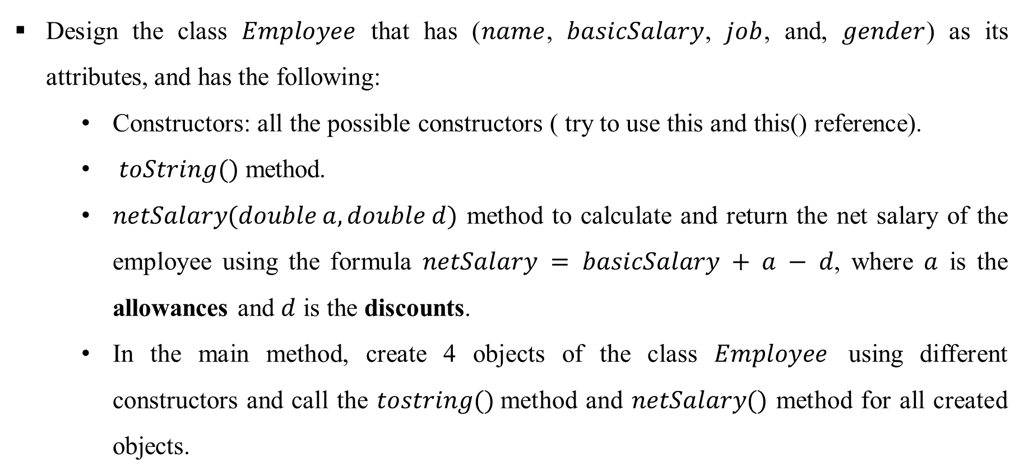
Question
Design the class $Employee$ that has ($name$, $basicSalary$, $job$, and, $gender$) as its attributes, and has the following:
  Constructors: all the possible constructors ( try to use this and this() reference).
  $toString()$ method.
  $netSalary(double a, double d)$ method to calculate and return the net salary of the employee using the formula $netSalary = basicSalary + a − d$, where $a$ is the allowances and $d$ is the discounts.
  In the main method, create 4 objects of the class $Employee$ using different constructors and call the $tostring()$method and $netSalary()$ method for all created objects.

